Slide 1
CSS
WORKSHOP
Design Principles for Web Standards

Slide 2
“Every line of CSS you write is a suggestion. You are not dictating how the HTML should be rendered; you are suggesting how the HTML should be rendered.”
Jeremy Keith
https://adactio.com/journal/7653
Notes:
On the week of October 14th, 2014 the CSS specifications turned 20 years old. The core building blocks of the web need to be learnable by everyone, not just programmers.

Slide 3
CSS RULES
p.introduction {
line-height: 1.5;
text-align: center;
margin-bottom: 1rem;
}
selector
declaration
value
property

Slide 4
Browser's default
User's styles
Author's styles
CASCADING PRINCIPLES
Notes:
Author. The author specifies style sheets for a source document according to the conventions of the document language. For instance, in HTML, style sheets may be included in the document or linked externally.
User: The user may be able to specify style information for a particular document. For example, the user may specify a file that contains a style sheet or the user agent may provide an interface that generates a user style sheet (or behaves as if it did).
User agent: Conforming user agents must apply a default style sheet (or behave as if they did). A user agent's default style sheet should present the elements of the document language in ways that satisfy general presentation expectations for the document language (e.g., for visual browsers, the EM element in HTML is presented using an italic font). See A sample style sheet for HTML for a recommended default style sheet for HTML documents.

Slide 5
<h1>
The headline
<em>is</em> important!
</h1>
INHERITANCE
Notes:
Besides the cascading approach, some property values are inherited by the children of an element.
When inheritance occurs, elements inherit computed values. The computed value from the parent element becomes both the specified value and the computed value on the child.

Slide 6
SELECTORS
Selectors allow us to target a specific HTML element to apply rules to it in a CSS declaration.
http://www.w3.org/TR/selectors/

Slide 7
SELECTORS
Type Selectors
ID Selectors
Class Selectors
Contextual Selectors
Attribute Selectors
Pseudo-classes Selectors
Pseudo-elements Selectors
Adjacent Selectors

Slide 8
p { font-size: 0.9em
}
TYPE SELECTORS

Slide 9
#main { border: 1px solid; }
ID SELECTORS

Slide 10
.alert { color: #C00;
}
CLASS SELECTORS

Slide 11
p span{ font-size: 90%;
}
CONTEXTUAL SELECTORS

Slide 12
input[type=submit] { color: #FFF; background: #C00;
}
ATTRIBUTE SELECTORS

Slide 13
a:hover { text-decoration: none;
}
PSEUDO-CLASSES SELECTORS
Notes:
The pseudo-class concept is introduced to permit selection based on information that lies outside of the document tree or that cannot be expressed using the other simple selectors.
:target / :focus…/ :lang

Slide 14
li:last-child { border: none;
}
STRUCTURAL PSEUDO-CLASSES
Notes:
Allows you to fine-tune your target to a specific element
:last-child / :first-child / :nth-child() / of-type / :not()

Slide 15
p::before { content: ‘>’;
}
PSEUDO-ELEMENTS SELECTORS
Notes:
TODO : Préparer une démo via la console chrome

Slide 16
/* Descendents */
#main h2 {…}
#main > h2 {…}
/* Siblings */ h2 ~ h3 {…} h2 + h3 {…}
CHILD & ADJACENT SELECTORS
Notes:
Draw the flow chart to show relation between descendents and siblings

Slide 17
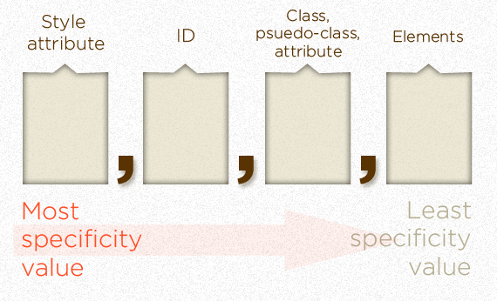
SELECTOR SPECIFICITY

Slide 18
SELECTOR SPECIFICITY
- Equal specificity: the latest rule is the one that counts.
- Unequal specificity: the more specific rule is the one that counts.
Notes:
If you have written the same rule into your external style sheet twice, than the lower rule in your style sheet is closer to the element to be styled, it is deemed to be more specific and therefore will be applied.
A selector can contain one or more reference points, the greater the specificity rating of these reference points the more specific your rule is.” Browsers select the most specific rules to display.

Slide 19
PROPERTIES AND VALUES
Font &Text Styles
Color & Shape
Display & Dimensions
Positioning and Layout

Slide 20
SELECTORS
Hands-on
Notes:
http://flukeout.github.io/

Slide 21
p.mytext { font-family:
Arial, sans-serif; font-size: 2em; font-weight: bold;
}
FONT & TEXT STYLES
My text

Slide 22
p.mytext {
… text-align: center; letter-spacing: 0.3em; text-transform: uppercase;
}
FONT & TEXT STYLES
M Y T E X T
Notes:
TO DO: trouver une référence

Slide 23
p.mytext {
… color: #00CC33; background: #FFFFF; border-weight: 5px; border-type: solid; border-color: #FF0000;
}
COLOR & SHAPE
M Y T E X T

Slide 24
p.mytext {
… color: #0C3; background: #FFF; border: 5px solid #F00;
}
COLOR & SHAPE
M Y T E X T

Slide 25

p.mytext {
… background-image: url(myimage.jpg); background-position: 0 0; background-repeat: no-repeat;
}
COLOR & SHAPE
M Y T E X T
Notes:
URL Sans guillemets

Slide 26
BASICS
Hands-on
Notes:
Reprendre la partie faite en HTML et appliquer les CSS pour obtenir le résultat attendu ( voir solution_images/1.png ).
Il s’agit donc essentiellement de gérer:
Les titres
Les polices
Les couleurs
-----------------------------------------------
Définir les polices suivantes: open_sansbold, open_sansregular.
Remarques: Les fichiers associés à ces polices sont dans le repertoire css, gérer les différents formats.
Exemples et explications ici: http://css-tricks.com/snippets/css/using-font-face.
2) Utiliser open_sansregular par défaut dans l’ensemble du document et open_sansbold par défaut pour les éléments de titre de niveau 2.
3) N’oubliez pas d’ajouoter des fallback : "Helvetica Neue", Helvetica, Arial, sans-serif

Slide 27
DISPLAY & DIMENSIONS
When your browser displays an element, the element takes up space. You can think of all HTML elements as boxes. All boxes have certain dimensions and are specified by four properties: a content area of the element (e.g., a picture, a text header, etc.) and the optional padding, border and margin properties.
http://docs.webplatform.org/wiki/tutorials/box_model

Slide 28
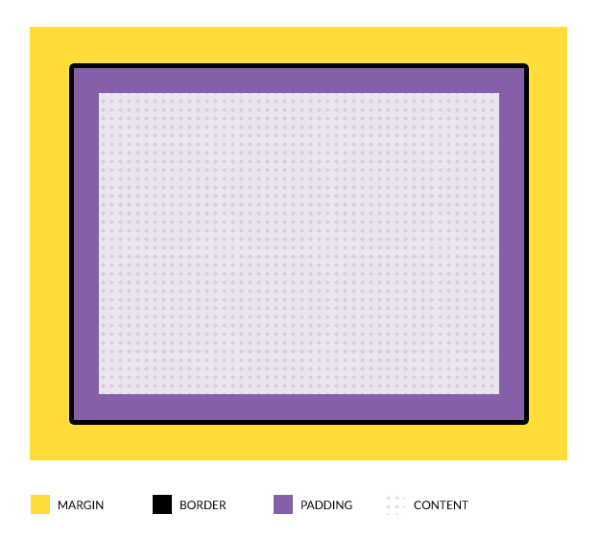
DISPLAY & DIMENSIONS: The Box Model
Notes:
Default box-model: css width value won’t count paddings, borders, margins (so, if you say that a box is 500px wide with a 10px padding, it will occupy, in the page, 520px.
Width = content + padding + border

Slide 29
div.mybox { width: 500px; height: 200px; padding: 20px; margin: 10px 5px 10px 5px; border: 5px solid #FFF;
}
DISPLAY & DIMENSIONS: The Box Model
Notes:
Width = content + padding + border. What is the width for the box??

Slide 30
div.mybox { box-sizing: border-box;
// or padding-box width: 500px; height: 200px; padding: 20px; margin: 10px 5px 10px 5px; border: 5px solid #FFF;
}
DISPLAY DIMENSIONS: The Box Model
Notes:
What is the width for the box??
What is the width for the content??
(default value is “content-box”)

Slide 31
DISPLAY & DIMENSIONS
Block Elements
A block-level element occupies the entire space of its parent element.
Browsers typically display the block-level element with a new line both before and after the element.
div, section, article, aside, footer, header, h1, h2…, p, etc.
Notes:
The default behavior of a DIV element, for example

Slide 32
DISPLAY & DIMENSIONS
Inline Elements
An inline-level element has no dimensions (no width/height)
Browsers typically display the inline-level elements one beside the other.
a, span, strong, em, input, etc.
Notes:
The default behavior of a A element, for example

Slide 33
a { display: inline-block;
}
DISPLAY & DIMENSIONS
Home
Next
<p>
<a href=“index.html”>Home</a>
<a href=“next.html”>Next</a>
</p>
Notes:
A good practice, to be compatible with old browsers

Slide 34
a { display: block;
}
DISPLAY & DIMENSIONS
Home
Next
Notes:
The default behavior of a A element, for example

Slide 35
POSITIONING AND LAYOUT
Position
Float
Flex
Grid, …

Slide 36
<div class=“child”></div>
POSITION PROPERTY
Absolute
. child{
position: absolute;
width: 55%;
top: 0;
left:0;
}
Notes:
The default behavior of a A element, for example

Slide 37
<div class=“father”>
<div class=“child”></div>
</div>
POSITION PROPERTY
Absolute
.father { margin: 20px; }
.child{
position: absolute;
width: 55%;
top: 0;
left:0;
}
Notes:
The default behavior of a A element, for example

Slide 38
<div class=“father”>
<div class=“child”></div>
</div>
POSITION PROPERTY
Absolute
.father {
position: relative;
margin: 20px;
}
.child{
position: absolute;
width: 55%;
top: 0;
left:0;
}
Notes:
TODO : trouver un exemple pratique

Slide 39
<div class=“father”>
<div class=“child”></div>
</div>
POSITION PROPERTY
Relative
.father {
position: relative;
margin: 20px;
top: 20px
left: 20px;
}
.child{
position: absolute;
width: 55%;
bottom: 5px;
right: 5px;
}
Notes:
TODO : trouver un exemple pratique

Slide 40
<div></div>
<div></div>
<div></div>
<div></div>
FLOAT POSITIONING
1
2
3
4
Notes:
Dès que tu mets float, l’élement devient block

Slide 41
<div></div>
<div></div>
<div></div>
<div></div>
FLOAT POSITIONING
1
2
3
4
div {
float: left;
width: 30%;
margin: 1% 1% 0;
}
Notes:
Dès que tu mets float, l’élement devient block

Slide 42
<div></div>
<div></div>
<div></div>
<div></div>
FLOAT POSITIONING
3
2
1
4
div {
float: right;
width: 30%;
margin: 1% 1% 0;
}
Notes:
Dès que tu mets float, l’élement devient block

Slide 43
<div class=“father”>
<div></div>
<div></div>
<div></div>
<div></div>
</div>
FLOAT POSITIONING
1
2
3
4
.father {
background-color: #CCC;
}
.father div {
float: left;
width: 30%;
margin: 1% 1% 0;
}
Notes:
The Float property gives a “block behavior” to an element, even if it is an inline one

Slide 44
<div class=“father”>
<div></div>
<div></div>
<div></div>
<div></div>
</div>
FLOAT POSITIONING
1
2
3
4
.father {
float: left;
width: 100%;
background-color: #CCC;
}
.father div {
float: left;
width: 30%;
margin: 1% 1% 0;
}
Notes:
Or… Father can be overflow: auto

Slide 45
POSITIONING
Hands-on
Notes:
Partie 1:
Mettre en place les règles nécessaire pour améliorer le layout global (image TODO)
Partie 2:
Ajouter les CSS pour aligner les PINs de gauche à droite
et “de bas en haut” (pas de scrollbar horizontale, retour à la ligne …)
(image TODO)

Slide 46
FLEX POSITIONING
The flex CSS property is a shorthand property specifying the ability of a flex item to alter its dimensions to fill available space. Flex items can be stretched to use available space proportional to their flex grow factor or their flex shrink factor to prevent overflow.

Slide 47
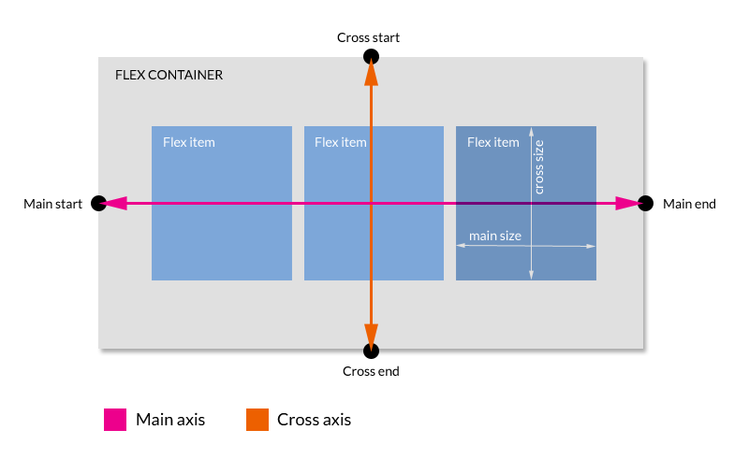
FLEX POSITIONING

Slide 48
div.father { display: flex; display: -webkit-flex;
}
FLEX POSITIONING
First, tell the container its kids are « flex »:
<div class=“father”>
<div></div>
<div></div>
<div></div>
<div></div>
</div>
Notes:
IE Support: supported from v10 (old syntax, with –ms- prefix -> display:-ms-flexbox). Foresee fallback with float
Consider –webkit prefix also

Slide 49
div.father div { flex: 1 0 auto;
-webkit-flex: 1 0 auto;
}
FLEX POSITIONING
Then, determine how the kids will behave:
<div class=“father”>
<div></div>
<div></div>
<div></div>
<div></div>
</div>

Slide 50
div.father { display: flex; display: -webkit-flex; flex-direction: row;
-webkit-flex-direction: row;
}
FLEX POSITIONING
Flow of content: flow-direction
1
2
3
4
5
Notes:
Remember to always add –webkit prefix!
Values are: row, column, row-reverse, column-reverse (default “row”)

Slide 51
div.father { display: flex; display: -webkit-flex; flex-wrap: wrap;
-webkit-flex-wrap: wrap;
}
FLEX POSITIONING
Flow of content: flow-wrap
1
2
3
4
5
Notes:
Remember to always add –webkit prefix!
Values are: wrap, nowrap, wrap-reverse (default “nowrap”)

Slide 52
div.father { display: flex; display: -webkit-flex; flex-flow: row wrap;
-webkit-flex-flow: row wrap;
}
FLEX POSITIONING
Flow of content: A Shorthand
flexcontainer {
flex-flow: <flex-direction> || <flex-wrap>;
}
1
2
3
4
5
Notes:
Better use always shorthand declarations

Slide 53
div.father { display: flex; display: -webkit-flex; flex-flow: row wrap;
-webkit-flex-flow: row wrap; justify-content: center;
-webkit-justify-content: center;
}
FLEX POSITIONING
Alignment of content (main-axis):
justify-content
1
2
3
4
5
Notes:
defines how a browser distributes available space between and around elements when aligning flex items in the main-axis of the current line.
Default: flex-start
Stretch, flex-start, flex-end, center, space-between, space-around

Slide 54
div.father { display: flex; display: -webkit-flex; flex-flow: row wrap;
-webkit-flex-flow: row wrap; align-content: center;
-webkit-align-content: center;
}
FLEX POSITIONING
Alignment of content (cross-axis):
align-content
1
2
3
4
5
My kids are displayed in multiple lines!
Notes:
Aligns a flex container's lines within the flex container when there is extra space on the cross-axis. This property has no effect on single line flexible boxes.
Default: stretch
Stretch, flex-start, flex-end, center, space-between, space-around

Slide 55
div.father { display: flex; display: -webkit-flex; flex-flow: row wrap;
-webkit-flex-flow: row wrap; align-items: center;
-webkit-align-items: center;
}
FLEX POSITIONING
Alignment of content (perpendicular):
align-items
1
2
3
4
5
Notes:
aligns flex items of the current flex line the same way as justify-content but in the perpendicular direction.
Default: stretch
Stretch, flex-start, flex-end, center, baseline

Slide 56
div.father { display: flex; display: -webkit-flex; flex-flow: row wrap;
-webkit-flex-flow: row wrap;
} div.father div { flex-basis: 35%;
-webkit-flex-basis: 35%;
}
FLEX POSITIONING
Flex item behavior: flex-basis
1
2
3
4
5
Notes:
Item initial main size (width) – based on content-box

Slide 57
div.father { display: flex; display: -webkit-flex;
} div.father div { flex-basis: 5%;
} div.father div:nth-child(3) { flex-grow: 3;
}
FLEX POSITIONING
Flex item behavior: flex-grow
1
2
3
4
5
Notes:
Specifies the flex grow factor of a flex item

Slide 58
div.father { display: flex; display: -webkit-flex;
} div.father div { flex-basis: 5%;
} div.father div:nth-child(3) { flex-shrink: 0;
}
FLEX POSITIONING
Flex item behavior: flex-shrink
1
2
3
4
5
Notes:
Will keep initial width

Slide 59
div.father { display: flex; display: -webkit-flex; flex-flow: row wrap;
-webkit-flex-flow: row wrap;
} div.father div { flex: 1 1 auto;
}
FLEX POSITIONING
Flex item behavior: A Shorthand
flexitem {
flex: <flex-grow> || <flex-shrink> || <flex-basis>;
}
1
2
3
4
5
Notes:
Will grow, will shrink, no initial main size value

Slide 60
div.father { display: flex; display: -webkit-flex; flex-flow: row wrap;
-webkit-flex-flow: row wrap;
} div.father div:nth-child(3) { flex: 1 1 auto; order: -1;
}
FLEX POSITIONING
Flex item order: order
3
1
2
4
Notes:
specifies the order used to lay out flex items in their flex container. Elements are laid out by ascending order of the order value. Elements with the same order value are laid out in the order they appear in the source code. Default value = 0

Slide 61
FLEX POSITIONING
Hands-on
Notes:
Partie 1:
Se rendre sur le site suivant et appliquer les propriétés nécessaires pour obtenir l’image [TODO]
Partie 2:
Reprendre la dernière version du TP et ajouter les CSS pour aligner les PINs de gauche à droite
mais en utilisant flexbox cette fois.

Slide 62
MEDIA QUERIES
Syntax
Types
Features
Tools
Notes:
The default behavior of a A element, for example

Slide 63
MEDIA QUERIES
The @media CSS at-rule associates a set of nested statements, in a CSS block that is delimited by curly braces, with a condition defined by a media query. The @media at-rule may be used not only at the top level of a CSS, but also inside any CSS conditional-group at-rule.
https://developer.mozilla.org/en-US/docs/Web/CSS/@media

Slide 64
MEDIA QUERIES
Syntax
#wrapper { … }
@media <types><features> {
/* media-specific rules */
#wrapper { … }
}
Notes:
The default behavior of a A element, for example

Slide 65
MEDIA QUERIES
Types
All
Print
Screen
Speech
Notes:
The default behavior of a A element, for example

Slide 66
MEDIA QUERIES
Features
min-width
max-width
orientation, resolution, …
Notes:
The default behavior of a A element, for example

Slide 67
MEDIA QUERIES
Syntax
#wrapper { … }
@media screen
and (min-width: 500px ){
/* media-specific rules */
#wrapper { … }
}
Notes:
The default behavior of a A element, for example

Slide 68
MEDIA QUERIES
Syntax
#wrapper { … }
@media screen
and (min-width: 500px)
and (max-width: 800px) {
/* media-specific rules */
#wrapper { … }
}
Notes:
The default behavior of a A element, for example

Slide 69
MEDIA QUERIES
Tools
Ripple
Google Chrome Console
Firefox (Ctrl+Maj+M)
Notes:
The default behavior of a A element, for example

Slide 70
Kawwa
https://kawwa.atosworldline.com/
Web Platform
http://www.webplatform.org/
Mozilla Developer Network
https://developer.mozilla.org/
Flex Box Cheatsheets
http://www.sketchingwithcss.com/samplechapter/cheatsheet.html
http://jonibologna.com/flexbox-cheatsheet/
REFERENCES

