Slide 1
A CSS RULE
p.introduction {
line-height: 1.5;
text-align: center;
margin-bottom: 1rem;
}
selector
declaration
value
property

Slide 2
CASCADING
Browser's default
User's styles
Author's styles
Notes:
Author. The author specifies style sheets for a source document according to the conventions of the document language. For instance, in HTML, style sheets may be included in the document or linked externally.
User: The user may be able to specify style information for a particular document. For example, the user may specify a file that contains a style sheet or the user agent may provide an interface that generates a user style sheet (or behaves as if it did).
User agent: Conforming user agents must apply a default style sheet (or behave as if they did). A user agent's default style sheet should present the elements of the document language in ways that satisfy general presentation expectations for the document language (e.g., for visual browsers, the EM element in HTML is presented using an italic font). See A sample style sheet for HTML for a recommended default style sheet for HTML documents.

Slide 3
INHERITANCE
<h1>The headline <em>is</em> important!</h1>
Notes:
Besides the cascading approach, some property values are inherited by the children of an element.
When inheritance occurs, elements inherit computed values. The computed value from the parent element becomes both the specified value and the computed value on the child.

Slide 4
h1 { font-family: sans-serif; text-transform: uppercase; color: #F90;
}
THE HEADLINE IS IMPORTANT!

Slide 5
Selectors allow us to target a specific HTML element to apply rules to it in a CSS declaration.

Slide 6
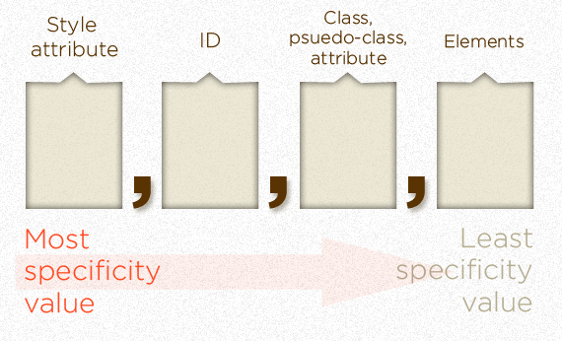
SELECTOR SPECIFICITY
Notes:
Specificity determines, which CSS rule is applied by the browsers.
Every selector has its place in the specificity hierarchy.
If two selectors apply to the same element, the one with higher specificity wins.
There are four distinct categories which define the specificity level of a given selector: inline styles, IDs, classes+attributes and elements.

Slide 7
- Equal specificity: the latest rule is the one that counts.
- Unequal specificity: the more specific rule is the one that counts.
Notes:
If you have written the same rule into your external style sheet twice, than the lower rule in your style sheet is closer to the element to be styled, it is deemed to be more specific and therefore will be applied.
A selector can contain one or more reference points, the greater the specificity rating of these reference points the more specific your rule is.” Browsers select the most specific rules to display.

Slide 8
TYPES OF SELECTORS
Simple selector
ID selector
Class selector
Contextual selector
Attribute selector
Pseudo-classes
Pseudo-elements
Notes:
Pseudo-element is a specific, unique part of an element that can be used to generate content “on the fly”, automatic numbering and lists.

Slide 9
CSS RESET AND DEFAULTS
Overriding user agents styles
Defining general styles
Notes:
Show how browsers display in a different way the page (without CSS)
Override margins, paddings, border
Define general styles
Body (font, background,)
Default for new HTML5 els
Size and font of general elements
(réf. Kawwa CSS)

