Slide 1
HTML
WORKSHOP
Beyond the tags
Notes:
Feedback from the audience: their level of knowledge and their opinion on HTML/CSS
First day: forget the CSS and we'll focus only on the HTML and how to write good, valid markup language
2nd day: CSS

Slide 2
“What’s the point
in having
content
in digital form?”
Notes:
Digital content can be shared, reused, transformed, ( filed ? )

Slide 3
Adds complexity
No, wait!!! There are tools for those tools!!!! (try stylus, jsFiddle, CodePen) And you can pay for that too!!! (Mac, $25 LiveReload, 10)
Manage large color palettes (ha!! Who needs that?!)
Reduce mental effort?? (like commonly used color??! Using variables? Really, is color management THAT hard?!)
Notes:
Some 25 years back, digital content were created to be printed. Digital content was polluted with printing instructions and they had proprietary format. There were no possibility of creating relations between different content or intelligent ways to explore data.
For example, if we wanted to have a document with a simple list like this one:

Slide 4
. . .
{\listlevel\levelnfc23\leveljc0\levelstartat1\levelfollow0{\leveltext \'01\u61607 ?;}{\levelnumbers;}\f14\fi-360\li5040}
{\listlevel\levelnfc23\leveljc0\levelstartat1\levelfollow0{\leveltext \'01\u61607 ?;}{\levelnumbers;}\f14\fi-360\li5760}
{\listlevel\levelnfc23\leveljc0\levelstartat1\levelfollow0{\leveltext \'01\u61607 ?;}{\levelnumbers;}\f14\fi-360\li6480}\listid3}
}{\listoverridetable{\listoverride\listid1\listoverridecount0\ls1}{\listoverride\listid2\listoverridecount0\ls2}{\listoverride\listid3\listoverridecount0\ls3}}{\info{\author Ricci Angela}{\creatim\yr2013\mo3\dy4\hr16\min52}{\author Ricci Angela}{\revtim\yr2013\mo3\dy6\hr9\min39}{\printim\yr0\mo0\dy0\hr0\min0}{\comment OpenOffice.org}{\vern3410}}\deftab708
{\*\pgdsctbl
{\pgdsc0\pgdscuse195\pgwsxn11906\pghsxn16838\marglsxn1417\margrsxn1417\margtsxn1417\margbsxn1417\pgdscnxt0 Standard;}}
\formshade{\*\pgdscno0}\paperh16838\paperw11906\margl1417\margr1417\margt1417\margb1417\sectd\sbknone\sectunlocked1\pgndec\pgwsxn11906\pghsxn16838\marglsxn1417\margrsxn1417\margtsxn1417\margbsxn1417\ftnbj\ftnstart1\ftnrstcont\ftnnar\aenddoc\aftnrstcont\aftnstart1\aftnnrlc
\pgndec\pard\plain \s28\ql\sl280\slmult0\nowidctlpar{\*\hyphen2\hyphlead2\hyphtrail2\hyphmax0}\li720\ri0\lin720\rin0\fi0\sb120\sa120\ltrpar\cf0\dbch\af7\afs24\loch\f4\fs24{\listtext\pard\plain \hich\af8\dbch\af7 -\tab}\ilvl0\ls2 \li1440\ri0\lin1440\rin0\fi-360\sb120\sa120{\afs22\fs20\fs20\fs20\fs20\fs20\fs20\fs20\fs20\fs20\rtlch \ltrch\loch\fs22\lang1033\loch\f3
Adds complexity}
\par \pard\plain \s28\ql\sl280\slmult0\nowidctlpar{\*\hyphen2\hyphlead2\hyphtrail2\hyphmax0}\li720\ri0\lin720\rin0\fi0\sb120\sa120\ltrpar\cf0\dbch\af7\afs24\loch\f4\fs24{\listtext\pard\plain \hich\af8\dbch\af7 -\tab}\ilvl0\ls2 \li1440\ri0\lin1440\rin0\fi-360{\afs22\rtlch \ltrch\loch\fs22\lang1033\loch\f3
No, wait!!! There are tools for those tools!!!! (try stylus\'94, \'93jsFiddle\'94, \'93CodePen\'94\'85) And you can pay for that too!!! CodeKit (Mac, $25 \'96 LiveReload, 10)}
\par \pard\plain \s28\ql\sl280\slmult0\nowidctlpar{\*\hyphen2\hyphlead2\hyphtrail2\hyphmax0}\li720\ri0\lin720\rin0\fi0\sb120\sa120\ltrpar\cf0\dbch\af7\afs24\loch\f4\fs24{\afs22\rtlch \ltrch\loch\fs22\lang1033\loch\f3
}
\par \pard\plain \s28\ql\sl280\slmult0\nowidctlpar{\*\hyphen2\hyphlead2\hyphtrail2\hyphmax0}\li720\ri0\lin720\rin0\fi0\sb120\sa120\ltrpar\cf0\dbch\af7\afs24\loch\f4\fs24{\listtext\pard\plain \hich\af8\dbch\af7 -\tab}\ilvl0\ls2 \li1440\ri0\lin1440\rin0\fi-360{\afs22\rtlch \ltrch\loch\fs22\lang1033\loch\f3
Manage large color palettes (ha!! Who needs that?! )\line }
\par \pard\plain \s28\ql\sl280\slmult0\nowidctlpar{\*\hyphen2\hyphlead2\hyphtrail2\hyphmax0}\li720\ri0\lin720\rin0\fi0\sb120\sa120\ltrpar\cf0\dbch\af7\afs24\loch\f4\fs24{\listtext\pard\plain \hich\af8\dbch\af7 -\tab}\ilvl0\ls2 \li1440\ri0\lin1440\rin0\fi-360{\afs22\rtlch \ltrch\loch\fs22\lang1033\loch\f3
Reduce mental effort?? (like commonly used color??! Using variables? Really, is color management THAT hard?!)\line }
\par \pard\plain \s28\ql\sl280\slmult0\nowidctlpar{\*\hyphen2\hyphlead2\hyphtrail2\hyphmax0}\li720\ri0\lin720\rin0\fi0\sb120\sa120\ltrpar\cf0\dbch\af7\afs24\loch\f4\fs24{\listtext\pard\plain \hich\af8\dbch\af7 -\tab}\ilvl0\ls2 \li1440\ri0\lin1440\rin0\fi-360{\afs22\rtlch \ltrch\loch\fs22\lang1033\loch\f3
Notes:
And then we printed, and to get content we would scan and OCR it... and format it again to print. (?)
Imagine how much time and money were wasted in the process!
“So, how to “fix” this situation?”
By creating digital content that can be properly stored, exploitable, exchangeable, extensible and reusable through digital systems.
In order to do that, we needed to:

Slide 5
Separate content (data) from
print instructions or presentation
Define a « Lingua Franca » (standards)
Notes:
Tim Berners-Lee defined HTML as a subset of the SGML language (a bit more complex).
The idea was to separate content from printing or presentational instructions and give the content the information needed so it could be interpreted correctly only by its nature or role.
HTML does that by marking-up (or labeling) the content based on its function on the document (this is a title, this is a paragraph). Once something is "labeled", we know what we're supposed to do with them.

Slide 6
“What is it?”
&
“What does it do?”
Notes:
As in Object Oriented Programming, HTML elements have specific behavior and attributes.
HTML semantic standard tags will assure that the content will be predictable, understandable and robust for all user agents

Slide 7
Predictable
Understandable
Robust
Notes:
Standards assure that content are predictable, understandable and robust.
Predictable: browsers know what to expect of it
Understandable: browsers know how to interpret it
Robust: it will be understood and interpreted in the same way by all browsers
Give the example of the button (?)

Slide 8
CLICK
<div onclick=“”>
CLICK
</div>
Notes:
For example: if you want a button. Would you do that?
Browsers don’t know what to do with it: div is a non-semantic tag, it has no intrinsic behavior, nor explains the nature of the content. Browser don’t know it is a button, even if you make it look like one via CSS. And we have to rely on a js function to say it is clickable and that there’s an action behind it.

Slide 9
Se-man-tic adjective
1: of or relating to meaning in language
Merriam Webster
Notes:
HTML tags that give this extra "meaning" to our content are what we call "semantic" tags.
Semantics gives our content an extra meaning that allows the browser to correctly deal with it.
So, if we went a button, we should consider using the tag created for it:

Slide 10
<button>
CLICK
</button>
Notes:
Now browsers know this is a button, and it will expect an interaction with the user, and that an action will be related to it.

Slide 11
<ul>
<li>Adds complexity</li>
<li>No, wait!!! There are tools for those tools!!!! (try stylus, jsFiddle, CodePen) And you can pay for that too!!! (Mac, $25 LiveReload, 10)</li>
<li>Manage large color palettes (ha!! Who needs that?!)</li>
<li>Reduce mental effort?? (like commonly used color??! Using variables? Really, is color management THAT hard?!)</li>
</ul>
Notes:
Let’s get back to our list. Using the proper semantic tags the browser (any web user agent) won’t make any effort to undertand and interpret the content.
It knows it is a list of 4 items.

Slide 12
<div class="theplugin">
<div class="borderTop"></div>
<div class="title">
This is the title
</div>
<div class="content">
<span>This is the content</span>
<div class="button">
Close
</div>
</div>
<div class="borderBottom"></div>
</div>
Notes:
WHAT IF MY HTML IS NOT SEMANTIC?
If we look at this markup, what you can tell me about it?
If content is not correctly labeled, it cannot be correctly interpreted, so we'd have:

Slide 13
This is the title
This is the content
Close
Notes:
Explain here the barriers we'd have to face if we wanted to manipulate this code (by CSS, by, js). Explain the role of assistive techs like screen readers. This code is not reusable either.
Laundry symbols:
What if those symbols were not standard? We wouldn't know how to deal with our laundry. It is pretty much the same with the HTML: if we don't respect the standard, we won't control how the user agent will interpret our code.

Slide 14
<!DOCTYPE html PUBLIC "-//W3C//DTD XHTML 1.0 Strict//EN" "http://www.w3.org/TR/xhtml1/DTD/xhtml1-strict.dtd">
Notes:
Now, let’s take a look at how an HTML document is built.
The DOCTYPE
Doctypes are a way to tell web user agents or parsers what type of document they’re dealing with.
Before we had to point to the DTD (Document Type Definition) hosted in W3C, and there were several of them (HTML, XHTML, strict or loose)

Slide 15
<!doctype html>
Notes:
But today, when using HTML5, we can simply inform the UA it is dealing with a HTML file.
We don't have to specify the version anymore, or the level of exigence when parsing our markup. First, because future specifications will simply be a development of what we have today, and there's no more level of exigence, as HTML5 parsers are much more permissible.

Slide 16
HTML IS ONLY:
<tag attribute=”value”>content</tag>

Slide 17
<HTML>
<HEAD>
<BODY>
Notes:
We'll handle the home page to all participants to define with them the role of each portion of content. It must have 3 or 4 levels of titles, paragraphs, lists, addresses (dl), images, links.
Add step by step elements of HTML, HEAD, BODY
HEAD: metas, title, links(imports)
Show your screen: as you type each HEAD element, explain it and tell them to add it to their own files
( Pas clair pour moi ce q’on doit faire ici?)

Slide 18
Flow content most HTML elements
HTML TYPES OF CONTENT
Notes:
Almost all elements in the body are categorized as Flow content.
(?) Est ce qu’on peut dire que c’est les l’ensemble des éléments qui représentent le flux qui est affiché par le navigateur.
Remark: Elements can be part of several types at a time

Slide 19
Sectioning content section, article, nav, aside, main
HTML TYPES OF CONTENT
Notes:
Sectioning content is content that defines the scope of headings and footers
Heading element mandatory recommended

Slide 20
Sectioning content section
HTML TYPES OF CONTENT
http://www.w3.org/wiki/HTML/Elements/section
Notes:
The <section> element represents a generic section of a document or application.
Most generic sectioning element, it is a thematic grouping of content.
Could be used to mark a chapter, the content of tabbed pages…
Section element should be associated to a heading element, because it will impact the document outline
(http://gsnedders.html5.org/outliner/)

Slide 21
Sectioning content article
HTML TYPES OF CONTENT
http://www.w3.org/wiki/HTML/Elements/article
Notes:
The <article> element represents an independent item section of content
“Independent” is important because it can be seen as a reusable and distributable content:
-> Forum or blog post
-> newspaper/mag article

Slide 22
Sectioning content nav
HTML TYPES OF CONTENT
http://www.w3.org/wiki/HTML/Elements/nav
Notes:
The <nav> element represents a section with navigation links
Links to other pages or within the page
Not every link in the page, major navigation blocks only
It is a section element, so it should have a title, but why have a title on a the navigation part?
It can be usefull to have a title whith a link which allows to skip this section (audio browsers, navigation with keyboard)
Montrer https://kawwa.atosworldline.com/component/mainNav

Slide 23
Sectioning content aside
HTML TYPES OF CONTENT
http://www.w3.org/wiki/HTML/Elements/aside
Notes:
The <aside> element represents a section of a page whose content is related to the content around it,
but which could be considered separated from that content.
Examples:
-> Group of nav elements
-> Side bars
-> quotes
-> publicity

Slide 24

Heading content h1…h6
HTML TYPES OF CONTENT
Notes:
defines the header of a section

Slide 25
Phrasing content
Running-in text, strings
HTML TYPES OF CONTENT
Notes:
Essayer de revoir les tags : http://www.w3.org/TR/2011/WD-html5-20110525/content-models.html#phrasing-content
Phrasing content is the text of the document, as well as elements that mark up that text at the intra-paragraph level.
Runs of phrasing content form paragraphs

Slide 26
Embeded content audio, video, canvas, embed, iframe, img, math, object, svg
HTML TYPES OF CONTENT
Notes:
content that imports another resource into the document, or content from another vocabulary that is inserted into the document

Slide 27
Interactive content specifically intended for user interaction, like form elements
HTML TYPES OF CONTENT
Notes:
A titre indicatif, …, mais ca n’a pa d’impact particulier sur les dev html.

Slide 28
Structure of the document
Previsously based on headings elements only
Now also take into account sectioning elements
Document outline
Notes:
The outline of a web page is the structure of the document
In HTML4, the outline algorithm was only based on the heading elements (h1, ..., h6)
In HTML5, the outline algorithm takes also in consideration the new sectioning tags we have seen before ( body, section, article, aside, footer, header et nav)
The use of these element implies a new subsection in the outline

Slide 29
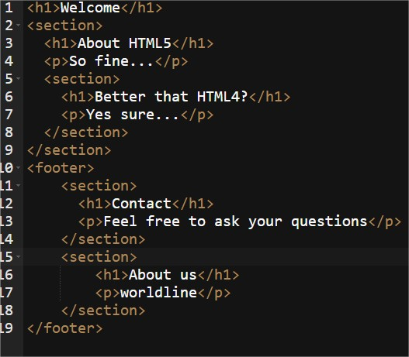
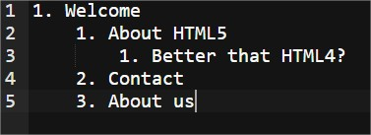
Document outline
Notes:
Use HTML5 Outliner:
http://gsnedders.html5.org/outliner/

Slide 30
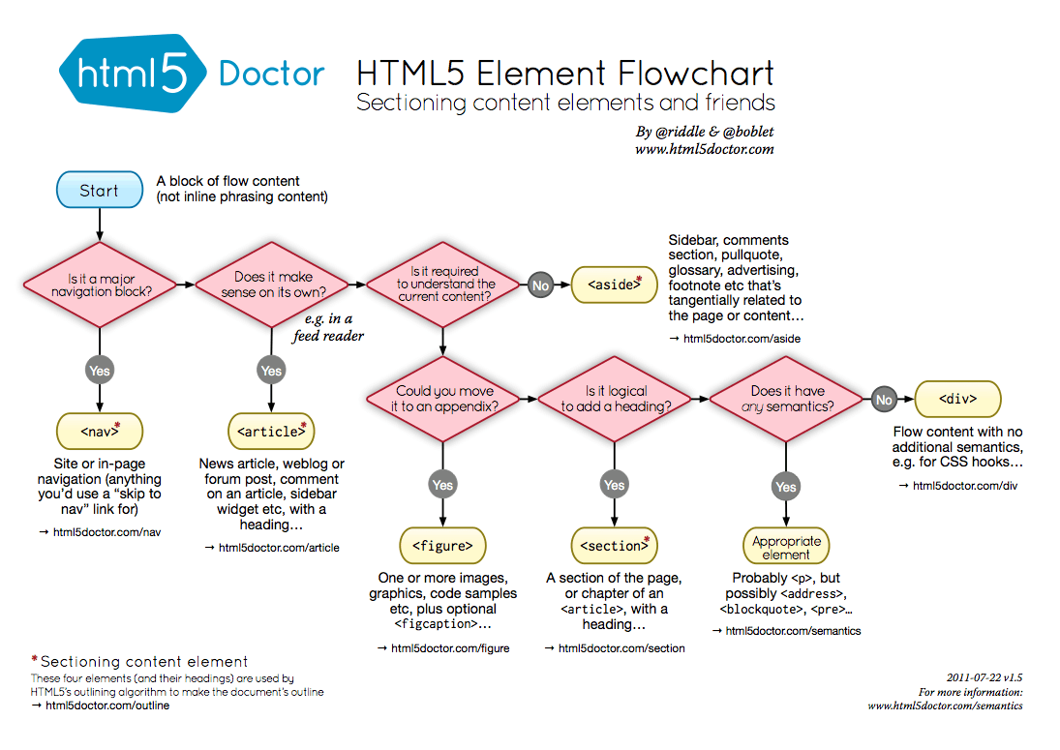

Slide 31
Hands-on
Let’s mark-up the page together
Notes:
We'll mark-up the page, step by step.
The points to review are:
hierarchy of titles
cases of use of definition lists
using lists, paragraphs
using phrasing content elements (strong, em, q, etc)
Make the audience participate asking them which type of HTML element we should use to markup content.
This exercise should be quite quick, because most of the HTML elements introduced are already known (or should be!) by the audience.

Slide 32
-> Comparable to microformats, but HTML5 only
-> Still related to semantic
-> Annotate your code with specific attributes
-> schema.org defines a markup language recognized by most search engines (Yahoo, Bing, Google, Yandex)
-> Rich vocabulary, allows to say to the search engine that an information is specific to a person, a movie, a recipe...
Microdatas
Notes:
Ajouter microformats ou supprimer microdatas! => metadonnées

Slide 33
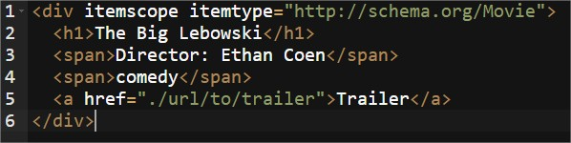
itemscope just tells: be aware that my content is a specific item, nothing more itemtype specifies the type of item
Microdatas

Slide 34
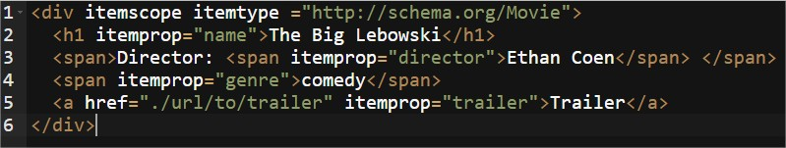
itemprop allows to specify properties to a given itemtype
Microdatas
Notes:
Detailled properties for a given type can be found by just following on http://schema.org

Slide 35
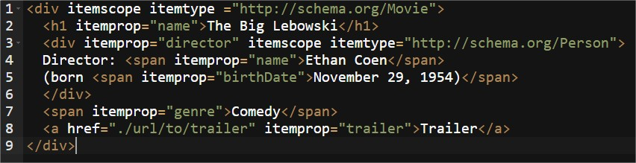
Properties also have a type:
Movie contains a property director of type Person
Microdatas

Slide 36
Kawwa
https://kawwa.atosworldline.com/
HTML5Doctor
http://html5doctor.com/
Web Developer Firefox Add-on
https://addons.mozilla.org/en-US/firefox/addon/web-developer/
Document Outliner
http://gsnedders.html5.org/outliner/
Web Platform
http://www.webplatform.org/
Mozilla Developer Network
https://developer.mozilla.org/
REFERENCES

