Slide 1
Atos WorldLine
Tapestry 5 Projects

Slide 2
Several Tapestry projects are pushed inside Atos Worldline
Theses projects are
  Innovative
    They are using latest Tapestry versions and the best technologies possible
    Powerful collaborative tools such as JIRA, Maven , Hudson and dedicated mailing list are used to help development process
  Open Source (Restricted to Atos WorldLine)
    All source code is available to Atos WorldLine developers
  Actives
    Lot of people are involved on theses projects. They are all followed by a dedicated team
  Open for Contributions
    Contributors are very welcome. Developers with time, fresh ideas or just wanting to learn new technologies can easily get involved.

Slide 3
Kawwa2
  Access to 50 components
  Dynamic CSS themes selection
  Informations about how to use Kawwa2 components with the Tapestry5-jQuery framework
  7 Templates pack
  Best Practices : HTML, CSS, Accessibility…
  For more informations, visit the Kawwa2 Portal:
    https://kawwa.atosworldline.com/
  Mailing-list :
    dl-kawwa@atos.net

Slide 4

Tapestry jQuery
  jQuery Integration for Tapestry 5
  Possibility to remove Prototype and Scriptaculous libraries
  jQuery components library
  More Informations :
    http://github.com/got5/tapestry-jquery
    https://groups.google.com/forum/?hl=fr#!forum/tapestry5-jquery
  Mailing-list :
    dl-dev-tapestry5-jquery.ext@atosorigin.com

Slide 5

Tapestry AWL Contribution
  Components libraries wich provide
    Provides new Tapestry mechanisms such as new services, new commons components
    Graphical components, based on high value JavaScript, and using libraries such as jQuery
    Already customized components built on Kawwa model, they are providing a good start for SPOP projects
  More Information :
    http://10.25.20.165/maven2/tapestry5-awl-contrib/
  Mailing-list :
    dlfr-t5-awl-components-dev@atosorigin.com

Slide 6
Tapestry-cdi
Bring CDI powerful to Tapestry
  Bridge between tapestry and CDI (J2EE ioc)
  JSR-299 and 330
  Live with tapestry-ioc without conflict
  Allow injecting external resources (beans, webservices, ejbs, …) and using « qualifier », « stereotype » and CDI scopes
  Tested against Apache TomEE, JBossAS7 and glassfish
  Mode details on :
    http://github.com/got5/tapestry-cdi

Slide 7

WorldLine Mobile Next Generation
  Tapestry extension dedicated to provide helpers for creating Smartphone websites
    iPhone, Android, BlackBerry etc..
  Offers the extensions that provide Smartpphone identification and content adaptation, such as
    JavaScript, CSS, Images or video size
  More Informations :
    http://10.25.20.165/maven2/wlm-tapestry/
  Mailing-list :
    dlfr-wlmobilenextgen@atosorigin.com

Slide 8
Gabarit
  Rich application heavily based on Prototype JS framework. This application consists of a back office that let you customize on the fly the entire look of your web application just by drag and dropping components
  This is the perfect tool to offer to your customers the possibility to customize a portal or an commercial website.
  Force component oriented development
  Availability : already released. In production for "France Loisirs"
  Mailing-list :!OD-CEPC-FO-INT-FC

Slide 9
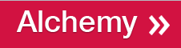
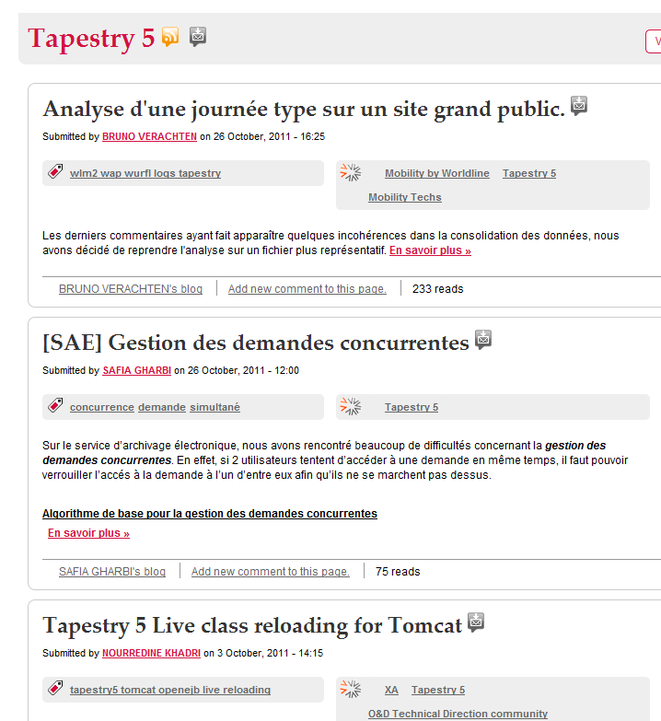
Alchemy
  http://alchemy.atosworldline.com/
  Interesting communities :
    Tapestry5
    JavaScript & Ajax
    O&D Technical Direction
    community
    Kawwa

