Slide 1
Basic mechanisms
Declaring a Template
Unit Tests
Request processing
Basic components
Form management
Other components

Slide 2
Request processing
Activation
All incoming requests (action or rendering) go through the activation phase
Activation allows the page to restore its internal status from the data encoded in the URL (activation context)‏
An activation method will be annotated by @OnEvent("activate")‏
  e.g.
  @OnEvent("activate")
  private void setupManager(){
  this.manager = UserManager.getInstance();
  }

Slide 3
Request processing
Activation
An activation method can contain parameters
These parameters are passed in the application’s URL via the context (written in bold below)‏
  e.g. http://localhost:8000/user/3
In this case, the activation method can contain a parameter of type long
  @OnEvent("activate")
  private void getUserFromDb(long id){
  …
  }

Slide 4
Request processing
Passivation
There is also a “passivate” event
@OnEvent("passivate")
public long retrieveUserFromDb(){
return this.id;
}
This method must return every element needed to activate the page
This method allow Tapestry to modify URLs that refer to the page by adding the corresponding context
Warning : this method is called on each link creation

Slide 5
Request processing
Rendering – state machine
Component rendering is based on a state machine
The rendering process is made up of simple parts
  Easy implementation or overloading

Slide 6
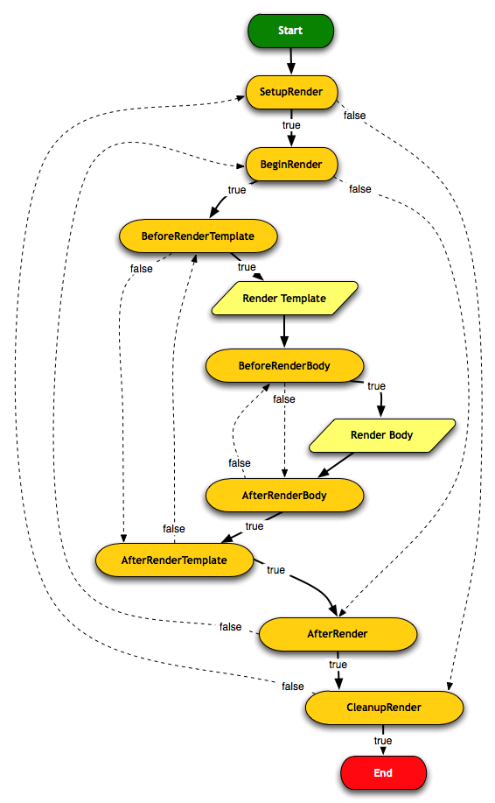
Each orange step corresponds to an annotation
  SetupRender
  BeginRender
  …
The methods marked by these annotations are called "rendering methods"
Tapestry calls these methods to display a page
They can return "void" or a boolean value
  false: dotted arrow
  "void" or true: full arrow
Notes:
Tapestry offers different states. These states refer to annotations, which may be associated to methods. These methods will be executed in the order states.
This state machine is used to navigate between each state. If we return true, we move to the next state, otherwise we return to the previous state.
It is not mandatory to implement all these methods.

Slide 7


Request processing
Rendering - Rendering methods
Rendering phase methods can have a "MarkupWriter"-type parameter
This object will make it possible to modify the DOM file generated by Tapestry from the Template
Optional methods
DOM manipulation can cause performance issues
Preferably use the Template, as much as possible
Notes:
Generally, the code won’t include all the methods associated to the “SetupRender”, “BeginRender”, “AfterRender” and “CleanupRender” phases, but just one or two of them.

Slide 8
public class Count {
@Parameter
private int _start = 1;
@Parameter(required = true)
private int _end;
@Parameter
private int _value;
private boolean _increment;
@SetupRender
void initializeValue() {
_value = _start;
_increment = _start < _end;
}
@AfterRender
boolean next() {
if (_increment) {
int newValue = _value + 1;
if (newValue <= _end) {
_value = newValue;
return false;
}
} else {
int newValue = _value - 1;
if (newValue >= _end) {
_value = newValue;
return false;
}
}
return true;
}
}
Notes:
This is an example of the state machine usage.
InitializeValue method will initialize two variables. The next () method tests if a variable is lower than or equal to the variable end.
If not equal, Tapestry returns false, and processing returns to the state BeginRender.
As no method is declared between the states,Tapestry loops back to the next () method, as the value is different.

Slide 9
Request processing
Rendering – SetupRender
@SetupRender
You can prepare the rendering for the component in the method associated with this annotation
  Reading parameters
  Creating temporary variables
  Potentially, calling the MIDDLE tier to pre-load data
  …
Returning "true" or "void" makes the machine go to the "BeginRender" phase
Returning "false" skips this phase and makes the machine go directly to the "CleanupRender" phase

Slide 10
Request processing
Rendering – CleanupRender
@CleanupRender
Equivalent of "SetupRender"; it makes it possible to "clean up" unused variables or useless connections
Returning "false" takes us back to "SetupRender"

Slide 11

Request processing
Rendering – Annotations vs Naming
public class MonBean {
public void setupRender() {
}
public void cleanupRender() {
}
}
public class MonBean {
@SetupRender
public void init()
{
}
@CleanupRender
public void raz()
{
}
}
Methods' names are highly generic
If the Framework evolves "re-factoring" can become complex
Generally, use annotations preferably and write explicit method names e.g. "setupRender" becomes "setupCountryList "
Notes:
e.g. : the example shown before becomes
import org.apache.tapestry5.annotations.Parameter;
public class Count {
@Parameter
private int _start = 1;
@Parameter(required = true)
private int _end;
@Parameter
private int _value;
private boolean _increment;
void setupRender() {
_value = _start;
_increment = _start < _end;
}
boolean afterRender() {
if (_increment) {
int newValue = _value + 1;
if (newValue <= _end) {
_value = newValue;
return false;
}
} else {
int newValue = _value - 1;
if (newValue >= _end) {
_value = newValue;
return false;
}
}
return true;
}
}

Slide 12
Action Request
"Action "-type requests can be generated by components such as "actionlink"
An action is identified by
  The type of event (e.g. action, submit, failure…)‏
  The id of the sending component
Use the OnEvent annotation to identify action methods
  @OnEvent(value="action", component="select")
  void valueChosen(int aValue) {
  value = aValue;
  }

Slide 13
Action Request
OnEvent
@OnEvent(value="…", component="…")‏
The OnEvent annotation makes it possible to identify the methods that will process "Action"-type requests
This annotation has two parameters
  value: name of the event to match
  component: id of the sending component
By default, the value of "value" is "action" and is sent by "actionlink"-type or "form"-type components
If the "component" parameter is omitted, the method will be executed for all the events whose type is that defined by the value parameter

Slide 14
Action Request
Navigation
Return value of action methods (continued)‏
  Page: In this case, a page instance previously injected via the @InjectPage annotation must be returned. This makes it possible to perform processing on the instance before redirecting the user to it.
  e.g.
  @InjectPage
  private Welcome welcome;
  @OnEvent("action")‏
  private Object back(){
  welcome.setBackMessage("…");
  return welcome;
  }

Slide 15
Action Request
Navigation
Return value of action methods (continued)‏
  Link: this Tapestry object makes it possible to redirect the user. It will be possible to create that type of object via the "ComponentResources" object, which will have to be injected into the page beforehand
  StreamResponse: this is an interface for returning binary content to the user
  URL (J2SE API)
  Other: any other type is considered as an error

Slide 16
Action Request
Annotations vs Naming
If the Framework evolves, "re-factoring" can become complex
Generally, use annotations preferably and write explicit method names
public class MonBean {
public void onActionFromSelect() {
}
}
public class MonBean {
@OnEvent(value="action", component="select")
public void champSelect()
{
}
  }
Notes:
E.g.: the example shown beforehand becomes
import org.apache.tapestry5.annotations.Parameter;
public class Count {
@Parameter
private int _start = 1;
@Parameter(required = true)
private int _end;
@Parameter
private int _value;
private boolean _increment;
void setupRender() {
_value = _start;
_increment = _start < _end;
}
boolean afterRender() {
if (_increment) {
int newValue = _value + 1;
if (newValue <= _end) {
_value = newValue;
return false;
}
} else {
int newValue = _value - 1;
if (newValue >= _end) {
_value = newValue;
return false;
}
}
return true;
}
}

