Slide 1
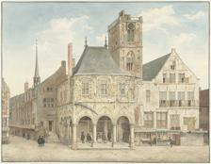
ResNet
18d
Ensemble
ResNet
34d
SSL
target
{0, 1, 2, 3}
Swin
tiny
SimSiam
Efficient
4
Ridge
Swin
small
MSE Loss
16
materials
{cardboard, ink, …}
date
{1871, …}
Swin
small
10
techniques
{brush, chalk, …}
Swin
small
1

