Slide 1
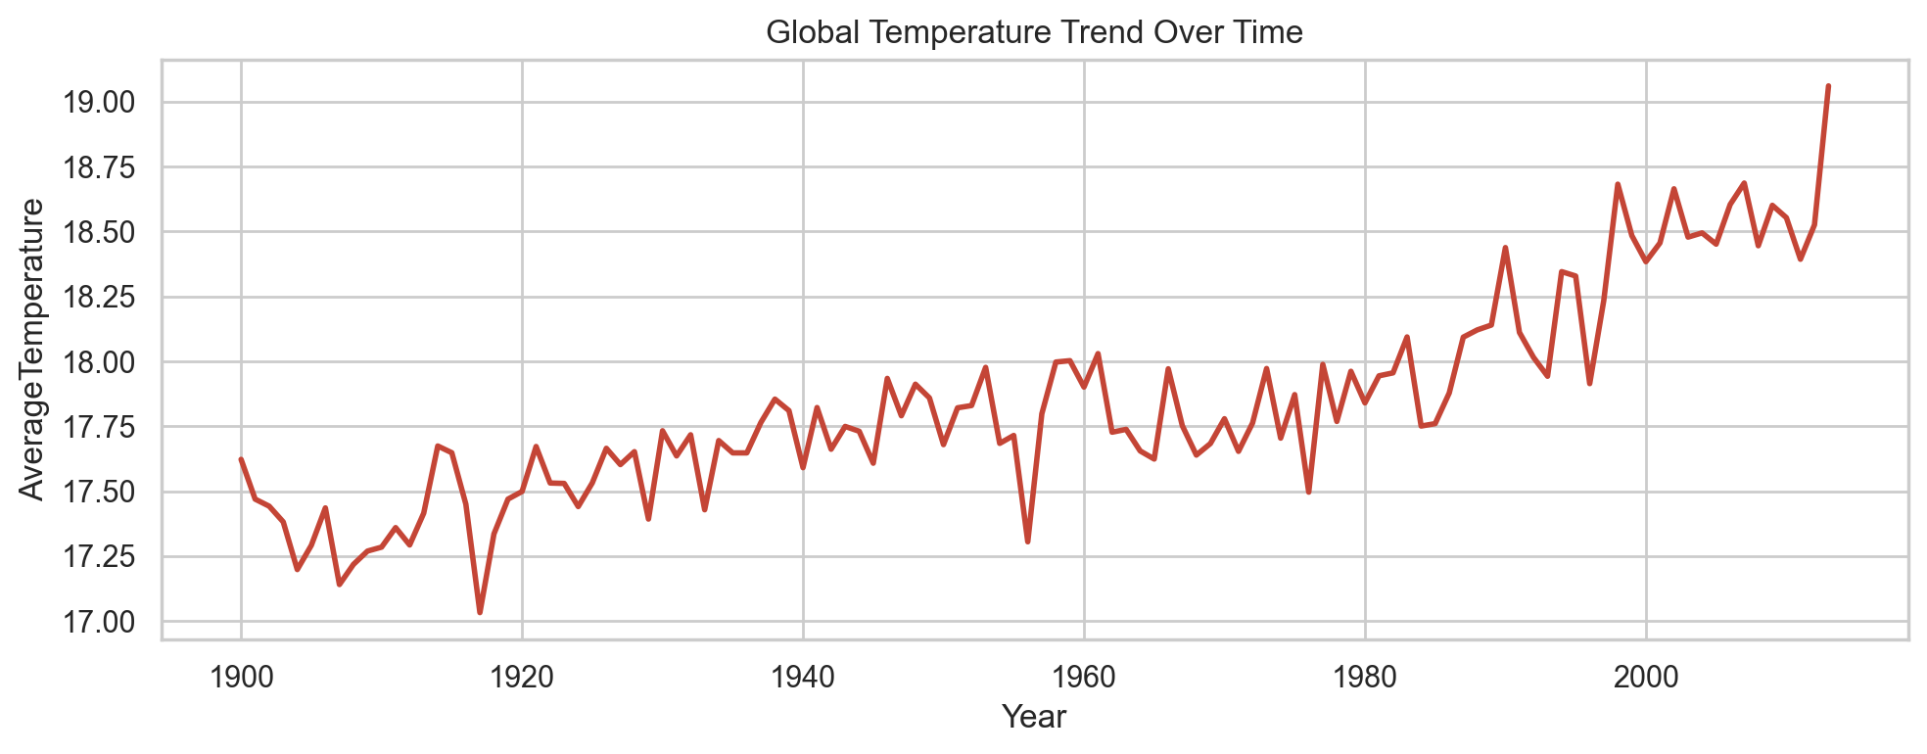
Climate Change Analysis and Temperature Prediction
Predicting city-level temperature trends using historical climate records and machine learning
Student: Gotam Kumar (23k-0860)
Course: Data Science
Instructor: Dr. Rabia Tabassum
Institution: FAST-NUCES
Dataset: Berkeley Earth GlobalLandTemperaturesByCity.csv
1.372
Best RMSE
0.980
Best R2
Final Recommendation
Random Forest for chronological prediction
01

Slide 2
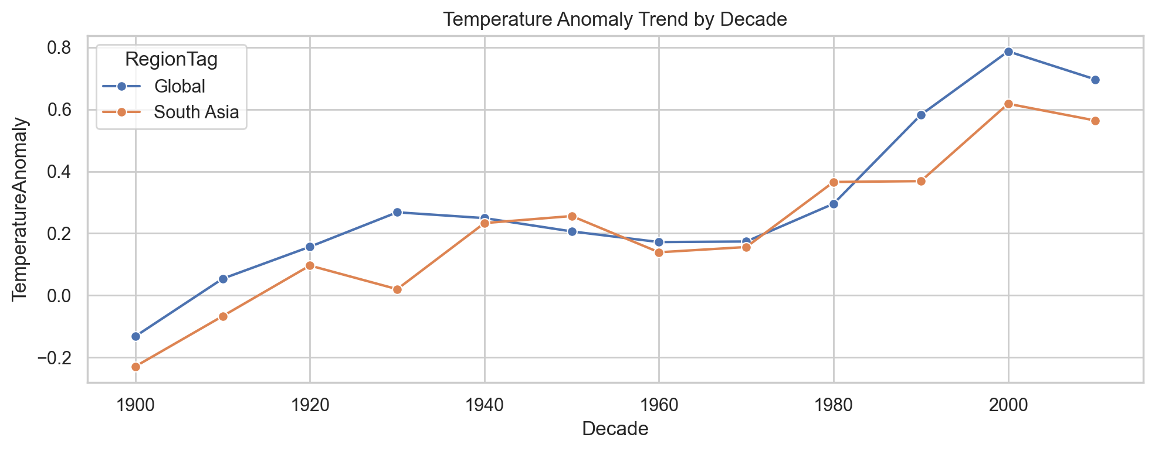
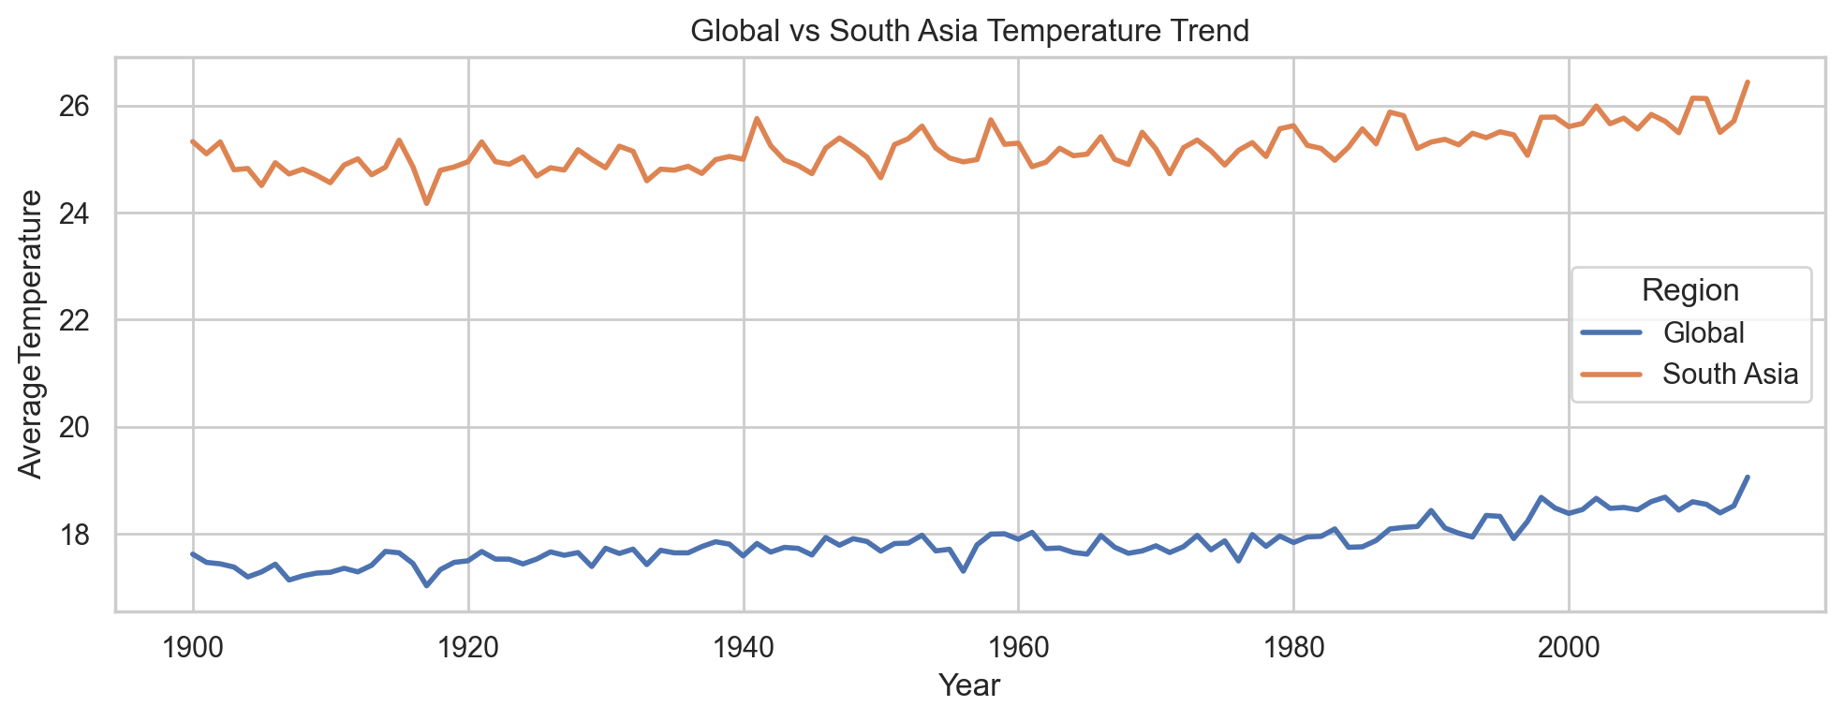
Problem and Research Goal
Climate change affects agriculture, health, water security, infrastructure, and regional planning.
The project predicts monthly city-level AverageTemperature from historical climate records.
This is a regression task because the target is a continuous temperature value, not a class label.
Research question: which feature engineering and model strategy gives the best balance of accuracy, generalization, and climate relevance?
02

Slide 3
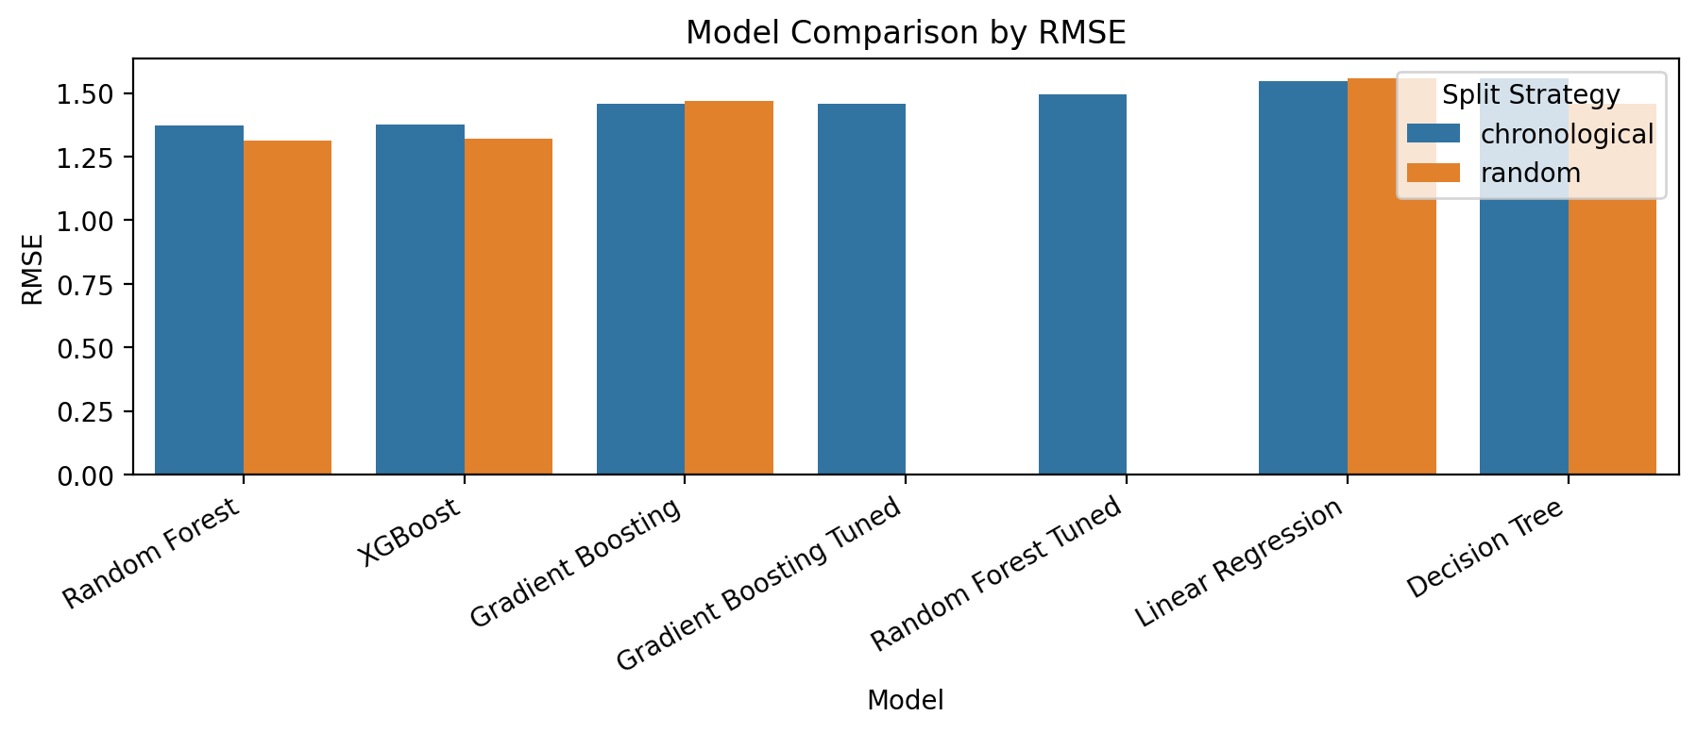
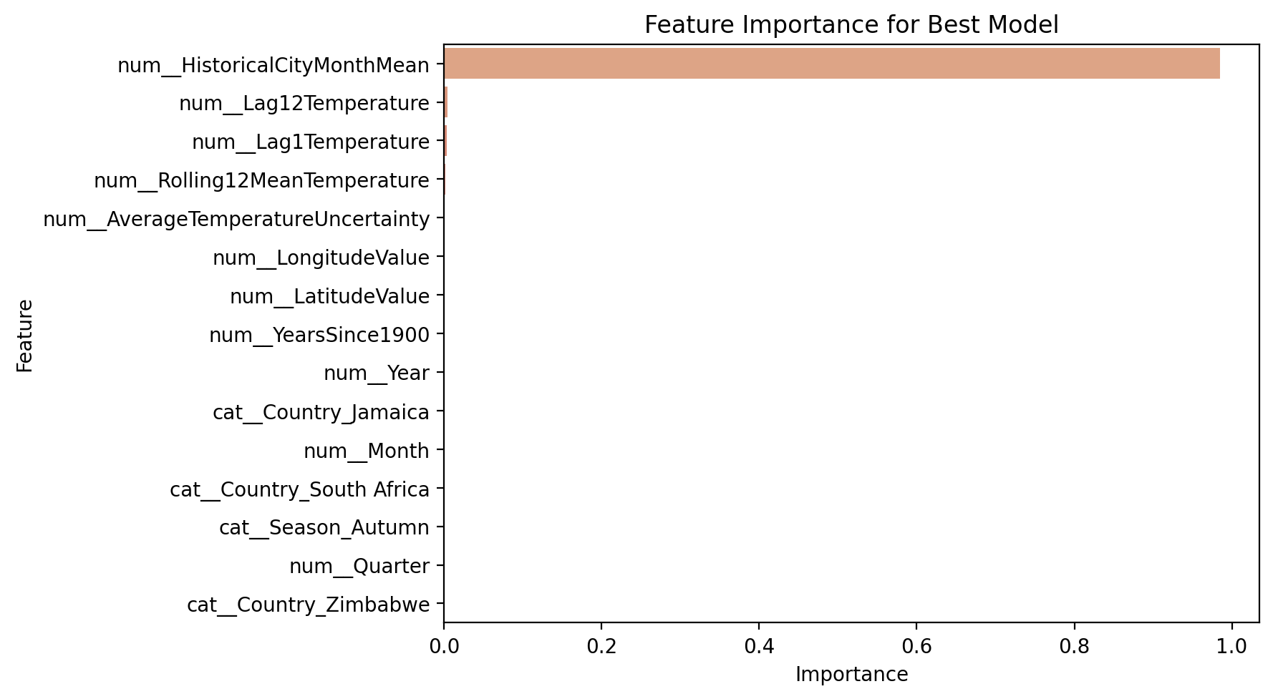
End-to-End Workflow
How the code moves from raw climate data to final evaluation
Raw Data
Cleaning
Features
EDA
Models
Evaluation
Paper/PPT
Raw CSV is loaded from data/raw/GlobalLandTemperaturesByCity.csv.
Cleaning and feature engineering are handled in src/preprocessing.py.
EDA figures are generated into outputs/figures.
Modeling and tuning produce CSV result tables in outputs/tables.
The research paper and this presentation are generated from the saved artifacts.
03

Slide 4
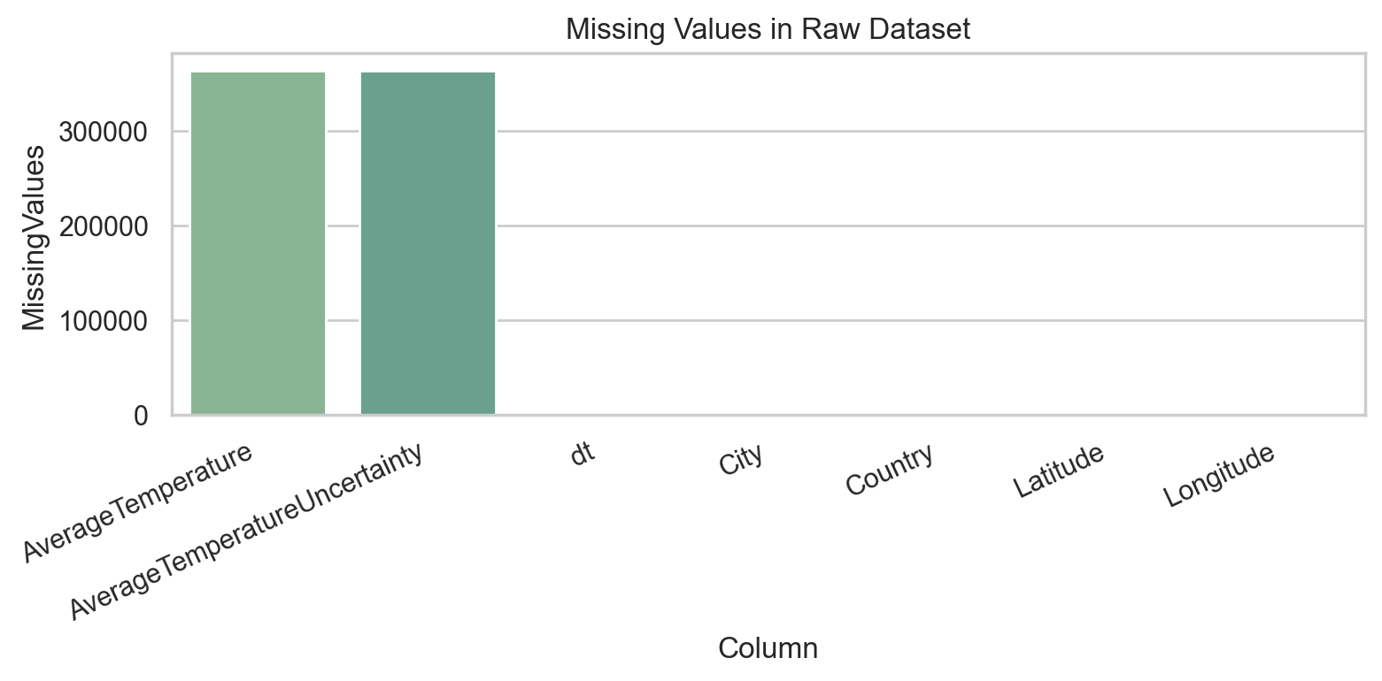
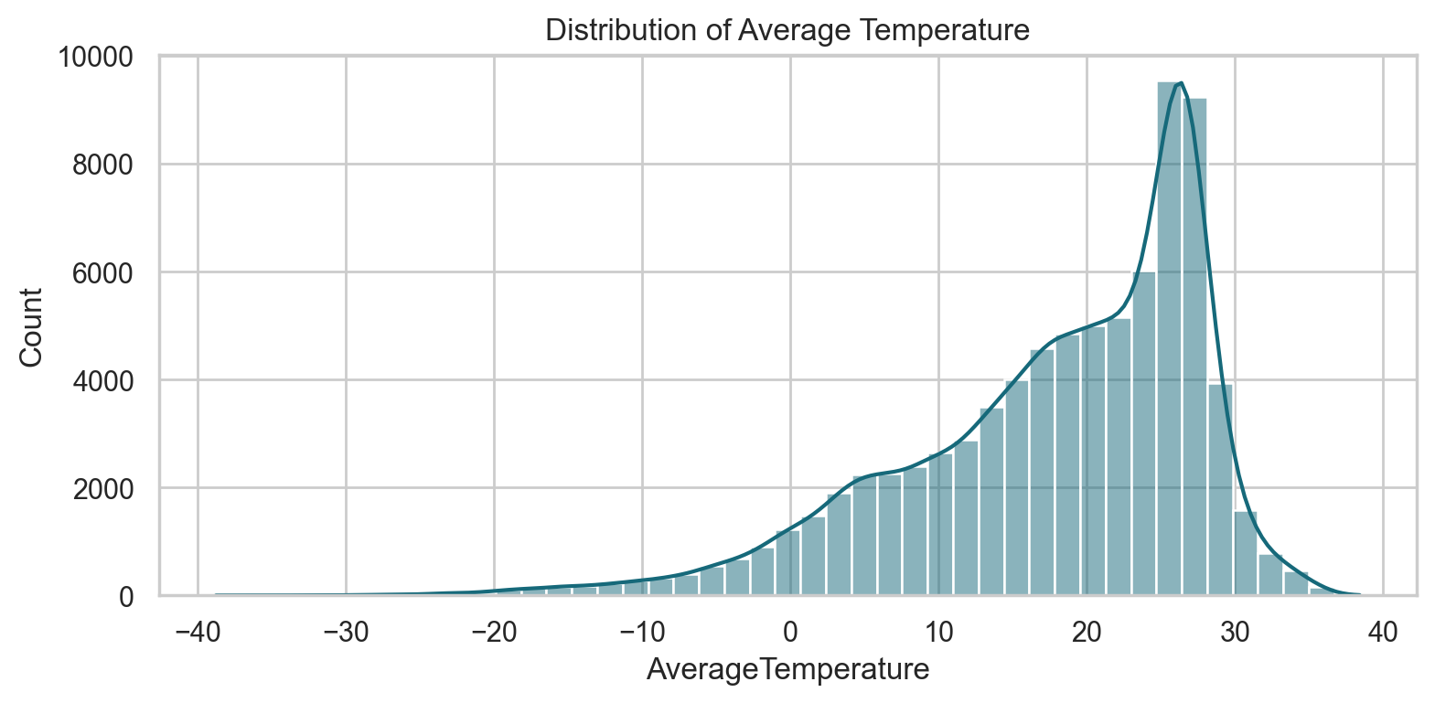
Dataset
Source: Berkeley Earth Climate Change Dataset on Kaggle.
File used: GlobalLandTemperaturesByCity.csv.
Raw scale: approximately 8.6 million monthly city-level records.
Columns: dt, AverageTemperature, AverageTemperatureUncertainty, City, Country, Latitude, Longitude.
Working analysis window: 1900 onward after cleaning.
04

Slide 5
Preprocessing Pipeline
Implemented in src/preprocessing.py and notebooks/01_data_cleaning.ipynb
Parsed dt as datetime and converted temperature columns to numeric.
Dropped rows with missing dt or AverageTemperature and removed duplicate records.
Converted latitude/longitude strings into signed float values.
Restricted the working dataset to 1900 onward.
Created cleaned data, South Asia subset, modeling sample, and chronological train/test split.
4.79M
Cleaned Rows
75K
Modeling Rows
60K
Train Rows
15K
Test Rows
05

Slide 6
Feature Engineering
Temporal: Year, Month, Quarter, Season, Decade, YearsSince1900.
Geographic: LatitudeValue, LongitudeValue, Hemisphere, Country, RegionTag.
Historical signals: Lag1Temperature, Lag12Temperature, Rolling12MeanTemperature.
Climate interpretation: HistoricalCityMonthMean, TemperatureAnomaly, ClimateRiskIndex.
South Asia region tag supports local climate interpretation and viva discussion.
Feature | Importance
num__HistoricalCityMonthMean | 0.985
num__Lag12Temperature | 0.004
num__Lag1Temperature | 0.003
num__Rolling12MeanTemperature | 0.001
num__AverageTemperatureUncertainty | 0.001
num__LongitudeValue | 0.001
06

Slide 7
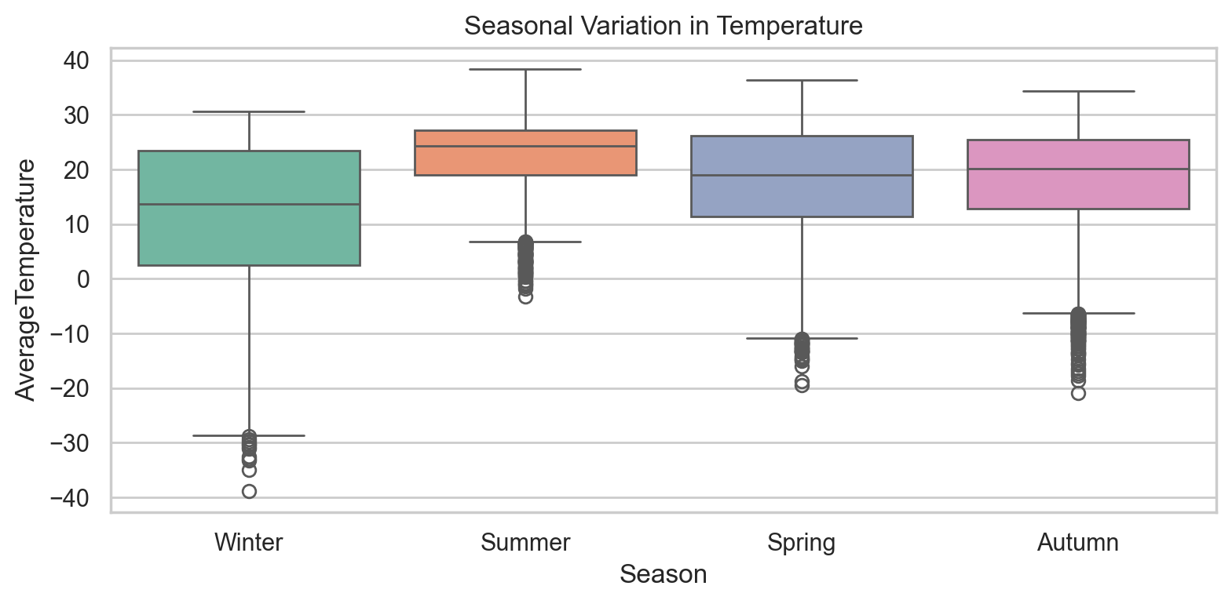
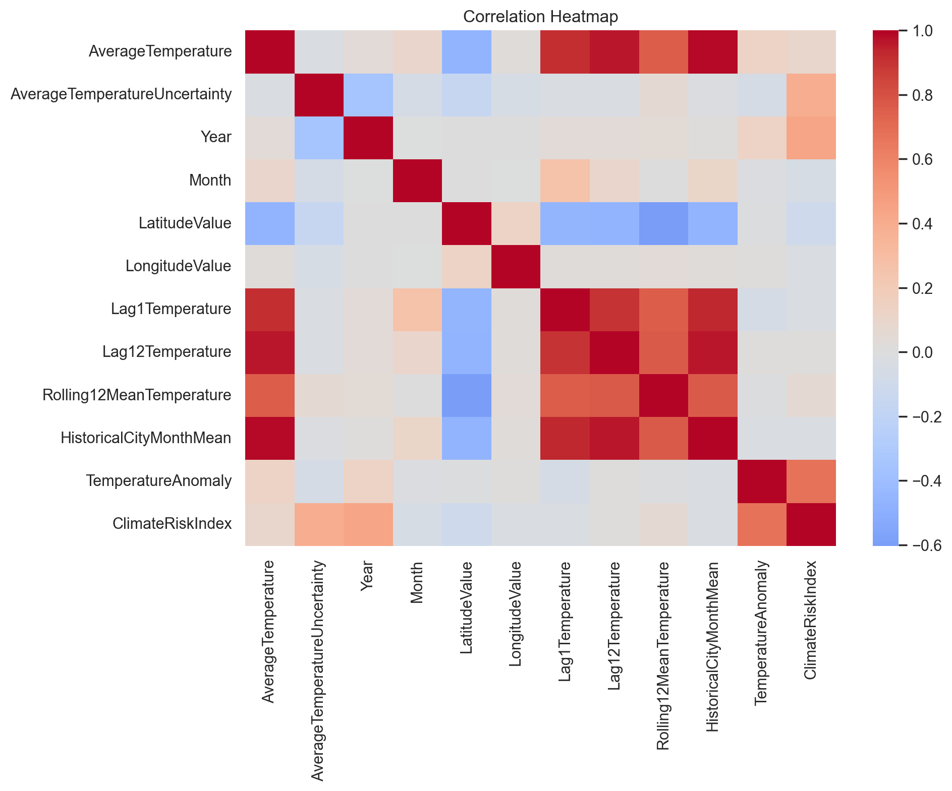
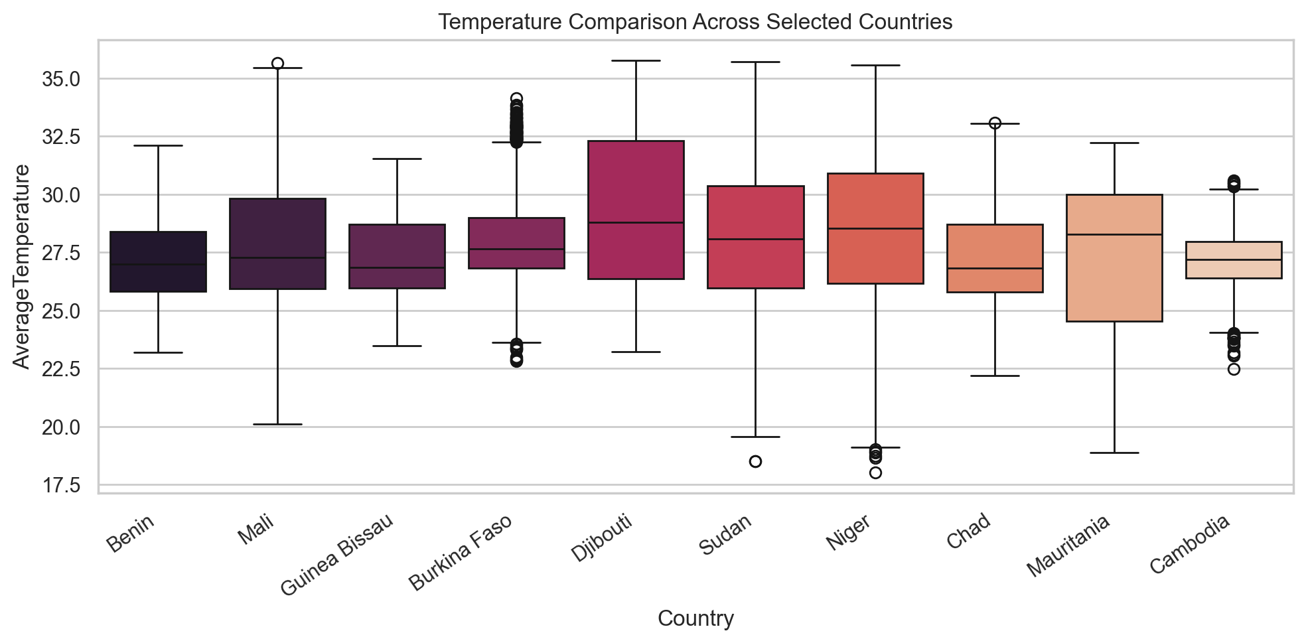
EDA Findings
Global trend shows a clear warming direction over the modern climate record.
Seasonal boxplot confirms strong month/season structure in the target.
Correlation heatmap supports the importance of lagged and historical average features.
Outlier and country plots show wide geographic temperature variation.
07

Slide 8
Implemented Models
Implemented in src/train.py and scripts/run_modeling.py
Linear Regression: interpretable baseline.
Decision Tree Regressor: non-linear rule-based model.
Random Forest Regressor: robust bagging ensemble.
Gradient Boosting Regressor: sequential boosting ensemble.
XGBoost Regressor: optimized tree boosting model.
Numerical features were imputed and scaled; categorical features were imputed and one-hot encoded.
5
Models Compared
2
Validation Splits
08

Slide 9
Chronological Model Results
Model | MAE | RMSE | MAPE | R2 Score
Random Forest | 0.927 | 1.372 | 48.649 | 0.980
XGBoost | 0.932 | 1.376 | 42.640 | 0.980
Gradient Boosting | 0.965 | 1.458 | 47.808 | 0.978
Linear Regression | 1.009 | 1.546 | 56.321 | 0.975
Decision Tree | 1.040 | 1.557 | 76.755 | 0.975
Best chronological model: Random Forest with RMSE 1.372 and R2 0.980.
XGBoost is practically close on chronological split with RMSE 1.376.
Linear Regression remains a useful baseline but has higher RMSE 1.546.
MAPE is not the primary selection metric because near-zero temperatures inflate percentage errors.
MAPE Note
High MAPE is caused by near-zero temperatures; RMSE and R2 are primary.
09

Slide 10
Cross-Validation and Generalization
Model | CV Mean RMSE | CV Mean R2
XGBoost | 1.403 | 0.980
Random Forest | 1.467 | 0.978
Gradient Boosting | 1.476 | 0.978
Linear Regression | 1.552 | 0.976
Decision Tree | 1.666 | 0.972
XGBoost has best average CV RMSE: 1.4029.
Random Forest leads on chronological holdout, showing that ranking depends on validation design.
Chronological validation is more realistic for climate prediction because it tests later years using earlier observations.
1.4228
Random Split Avg RMSE
1.4657
Chronological Avg RMSE
10

Slide 11
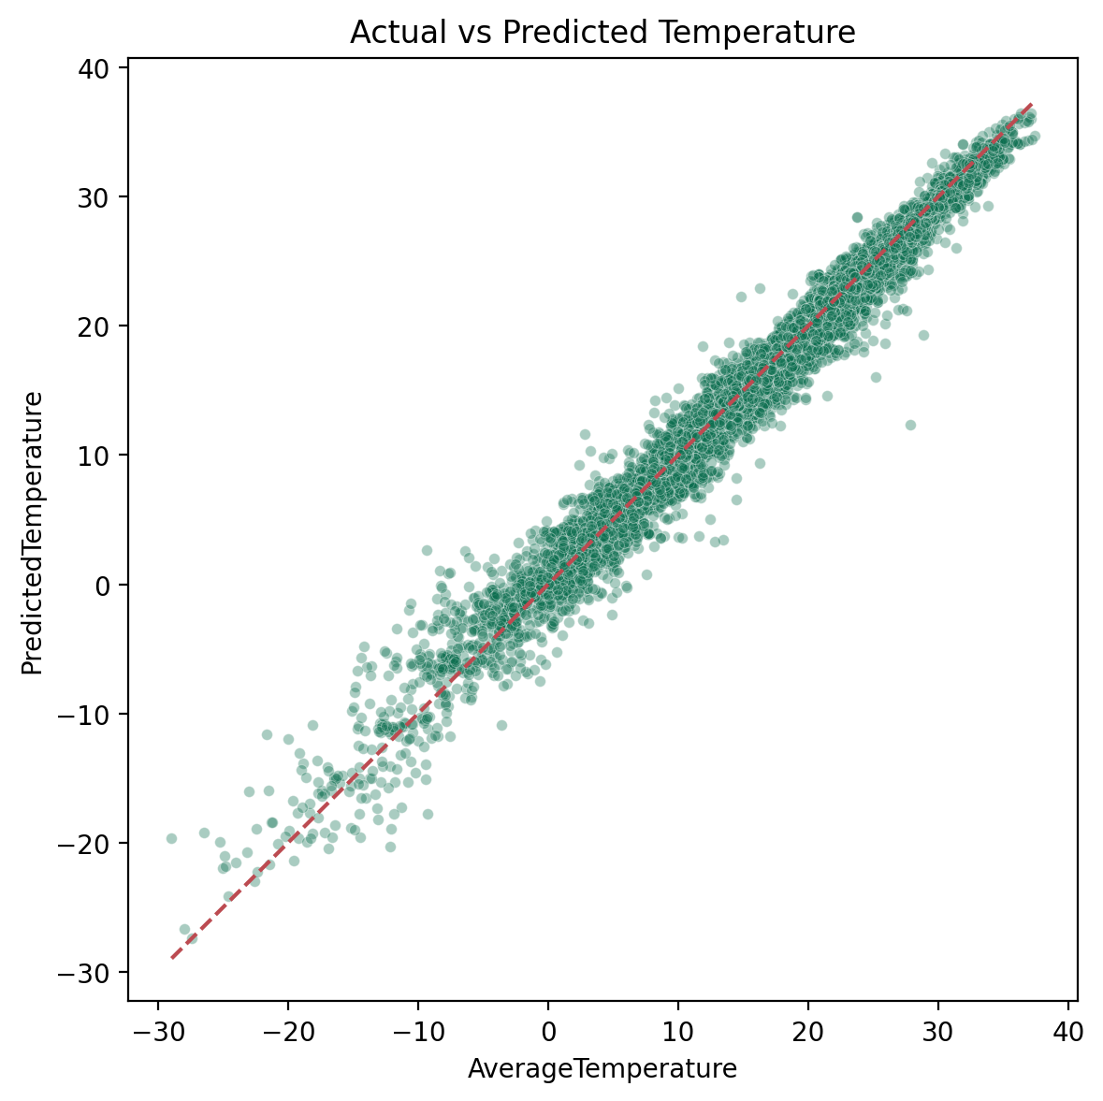
Comparative Analysis
Random Forest
Best chronological RMSE: 1.372
XGBoost
Best CV RMSE: 1.4029
Linear Regression
Weakest baseline RMSE: 1.546
Random Forest and XGBoost are practically close on chronological holdout: 1.372 vs 1.376.
Ensemble models outperform simple linear and single-tree baselines.
XGBoost is stronger under cross-validation, while Random Forest is stronger under chronological testing.
Decision Tree is easier to explain but weaker in predictive accuracy.
Final recommendation: Random Forest for future-period prediction; XGBoost as the CV-focused alternative.
11

Slide 12
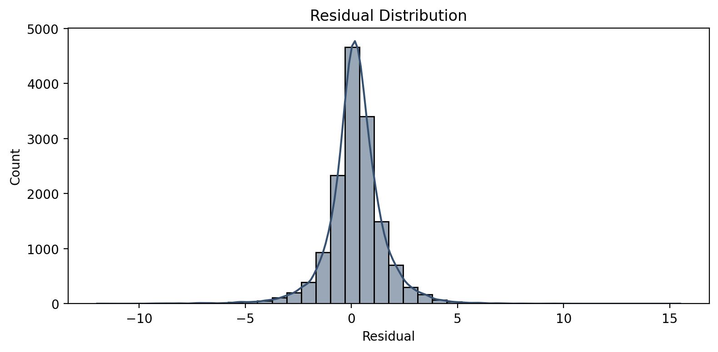
Best Model Diagnostics
Actual vs predicted plot shows close alignment around the ideal diagonal.
Residuals are concentrated near zero.
HistoricalCityMonthMean is the dominant feature, followed by lag and rolling features.
12

Slide 13
Hyperparameter Tuning
Baseline Model | Baseline RMSE | Tuned RMSE | RMSE Change
Random Forest | 1.372 | 1.494 | 0.122
Gradient Boosting | 1.458 | 1.458 | 0.000
RandomizedSearchCV was applied to Random Forest and Gradient Boosting.
The saved results show tuning did not improve chronological holdout RMSE.
This is still useful: CV-optimized parameters do not always improve future-period performance.
The baseline Random Forest remains the final recommended model for chronological prediction.
13

Slide 14
Decade-Wise Error
Decade | Rows | MeanAbsoluteError | RootMeanSquaredError
1990 | 5896 | 0.887 | 1.306
2000 | 6656 | 0.940 | 1.379
2010 | 2448 | 0.990 | 1.500
RMSE increases from the 1990s to the 2010s.
This suggests recent climate conditions are harder to predict using historical city-month patterns.
The decade analysis adds interpretation beyond a single aggregate accuracy number.
14

Slide 15
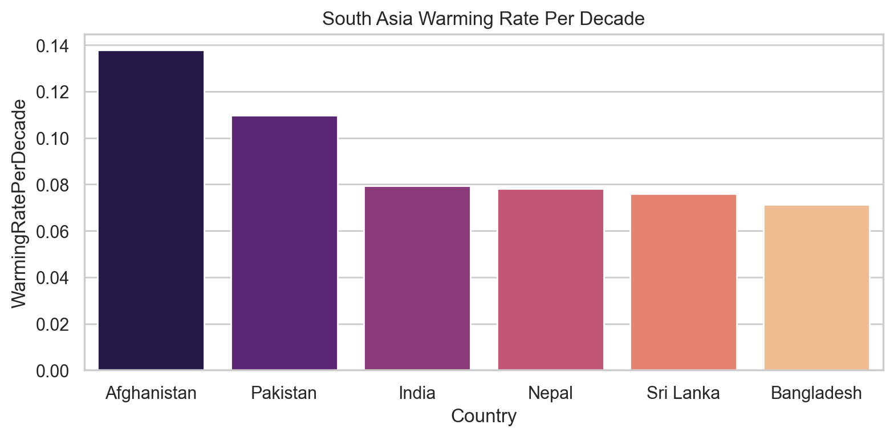
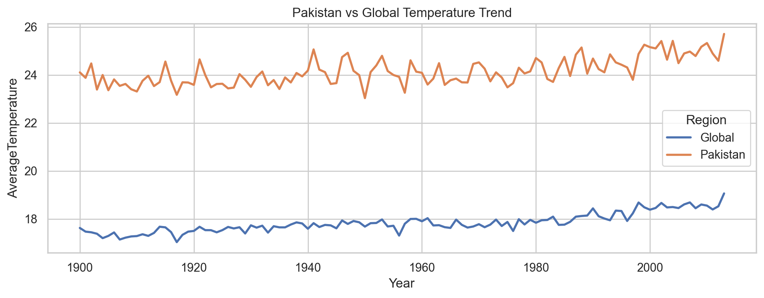
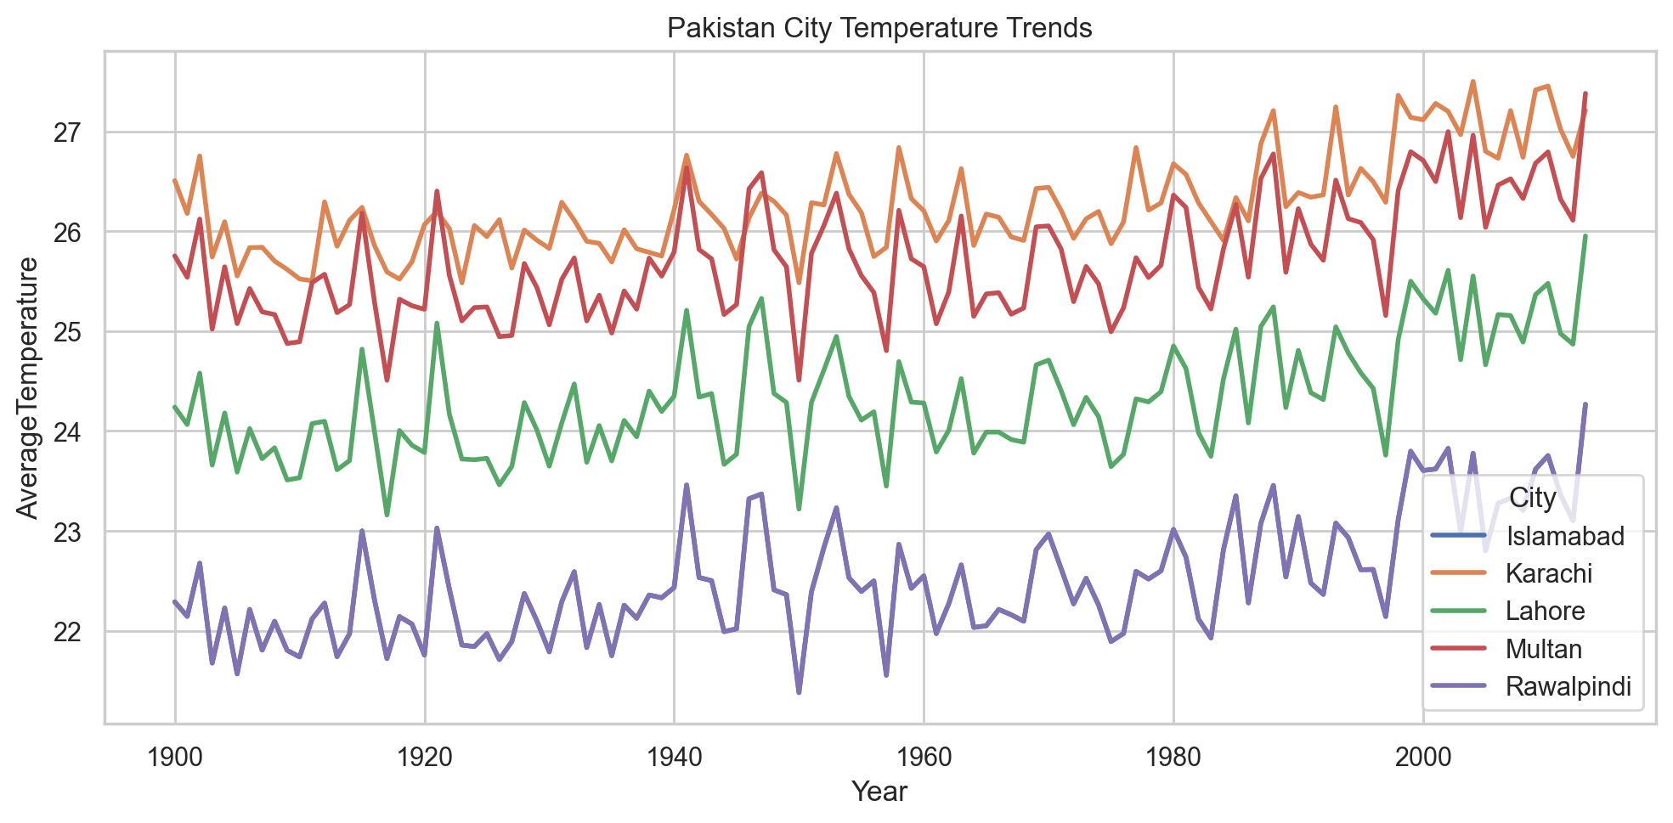
South Asia Case Study
Country | WarmingRatePerDecade
Afghanistan | 0.138
Pakistan | 0.110
India | 0.079
Nepal | 0.078
Sri Lanka | 0.076
Bangladesh | 0.071
South Asia analysis gives the project regional climate relevance.
Afghanistan and Pakistan have the highest estimated warming rates in the saved table.
15

Slide 16
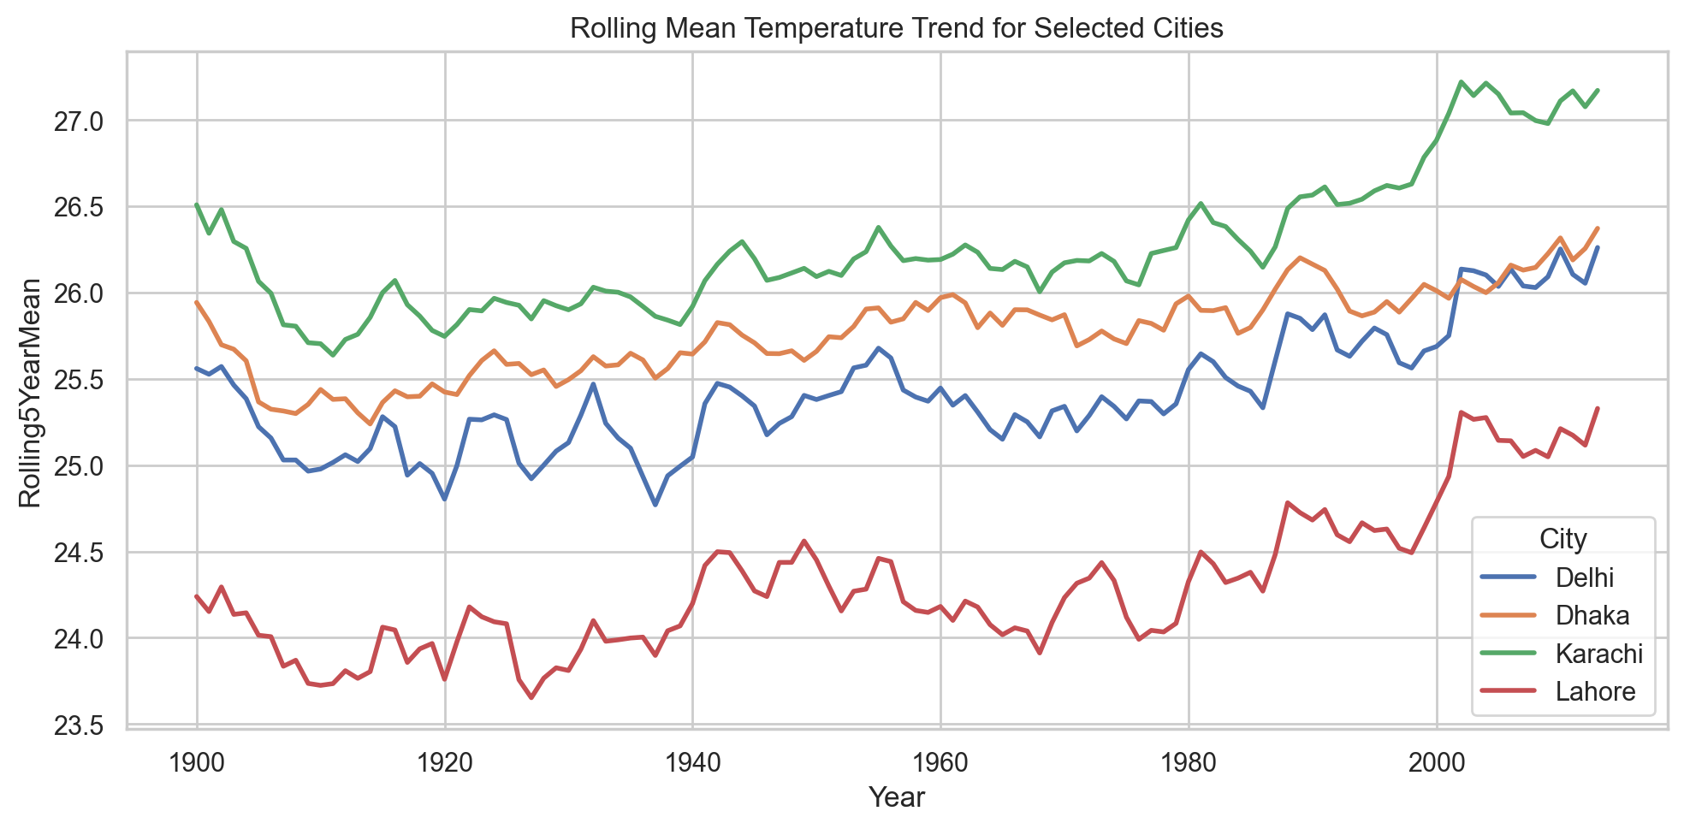
Novelty and Contribution
Novelty 1: anomaly-based climate interpretation, not only raw prediction.
Novelty 2: chronological validation to reduce temporal leakage.
Novelty 3: South Asia and Pakistan-focused analysis for local relevance.
Novelty 4: comparative evaluation across baseline, tree, ensemble, and boosting models.
Contribution: a reproducible city-level climate ML pipeline with real metrics, figures, and model artifacts.
16

Slide 17
Key Takeaways for Viva
Why regression? AverageTemperature is continuous, so RMSE and R2 are appropriate.
Why chronological split? Climate prediction should test future periods using earlier observations.
Why MAPE is high? Near-zero temperatures inflate percentage error.
What features mattered most? Historical city-month mean, lagged temperatures, and rolling means.
What is novel? Anomaly analysis, time-aware validation, South Asia case study, and model comparison.
Random Forest
Best Model
1.372
Chronological RMSE
XGBoost
Best CV Model
17

Slide 18
Conclusion and Future Work
Best chronological model: Random Forest with RMSE 1.372 and R2 0.980.
Best CV model: XGBoost with CV RMSE 1.4029.
Lagged and historical city-month features are the strongest predictors.
Chronological split gives a more realistic estimate than random split for climate forecasting.
Future work: LSTM/Transformer models, post-2013 NASA/NOAA data, added CO2/rainfall/humidity variables, and a Streamlit app.
Random Forest
Final Model
1.372
RMSE
0.980
R2
18

