Slide 1
How does Liverpool score goals?
A data driven analysis based on 19 of their goals

Slide 2
Categorizing the goals
3 categories:
Standard goals
Goal after controlled possession
Goal after quick transition from defense to offense

Slide 3
Categorizing the goals
1
9
9

Slide 4
Transition Goals
- 9 of the 19 analysed goals followed a quick transition from defense to offense
- 2.1 passes from transition to goal
- very vertical play

Slide 5
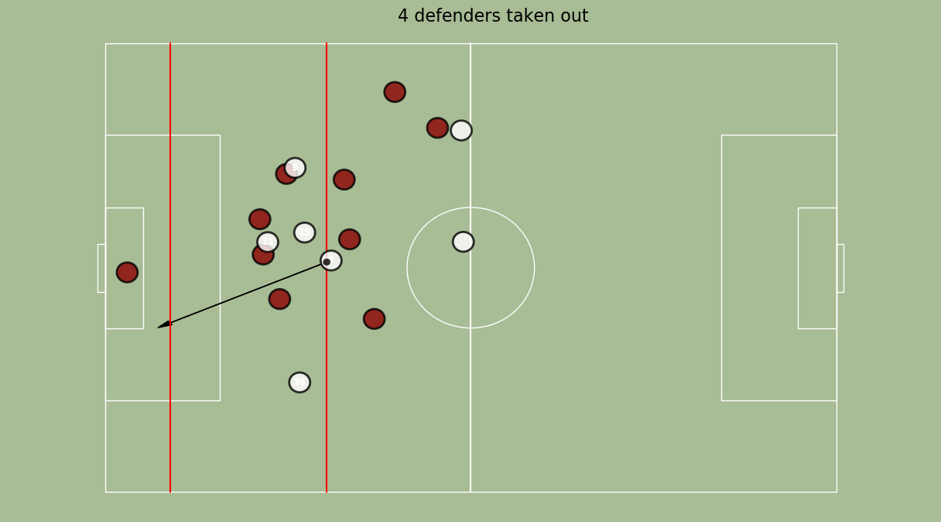

Slide 6
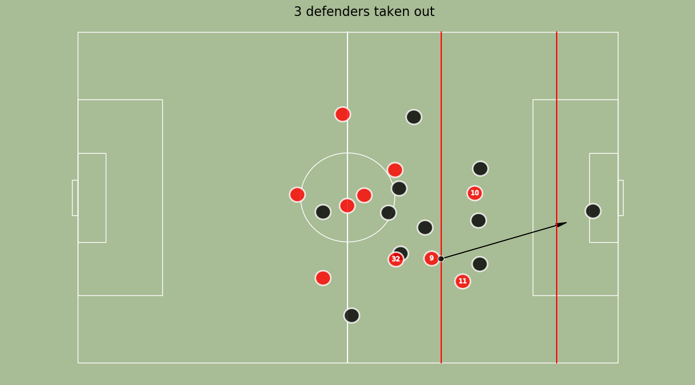

Slide 7
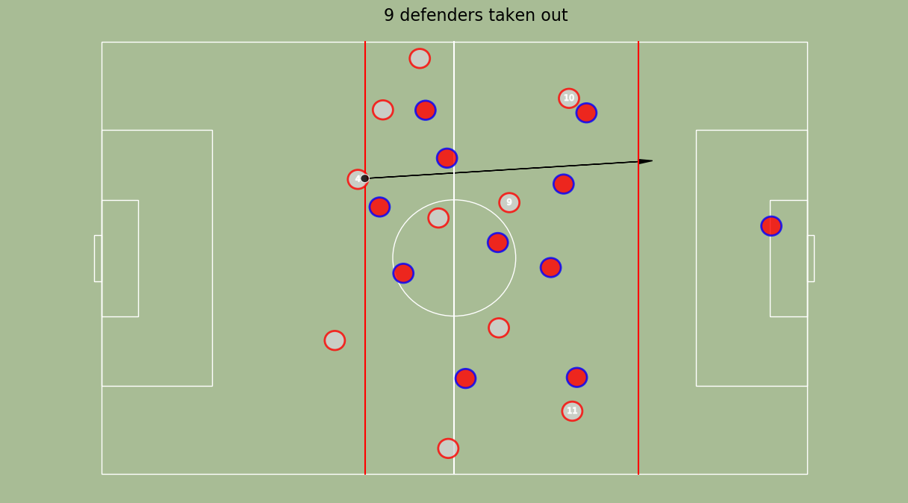

Slide 8
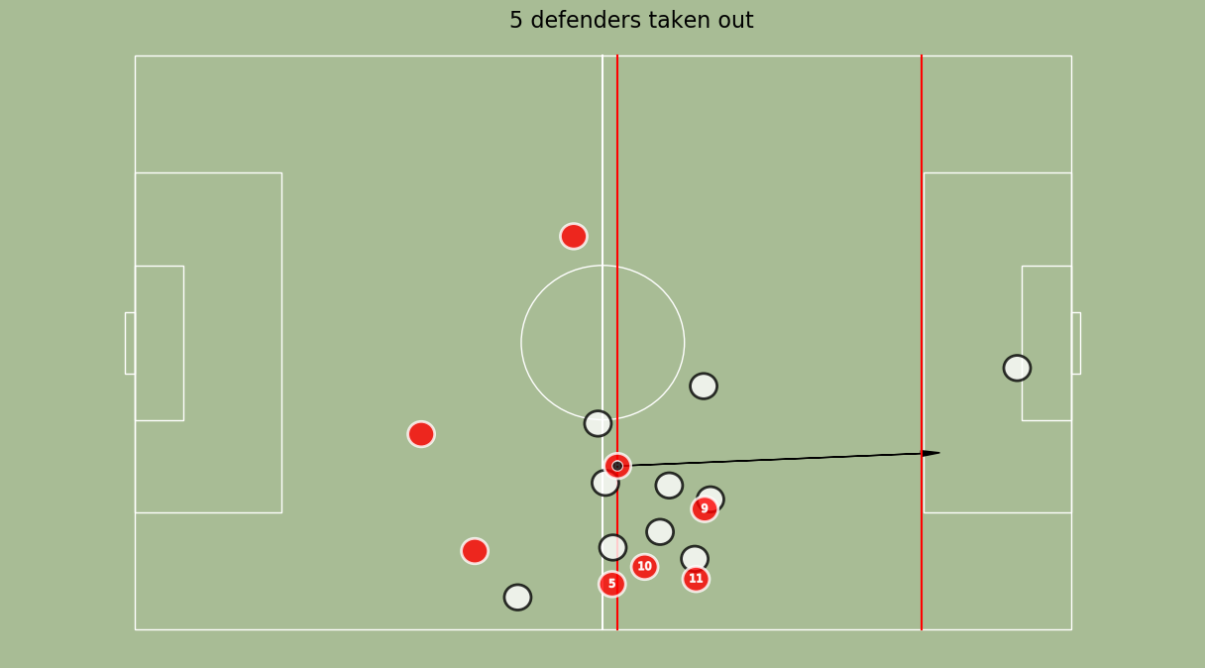

Slide 9
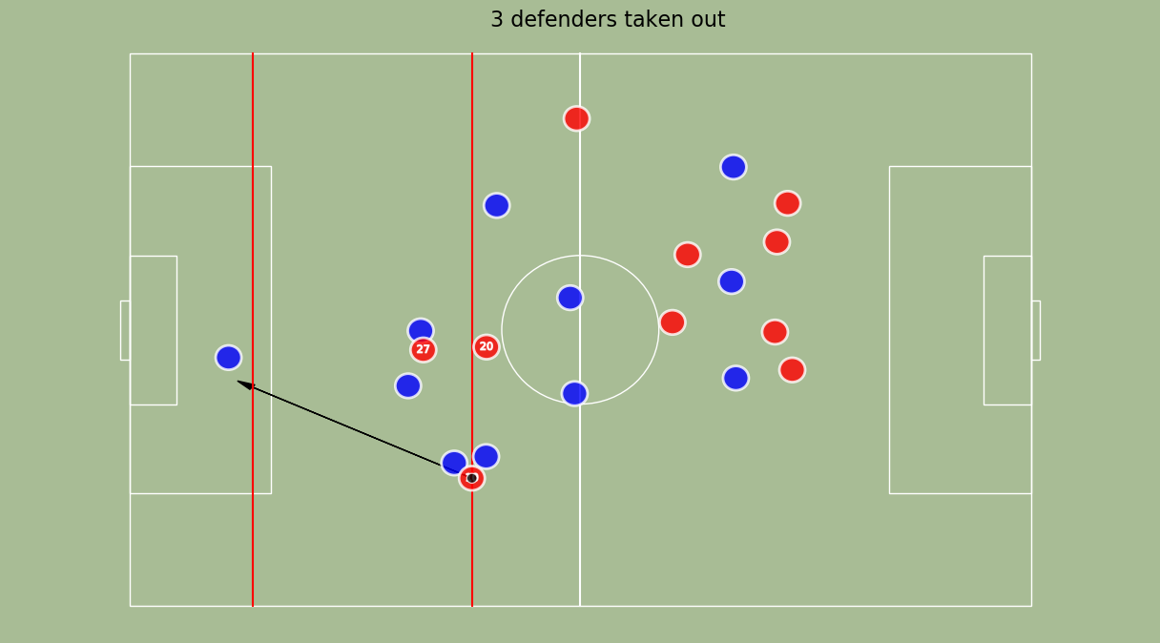

Slide 10
Speed
- 5.069 m/s vs 5.696 m/s
- helps to win the ball after risky passes

Slide 11
During possesion
- Full-backs high up on the pitch
- Sticking to their side to create space

Slide 12
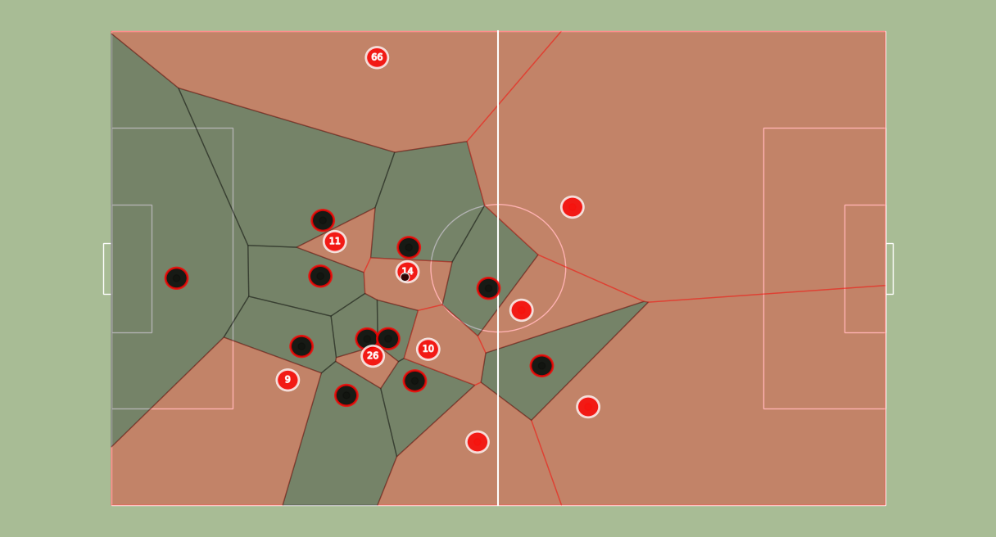
Goal against Salzburg

Slide 13
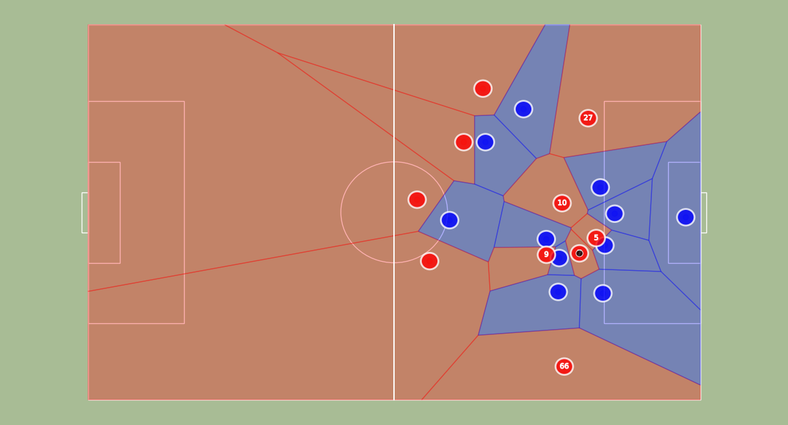
Goal against Leicester City

Slide 14
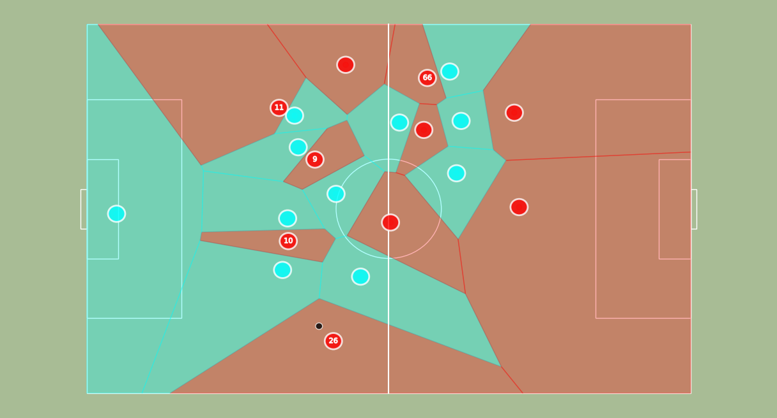
Goal against Manchester City

Slide 15
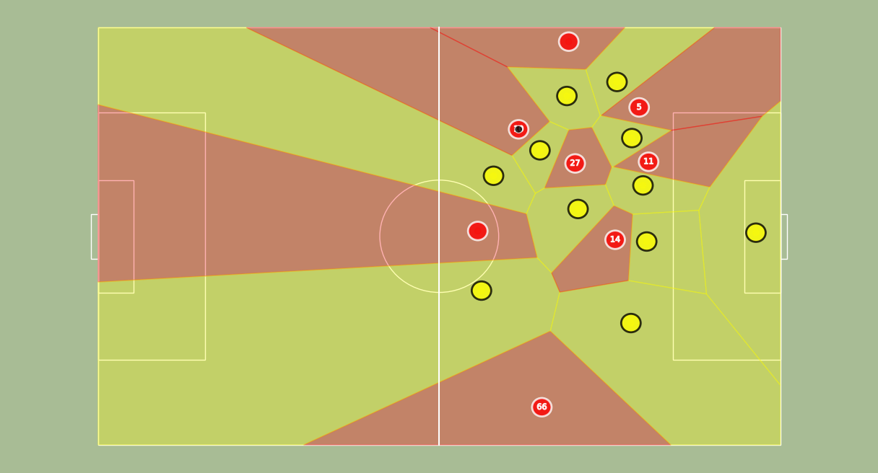
Goal against Wolves

Slide 16
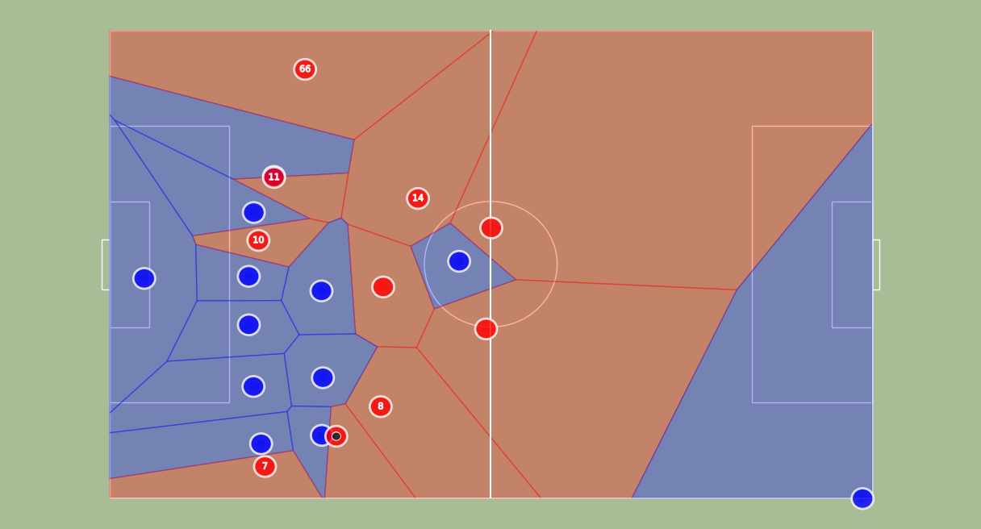
Goal against Porto

Slide 17
Summary: How does Liverpool score goals?
Lots of Goals after transition
Vertical play, few passes, superior speed
Using high full-backs to break lower defending sides

