Slide 1
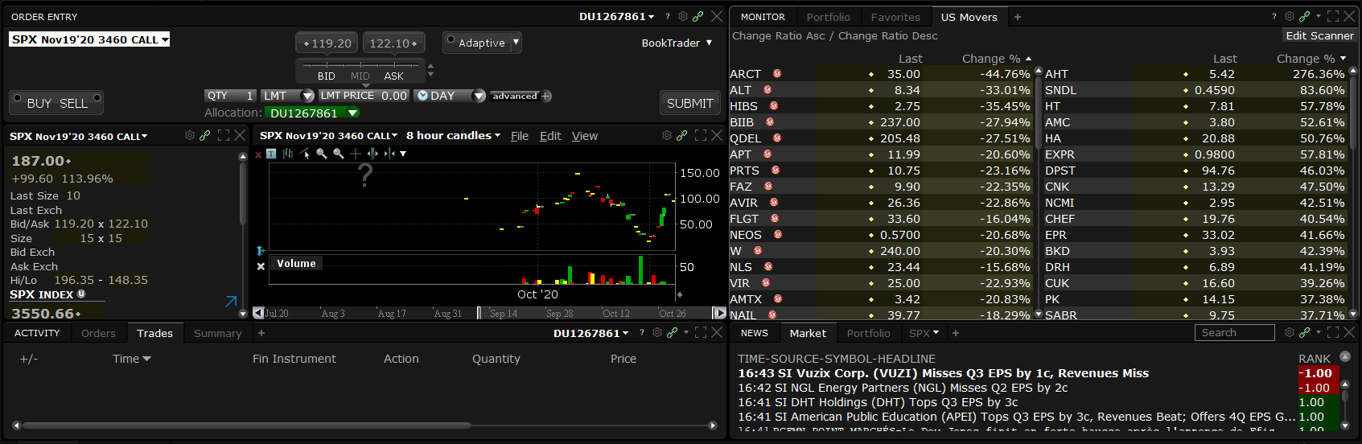

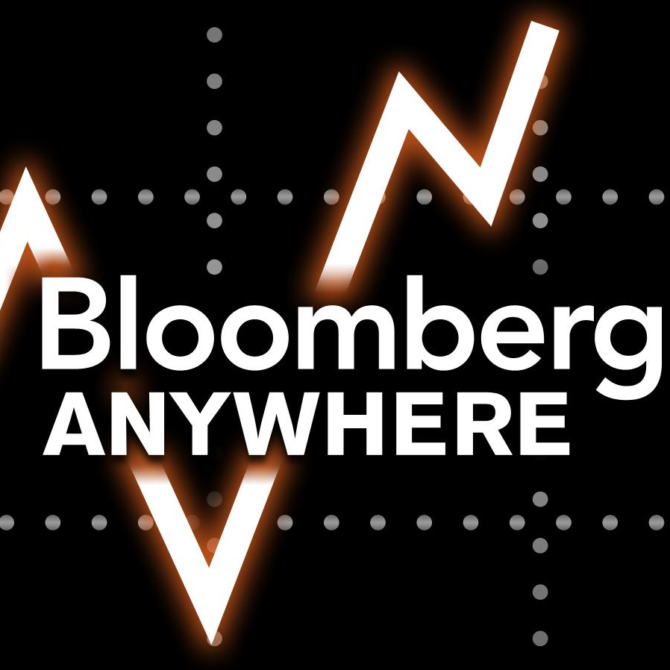

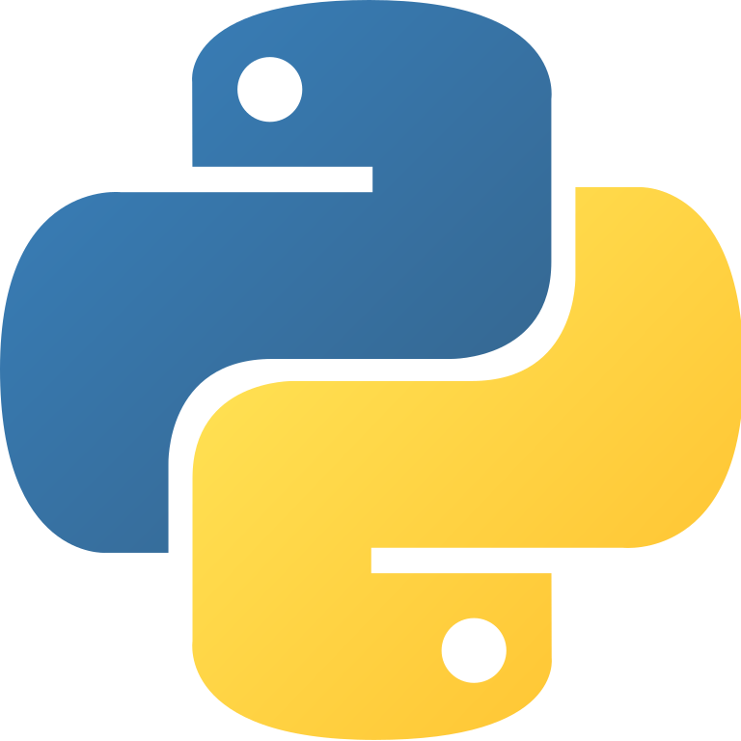
Independent Study Opportunity
Build a Python package
Working in teams of 3-4, students will craft a unique economic insight and translate it into an actionable trading algorithm using Python. Each team will visualize their backtest results, market data, and performance metrics using interactive Dash web apps. At the end of the semester, teams will present their app, strategy, and results to a panel of finance industry professionals at the 3rd annual Alpha Summit event.
FINTECH 534
Fall 2021
Students will gain experience with:
Workflow management in git, a skill highly sought after by employers. Those teams who wish to publish their app on GitHub gain the ability to showcase their teamwork, financial, and technical skills to prospective employers.
Identifying, retrieving, cleaning, and integrating historical data obtained from the industry’s leading data vendor via Duke University’s Bloomberg Anywhere subscription.
Exchanging trade orders and streaming real-time market data between live trading algorithms and IB Gateway, a professional-grade trade execution system used by traders and institutions.
IB Gateway made available in cooperation with Interactive Brokers, LLC (NYSE: IBKR).
Programming, training, and evaluating machine learning algorithms in Python – using any number of public or custom libraries – and elegantly visualizing the results in Dash.
Prerequisites:
Students enrolling in FINTECH 534 must satisfy one (or more) of the following:
Completion of FINTECH 533: Financial Engineering (Spring 2021)
Sufficient background in both ECON and Python programming
Demonstrated ability to bend spoons with your mind.
Please email Profs. Emma Rasiel (ebr4@duke.edu) or Jake Vestal (jmv13@duke.edu) for course permission codes and more information.

Slide 2

Financier
The Language of Algorithmic Trading

