Slide 1

Tableau mini-Project Ayiti Analytics/ Bootcamp 2021
Analyze on Credit Risk
Prepared by :
Gothie Ridgina PASTEUR
This assignment involves the use of a spreadsheet program to study data regarding the risks of lending money in any area.
Therefore, we have made a risk analysis to find out which gender, which annual income group, which grade, which degree, which age group are likely to default on the loans

Slide 2
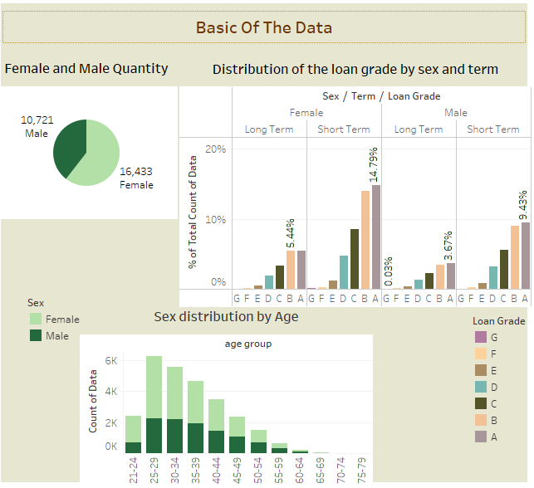
These graphs show us that there are a total of 27,154 people of whom 60.52% are women, and that 14.77% of these women are between 25 and 29 years old. 14.79% of these women are in the A grade and lend money in the short term
On the side of men, the majority of men of which 8.26% are between 25 and 29 years old and 9.43% belong to group A and lend money in the short term.

Slide 3
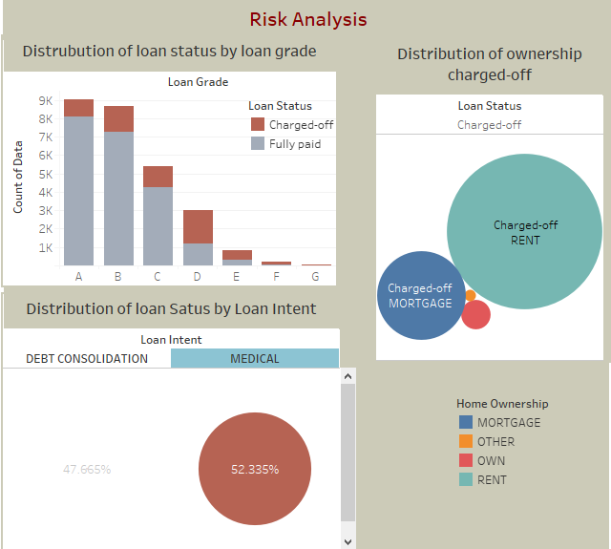
These grapes show us that:
All the people in the g-grade have not paid back their debts
73,15% of the people who do not pay are in rent.
52.33 % of the people who lend for medical reasons do not pay back their loan

Slide 4
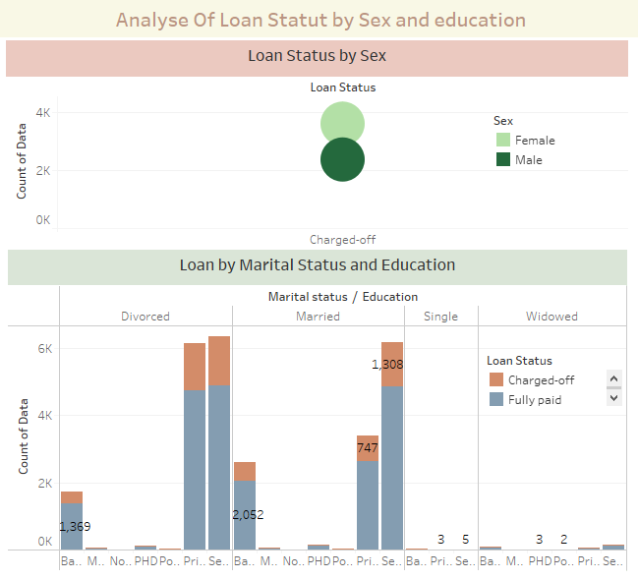
These graphs show that there are a total of 1476 high school graduates who are divorced and do not pay their credits.
Out of 5987 people who do not pay their debts, only 39.655 are men.

Slide 5
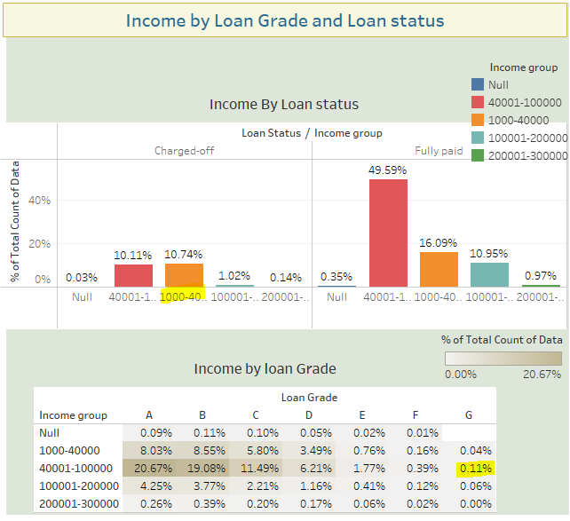
These data show us that 10.74% of the clients who do not pay their debts have an annual income between 400001 and 100000 dollars. And 11% of the people who do not pay their loans in group G have this same annual income

Slide 6

Result on the risk analysis
The analysis of the data showed that if the person is in the rent, divorced, and belongs to group G, the risk of non-repayment is very high.
If this person takes out a loan because of medical problems or a consolidation, and is between 25 and 29 years old, the risk of repayment is high.
The annual income of people at risk for a loan is between 40001 and 100000 thousand dollars

