Slide 1

Xiang Herbs & Tea Project
John Horne

Slide 2
Goals
Recreate the prototype 1:1
Incorporate Bootstrap to allow dynamic scaling
Create a complete template for backend integration

Slide 3
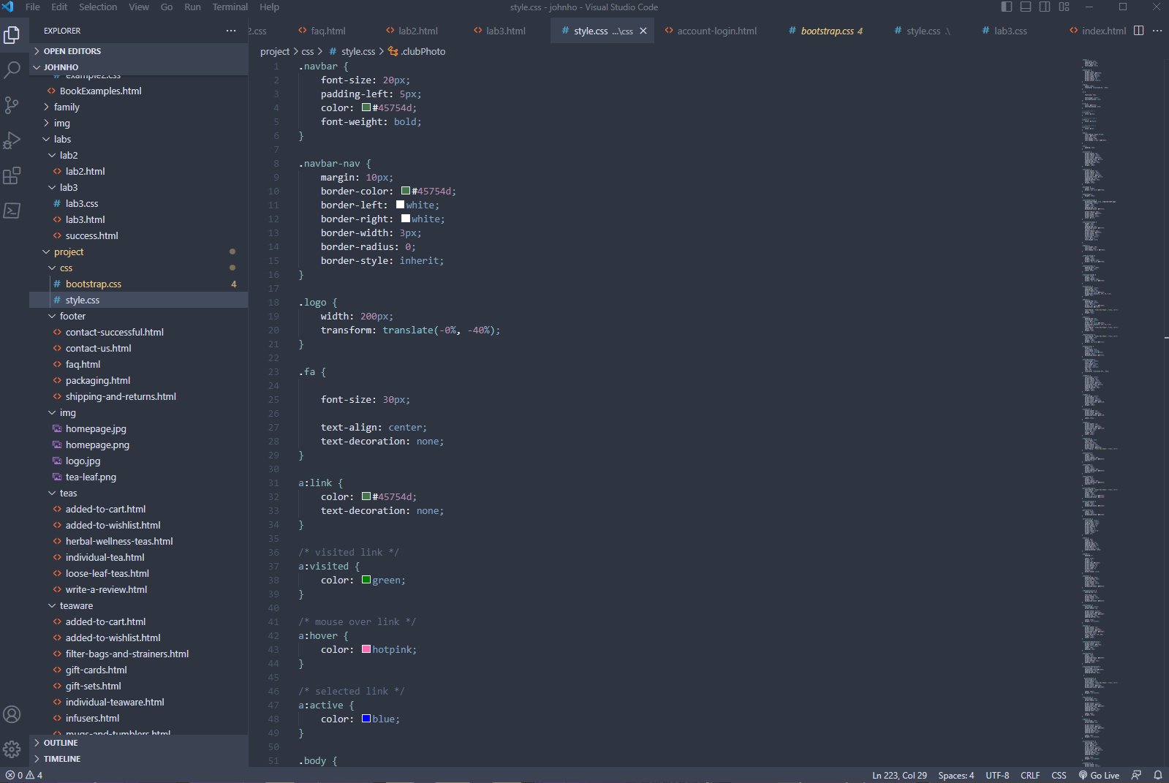

Difficulties
Becoming familiar with Bootstrap
Comprehensive external CSS for every element
Sheer scale of the prototype

Slide 4
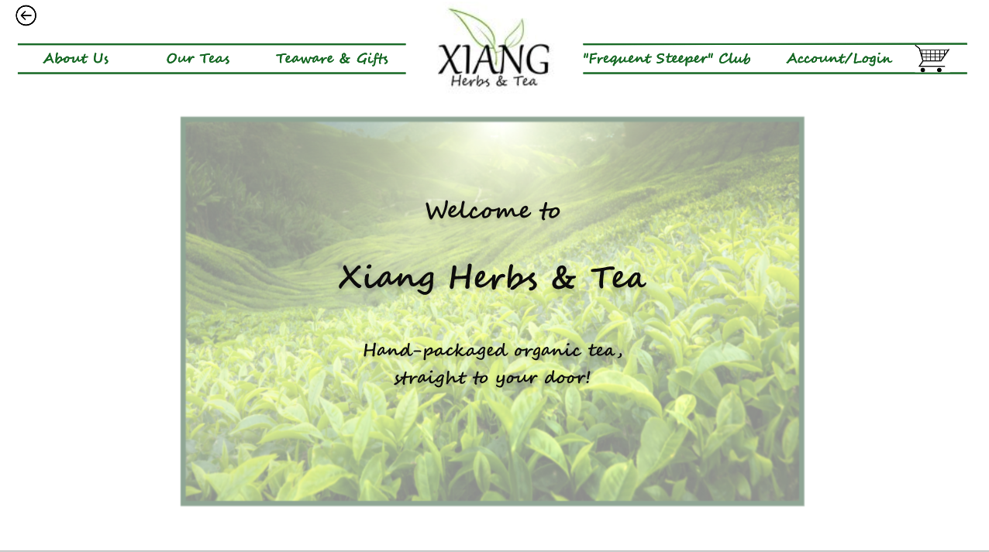
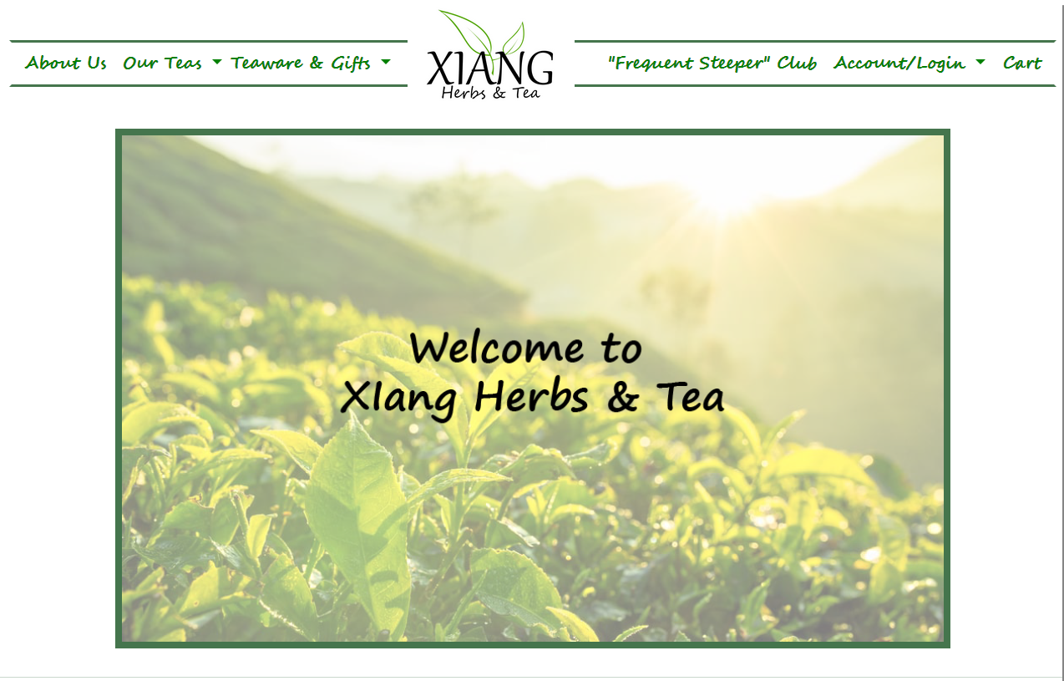
End Product
Prototype
My version

Slide 5
Takeaways
Bootstrap
Site Structure
Efficiently Re-Using CSS
Linking Bootstrap file (online and local)
Editing existing templates
Grid system
Using ‘div’s for nonlinear layout
Nesting folders for organization and readability
When to reuse a template
When to create new template from scratch
Making CSS easy to find

Slide 6
Conclusion
Thanks!

