Slide 1


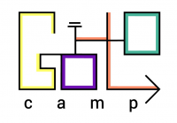
Reinforcement learning
What it does and why should you care?

Slide 2
Terms
All questions are always welcome
  Even if question feels stupid,
    Chances are, half of the group is just like you.

Slide 3
<a convenient slide for public survey>

Slide 4
Supervised learning
Given:
    objects and answers
    algorithm family
    loss function
Find:

Slide 5
Supervised learning
Given:
    objects and answers
    algorithm family
    loss function
Find:
[banner,page], ctr
linear / tree / NN
MSE, crossentropy

Slide 6
Supervised learning
Great... except if we have no reference answers

Slide 7


Online Ads
Great... except if we have no reference answers
We have:
  YouTube at your disposal
  Live data stream
  (banner & video features, #clicked)
  (insert your favorite ML toolkit)
We want:
  Learn to pick relevant ads
Ideas?

Slide 8


Duct tape approach
Common idea:
  Initialize with naïve solution
  Get data by trial and error and error and error and error
  Learn (situation) → (optimal action)
  Repeat

Slide 9
Problems
Problem 1:
  What exactly does the “optimal action” mean?
  Extract as much
  money as you can right now
  VS
Make user happy
so that he would visit you again

Slide 10
Problems
Problem 2:
  If you always follow the “current optimal” strategy, you may never discover something better.
  If you show the same banner to 100% users, you will never learn how other ads affect them.
  Ideas?

Slide 11

Duct tape approach

Slide 12

Reinforcement learning

Slide 13

What-what learning?
      Supervised learning
  Learning to approximate reference answers
  Needs correct answers
  Model does not affect the input data
      Reinforcement learning
  Learning optimal strategy
by trial and error
  Needs feedback on agent's own actions
  Agent can affect it's own observations

Slide 14
What-what learning?
      Unsupervised learning
  Learning underlying
  data structure
  No feedback required
  Model does not affect the input data
      Reinforcement learning
  Learning optimal strategy
by trial and error
  Needs feedback on agent's own actions
  Agent can affect it's own observations

Slide 15

What is: bandit
observation
Agent
action
Feedback
Examples:
  banner ads (RTB)
  recommendations
  medical treatment

Slide 16

What is: bandit
observation
Agent
action
Feedback
Examples:
  banner ads (RTB)
  recommendations
  medical treatment

Slide 17
What is: bandit
observation
Agent
action
Feedback
Examples:
  banner ads (RTB)
  recommendations
  medical treatment
Q: what's observation, action and feedback in the banner ads problem?

Slide 18
What is: bandit
observation
Agent
action
Feedback
user features
time of year
trends
show
banner
click,
money
Examples:
  banner ads (RTB)
  recommendations
  medical treatment

Slide 19
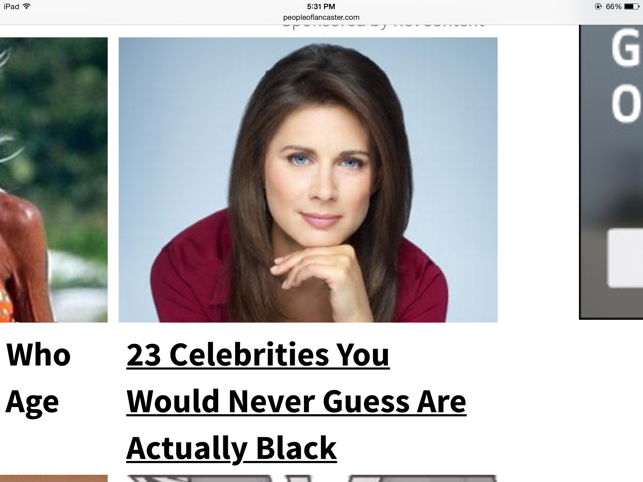
What is: bandit
observation
Agent
action
Feedback
user features
time of year
trends
show
banner
click,
money
Q: You're Yandex/Google/Youtube.
There's a kind of banners that would have great click rates: the “clickbait”.
Is it a good idea to show clickbait?

Slide 20
What is: bandit
observation
Agent
action
Feedback
Q: You're Google/Yandex/Youtube.
There's a kind of banners that would have great click rates: the “clickbait”.
Is it a good idea to show clickbait?
No, no one will trust you after that!

Slide 21
What is: decision process
Agent
observation
action
Environment

Slide 22
What is: decision process
Agent
Can do anything
observation
action
Can't even see
(worst case)
Environment

Slide 23

Applications: web
Cases:
  Pick ads to maximize profit
  Design landing page to maximize user retention
  Recommend movies to users
  Find pages relevant to queries
Example
  Observation – user features
  Action – show banner #i
  Feedback – did user click?

Slide 24




Applications: dynamic systems

Slide 25

Applications: dynamic systems
Cases:
    Robots
    Self-driving vehicles
    Pilot assistant
    More robots!
Example
  Observation: sensor feed
  Action: voltage sent to motors
  Feedback: how far did it move
    forward before falling

Slide 26




Applications: videogames
  Q: What are observations, actions and feedback?

Slide 27
Applications: videogames
  Q: What are observations, actions and feedback?

Slide 28


More use cases
Personalized medical treatment
Even more games (Go, chess, etc)
  Q: What are observations, actions and feedback?

Slide 29


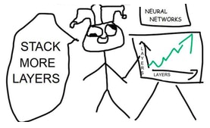
Other use cases
Conversation systems
  learning to make user happy
Quantitative finance
  portfolio management
Deep learning
  optimizing non-differentiable loss
  finding optimal architecture

Slide 30

The MDP formalism
Markov Decision Process
  Environment states:
  Agent actions:
  Rewards
  Dynamics:

Slide 31
The MDP formalism
Markov Decision Process
  Markov assumption

Slide 32

Total reward
Total reward for session:
Agent's policy:
Problem: find policy with
highest reward:

Slide 33
Objective
The easy way:
is an expected sum of rewards
that agent with policy earns per session
The hard way:

Slide 34
How do we solve it?
Value-based approach:
What is the expected reward I get if I take this action?
Value Iteration, Q-learning, SARSA, DQN
...

Slide 35
How do we solve it?
Value-based approach:
What is the expected reward I get if I take this action?
Value Iteration, Q-learning, SARSA, DQN
Policy-based:
Environment takes policy and computes expected reward.
Find such policy that produces best reward!
Crossentropy Method, Policy Gradient, TRPO, ES

Slide 36
Black box optimization setup
Agent

Slide 37
Black box optimization setup
Agent
Policy
params
R

Slide 38
Black box optimization setup
black
box
Agent
Policy
params
R

Slide 39
Black box optimization setup
black
box
Agent
Policy
params
R
How to find argmax R?

Slide 40
How do we solve it?
General idea:
  Play a few sessions
  Update your policy
  Repeat

Slide 41
Crossentropy method
Intialize policy
Repeat:
  Sample N[100] sessions
  Pick M[20] best sessions, called elite sessions
  Change policy so that it prioritizes
  actions from elite sessions

Slide 42
Tabular crossentropy method
Policy is a matrix
Sample N games with that policy
Get M best sessions (elites)

Slide 43
Tabular crossentropy method
Policy is a matrix
Sample N games with that policy
Take M best sessions (elites)
Aggregate by states

Slide 44
Tabular crossentropy method
Policy is a matrix
Sample N games with that policy
Take M best sessions (elite)
Aggregate by states
In M best
games

Slide 45
Smoothing
If you were in some state only once, you only take this action now.
Apply smoothing
Alternative idea: smooth updates
In M best
games

Slide 46
Stochastic MDPs
If there's randomness in environment, algorithm will prefer “lucky” sessions.
Training on lucky sessions is no good
Solution: sample action for each state and run several simulations with these state-action pairs. Average the results.

Slide 47
Crossentropy Method

Slide 48
Crossentropy Method

Slide 49
Crossentropy Method

Slide 50
Crossentropy Method

Slide 51
Crossentropy Method

Slide 52
Crossentropy Method

Slide 53
Crossentropy Method

Slide 54
Crossentropy Method

Slide 55
Crossentropy Method

Slide 56
Crossentropy Method

Slide 57
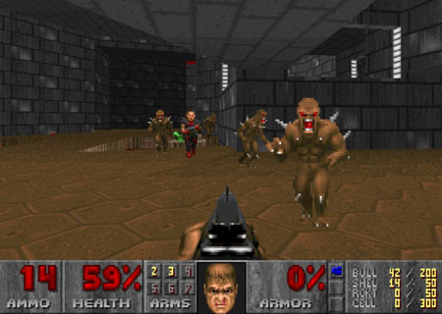
Grim reality
If your environment has infinite/large state space

Slide 58
Approximate crossentropy method
Policy is approximated
  Neural network predicts given s
  Linear model / Random Forest / ...
Can't set explicitly
All state-action pairs from M best sessions

Slide 59
Approximate crossentropy method
Policy is approximated
  Neural network predicts given s
  Linear model / Random Forest / ...
Can't set explicitly

Slide 60
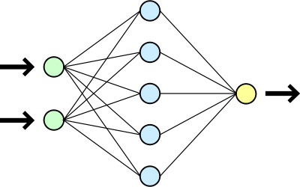
Approximate RL
Agent
observe
apply
action
(some ML model)
Observation
action
Environment

Slide 61
Approximate crossentropy method
Policy is approximated
  Neural network predicts given s
  Linear model / Random Forest / ...
Can't set explicitly
All state-action pairs from M best sessions

Slide 62
Approximate crossentropy method
Neural network predicts given s
All state-action pairs from M best sessions
Maximize likelihood of actions in “best” games

Slide 63
Approximate crossentropy method
Neural network predicts given s
All state-action pairs from M best sessions
Maximize likelihood of actions in “best” games
conveniently,
nn.fit(elite_states,elite_actions)

Slide 64
Approximate crossentropy method
Initialize NN weights
Loop:
  Sample N sessions
  elite = take M best sessions and concatenate

Slide 65
Approximate (deep) version
Initialize NN weights
Loop:
  Sample N sessions
  elite = take M best sessions and concatenate
model = MLPClassifier()
model.fit(elite_states,elite_actions)

Slide 66
Continuous action spaces
Continuous state space
Model
  Mu(s) is neural network output
  Sigma is a parameter or yet another network output
Loop:
  Sample N sessions
  elite = take M best sessions and concatenate
What changed?

Slide 67
Continuous action spaces
Continuous state space
Model
  Mu(s) is neural network output
  Sigma is a parameter or yet another network output
Loop:
  Sample N sessions
  elite = take M best sessions and concatenate
Nothing!
model = MLPRegressor()
model.fit(elite_states,
elite_actions)

Slide 68

Tricks
Remember sessions from 3-5 past iterations
  Threshold and use all of them when training
  May converge slower if env is easy to solve.
Regularize with entropy
  to prevent premature convergence.
Parallelize sampling
Use RNNs if partially-observable (later)

Slide 69


Slide 70
Evolution Strategies
  Introduce distribution over weights
  Maximize expected reward

Slide 71
Evolution Strategies
  Introduce distribution over weights
  Maximize expected reward
other P(θ) will
work as well

Slide 72
Evolution Strategies
  Introduce distribution over weights
  Maximize expected reward

Slide 73
Evolution Strategies
  Expected reward (using math. Expectation)
Q: How can we estimate J in practice?
for large/infinite state space

Slide 74
Evolution Strategies
  Expected reward (using math. Expectation)
  Approximate with sampling
Sample Θ from

Slide 75
Evolution Strategies
  Expected reward (using math. Expectation)
  Approximate with sampling
sample full
episodes
Sample Θ from

Slide 76
Evolution Strategies
  Expected reward (using math. expectation)
  What we need
Q: you compute ∇J w.r.t. what?

Slide 77
Evolution Strategies
  Expected reward (using math. expectation)
  What we need
Gradient w.r.t. distribution parameters

Slide 78
Evolution Strategies
  Expected reward (using math. expectation)
  What we need

Slide 79
Evolution Strategies
  Expected reward (using math. expectation)
  What we need

Slide 80
Evolution Strategies
  Expected reward (using math. expectation)
  What we need
Can't estimate by sampling!
∇ N (Θ|μ,σ) is not a distribution

Slide 81
Logderivative trick
Simple math
(try chain rule)

Slide 82
Logderivative trick
Simple math

Slide 83
Logderivative trick
Analytical inference

Slide 84
Evolution Strategies
Analytical inference
Q: How can we estimate ∇J in now?

Slide 85
Evolution Strategies
Analytical inference
Sampled estimate
Sample Θ from

Slide 86
Evolution Strategies

Slide 87
Evolution Strategies

Slide 88
Evolution Strategies

Slide 89
Evolution Strategies

Slide 90
Evolution Strategies

Slide 91
Evolution Strategies

Slide 92
Evolution strategies
Algorithm
1. Initialize
2. Forever:

Slide 93
Evolution strategies
Algorithm
1. Initialize
2. Forever:

Slide 94
Evolution strategies
Algorithm
1. Initialize
2. Forever:

Slide 95
Reward baselines
TL;DR normalize reward

Slide 96
Evolution strategies
Features
  A general black box optimization
  Easy to implement & scale

Slide 97
Evolution strategies
Features
  A general black box optimization
  Easy to implement & scale
Q: You have 1000 CPUs.
Optimize this formula!

Slide 98
Evolution strategies
Features
  A general black box optimization
  Easy to implement & scale
You can compute every session in parallel

Slide 99
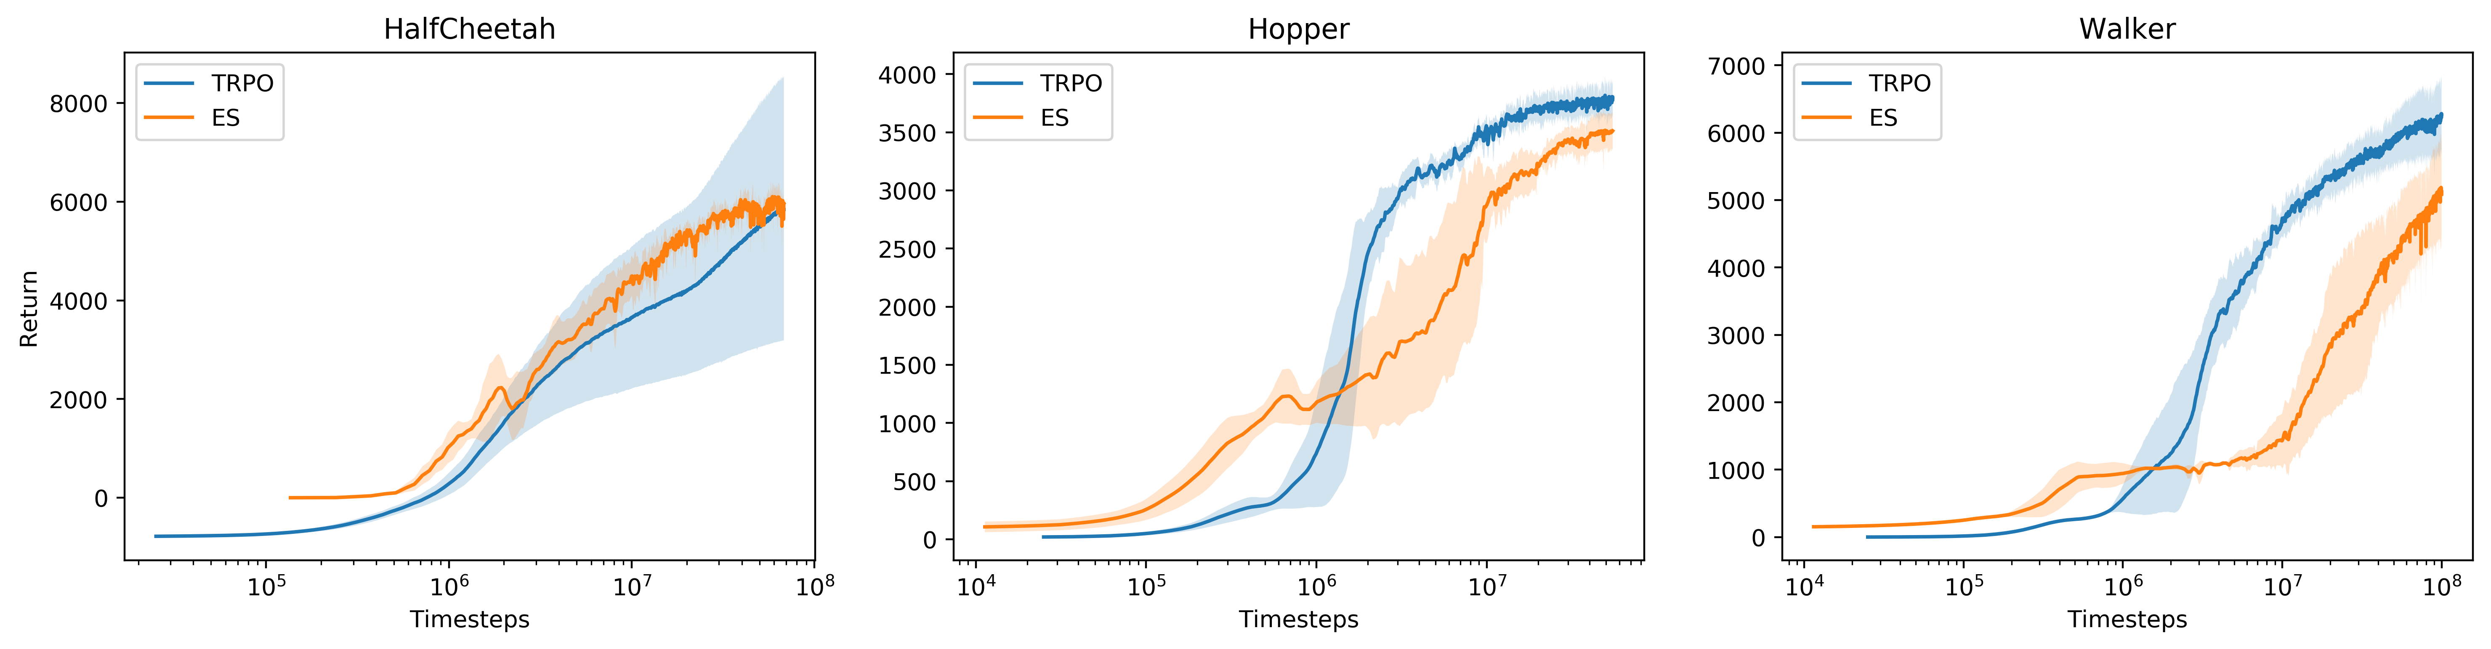
Evolution strategies
Features
  A general black box optimization
  Some results on gym
https://blog.openai.com/evolution-strategies/

Slide 100
Common drawback
Both CEM, ES and all similar methods
  Train from full sessions only
  Require a lot of samples

Slide 101

Common drawback
Both CEM, ES and all similar methods
  Train from full sessions only
  Require a lot of samples

