Slide 1
How to measure the latency
simple-mixer/public/120bpm-cowbells.mp3
Open the sound source, play back with record
mute (vol. 0) the source and export recorded track
mute the recorded track and export the source track
use Audacity to show waveform of the two exported files

Slide 2
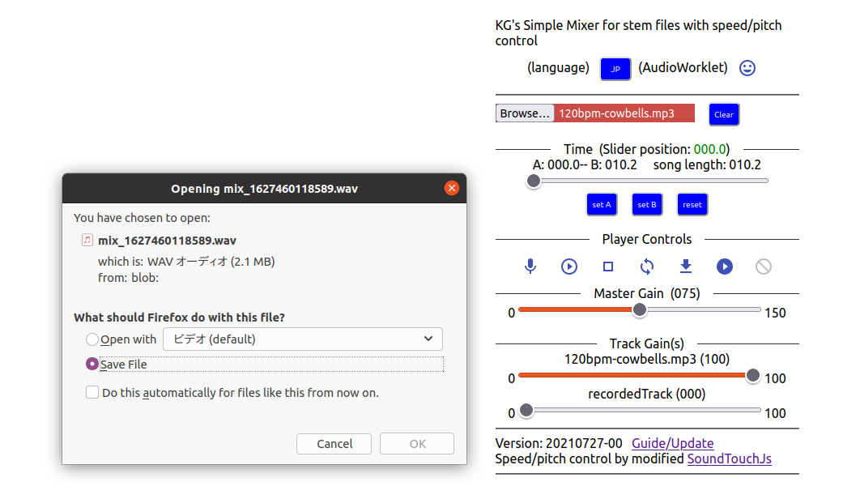
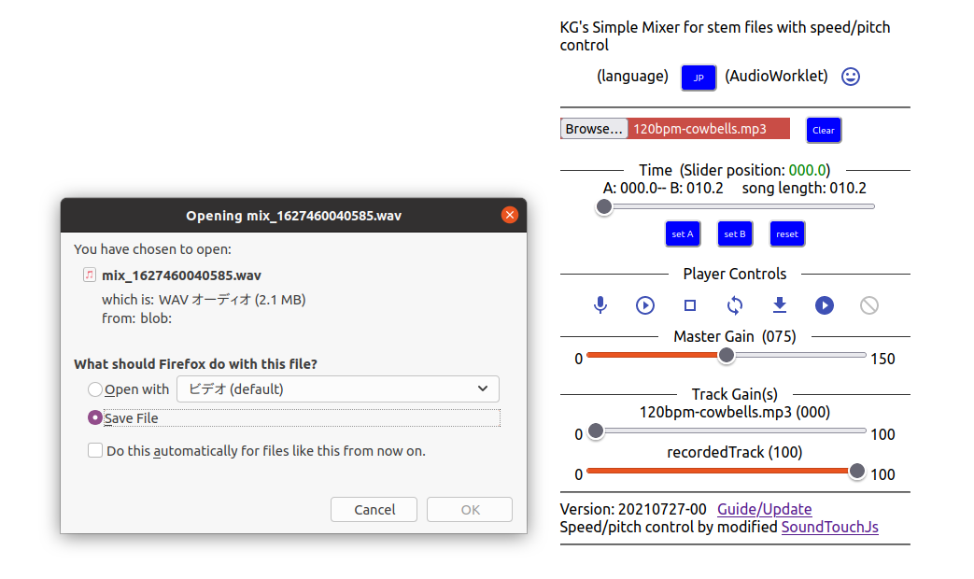
Export track by track

Slide 3
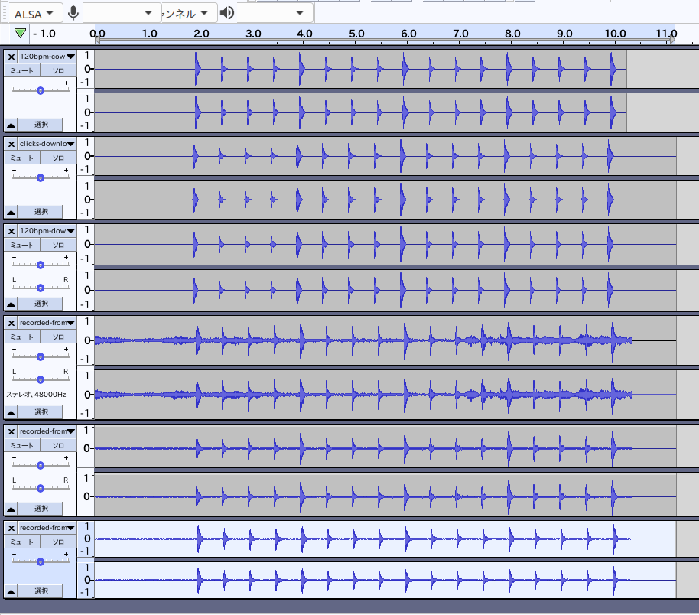
Latency on Ubuntu (overview)
120bpm cowbell count (source)
play back (Firefox) exported file
play back (Chrome) exported file
recorded from internal audio (Firefox)
recorded from built-in mic (Firefox)
recorded from built-in mic (Chrome)
Mozilla Firefox for Ubuntu 90.0
Google Chrome 92.0.4515.107
Note: Chrome does not support recording of internal audio

Slide 4
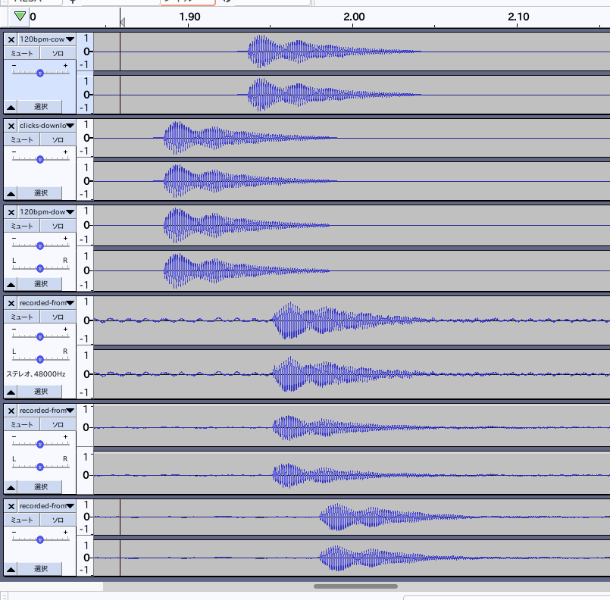
Latency on Ubuntu (details)
120bpm cowbell count (source)
play back (Firefox) exported file
play back (Chrome) exported file
recorded from internal audio (Firefox)
recorded from built-in mic (Firefox)
recorded from built-in mic (Chrome)
track 2/3 is earlier than track 1
  possibly a bug (to be fixed)
track 2 and 3 are same (F and C)
track 4 and 5 are same in terms of time
  internal audio and mic input
track 6 (mic input Chrome) is later than track 5
  browser dependent?
track 5 is later than track 4 by 0.06 to 0.07 seconds (60 to 70 milliseconds)
latency of track 6 is about 0.1 sec

Slide 5
this.recLatency affects?
const constraints = {
audio: {
autoGainControl: false, // default true
// channelCount: 2, // device dependent
echoCancellation: false, // default true
latency: 0.1, // previous results
noiseSuppression: false, // default true
sampleRate: 44100,
sampleSize: 16, // 16 bits?
// volume: // deprecated
},
};
//
navigator.mediaDevices.getUserMedia(constraints)
Experiments with
0.1, 0.05, 0.02, 0.01 etc
→ next slide

Slide 6
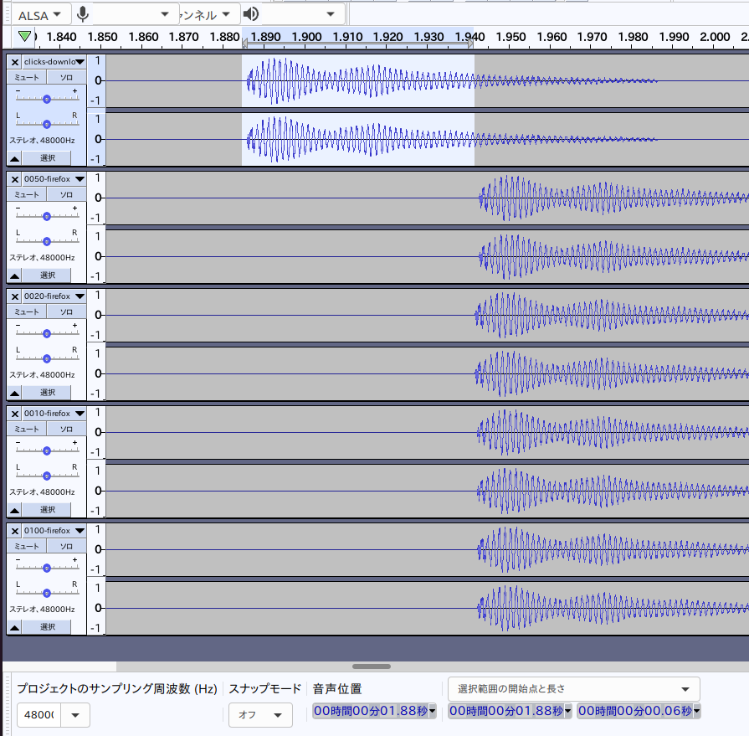
Result is NO (Firefox)
click track (exported)
  selected range – 60ms
constraints – latency: 0.1
latency: 0.05
latency: 0.02
latency: 0.01

Slide 7
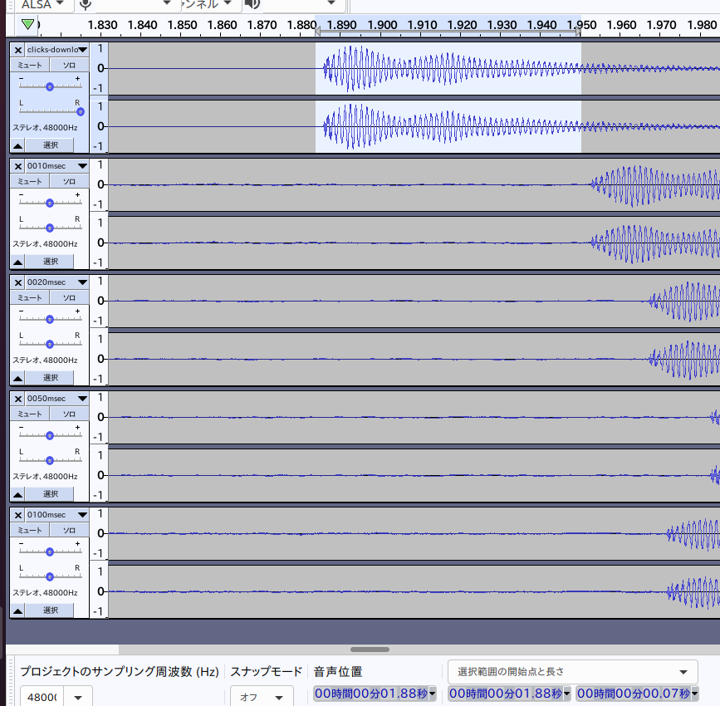
Random (Chrome)
click track
latency: 0.01 (10 msec) – 67 msec
latency: 0.02 (20 msec)
latency: 0.05 – worst
latency: 0.10 – better than 0.05 (why?)

