Slide 1
Let’s talk about SOAP, baby. Let’s talk about UPnP.
Ricky “HeadlessZeke” Lawshae – Ruxcon 2014

Slide 2
Do you have any idea who I am?
Security Researcher for HP TippingPoint’s DVLabs team
At Rapid7 before that, and BreakingPoint before that
Speaker at Defcon, Recon, Insomni’hack, and Texas State University Cyber Security Awareness Day (go Bobcats!)
Voider of warranties
Reader of comic books
Drinker of beers
TRIVIA: I once got a job at a police department while I had 4 active warrants out for my arrest.

Slide 3
What are we talking about?
The Internet of Things™ (ugh…)
  It’s here, whether you like it or not
  “Just put a network interface on it. We’ll worry about why later.”
Smart devices aren’t very smart
  Need simple way to talk to each other
  Ease-of-use: Get the tech out of the way of UX
Often accomplished with SOAP/UPnP services
  Super talkative
  Happily tell you all their capabilities in a well-structured format
  Also, don’t bother themselves with pesky issues like security

Slide 4
What are we talking about?
UPnP
  Universal Plug and Play
SSDP
  Simple Service Discovery Protocol
SCPD
  Service Control Protocol Definition
SOAP
  Simple Object Access Protocol

Slide 5
Let’s talk about all the good things…

Slide 6
UPnP
1900/UDP
  HTTP over UDP allowing devices to discover each other
  Multicast 239.255.255.250
UPnP Stack^{[1]}
  Discovery
    Advertising and Searching
  Description
    An XML file describing the device
  Control
    Call an action or query for a value
  Eventing
    Used for announcing state changes
  Presentation
    UI…I have never seen this implemented
^{[1]} http://www.upnp.org/specs/arch/UPnP-arch-DeviceArchitecture-v1.0-20080424.pdf

Slide 7
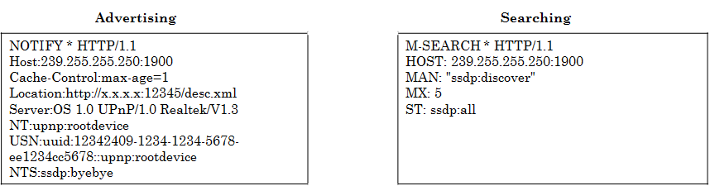
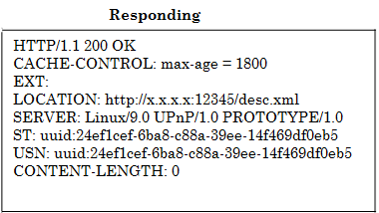
UPnP – Discovery
All you need to know about discovery. Also, this is the really noisy part.

Slide 8
UPnP – Discovery
All you need to know about discovery. Also, this is the really noisy part.

Slide 9
UPnP – Description
XML file usually hosted on a high number TCP port
Version info
  upnp.org spec
  Usually just 1.0
Device definitions
  Device type
  Make/model/UUID
  Service list
    Service type
    SCPD URL
    Control URL
    Event URL

Slide 10
UPnP – Description
<specVersion>
<major>1</major>
<minor>0</minor>
</specVersion>
<URLBase>http://10.0.0.1:5000/</URLBase>
<device>
<pnpx:X_hardwareId>VEN_01f2&…&REV_01</pnpx:X_hardwareId>
<pnpx:X_deviceCategory>NetworkInfrastructure.Router</pnpx:X_deviceCategory>
<df:X_deviceCategory>Network.Router.Wireless</df:X_deviceCategory>
<pnpx:X_compatibleId>urn:schemas-upnp-org:device:InternetGatewayDevice:1</pnpx:X_compatibleId>
<deviceType>urn:schemas-upnp-org:device:InternetGatewayDevice:1</deviceType>
<friendlyName>WNDR3400v2 (Gateway)</friendlyName>
<manufacturer>NETGEAR, Inc.</manufacturer>
<manufacturerURL>http://www.NETGEAR.com</manufacturerURL>
<modelDescription>NETGEAR WNDR3400v2 N600 Wireless Router</modelDescription>
<modelNumber>WNDR3400v2</modelNumber>
<modelName>WNDR3400v2</modelName>
<modelURL>http://www.netgear.com</modelURL>
<UDN>uuid:bc567461-ee40-a9c2-39d3-5338c402cc8d</UDN>
<iconList>…</iconList>
<serviceList>
<service>
<serviceType>urn:schemas-upnp-org:service:Layer3Forwarding:1</serviceType>
<serviceId>urn:upnp-org:serviceId:L3Forwarding1</serviceId>
<SCPDURL>/Public_UPNP_Layer3F.xml</SCPDURL>
<controlURL>/Public_UPNP_C1</controlURL>
<eventSubURL>/Public_UPNP_Event_1</eventSubURL>
</service>
</serviceList>
</device>

Slide 11
UPnP – Description
<specVersion>
<major>1</major>
<minor>0</minor>
</specVersion>
<URLBase>http://10.0.0.1:5000/</URLBase>
<device>
<pnpx:X_hardwareId>VEN_01f2&…&REV_01</pnpx:X_hardwareId>
<pnpx:X_deviceCategory>NetworkInfrastructure.Router</pnpx:X_deviceCategory>
<df:X_deviceCategory>Network.Router.Wireless</df:X_deviceCategory>
<pnpx:X_compatibleId>urn:schemas-upnp-org:device:InternetGatewayDevice:1</pnpx:X_compatibleId>
<deviceType>urn:schemas-upnp-org:device:InternetGatewayDevice:1</deviceType>
<friendlyName>WNDR3400v2 (Gateway)</friendlyName>
<manufacturer>NETGEAR, Inc.</manufacturer>
<manufacturerURL>http://www.NETGEAR.com</manufacturerURL>
<modelDescription>NETGEAR WNDR3400v2 N600 Wireless Router</modelDescription>
<modelNumber>WNDR3400v2</modelNumber>
<modelName>WNDR3400v2</modelName>
<modelURL>http://www.netgear.com</modelURL>
<UDN>uuid:bc567461-ee40-a9c2-39d3-5338c402cc8d</UDN>
<iconList>…</iconList>
<serviceList>
<service>
<serviceType>urn:schemas-upnp-org:service:Layer3Forwarding:1</serviceType>
<serviceId>urn:upnp-org:serviceId:L3Forwarding1</serviceId>
<SCPDURL>/Public_UPNP_Layer3F.xml</SCPDURL>
<controlURL>/Public_UPNP_C1</controlURL>
<eventSubURL>/Public_UPNP_Event_1</eventSubURL>
</service>
</serviceList>
</device>

Slide 12
UPnP – SCPD
XML file defining the service actions and arguments
Version info
  Same deal as description
Action list
  Action name
  Arguments
    Argument name
    Direction (input/output)
    Variable name
Variable list
  Variable name
  Data type

Slide 13
UPnP – SCPD
<actionList>
<action>
<name>SetDefaultConnectionService</name>
<argumentList>
<argument>
<name>NewDefaultConnectionService</name>
<direction>in</direction>
<relatedStateVariable>DefaultConnectionService</relatedStateVariable>
</argument>
</argumentList>
</action>
<action>
<name>GetDefaultConnectionService</name>
<argumentList>
<argument>
<name>NewDefaultConnectionService</name>
<direction>out</direction>
<relatedStateVariable>DefaultConnectionService</relatedStateVariable>
</argument>
</argumentList>
</action>
</actionList>
<serviceStateTable>
<stateVariable sendEvents="yes">
<name>DefaultConnectionService</name>
<dataType>string</dataType>
</stateVariable>
</serviceStateTable>

Slide 14
UPnP – SCPD
<actionList>
<action>
<name>SetDefaultConnectionService</name>
<argumentList>
<argument>
<name>NewDefaultConnectionService</name>
<direction>in</direction>
<relatedStateVariable>DefaultConnectionService</relatedStateVariable>
</argument>
</argumentList>
</action>
<action>
<name>GetDefaultConnectionService</name>
<argumentList>
<argument>
<name>NewDefaultConnectionService</name>
<direction>out</direction>
<relatedStateVariable>DefaultConnectionService</relatedStateVariable>
</argument>
</argumentList>
</action>
</actionList>
<serviceStateTable>
<stateVariable sendEvents="yes">
<name>DefaultConnectionService</name>
<dataType>string</dataType>
</stateVariable>
</serviceStateTable>

Slide 15
UPnP – Control
This is where SOAP comes in (finally!)
Mostly just frontends for an RPC service or CGI script
SOAP envelopes
  XML-formatted API calls
  Service type from description XML
  Action name and arguments from SCPD XML
POST envelope to control URL

Slide 16
UPnP – Control
POST /Public_UPNP_C1 HTTP/1.1
Content-Type: text/xml; charset=utf-8
SOAPAction: "urn:schemas-upnp-org:service:Layer3Forwarding:1#SetDefaultConnectionService"
Content-Length: 568
Host: x.x.x.x:12345
<?xml version="1.0" encoding="utf-8" ?>
<env:Envelope xmlns:xsi="http://www.w3.org/2001/XMLSchema-instance"
xmlns:xsd="http://www.w3.org/2001/XMLSchema"
xmlns:env="http://schemas.xmlsoap.org/soap/envelope/">
<env:Body>
<n1:SetDefaultConnectionService xmlns:n1="urn:schemas-upnp-org:service:Layer3Forwarding:1">
<NewDefaultConnectionService xsi:type="xsd:string">blah</NewDefaultConnectionService>
</n1:SetDefaultConnectionService>
</env:Body>
</env:Envelope>

Slide 17
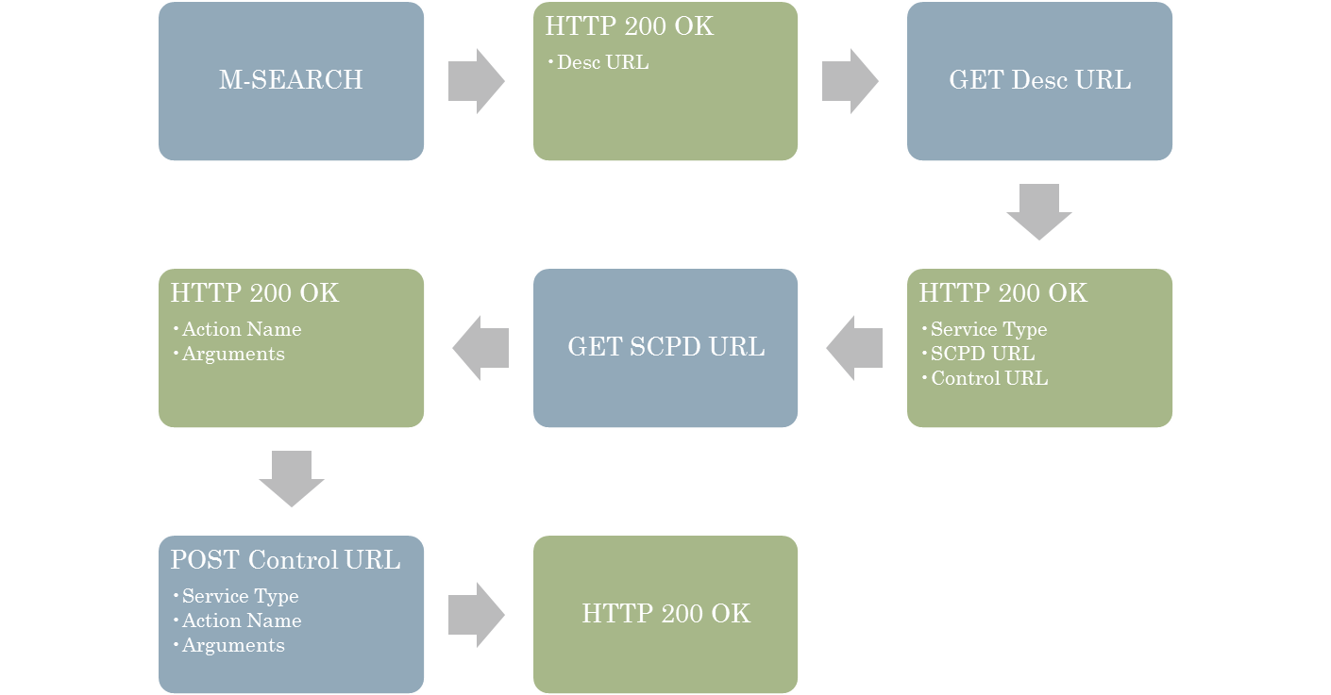
TL;DR

Slide 18
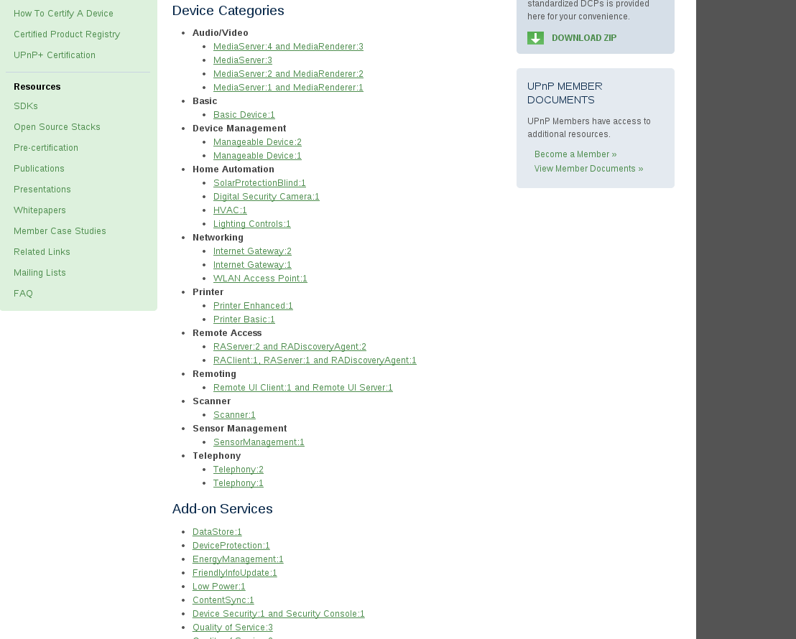
But what can you do with it?

Slide 19
But what can you do with it?
Control AV equipment
Home automation
Network administration
Physical security systems (ok, easy there buddy)
Industrial monitoring and control (uh…what?)
And this is just the official specs

Slide 20
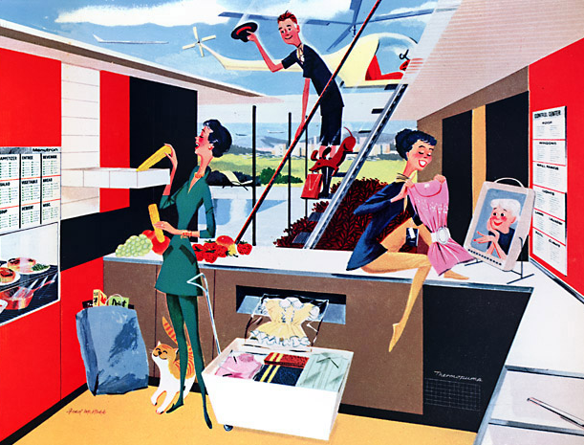
Neat, so…
All our devices can talk to each other!
Brave new worlds of remote control and automation!
Have your toaster turn on the lights, set the TV to the news channel, and send you a text message when breakfast is ready!
The future is now!
Nothing could possibly go wrong!

Slide 21
And the bad things…

Slide 22
What about security?
Embedded devices
  Limited memory and processing power
  Board dev and software dev are often completely different companies
  Copy-and-paste development
  Keep costs low
  Not exactly concerned/knowledgeable
Deployment
  Millions of internet-facing UPnP-enabled devices
  Too many vendors to count
  Frontend is standardized, backend varies even within same vendor
  Difficult to patch/update firmware
  Just because you can, doesn’t mean you should

Slide 23
What about security?
XML parsing is hard
  Needs lots of system resources
  Free-form, user-supplied data
  In 2013, 2.5% of CVE’s were XML-related^{[2]}
  Of those, almost 36% had CVSS severity of 7 or above
  As the use-cases for XML grow, so do the classes of vulns
    Recursion bugs, XXE, command injection, etc…
^{[2]} http://cve.mitre.org/cgi-bin/cvekey.cgi?keyword=xml

Slide 24
Attack surface
UPnP service
  HTTP header parsing
  SSDP parsing
  OS command injection
  Information disclosure
SOAP service
  HTTP header parsing
  XML parsing
  Injection vulns
    OS command
    SQL injection
    SOAP injection
  Information disclosure
  Ridiculous levels of unauthenticated device control

Slide 25
Attack surface – UPnP
CVE-2012-5958
  Disclosed last year by HD Moore (one of many)
  https://community.rapid7.com/docs/DOC-2150
  Calls strncpy to copy a string from the ST header into TempBuf[COMMAND_LEN]
  Size argument for strncpy is based on number of characters between colons

Slide 26
Attack surface – UPnP
CVE-2012-5958
  Disclosed last year by HD Moore (one of many)
  https://community.rapid7.com/docs/DOC-2150
  Calls strncpy to copy a string from the ST header into TempBuf[COMMAND_LEN]
  Size argument for strncpy is based on number of characters between colons
M-SEARCH * HTTP/1.1
Host:239.255.255.250:1900
ST:uuid:schemas:device:[string longer than COMMAND_LEN]:blah
Man:"ssdp:discover"
MX:3

Slide 27
Attack surface – UPnP
D-Link DIR-815 UPnP Command Injection
  Disclosed last year by Zach Cutlip
  http://shadow-file.blogspot.com/2013/02/dlink-dir-815-upnp-command-injection.html
  Contents of ST header get passed as arguments to M-SEARCH.sh
  No validation or sanitization

Slide 28
Attack surface – UPnP
D-Link DIR-815 UPnP Command Injection
  Disclosed last year by Zach Cutlip
  http://shadow-file.blogspot.com/2013/02/dlink-dir-815-upnp-command-injection.html
  Contents of ST header get passed as arguments to M-SEARCH.sh
  No validation or sanitization
M-SEARCH * HTTP/1.1
Host:239.255.255.250:1900
ST:uuid:`[shell command]`
Man:"ssdp:discover"
MX:3

Slide 29
Attack surface – SOAP
XBMC soap_action_name Buffer Overflow
  Disclosed Oct 2010 by n00b
  http://www.exploit-db.com/exploits/15347/
  ProcessHttpPostRequest function allocates statically-sized buffer
  Calls sscanf to copy value of SOAPAction header into it with no bounds checking

Slide 30
Attack surface – SOAP
XBMC soap_action_name Buffer Overflow
  Disclosed Oct 2010 by n00b
  http://www.exploit-db.com/exploits/15347/
  ProcessHttpPostRequest function allocates statically-sized buffer
  Calls sscanf to copy value of SOAPAction header into it with no bounds checking
POST /AVTransport/[UUID]/control.xml HTTP/1.1
Content-Type: text/xml; charset=utf-8
SOAPAction: "urn:schemas-upnp-org:service:AVTransport:1#[more than 100 bytes]"
Content-Length: [length of req]
Host: x.x.x.x:50988

Slide 31
Attack surface – SOAP
Broadcom SetConnectionType Format String Vulnerability
  Disclosed last year by Leon Juranic and Vedran Kajic
  http://sebug.net/paper/Exploits-Archives/2013-exploits/1301-exploits/DC-2013-01-003.txt
  SetConnectionType action feeds value of NewConnectionType argument to snprintf
  No sanitization of user-controlled value

Slide 32
Attack surface – SOAP
Broadcom SetConnectionType Format String Vulnerability
  Disclosed last year by Leon Juranic and Vedran Kajic
  http://sebug.net/paper/Exploits-Archives/2013-exploits/1301-exploits/DC-2013-01-003.txt
  SetConnectionType action feeds value of NewConnectionType argument to snprintf
  No sanitization of user-controlled value
<SOAP-ENV:Body>
<m:SetConnectionType xmlns:m="urn:schemas-upnp-org:service:WANIPConnection:1" as="">
<NewConnectionType>[format string]</NewConnectionType>
</m:SetConnectionType>
</SOAP-ENV:Body>

Slide 33
Attack surface – SOAP
CVE-2014-3242
  Disclosed earlier this year by pnig0s
  http://www.pnigos.com/?p=260
  SOAPpy allows declaration of user-defined XML External Entities in SOAP request
  No sanitization of user-controlled value

Slide 34
Attack surface – SOAP
CVE-2014-3242
  Disclosed earlier this year by pnig0s
  http://www.pnigos.com/?p=260
  SOAPpy allows declaration of user-defined XML External Entities in SOAP request
  No sanitization of user-controlled value
<!DOCTYPE v1 [<!ENTITY xxe SYSTEM "file:///etc/passwd">]>
<SOAP-ENV:Envelope … >
<SOAP-ENV:Body>
<echo SOAP-ENC:root="1">
<v1 xsi:type="xsd:string">&xxe;</v1>
</echo>
</SOAP-ENV:Body>
</SOAP-ENV:Envelope>

Slide 35
Attack surface – SOAP
CVE-2014-2928
  Disclosed earlier this year by Brandon Perry (PBerry Crunch!)
  http://seclists.org/fulldisclosure/2014/May/32
  F5 iControl API set_hostname action passes value of hostname argument to shell
  Once again, no sanitization of user-controlled value

Slide 36
Attack surface – SOAP
CVE-2014-2928
  Disclosed earlier this year by Brandon Perry (PBerry Crunch!)
  http://seclists.org/fulldisclosure/2014/May/32
  F5 iControl API set_hostname action passes value of hostname argument to shell
  Once again, no sanitization of user-controlled value
<SOAP-ENV:Body>
<n1:set_hostname xmlns:n1="urn:iControl:System/Inet">
<hostname>`[shell command]`.whatever.com</hostname>
</n1:set_hostname>
</SOAP-ENV:Body>

Slide 37
Attack surface – SOAP
CVE-2011-4499, CVE-2011-4500, CVE-2011-4501, CVE-2011-4503, CVE-2011-4504, CVE-2011-4505, CVE-2011-4506, more?
  Disclosed at Defcon 19 by Daniel Garcia
  http://toor.do/DEFCON-19-Garcia-UPnP-Mapping-WP.pdf
  UPnP IGD uses actions such as AddPortMapping and DeletePortMapping to allow for remote administration of routing rules
  Lacks authentication and is available on WAN interface
  Gives attackers the ability to perform:
    NAT traversal
    External/internal host port mapping
    External network scanning of internal LAN

Slide 38
DEMO TIME

Slide 39
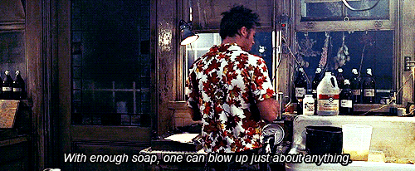
Conclusion

Slide 40
Playing along at home
Know your network
  M-SEARCH every network you connect to
  Watch for new NOTIFY messages
If you don’t need UPnP, disable it
  If not on the device, then at the router
Keep on top of firmware updates
  Not always automatic
Fuzz the crap out of it
  Burp – http://portswigger.net/burp/
  WSFuzzer – https://www.owasp.org/index.php/Category:OWASP_WSFuzzer_Project
  Miranda – http://code.google.com/p/miranda-upnp/
  My stuff…if I ever release it, which I probably won’t…

Slide 41
Hit me up
@HeadlessZeke on twitter
Usually lurking on freenode as HeadlessZeke
headlesszeke@hp.com
  PS: We’re always hiring, send me resumes

Slide 42
Thank you!

