Slide 1
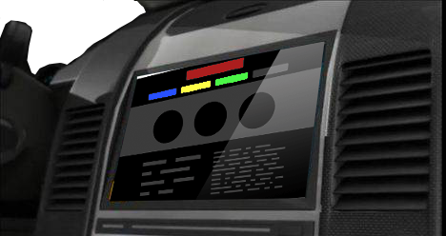
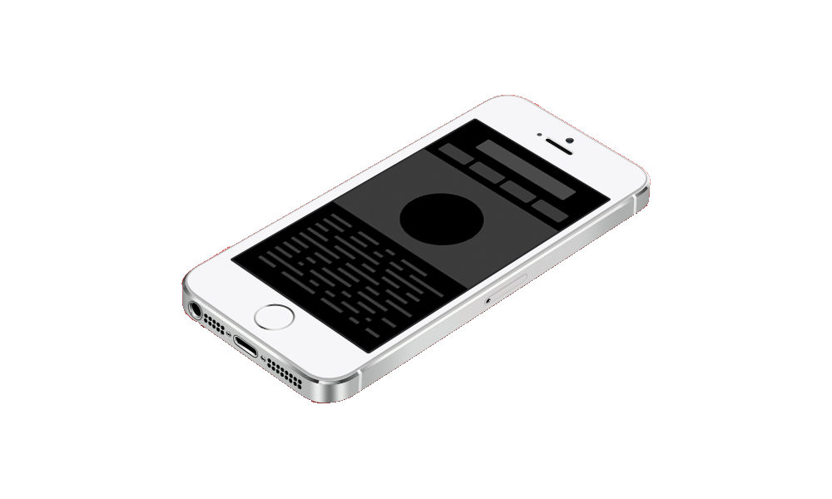
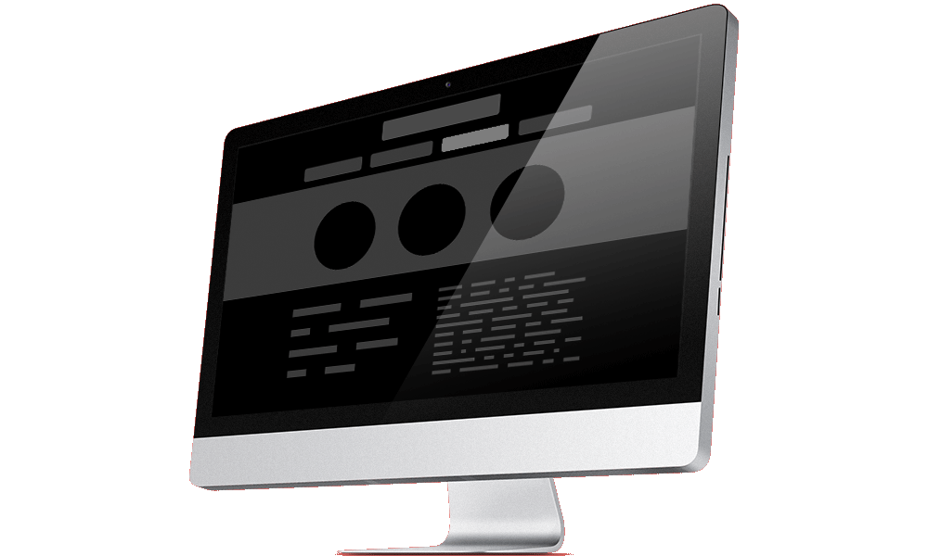
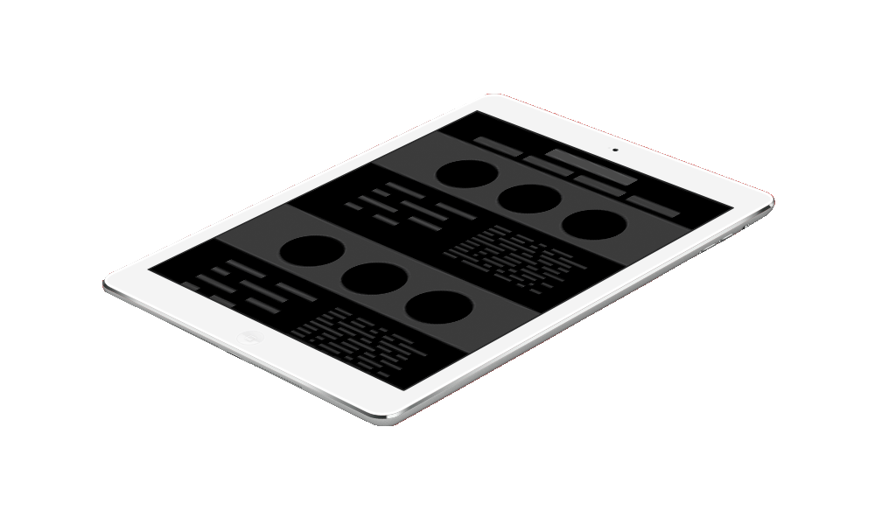
RADOME : Remote Adaptive Display On
Multiclient & Embedded Research Project
Context & Involvement
Facing with the growing development of highly promising technologies from the web , MATIS has launched a project to develop rich UI based on the opportunities and benefits of HTML5, including among others the remote accessibility and platform independence. The proposed target is the automotive world and especially infotainment systems. The challenge is to show the reliability, effectiveness and relevancy of HTML5 technologies for the embedded world.
Affected Tasks
Functional analysis, design of software architecture
Realization of working skeleton for communication between client and server
Studies of technologies that can be used
Integration & test on a local desktop
Development of some advanced graphic components (gauge, tanks, etc…)
Test of remote device interaction with server-side display
Launching server computations & view results
Viewing media from server / sending media to server
Responsive design to adapt display to multiple targets
Technical Environment
HTML5 (CSS3, JavaScript, HTML5…), C/C++, websockets , CAN, TCP/IP
2014
2015
Demonstrator Specification
RADOME demonstrator development
Real hardware integration for demonstrator
Demonstrator
Notes:
Project Leader : Gautier DUVAL

