Slide 1

SIR C.R.Reddy College of Engineering
Department of Computer Science and Engineering
IVth Year Project
PRIVACY PROTECTION AND INTRUSION AVOIDANCE FOR CLOUDLET
BASED MEDICAL DATA SHARING
PROJECT GUIDE: PROJECT MEMBERS (Batch -1):
Dr A.YESUBABU KIMIDI SIVA RAMA KRISHNA (315177110076)
(Head of Department) MODEPALLI RUKMINI (315177110111)
KARRI VENKATESH (315177110074)
MANTHENA OMKAR (315177110094)
KOSARAJU GOWTHAM (315177110086)
PROJECT CO-ORDINATOR:
Dr G.NIRMALA

Slide 2
Introduction
As more and more healthcare organizations adopt electronic health records (EHRs), the case for cloud data storage becomes compelling for deploying EHR systems: not only is it inexpensive but it also provides the flexible, wide-area mobile access increasingly needed in the modern world.
However, before cloud-based EHR systems can become a reality, issues of data security, patient privacy, and overall performance must be addressed.

Slide 3
Abstract
With the popularity of wearable devices, along with the development of clouds and cloudlet technology, there has been increasing need to provide better medical care. The processing chain of medical data mainly includes data collection, data storage and data sharing, etc. Traditional healthcare system often requires the delivery of medical data to the cloud, which involves users’ sensitive information and causes communication energy consumption. Practically, medical data sharing is a critical and challenging issue. Thus we build up a novel healthcare system by utilizing the flexibility of cloudlet. The functions of cloudlet include privacy protection, data sharing and intrusion detection.

Slide 4
Existing System
As there is tremendous advancement of clouds and cloudlet innovation, there has been expanding need to give better medical care.
Customary medicinal services system regularly requires the conveyance of medical information to the cloud, which includes clients' delicate data and causes correspondence vitality utilization.
The elements of cloudlet incorporate security insurance, information sharing and intrusion detection.
Those information will be transmitted to close cloudlet in a vitality productive design.
we exhibit another trust model to help clients to choose trustable accomplices who need to share put away information in the cloudlet.

Slide 5
Disadvantages
Unauthorized accessing of cloud data is possible.
There is no proper security check for medical data which cannot be given out freely.
Proper Auditing mechanism is not there in existing system.

Slide 6
Proposed System
This paper proposes a cloudlet based healthcare system. The body data collected by wearable devices are transmitted to the nearby cloudlet. Those data are further delivered to the remote cloud where doctors can access for disease diagnosis.
According to data delivery chain, we separate the privacy protection into three stages. In the first stage, user’s vital signs collected by wearable devices are delivered to a closet gateway of cloudlet. During this stage, data privacy is the main concern. In the second stage, user’s data will be further delivered toward remote cloud through cloudlets.
A cloudlet is formed by a certain number of mobile devices whose owners may require and/or share some specific data contents. Thus, both privacy protection and data sharing are considered in this stage. Especially, we use trust model to evaluate trust level between users to determine sharing data or not.

Slide 7
Advantages
We share information in the cloudlet, we utilize trust model to gauge clients‘ confide in level to judge whether to share information or not.
Data will be safe.
Any unauthenticated or unauthorized person cannot see confidential medical data.
If any one trying to access the data directly, an alert will be sent to admin to take proper action.

Slide 8
Software & Hardware Requirements
Technology : Java
Web/Application Server : Tomcat Server
Database : Oracle
Application : JavaNetBeans
Core : i3/i5
RAM : 2GB
Operating System : Win7/10
Cloud Platform : RackSpace Cloud Server

Slide 9
Algorithms
Filter Based Algorithm to provide fire wall feature
AES Algorithm to provide Security
Message Algorithm to send Mails

Slide 10
Modules
Patient Module
Doctor Module
Cloud Module
Detection Module

Slide 11
Patient
Register
He will login
Post his problem
View Solutions

Slide 12
Doctor
Login
See the list of patients
See the problems
Provide the solutions

Slide 13
Cloud
Login
Adding Doctor
View All Patients
View all Problems
Assign the problem to the doctor

Slide 14
Detection
Filter Algorithm
AES Algorithm
Mail Notification

Slide 15
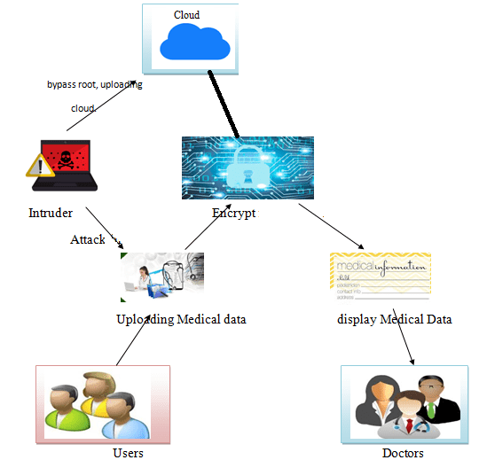
Architecture

Slide 16
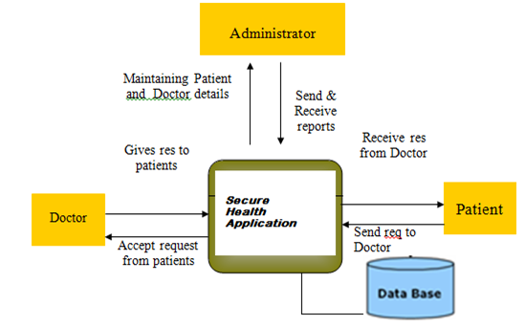
Context Diagram

Slide 17
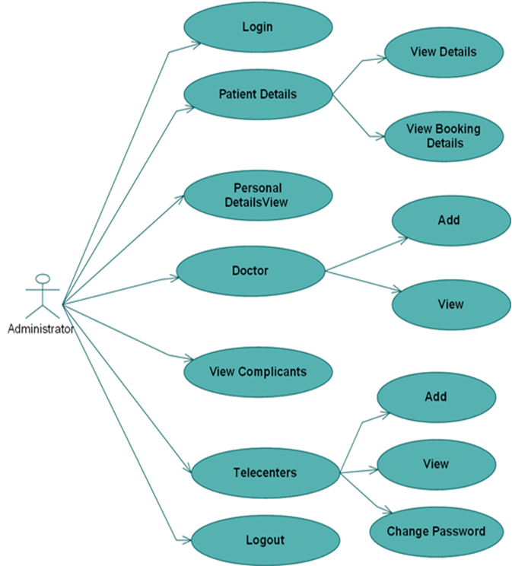
Use Case

Slide 18
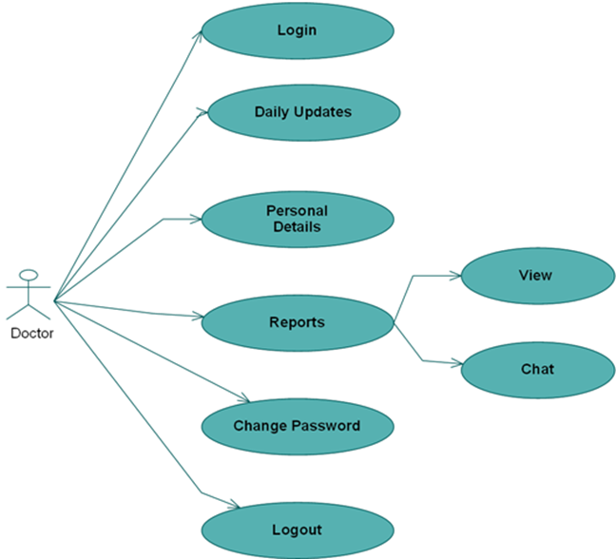

Slide 19
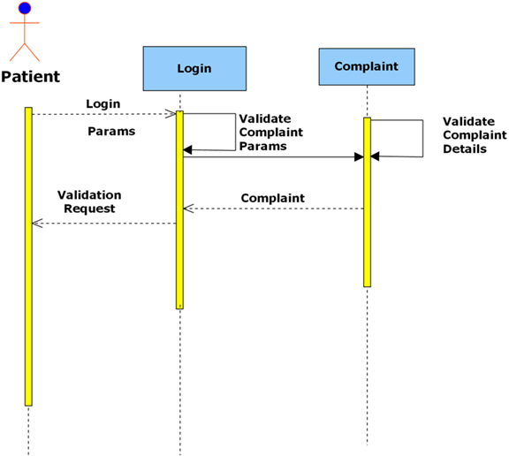
sequence

Slide 20
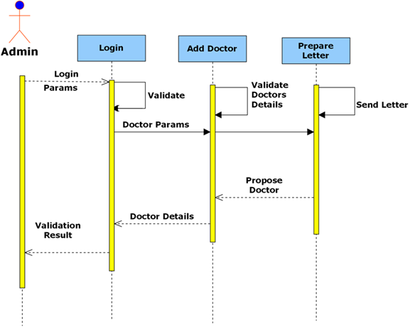

Slide 21
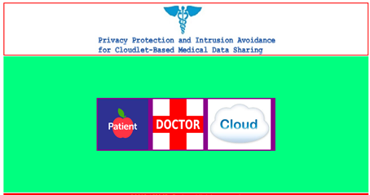
Welcome Screen

Slide 22
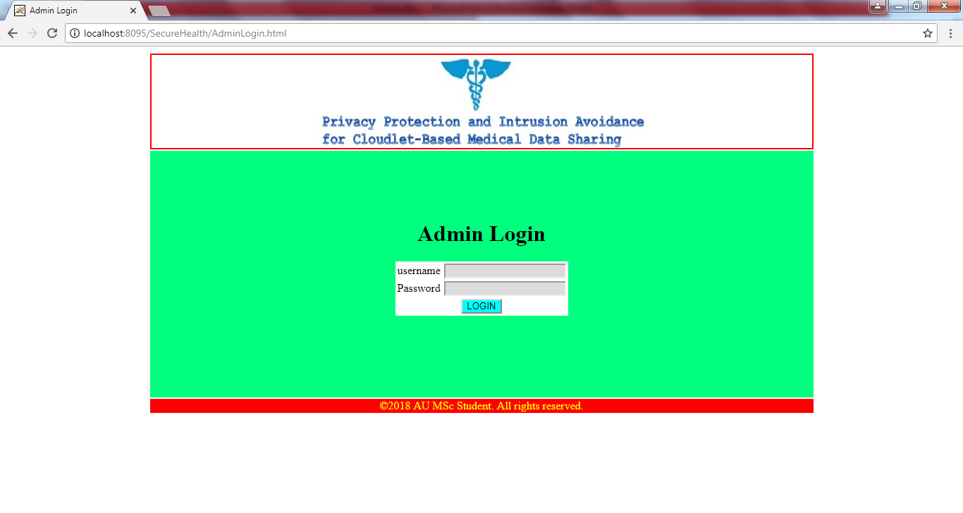
Admin Login

Slide 23
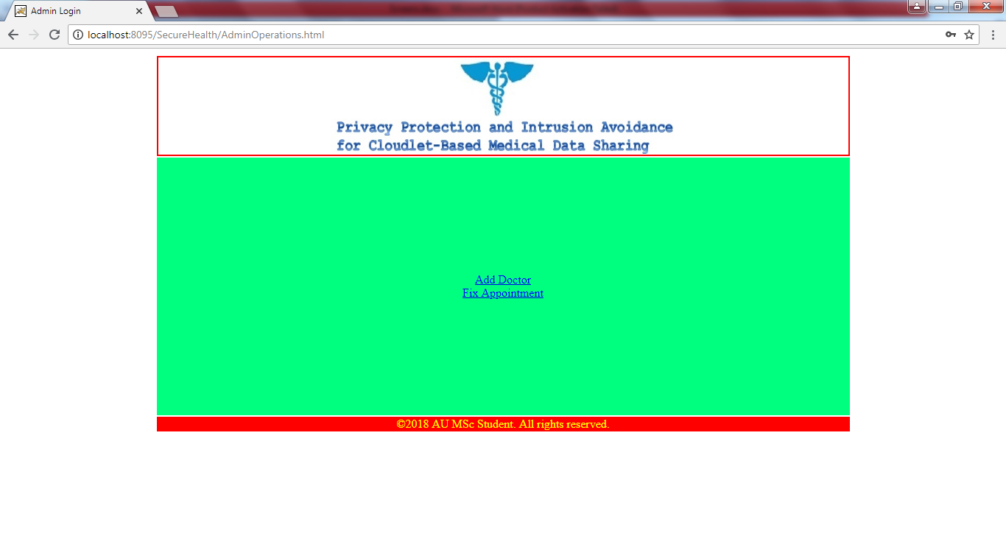

Slide 24
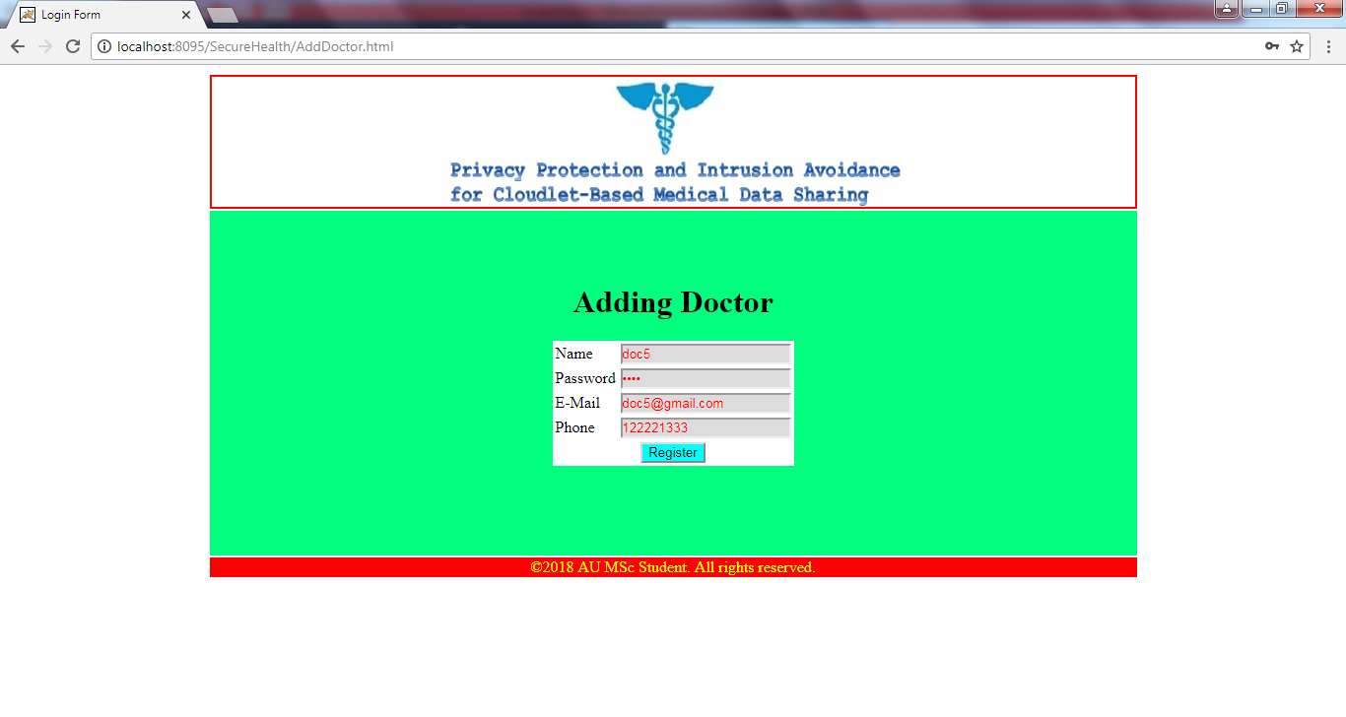

Slide 25
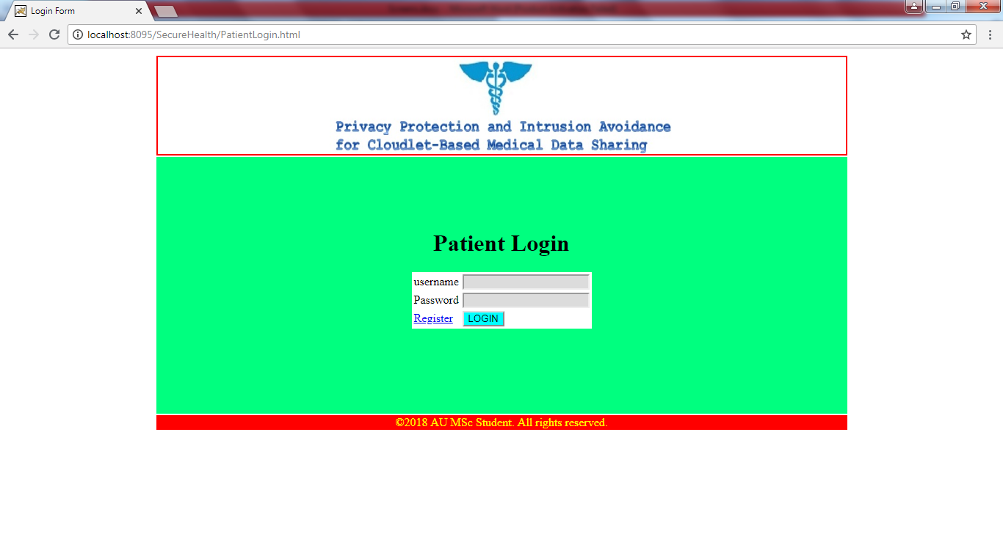

Slide 26
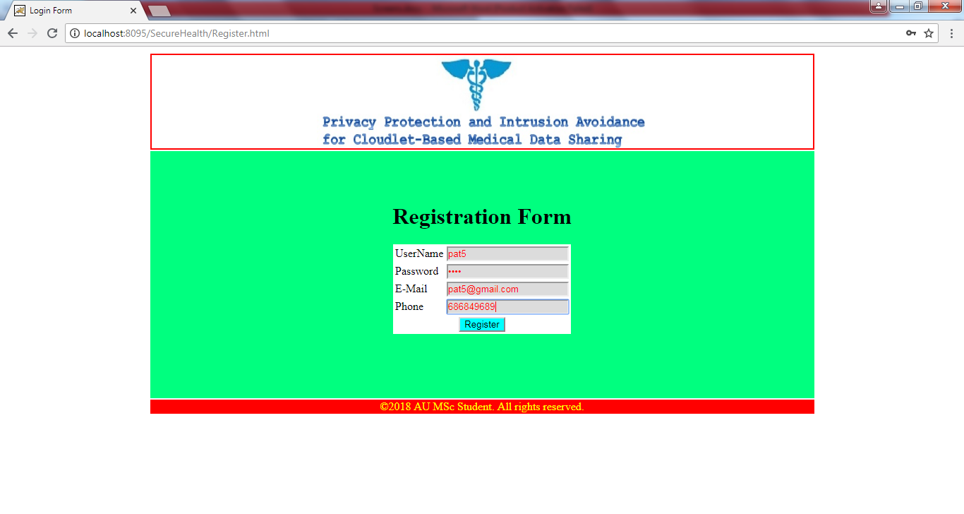

Slide 27


Slide 28
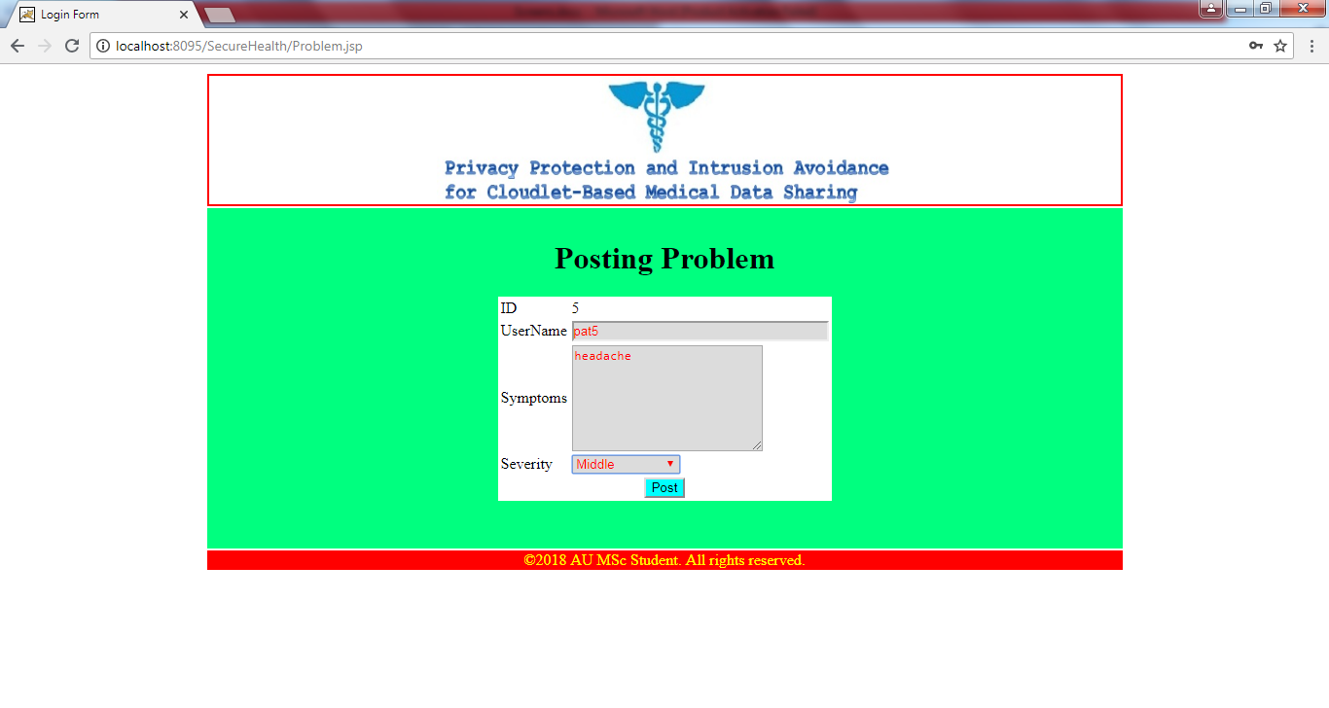

Slide 29
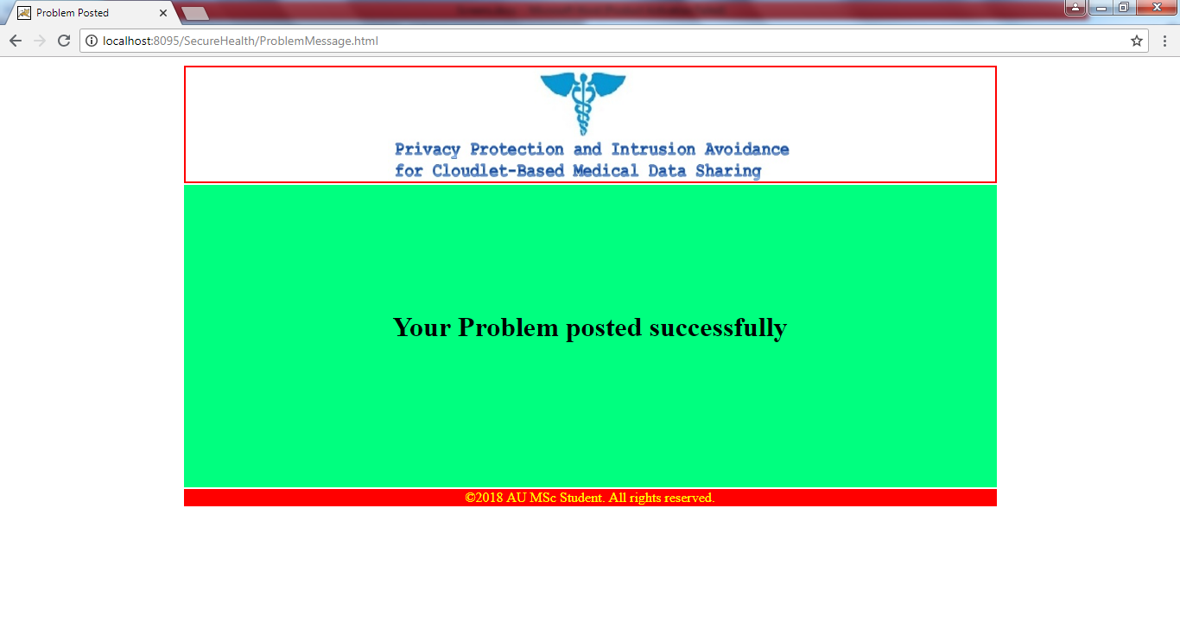

Slide 30
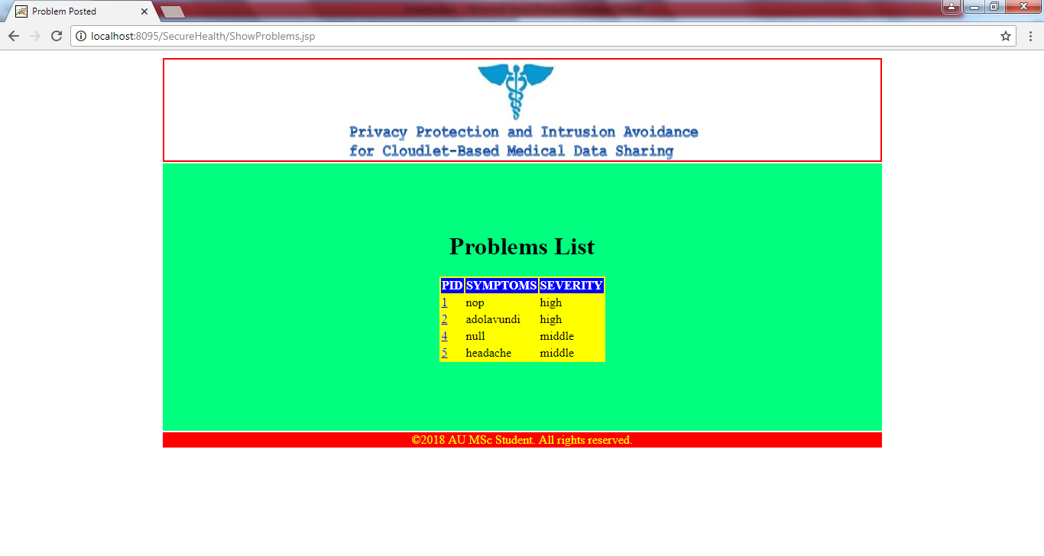

Slide 31
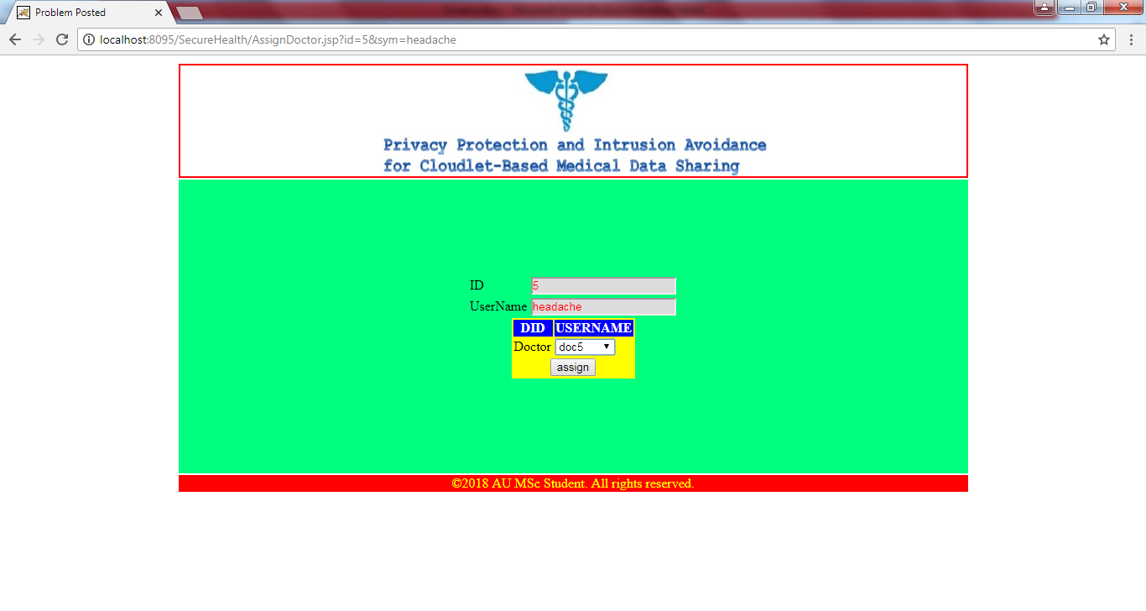

Slide 32


Slide 33
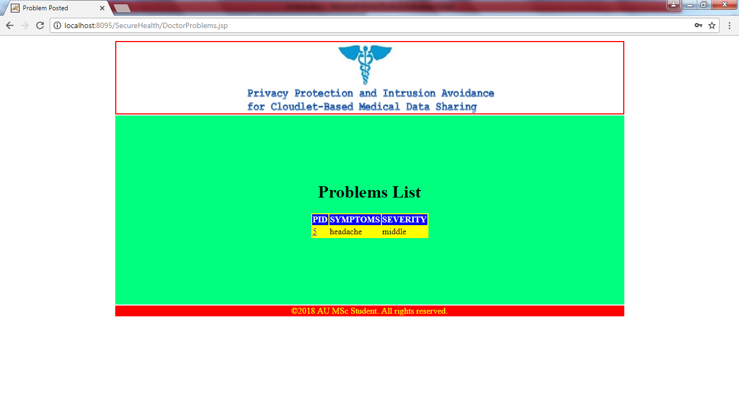

Slide 34
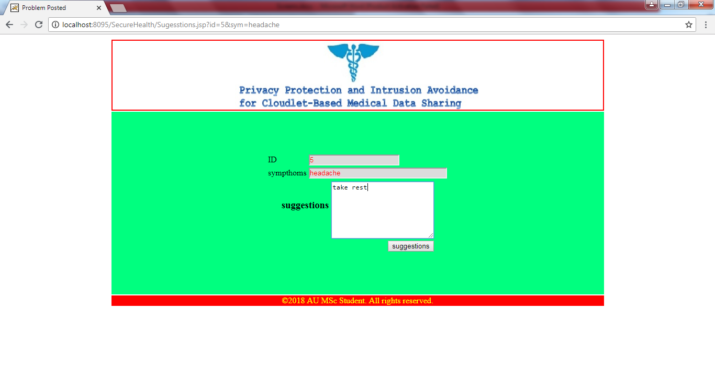

Slide 35
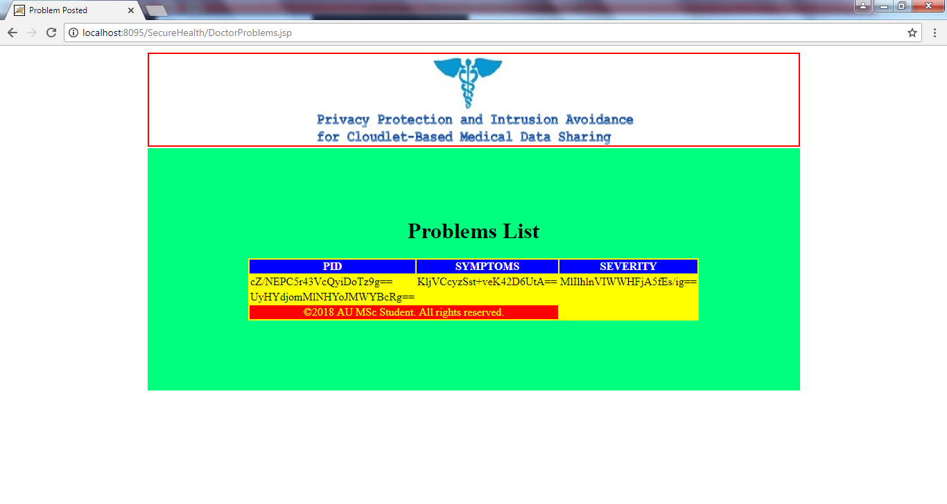

Slide 36
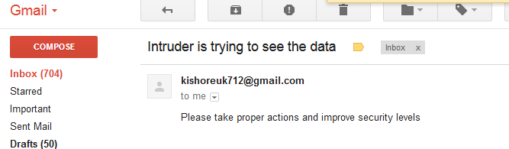

Slide 37
THANK YOU

