Slide 1
HotStuff
PPT 1
Consensus Protocol and Live Demo
How four replicas build evidence, preserve safety and make progress after failures
Proposal Vote QC Lock Commit
HotStuff / Protocol
01
Notes:
This session explains how replicas agree on the order of proposals. B0, B1 and B2 are protocol proposal nodes with parent pointers and empty payloads. Focus on View, Proposal, Vote, QC, Lock and Commit. Allow 25–30 minutes, including about eight minutes of live demonstration. The slide labels match the English dashboard controls.
References
HotStuff (PODC 2019), Sections 3–6 and the safety appendices: https://arxiv.org/html/1803.05069v6
Authors' reference implementation: https://github.com/hot-stuff/libhotstuff
Project sources: backend/node.py, backend/hotstuff.py and README.md.
Screenshots show the protocol area of an isolated instance of the same demo. Live demonstration: http://localhost:8000.

Slide 2
Protocol Goals and Assumptions
Safety: correct replicas commit compatible histories
Message delays and view changes must not cause conflicting commits.
Liveness: decisions continue when conditions hold
After the network stabilizes, a correct leader can collect enough responses.
Classroom setup: n = 4, f = 1
Membership is fixed. The protocol requires authentication. The demo uses node IDs.
HotStuff / Protocol
02
Notes:
Distinguish safety from liveness. Safety means that correct replicas do not commit conflicting histories. Liveness means that decisions eventually continue under the required network and leadership conditions. HotStuff assumes fixed membership, authenticated communication and partial synchrony, with at most f Byzantine replicas. Partial synchrony means that message delays have a bound after an unknown global stabilization time, GST. It does not mean that the network is always fast. This demo uses a deterministic message queue and cannot prove safety under arbitrary network behavior.
References
HotStuff (PODC 2019), Sections 3–6 and the safety appendices: https://arxiv.org/html/1803.05069v6
Authors' reference implementation: https://github.com/hot-stuff/libhotstuff
Project sources: backend/node.py, backend/hotstuff.py and README.md.
Screenshots show the protocol area of an isolated instance of the same demo. Live demonstration: http://localhost:8000.

Slide 3
Why the Quorum Is Three
q = 2f + 1 = 3
Set | Voters
Quorum A | N1, N2, N3
Quorum B | N2, N3, N4
Intersection | N2, N3: at least one correct replica
|QA ∩ QB| ≥ 3 + 3 − 4 = 2 > f
Quorum intersection and one vote per view rule out conflicting QCs in the same view.
HotStuff / Protocol
03
Notes:
With n=3f+1, choose q=2f+1. Here n=4 and f=1, so q=3. Any two sets of three replicas overlap in at least two replicas, at least one of which must be correct. Compare {N1,N2,N3} with {N2,N3,N4}: the intersection is N2 and N3. A correct replica votes at most once per view, so two conflicting proposals in the same view cannot both gather three votes. Across different views, quorum intersection alone is insufficient. The locking rule carries the safety constraint forward.
References
HotStuff (PODC 2019), Sections 3–6 and the safety appendices: https://arxiv.org/html/1803.05069v6
Authors' reference implementation: https://github.com/hot-stuff/libhotstuff
Project sources: backend/node.py, backend/hotstuff.py and README.md.
Screenshots show the protocol area of an isolated instance of the same demo. Live demonstration: http://localhost:8000.

Slide 4
HotStuff's Core Design
QC: votes become transferable evidence
A successor proposal carries the certificate for its parent.
HighQC and LockedQC: progress and voting constraints
The leader chooses an extension point. Replicas check whether they can vote.
Chaining: successor certificates advance ancestor commits
Each new proposal also advances earlier proposals in the pipeline.
Pacemaker: coordination of views and leaders
The protocol separates safety rules from mechanisms that drive progress.
HotStuff / Protocol
04
Notes:
Use these mechanisms as the main thread of the lecture. A QC turns votes into evidence that later messages can carry. HighQC helps a new leader choose where to extend, while LockedQC constrains what each replica may accept. Chained HotStuff spreads certification across linked proposals, so successors help ancestors reach finality. The pacemaker coordinates progress and view changes. Voting and locking enforce safety. Linear communication and optimistic responsiveness are explained later. The demo's fixed 0.8-second playback interval is not a protocol performance measurement.
References
HotStuff (PODC 2019), Sections 3–6 and the safety appendices: https://arxiv.org/html/1803.05069v6
Authors' reference implementation: https://github.com/hot-stuff/libhotstuff
Project sources: backend/node.py, backend/hotstuff.py and README.md.
Screenshots show the protocol area of an isolated instance of the same demo. Live demonstration: http://localhost:8000.

Slide 5
Node State and Its Meaning
Dashboard field | Meaning
View / Leader | Current logical round and its designated proposer
HighQC | Highest-view certificate known locally
LockedQC | Certificate used by the safe-voting rule
Latest block | Most recently received proposal node
Commit block | Most recent ancestor whose decision is final
This session uses empty payloads. B0 is the pretrusted starting point.
HotStuff / Protocol
05
Notes:
Here, a block is only a proposal node in the consensus protocol. We do not discuss payloads or applications. View is the logical round, and the view determines the leader. HighQC is the certificate with the highest view known locally. LockedQC is the certificate used by the safety predicate. Latest block may be a proposal that just arrived. Commit block is the newest ancestor that the replica has already decided. Keep proposed, certified and committed states distinct.
References
HotStuff (PODC 2019), Sections 3–6 and the safety appendices: https://arxiv.org/html/1803.05069v6
Authors' reference implementation: https://github.com/hot-stuff/libhotstuff
Project sources: backend/node.py, backend/hotstuff.py and README.md.
Screenshots show the protocol area of an isolated instance of the same demo. Live demonstration: http://localhost:8000.

Slide 6
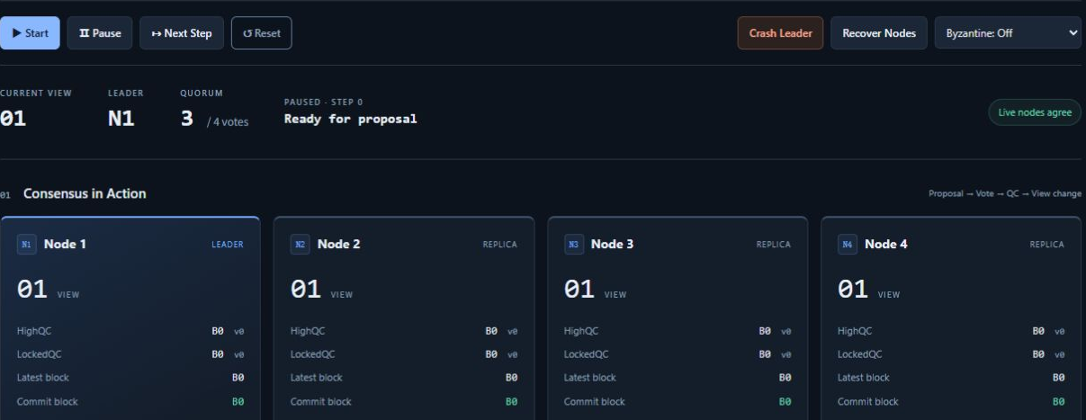
Demo 0: Initial State
Click Reset and keep the demo paused. Inspect all four replicas.
View 1, leader N1. HighQC = LockedQC = Commit block = B0.
HotStuff / Protocol
06
Notes:
Open http://localhost:8000 and click Reset. Confirm PAUSED and STEP 0. Do not submit any payload. Point out View 1, N1 as Leader and the other nodes as Replica. All four replicas show B0 for HighQC, LockedQC and Commit block. Start runs automatically. Pause stops playback. Next Step pauses automatic execution and advances exactly one event. During this protocol session, focus on the upper dashboard and Event log.
References
HotStuff (PODC 2019), Sections 3–6 and the safety appendices: https://arxiv.org/html/1803.05069v6
Authors' reference implementation: https://github.com/hot-stuff/libhotstuff
Project sources: backend/node.py, backend/hotstuff.py and README.md.
Screenshots show the protocol area of an isolated instance of the same demo. Live demonstration: http://localhost:8000.

Slide 7

Demo 1: The Leader Proposes
From the initial state, click Next Step once. Stop at STEP 1.
Latest block advances to B1. HighQC and Commit block remain at B0.
HotStuff / Protocol
07
Notes:
Click Next Step once. The log shows Leader N1 proposes B1. N1 extends B0, the node certified by its HighQC, and includes QC(B0). Explain that B1.parent_id is B0 and B1.qc is QC(B0). A proposal carries its parent's certificate. QC(B1) does not yet exist. All live replicas receive B1, so Latest block becomes B1. Receipt of a proposal does not certify or commit it.
References
HotStuff (PODC 2019), Sections 3–6 and the safety appendices: https://arxiv.org/html/1803.05069v6
Authors' reference implementation: https://github.com/hot-stuff/libhotstuff
Project sources: backend/node.py, backend/hotstuff.py and README.md.
Screenshots show the protocol area of an isolated instance of the same demo. Live demonstration: http://localhost:8000.

Slide 8
Vote: A Replica's Acceptance Rules
Each correct replica votes at most once per view
Basic checks
Current view, designated leader, valid parent QC and no earlier vote in this view.
Either safety condition must hold
Extend the locked node, or carry a QC with a strictly higher view than LockedQC.
Demo steps
STEP 2–5 show the votes of N1, N2, N3 and N4 in order.
HotStuff / Protocol
08
Notes:
From STEP 1, click Next Step four times to observe votes from N1, N2, N3 and N4. The leader also votes. Before voting, a replica checks the current view, the designated leader, a known valid parent QC and whether it has already voted in this view. The proposal must then extend the locked node or carry a justification QC whose view is strictly higher than the local LockedQC view. Equality is insufficient for the second condition. The later example explains both branches. The demo does not actively create malicious forks, so use the rule and the examples to explain that case.
References
HotStuff (PODC 2019), Sections 3–6 and the safety appendices: https://arxiv.org/html/1803.05069v6
Authors' reference implementation: https://github.com/hot-stuff/libhotstuff
Project sources: backend/node.py, backend/hotstuff.py and README.md.
Screenshots show the protocol area of an isolated instance of the same demo. Live demonstration: http://localhost:8000.

Slide 9
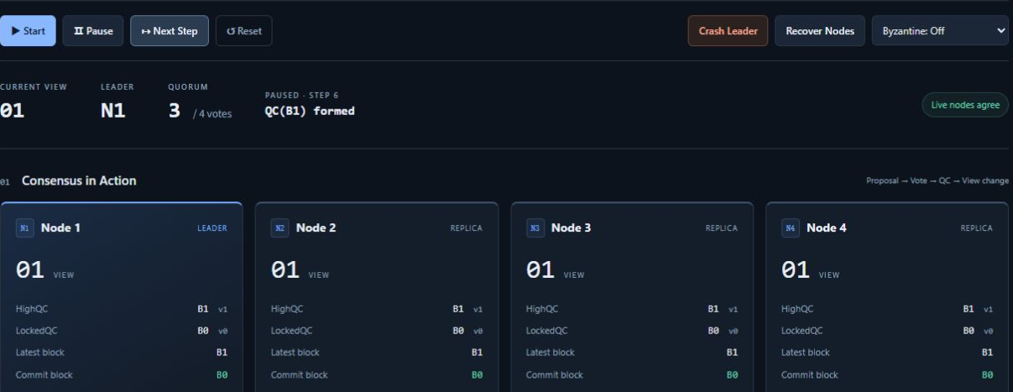
Demo 2: Votes Form a QC
Continue to STEP 6. Observe QC(B1) formed.
HighQC = B1, LockedQC = B0, Commit block = B0.
HotStuff / Protocol
09
Notes:
Advance to cumulative STEP 6. If the previous slide left the demo at STEP 5, click only once. At STEP 4, the third vote already satisfies the threshold. The queue processes N4's already-scheduled vote before broadcasting the QC at STEP 6, so the normal certificate lists four voters. The threshold is still three. QC(B1) certifies B1 but does not finalize it. HighQC advances to B1, while the lock and commit remain at B0. The fault experiment later shows a QC with exactly three voters.
References
HotStuff (PODC 2019), Sections 3–6 and the safety appendices: https://arxiv.org/html/1803.05069v6
Authors' reference implementation: https://github.com/hot-stuff/libhotstuff
Project sources: backend/node.py, backend/hotstuff.py and README.md.
Screenshots show the protocol area of an isolated instance of the same demo. Live demonstration: http://localhost:8000.

Slide 10
View Change Preserves Known Progress
Leader(view) = ((view − 1) mod 4) + 1
View | Leader | Extension point on the successful path
1 | N1 | B0 / QC(B0)
2 | N2 | B1 / QC(B1)
3 | N3 | B2 / QC(B2)
4 | N4 | B3 / QC(B3)
Pause at STEP 7 for leader rotation and STEP 8 for the new proposal's parent.
HotStuff / Protocol
10
Notes:
STEP 7 enters View 2 and changes the leader from N1 to N2. At STEP 8, N2 uses QC(B1) to propose B2. In this implementation, the new leader directly reads the live replicas' HighQCs and selects the highest. This represents a simplified NEW-VIEW information exchange, not a complete network implementation. Changing roles does not erase certificates or locks. A view is a logical round and may increase after a timeout even if no proposal succeeded.
References
HotStuff (PODC 2019), Sections 3–6 and the safety appendices: https://arxiv.org/html/1803.05069v6
Authors' reference implementation: https://github.com/hot-stuff/libhotstuff
Project sources: backend/node.py, backend/hotstuff.py and README.md.
Screenshots show the protocol area of an isolated instance of the same demo. Live demonstration: http://localhost:8000.

Slide 11
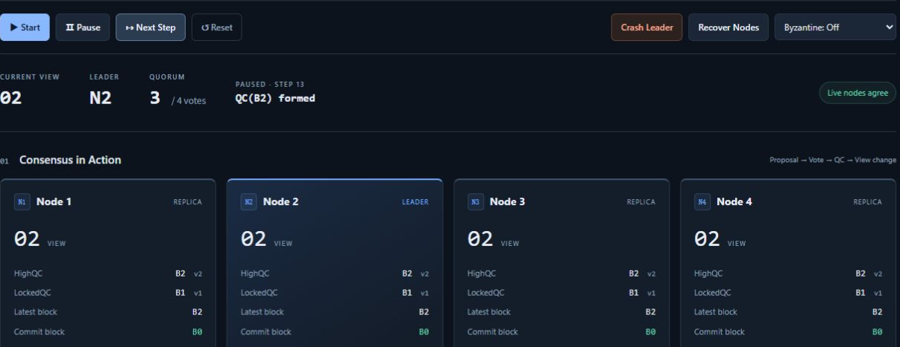
Demo 3: HighQC and LockedQC Diverge
Continue to STEP 13. Compare the two certificate positions.
QC(B2) advances HighQC to B2 and LockedQC to B1.
HotStuff / Protocol
11
Notes:
Stop at STEP 13. All four replicas have received QC(B2). HighQC=B2 describes the latest certified progress they know. LockedQC=B1 constrains subsequent votes using B1's branch. The proposal B2 already carries QC(B1), so receiving QC(B2) provides the trigger for locking its parent B1 in this demo. Commit block remains B0. HighQC and LockedQC have different responsibilities and need not be equal. The teaching implementation updates them atomically when a QC arrives.
References
HotStuff (PODC 2019), Sections 3–6 and the safety appendices: https://arxiv.org/html/1803.05069v6
Authors' reference implementation: https://github.com/hot-stuff/libhotstuff
Project sources: backend/node.py, backend/hotstuff.py and README.md.
Screenshots show the protocol area of an isolated instance of the same demo. Live demonstration: http://localhost:8000.

Slide 12
The Lock Rule: Which Proposals Can Pass?
Assume local LockedQC = QC(B1), with view = 1
Relationship to B1 | Justification QC view | safeNode
Extends B1 | ≥ 1 | Accept
Conflicts with B1 | ≤ 1 | Reject
Conflicts with B1 | 2, with a valid QC | Accept
Newer evidence can justify a branch change. The lock rejects unsupported switches.
HotStuff / Protocol
12
Notes:
Assume the local lock is QC(B1) from View 1. A proposal that extends B1 passes the first safety condition. A proposal on a conflicting branch with a QC view at most 1 fails. A proposal that does not extend the local lock but carries a valid QC from View 2 can pass the newer-QC condition. This table discusses only safeNode. The current-view, leader, certificate and one-vote checks still apply. The newer QC must be valid. A larger number by itself is not evidence.
References
HotStuff (PODC 2019), Sections 3–6 and the safety appendices: https://arxiv.org/html/1803.05069v6
Authors' reference implementation: https://github.com/hot-stuff/libhotstuff
Project sources: backend/node.py, backend/hotstuff.py and README.md.
Screenshots show the protocol area of an isolated instance of the same demo. Live demonstration: http://localhost:8000.

Slide 13
Certification in Chained HotStuff
Evidence for B1 | Certification event in the demo | B1 state
First certificate | QC(B1) | Certified
Successor support | QC(B2), with B1 as B2's parent | Lock basis
Further extension | QC(B3), with linked B1, B2, B3 | Committed
A successor advances itself and deepens the evidence for its ancestors.
The demo updates state when it receives a QC.
HotStuff / Protocol
13
Notes:
Basic HotStuff uses prepare, pre-commit and commit certification phases, followed by a decide notification. Chained HotStuff distributes phase progress across linked proposals. For B1, certification of its successors B2 and B3 increases the depth of evidence supporting it. The table explains the correspondence in this classroom implementation. Do not equate Basic HotStuff message phases literally with the demo's separate views. The demo broadcasts a completed QC and updates state immediately. The paper's chained pseudocode also specifies its own message triggers and pipeline details.
References
HotStuff (PODC 2019), Sections 3–6 and the safety appendices: https://arxiv.org/html/1803.05069v6
Authors' reference implementation: https://github.com/hot-stuff/libhotstuff
Project sources: backend/node.py, backend/hotstuff.py and README.md.
Screenshots show the protocol area of an isolated instance of the same demo. Live demonstration: http://localhost:8000.

Slide 14
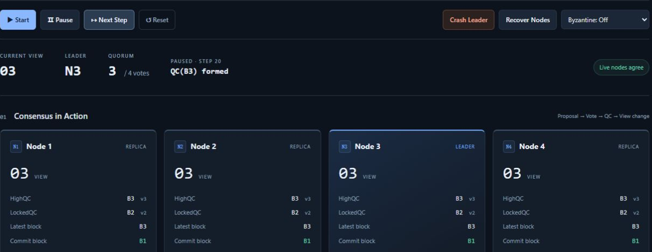
Demo 4: The Three-Chain Commit
Continue to STEP 20. Observe the first new commit, B1.
HighQC = B3, LockedQC = B2, Commit block = B1.
HotStuff / Protocol
14
Notes:
At STEP 20, the log shows both QC(B3) formed and B1 committed. B1, B2 and B3 are directly linked, their views are 1, 2 and 3, and all three have certificates. The oldest node, B1, commits. B2 and the latest proposal B3 remain uncommitted. This implementation requires consecutive views. Skipping a view postpones commitment until a new consecutive three-chain appears. Commit extends the history of final decisions. It has a different meaning from simply receiving the latest QC.
References
HotStuff (PODC 2019), Sections 3–6 and the safety appendices: https://arxiv.org/html/1803.05069v6
Authors' reference implementation: https://github.com/hot-stuff/libhotstuff
Project sources: backend/node.py, backend/hotstuff.py and README.md.
Screenshots show the protocol area of an isolated instance of the same demo. Live demonstration: http://localhost:8000.

Slide 15
Normal-Path Checkpoints
Total STEP | Event | HighQC | LockedQC | Commit
0 | Reset | B0 | B0 | B0
1 | Proposal B1 | B0 | B0 | B0
6 | QC(B1) | B1 | B0 | B0
7 | Enter View 2 | B1 | B0 | B0
13 | QC(B2) | B2 | B1 | B0
20 | QC(B3) | B3 | B2 | B1
Seven steps per normal view. Next Step executes one queued event.
HotStuff / Protocol
15
Notes:
Use this table as the live demonstration script. Begin with Reset and use Next Step throughout. Mixing automatic playback with manual steps can skip a planned checkpoint. A normal view takes seven steps: one proposal, four vote events, one QC event and one view change. STEP 20 is the third QC event. STEP 21 enters View 4. B0 is committed at initialization, so B1 is the first newly committed node. Ask the audience to predict the three fields at STEP 13 before advancing to it.
References
HotStuff (PODC 2019), Sections 3–6 and the safety appendices: https://arxiv.org/html/1803.05069v6
Authors' reference implementation: https://github.com/hot-stuff/libhotstuff
Project sources: backend/node.py, backend/hotstuff.py and README.md.
Screenshots show the protocol area of an isolated instance of the same demo. Live demonstration: http://localhost:8000.

Slide 16
Safety: Intersection, Locks and Commit Evidence
Within one view: correct replicas do not vote twice
Conflicting three-vote QCs would violate the one-vote rule.
Across views: LockedQC constrains future votes
A leader change preserves the existing safety constraints.
Final decisions: successive certificates build evidence
A QC, a lock and a commit represent different levels of confirmation.
The demo illustrates state transitions. Full safety depends on the protocol assumptions.
HotStuff / Protocol
16
Notes:
Connect the mechanisms. Quorum intersection and one vote per view constrain conflicting certificates within a view. The locking rule carries a constraint into later views. A larger view number alone does not remove it. Multiple certification stages establish constraints at enough correct replicas to support compatible final decisions. This is a mechanism-level explanation, not a proof that the teaching code resists every malicious attack. A full proof depends on the authentication, message rules and model assumptions in the paper.
References
HotStuff (PODC 2019), Sections 3–6 and the safety appendices: https://arxiv.org/html/1803.05069v6
Authors' reference implementation: https://github.com/hot-stuff/libhotstuff
Project sources: backend/node.py, backend/hotstuff.py and README.md.
Screenshots show the protocol area of an isolated instance of the same demo. Live demonstration: http://localhost:8000.

Slide 17
Timeout and the Pacemaker
Why a view stops making progress
The leader sends no proposal, fewer than three votes arrive, or no QC is broadcast.
How the demo advances
After the timeout, enter the next view and rotate the leader.
What survives the view change
Replicas retain HighQC and LockedQC. The new leader continues from known evidence.
Demo timeout: three logical ticks. Pause freezes both execution and timeout.
HotStuff / Protocol
17
Notes:
Safety rules cannot force a leader to send messages, so the protocol needs a progress mechanism. A timeout signals suspicion that the current view cannot progress. It does not prove malicious behavior. The pacemaker helps correct replicas converge on suitable views and helps a new leader obtain QC information. The demo uses one coordinator to advance all live replicas and three logical ticks to show the wait. Pausing freezes the ticks. Independent node clocks, timeout certificates and network partitions are outside this simulation.
References
HotStuff (PODC 2019), Sections 3–6 and the safety appendices: https://arxiv.org/html/1803.05069v6
Authors' reference implementation: https://github.com/hot-stuff/libhotstuff
Project sources: backend/node.py, backend/hotstuff.py and README.md.
Screenshots show the protocol area of an isolated instance of the same demo. Live demonstration: http://localhost:8000.

Slide 18
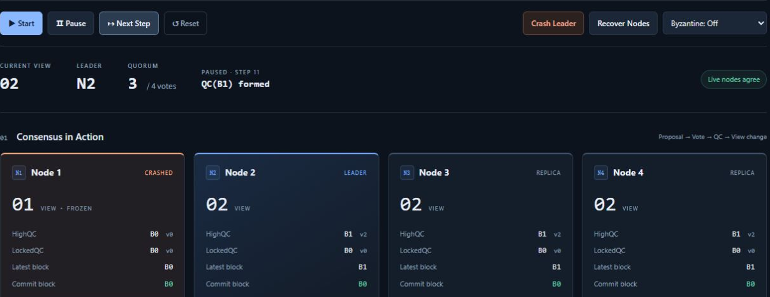
Demo 5: Progress After a Leader Crash
Click Reset, then Crash Leader. Advance to STEP 11.
N1 stays in View 1. Live nodes enter View 2, where N2 forms QC(B1).
HotStuff / Protocol
18
Notes:
Begin with Reset, then click Crash Leader. The fault button does not increase STEP. At STEP 1, N1 sends no proposal. STEPS 2, 3 and 4 show countdown values 3, 2 and 1. STEP 5 enters View 2 with leader N2. STEP 6 proposes B1: no proposal existed in the previous view, so the first proposal still has ID B1. STEP 7 skips N1's vote. STEPS 8–10 are the votes from N2, N3 and N4. STEP 11 forms QC(B1) with those three voters. Continuing to STEP 25 commits B1 through consecutive Views 2, 3 and 4. Recover Nodes catches up the offline replica and clears the faults.
References
HotStuff (PODC 2019), Sections 3–6 and the safety appendices: https://arxiv.org/html/1803.05069v6
Authors' reference implementation: https://github.com/hot-stuff/libhotstuff
Project sources: backend/node.py, backend/hotstuff.py and README.md.
Screenshots show the protocol area of an isolated instance of the same demo. Live demonstration: http://localhost:8000.

Slide 19
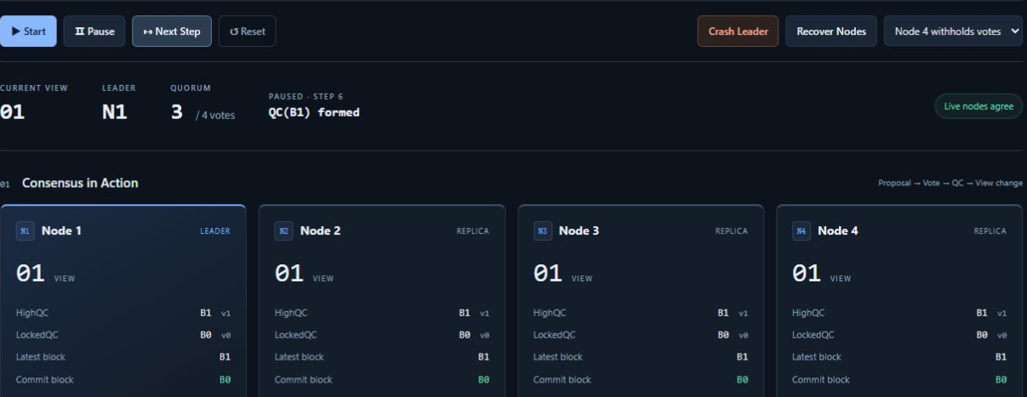
Demo 6: One Replica Withholds Its Vote
Reset, select Node 4 withholds votes, then advance to STEP 6.
QC(B1) has voters N1, N2 and N3, exactly meeting the three-vote threshold.
HotStuff / Protocol
19
Notes:
After Reset, choose Node 4 withholds votes. N1 proposes at STEP 1. N1, N2 and N3 vote at STEPS 2–4. STEP 5 logs that N4 skips its vote. STEP 6 forms a QC with three voters. Compare it with the four-voter certificate in the normal path. N4 still receives QCs, so its HighQC advances as well. The fault only withholds votes. N4 still proposes when it becomes leader. This experiment does not include equivocation or malicious forks and does not test the full Byzantine attack model.
References
HotStuff (PODC 2019), Sections 3–6 and the safety appendices: https://arxiv.org/html/1803.05069v6
Authors' reference implementation: https://github.com/hot-stuff/libhotstuff
Project sources: backend/node.py, backend/hotstuff.py and README.md.
Screenshots show the protocol area of an isolated instance of the same demo. Live demonstration: http://localhost:8000.

Slide 20
The Fault-Tolerance Boundary
Scenario | Available votes | Outcome
All replicas normal | 4 | QC forms
One replica withholds votes | 3 | QC still forms
One crash plus another withheld vote | 2 | No QC, repeated timeouts
Failures do not lower the quorum. Insufficient evidence means waiting.
HotStuff / Protocol
20
Notes:
Ask the audience to compare losing one vote with losing two. With f=1, three remaining replicas can still form a quorum. If N1 crashes while N4 withholds votes, only N2 and N3 can vote. When N2 leads, it gathers two votes and times out. It must not invent a QC. Optional experiment: Reset, Crash Leader, select Node 4 withholds votes. N2 proposes at STEP 6. Voting finishes at STEP 10. STEPS 11–13 count down, and STEP 14 enters View 3 without a new QC. Recover Nodes clears the faults. Two failures exceed the f=1 assumption, so liveness is not guaranteed.
References
HotStuff (PODC 2019), Sections 3–6 and the safety appendices: https://arxiv.org/html/1803.05069v6
Authors' reference implementation: https://github.com/hot-stuff/libhotstuff
Project sources: backend/node.py, backend/hotstuff.py and README.md.
Screenshots show the protocol area of an isolated instance of the same demo. Live demonstration: http://localhost:8000.

Slide 21
Linear Communication and Responsiveness
Linear communication: a leader collects votes into a QC
Compact threshold signatures enable O(n) authenticator communication.
Optimistic responsiveness: progress follows actual responses
After stabilization, a correct leader advances at the pace of sufficient replies.
What this demo does not measure
Node ID lists, a central queue and 0.8-second playback do not establish performance.
HotStuff / Protocol
21
Notes:
State the conditions behind linear communication. The original protocol combines a leader that collects votes with compact threshold-signature QCs. This supports linear authenticator communication for phase progress and successful leader replacement. Counting messages alone does not determine their total size: broadcasting a long voter list still carries a size cost. Optimistic responsiveness means that after the network stabilizes and a correct leader takes over, progress follows actual responses rather than waiting the worst-case network delay at each phase. Timeouts remain necessary. This demo has no threshold signatures and uses a central pacemaker and fixed playback timing, so it is not a performance benchmark.
References
HotStuff (PODC 2019), Sections 3–6 and the safety appendices: https://arxiv.org/html/1803.05069v6
Authors' reference implementation: https://github.com/hot-stuff/libhotstuff
Project sources: backend/node.py, backend/hotstuff.py and README.md.
Screenshots show the protocol area of an isolated instance of the same demo. Live demonstration: http://localhost:8000.

Slide 22
The Demo's Simplifications
Aspect | Classroom implementation | Scope limit
Signatures | List of voter node IDs | No real signature verification
View change | Read live replicas' HighQCs | Simplified NEW-VIEW exchange
Timing | Central queue and logical ticks | No independent node clocks
Commit | Check consecutive three-chain on QC | Conservative teaching rule
Faults | Crashes and withheld votes | No malicious forks or double votes
Recovery | Copy state from a trusted peer | No state-sync proof
HotStuff / Protocol
22
Notes:
Use this slide to distinguish the implementation from the paper. The teaching version retains views, leaders, proposals, votes, HighQC, LockedQC, parent pointers and three-chain commits. Node IDs replace real signatures. A direct read of live replicas' HighQCs stands in for NEW-VIEW exchange. One coordinator and logical ticks replace a complete pacemaker. The commit rule requires consecutive views. A recovering node copies state from a trusted peer. Arbitrary Byzantine behavior and network partitions are not modeled, so the experiments illustrate behavior within these simulation constraints.
References
HotStuff (PODC 2019), Sections 3–6 and the safety appendices: https://arxiv.org/html/1803.05069v6
Authors' reference implementation: https://github.com/hot-stuff/libhotstuff
Project sources: backend/node.py, backend/hotstuff.py and README.md.
Screenshots show the protocol area of an isolated instance of the same demo. Live demonstration: http://localhost:8000.

Slide 23
Live Demo Cue Sheet
Scenario | Actions and checkpoints | Teaching focus
Normal path | Reset. STEP 1 / 6 / 13 / 20 | Proposal, QC, lock, commit
Leader crash | Reset. Crash Leader. STEP 5 / 11 | Timeout and view change
Withheld vote | Reset. N4 withholds votes. STEP 6 | f = 1, quorum = 3
http://localhost:8000
Start: run. Pause: stop. Next Step: one event. Reset: a new scenario.
HotStuff / Protocol
23
Notes:
Keep this slide visible while running the live demo. Reset before every scenario so that one experiment does not leave faults active in the next. For the normal path, stop at cumulative STEPS 1, 6, 13 and 20. For the leader crash, stop at STEPS 5 and 11 to inspect the new leader and QC, then recover the nodes. For the withheld-vote case, stop at STEP 6 and inspect the log for voters N1, N2 and N3. Fault and control buttons do not add to STEP. Only Next Step and automatic execution ticks advance it. The dashboard labels are in English.
References
HotStuff (PODC 2019), Sections 3–6 and the safety appendices: https://arxiv.org/html/1803.05069v6
Authors' reference implementation: https://github.com/hot-stuff/libhotstuff
Project sources: backend/node.py, backend/hotstuff.py and README.md.
Screenshots show the protocol area of an isolated instance of the same demo. Live demonstration: http://localhost:8000.

Slide 24
Protocol Recap
QC certifies, a lock constrains votes, and commit finalizes
These are distinct protocol states.
View changes retain evidence and preserve the quorum
HighQC guides extension. The threshold remains three votes.
The three-chain uses successor evidence to finalize an ancestor
STEP 20 shows the first new commit in the normal run.
References: HotStuff, PODC 2019, Sections 3–6. Project node.py and hotstuff.py.
HotStuff / Protocol
24
Notes:
Close with questions. Why does QC(B1) not immediately commit B1? It is the first layer of evidence, and certification of successors supplies the remaining commit evidence. Can a new leader start from any node? It selects an extension point using HighQC, and replicas still enforce their locking rule. Why can one replica withhold a vote without stopping progress? Three remaining votes meet 2f+1. Why can two failures cause repeated timeouts? There are too few votes for a quorum. Finish by distinguishing safety constraints from the mechanisms that drive liveness. Refer to Sections 3–6 of the paper and to node.py and hotstuff.py in this project.
References
HotStuff (PODC 2019), Sections 3–6 and the safety appendices: https://arxiv.org/html/1803.05069v6
Authors' reference implementation: https://github.com/hot-stuff/libhotstuff
Project sources: backend/node.py, backend/hotstuff.py and README.md.
Screenshots show the protocol area of an isolated instance of the same demo. Live demonstration: http://localhost:8000.

