Slide 1

Formly
Less typing. More testing.
One-click test data for website forms
Chrome & Edge extension
Notes:
Product overview for Formly 0.7.0. Sources: public/manifest.json, src/background.ts, README.md. Artwork: project icon, provenance in docs/brand/README.md.

Slide 2

One click fills the form
Open a form
Click the toolbar icon to insert fictional values into eligible fields.
Click again for fresh values.
Submit when you are ready.
Notes:
The screenshot shows the first-install interactive preview, not a toolbar screenshot. Actual toolbar behavior is implemented in src/background.ts and tested in tests/ui.spec.ts. Finite pools can repeat and single-choice controls cannot change.

Slide 3
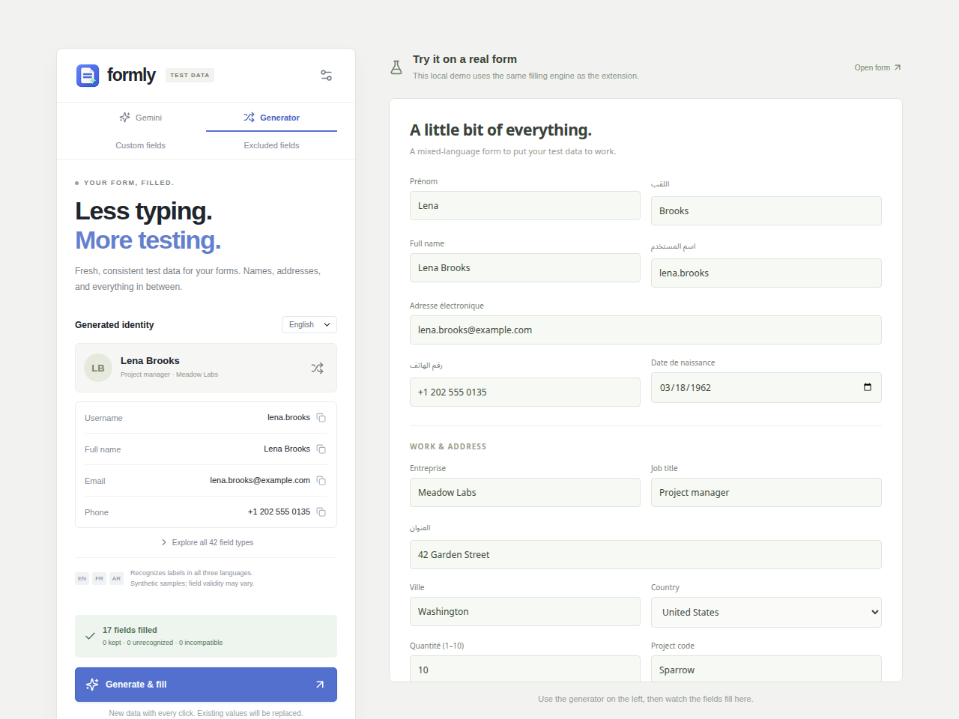
42 field categories, 3 languages
Names and matching emails
Addresses and work details
Numbers, dates and readable text
English, French and Arabic
Custom values and field exclusions adapt the generator to your forms.
Notes:
Source: src/data.ts defines 42 categories and en/fr/ar locales. src/engine.ts matches labels across languages. Screenshot: local development preview with synthetic data. Region-specific address and phone data is not guaranteed by language choice.

Slide 4
Optional Gemini suggestions
Page load prepares suggestions
Unknown field metadata goes to Gemini using your own key.
Toolbar clicks consume the prepared values.
1–60 minutes
Local fallback
Configurable cache duration
When suggestions are unavailable
Notes:
Sources: src/gemini.ts, src/background.ts, src/GeminiPanel.tsx. Default cache duration is 5 minutes. Optional website access enables automatic preparation. Requests use the user’s Google project quota and billing settings. Formly does not send entered field values, page URLs, or whole-page HTML.

Slide 5
Data handling and form boundaries
Local by default
Manual submission
Settings and rules stay in local extension storage. The local generator needs no account.
Formly never submits a form. It skips detected consent, payment and one-time-code fields.
Gemini sends field metadata.
Its saved API key is not encrypted.
Top-level native controls only.
Custom widgets need adapters.
Notes:
Sources: src/storage.ts, src/gemini.ts, src/engine.ts, public/manifest.json. Gemini field metadata can contain website-specific information in labels or placeholders. File uploads, hidden, disabled and read-only controls are also skipped. Frames and shadow DOM are not supported.

Slide 6
Install from source
01
Clone the repository
github.com/gouderhaithem/form-filler
02
Run npm ci, then npm run build
Use Node.js 22 and npm
03
Load dist/ in Developer mode
Pin Formly, open a form, and click the toolbar icon
Notes:
Sources: package.json, public/manifest.json, README.md. Open chrome://extensions or edge://extensions and use Load unpacked. Node.js 22 is the configured CI runtime. The repository does not require a Gemini key for local generation.

