Slide 1
Emphasis on the key factors derived from employee review text using NLP techniques
Kedarnath Goud Kothinti
M.Sc. in Machine Learning – Thesis Presentation

Slide 2
Introduction
Siginficant growth of the text analytic field has provided new horizons to make out meaningful insights of the text data across different domains in industry .
This employee review text will benefit online channels of modern employment for both employee and Organizations.
Emphasis on the key factors derived from employee review text using NLP techniques will have specific clusters for lucid review look up of organization/Job seekers.

Slide 3
Background
Most of the current rating system are numeric in nature.
As part of this research would like to purpose novel machine learning technique approach to constellate prime elements of modern employment market.
Text clustering was done mostly on news, movie and social media content ,there is need to explore more into employee review comments.

Slide 4
Problem Statement
To investigate the meaningful trends in employee reviews.
We will make use existing NLP techniques to propose most feasible yet less computation way to help organization/user to provide with good word clustering mechanism to be able to find trends of employee review comments how the markets trends are changing in modern digital world.

Slide 5
Aim and Objectives
Aim - Emphasis on the key factors derived from employee review text using NLP techniques will have specific clusters of similar topics being labelled.
Objectives –
What are the key features that can be extracted from the employee review comments like management, work life balance, and pay structure?
This insight of review text will help employer to make right investment in employee to make better workplace.

Slide 6
Literature Review and findings
By study classical book by [Charu C,2013] “Data Clustering: Algorithms and Applications” which has provided depth knowledge on handling text data and how K-means can be chosen to process vector representation of word in documents.
Xu, X [Xu, X,2018], along with others proposed Sentences similarity analysis based on word embedding and syntax analysis ,here they have used cosine distance to express the word similarity to calculate resemblance degree between words with this would to make use of TF-IDF with truncated SVD. Usop, E[Usop, E, 2017] , amongst others has proposed a way to improvise the coherence value between two sentences in corpus by using feature selection process of Parts of Speech(POS) and then applying LDA .

Slide 7
Literature Review and findings - Contd
Twinandilla [Twinandilla, S,2018] along with others have proposed a combination K-means text clustering and topic modelling using LDA, which was able to provide good document summarizations with better results. This was impressive contribution but still suffers if optimal cluster(K) value is not determined which we have mitigated in step 1,best component selection of truncated SVD in step2 and LDA hyperparameter tuning in step3 of this thesis contribution.

Slide 8
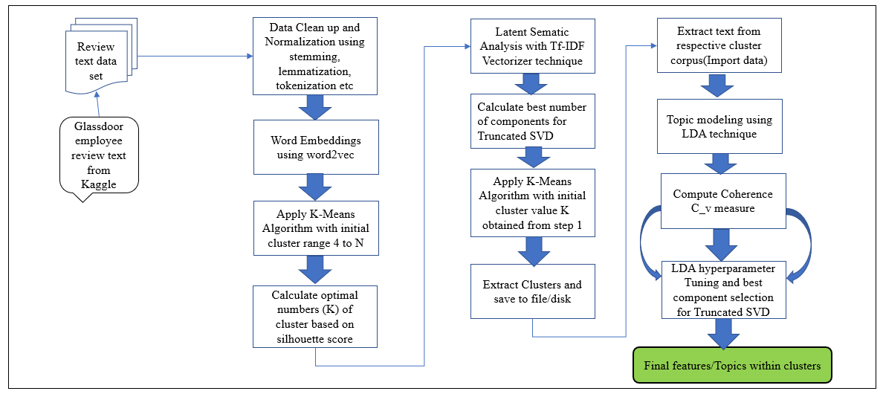
Proposed Methodology

Slide 9
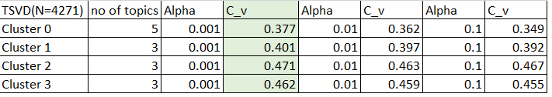
Results & Discussions
Experiment I – Word2Vec –> K-means Clustering –> LDA hyperparameter tuning
Experiment II – TF-IDF truncated SVD –> Kmeans Clustering –> LDA hyperparameter tuning.
Observations-
Hence from above experiments we arrived at best possible topic coherence C_v
when k=4(Optimal clusters for K-means)
N=4271(Best number of components for Truncated SVD at variance 0.95)
Alpha = 0.001 and No of topics = 3
Experiment I | Experiment II
Time taken for word vector compuation is high 30K rows is 69.729522s | Time taken for word vector computation is low 30K rows is 1.953883s
Low Coherence score ~0.35 | Better coherence score ~0.45

Slide 10
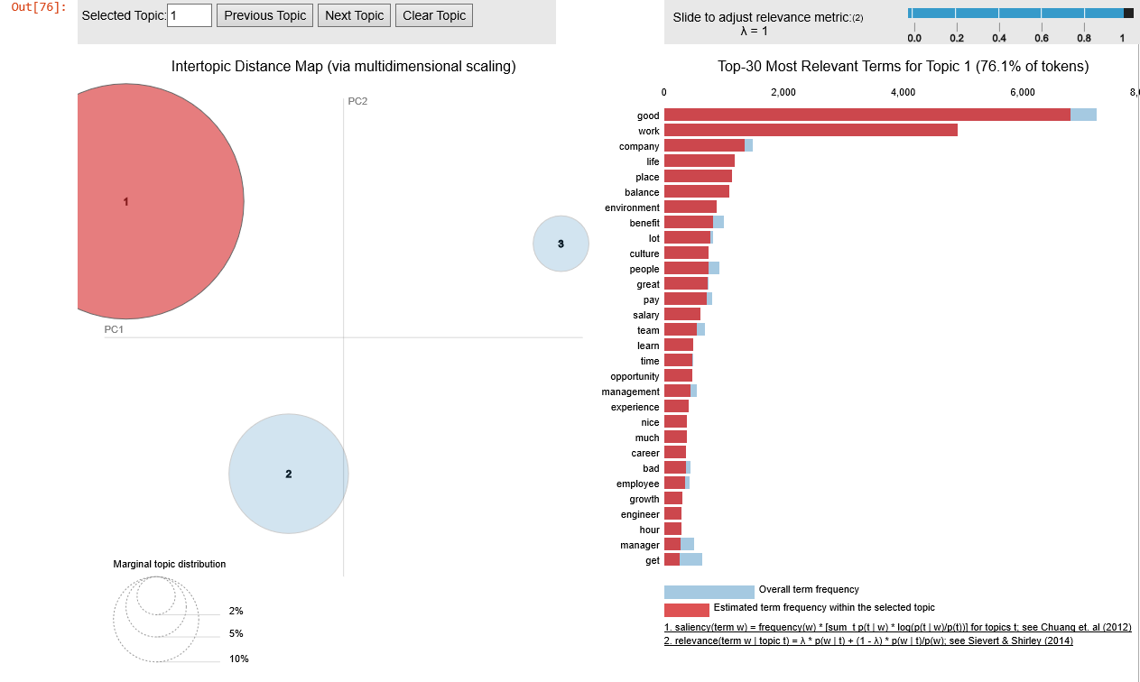
Python visualization of one of the cluster from Experiment II which show work life balance was key feature identified

Slide 11
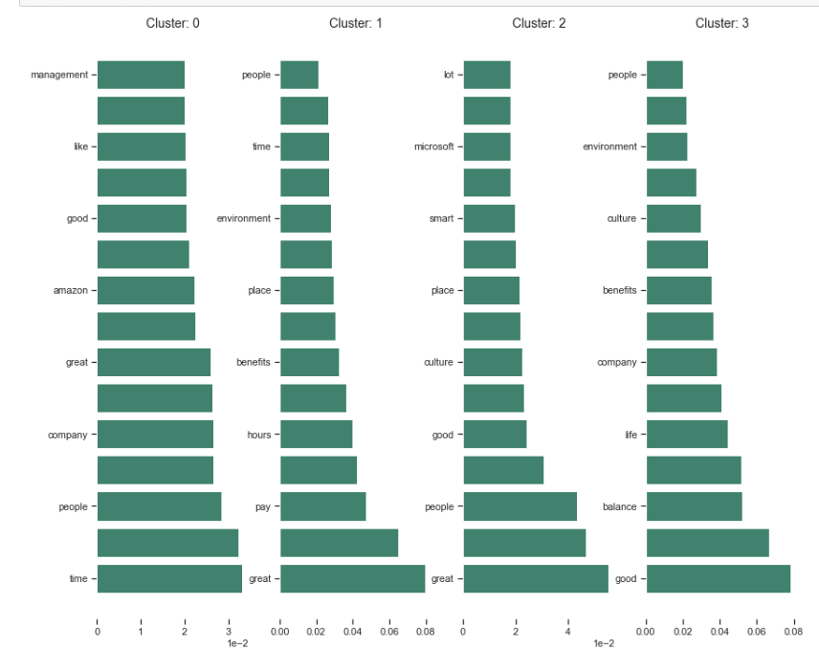
Predominant topics with each cluster for Experiment II

Slide 12
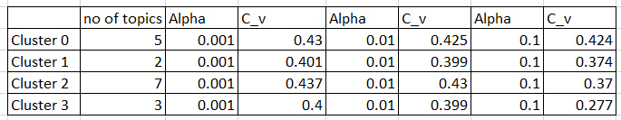
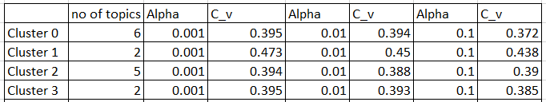
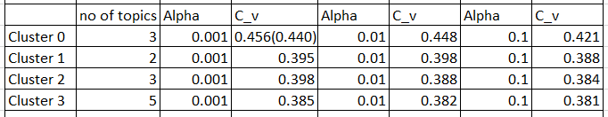
Truncated SVD – Selected Components when N=500
Truncated SVD – Selected Components when N=1000
Truncated SVD – Selected Components when N=2000

Slide 13
Contribution to Knowledge
By combining below NLP techniques we can achieve better coherence score and summarize text into
specific groups.
Determine Optimal(k) number of clusters using silhouette method on the word2vec embeddings
Extract Text clusters using best component number for Truncated SVD on TF-IDF vectorized words of document
Labelling Cluster Content using LDA hyperparameter tuning

Slide 14
Conclusion and Future work
Conclusion –
From this research its was observed that the quality of document cluster details on :
Method for extracting and representing the contextual-usage meaning of words by statistical computations to be able to make better inferences by machine learning algorithms.
How best selection of components of Trancated SVD will reduce computation of these algorithms in combination with LDA hyperparameter tuning.
Future work –
To make use of context dependent vectorization techniques like Elmo, BERT, ALBERT to create better word representation before we apply any clustering technique and topic modelling. This will improve the topic coherence as these models consider word order in their training

Slide 15
References
Chadha, A., & Kumar, S. (2014). An improved K-Means clustering algorithm: A step forward for removal of dependency on K. ICROIT 2014 - Proceedings of the 2014 International Conference on Reliability, Optimization and Information Technology. https://doi.org/10.1109/ICROIT.2014.6798312
Xu, X., & Ye, F. (2018). Sentences similarity analysis based on word embedding and syntax analysis. International Conference on Communication Technology Proceedings, ICCT. https://doi.org/10.1109/ICCT.2017.8359959
Usop, E. S., Isnanto, R. R., & Kusumaningrum, R. (2018). Part of speech features for sentiment classification based on Latent Dirichlet Allocation. Proceedings - 2017 4th International Conference on Information Technology, Computer, and Electrical Engineering, ICITACEE 2017. https://doi.org/10.1109/ICITACEE.2017.8257670
Twinandilla, S., Adhy, S., Surarso, B., & Kusumaningrum, R. (2018). Multi-Document Summarization Using K-Means and Latent Dirichlet Allocation (LDA) - Significance Sentences. Procedia Computer Science. https://doi.org/10.1016/j.procs.2018.08.220

Slide 16
Thank you

