Slide 1
Scale-space Processing Using Polynomial Representations Gou Koutaki and Keiichi Uchimura Kumamoto University, Japan
13:30-15:00 Oral 3D: Low-Level Vision & Image Processing
Thursday, June 26 @CVPR2014
Notes:
Thank you Mr. Chairman.
Good afternoon, ladies and gentlemen.
I will be talking about scale-space processing using polynomial representations.

Slide 2
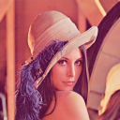






Scale-space Processing
Scale-Resolution
High
Computational Efficiency
Low
Notes:
Scale-space processing is a basic technique in computer vision.
The scale resolution improves as more images are generated, but
increasing the number of images also increases the computational time.

Slide 3
Basic Idea
PCA Compression
Notes:
In this presentation, we try to apply PCA to scale-space.

Slide 4
Scale-space Analysis
Gaussian kernel
Expand with eigenfunctions
Truncating
Exchange operation
Eigen image
How to obtain eigenfunctions φ?
Notes:
So, let’s analyze scale-space images.
Scale-space image I is defined as the convolution of the input image f and gaussian kernel g.
Then, we consider the expansion I with eigenfunctions phi.
Truncating the series.
Then, exchange convolution.
This equation shows that the scale-space image can be represented by sum of image q and eigenfunctions.
And the next question is how to obtain eigenfunctions phi?

Slide 5
Traditional Approach: Matrix-Based PCA
Matrix-based eigen problem:
Co-variant matrix
4
4
L=4
Notes:
In traditional approach, to obtain eigenfunctions,
The matrix-based eigen problem is solved.
For example, in the case of 4-images,
4 by 4 co-variance matrix is calculated.

Slide 6
Traditional Approach: Matrix-Based PCA
Matrix-based eigen problem:
8
8
L=8
Notes:
in the case of 8-images,
8 by 8 co-variance matrix is calculated.

Slide 7
Traditional Approach: Matrix-Based PCA
Matrix-based eigen problem:
?
∞
∞
L=∞
Notes:
So, we consider the case of infinite number of images.

Slide 8
Proposed: Spectral Decomposition
Fredholm integral equation
Integral kernel of Gaussian
L=∞
Notes:
Then, in this case, it is possible to use spectral decomposition.
The spectral decomposition is the infinite dimension’s version of PCA.
So, the matrix-based PCA is transformed to the following integral equation.
The co-variance matrix C is corresponding to the integral kernel K.
In the case of gaussian scale-space, the integral kernel is define as the following equation.

Slide 9

How to solve Integral Equation?
Polynomial approximation:
Integral equation can be converted to generalized eigenproblem:
Eigenimage
Eigenfunctions φ can be obtain in closed form
Notes:
So, next we have to consider how to solve the integral equation?
It is difficult to solve the equation exactly.
So, we approximate the eigenfunction with polynomials of scale parameter s.
Then, the integral equation can be converted to generalized eigenproblem.
Elements of matrix are defined as this equation.
This is 4 by 4 matrix. It can be solved easily in closed form.
Furthermore, eigenimage F is obtained as the equtation.
Here, the gamma is the generalized incomplete gamma function.
The numerical calculation algorithm is well known.

Slide 10
Proposed: Spectral Decomposition
Gaussian Blurred Image can be represented by polynomials of s
Notes:
Because the eigenfunction phi is cubic polynomials,
Scale-space image I can be represented by polynomials of scale parameter s.

Slide 11
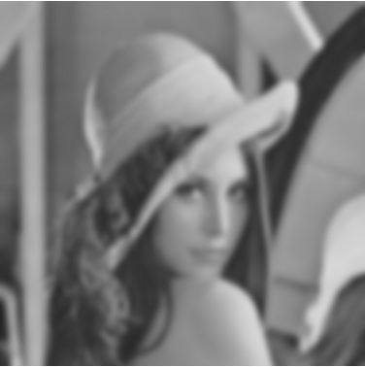
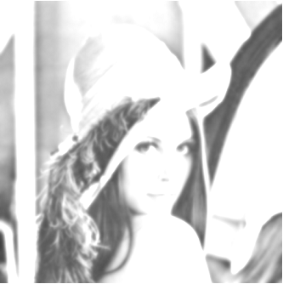
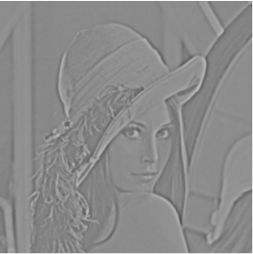


Proposed: Spectral Decomposition
=
+
s +
s² +
s³
Gaussian Blurred Image can be represented by polynomials of s
Notes:
This is an example of Lenna.

Slide 12
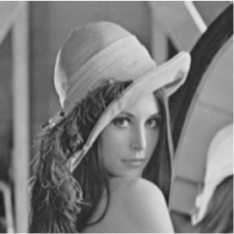

Proposed: Spectral Decomposition
=
+
1.5 +
1.5² +
1.5³
s = 1.5
Gaussian Blurred Image can be represented by polynomials of s
Notes:
This is the case of s=1.5.

Slide 13
Proposed: Spectral Decomposition
=
+
4.5 +
4.5² +
4.5³
s = 4.5
Gaussian Blurred Image can be represented by polynomials of s
Notes:
This is the case of s=4.5.
Only changing s, another scale image can be obtained.

Slide 14
Related works
1990s:
-Steerable filter [Freedman1991]
-Steerable-scalable filter [Perona1992]
-Improved Steerable-scalable filter [Shy1994]
-Fourier basis (sin and cos)
-solution is discretized and solved
numerically.
-depend on initial guess and iterations
-edge detection
2000s:
-SIFT [Lowe1999]
-Saliency map [Itti1998]
-Polynomial basis
-solution keeps continuity
-closed form
-more analytic form (gamma func.)
-SIFT application
Many scale-space applications, however….
Our method:
Notes:
I will introduce related works.
There were many researches of scale-space filtering.
The PCA of scale-space has been proposed in early 90s.
Steerable scalable filter is well known.
Those approach uses sin and cos basis functions,
And the solution is discretized and solved numerically.
The solution depends on initial guess.
As a application, multi-scale edge detection was shown.
After two thousands years, the new scale-space methods such as SIFT and saliency map gets attention.
However, the great techniques of 90s was not used.
On the other hand,
Our research refocuses the 90s researches.
The new points are as follows.
We use polynomial basis for approximation.
The solution is not discretized and keeps continuity.
And the solution can be solved in closed form.
Then we give more analytic form of eigenimages
And apply another scale-space applications.

Slide 15
Applications
Operator
Integral kernel
Applications
Gaussian
Blur image generation
SIFT descriptor
Saliency map
SIFT Detector
Edge detection
Edge detection
HOG
Scale-normalized LOG
Gaussian derivative
Notes:
We will show some applications.
In previous slide, we analyze the gaussian scale-space.
Acctually, there are some kind of scale-space such as
Scale-normalized LOG space and Gaussian derivative space.
However, in the same manner of gaussian scale-space,
It is possible to analyze those scale-space by only changing integral kernel.

Slide 16
Application 1: SIFT Keypoint Detector
Scale-Normalized LoG:
Keypoints can be detected at ∂sLoG/ ∂ s =0
Optimal scale can be obtained by
well known Quadratic formula easily!
Notes:
First application is SIFT keypoint detector.
By our method, the scale normalized LOG image can be represented by polynomial of s.
Here, the keypoints can be detected as the extreme position of sLOG.
The partial derivative can be obtained by the following equation.
It is easy to detect the scale by the following well known quadratic formula.

Slide 17

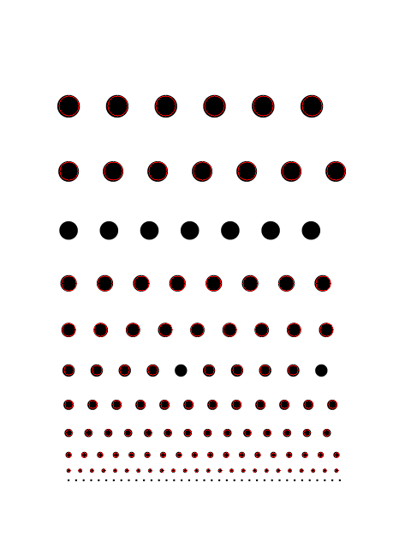

Application 1: SIFT Keypoint Detector
Simple Pattern Testing
Input
Previous(opencv)
Proposed
Notes:
We will show the results of the keypoint detection.
This is the simple input image of black disks with some radius.
This is the result of standard SIFT by openCV.
This is the result of our method.

Slide 18
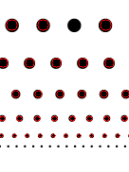
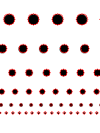
Application 1: SIFT Keypoint Detector
Simple Pattern Testing
zoom
Input
Previous(opencv)
Proposed
Previous SIFT missed some disks
even in simple case
Notes:
As you can see, previous SIFT missed some disks even in simple case.
On the other hand, our method can detect all disks.

Slide 19
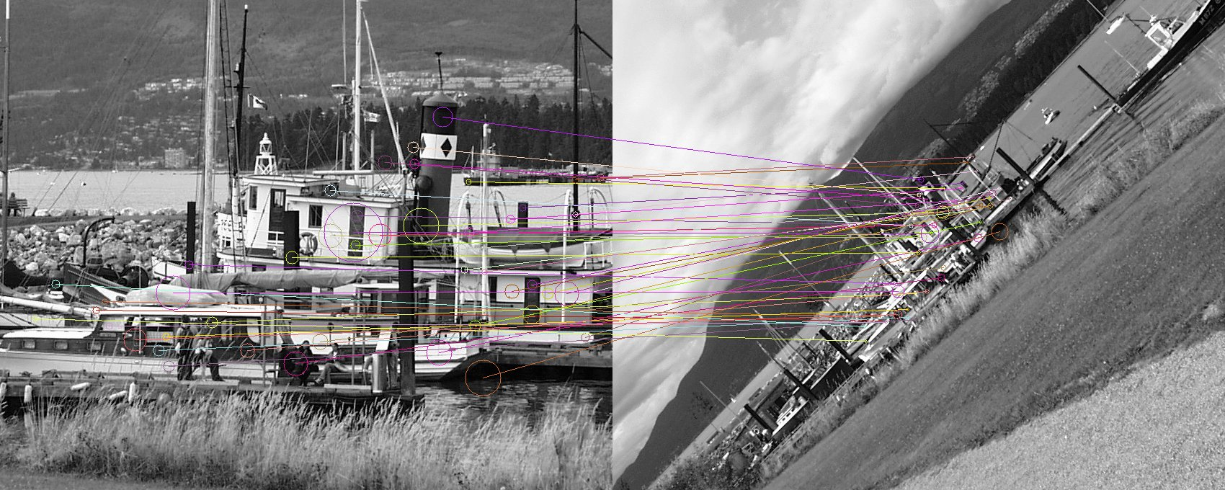
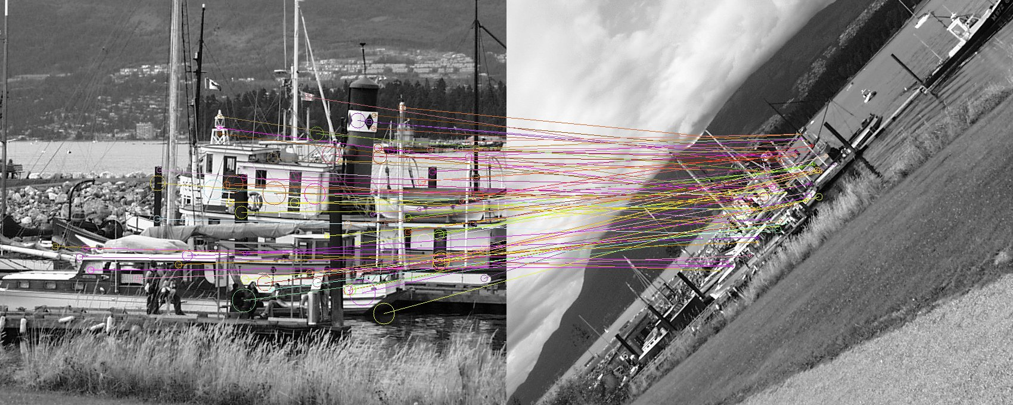
Application 1: SIFT Keypoint Detector
Previous SIFT: 56/500 Keypoints Match
Proposed SIFT: 79/500 Keypoints Match
Notes:
This is another result of boat image.
Our method can make more correspondences than previous SIFT.

Slide 20
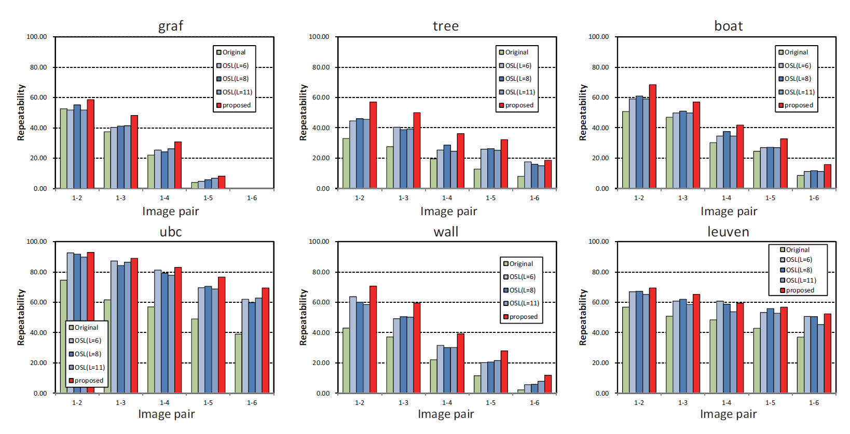
Application 1: SIFT Keypoint Detector
Repeatability for Oxford Datasets
Notes:
This is summery of repeatability for Oxford datasets.
Green bar is the result of original lowe binary.
Blue bars are previous SIFT of openCV.
Red bar is our method.
As you can see, our method show best repeatability.

Slide 21
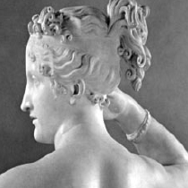
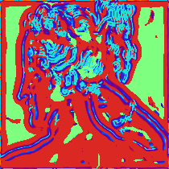
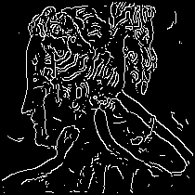
Application 2: Multi-scale Edge Detection
Derivative Gaussian:
S
L
Input
Estimated scale s*
Edge contours
Notes:
We will introduce another application.
By using our method, gaussian derivative image can be presented by polynomial of s.
So, the local optimal scale can be easily found.
This image shows the estimated local scales and this image shows the detected edge contours.

Slide 22
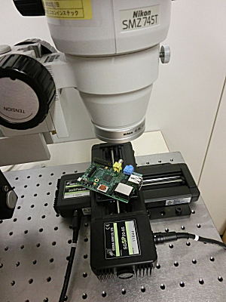
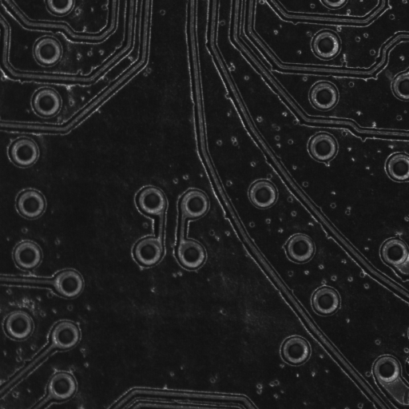
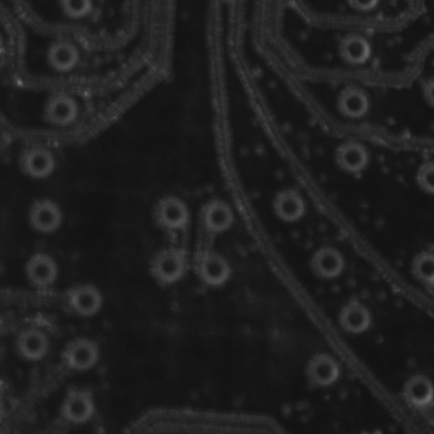
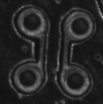

Application 3: Blurred Template Matching
Microscope
Just Focus
Out Focus
Blur Controllable Template
～
T(s) ≒ q₀(x,y) + q₁(x,y)s + q₂(x,y)s² + q₃(x,y)s³
Cross Correlation
R(x,y) = f * T = p₀(x,y) + p₁(x,y)s + p₂(x,y)s² + p₃(x,y)s³
Notes:
Final application is the template matching of visual inspection.
Generally, the captured image of microscope contains the focus blur.
So, in order to detect target robustly,
The blur controllable template matching is useful.
By using our method, the blur controllable template can be represented by polynomials of s.
So, the cross correlation can be represented by polynomials of s, too.
It is easy to detect the position with maximum cross correlation.

Slide 23
Conclusion
■Apply Spectral decomposition to scale-space
■Scale-space images can be represented
by polynomial of scale parameter
■There are many applications
Notes:
Conclusion is as follows.
We proposed to apply spectral decomposition to scale-space.
Then, we show that scale-space images can be represented by polynomial of scale parameter.
Finally, we show many applications.
I believe that our method can replace many other scale-space applications.
Thank you for your kind attention.

