Slide 1


Slide 2
Rah! Rah! Rah! Or Blah Blah Blah?
An analysis of the fight songs of the Power 5 Schools

Slide 3
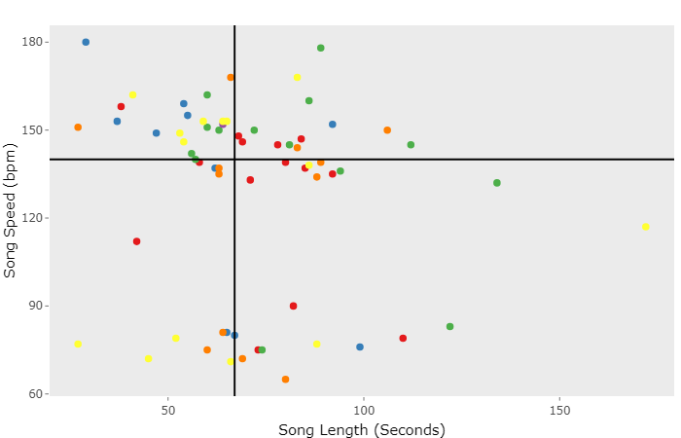
Song Speed, Length, and Division
Link to Plotly

