Slide 1
J-K Flip-Flop
Joshua Gould
12/11/2018
ECE 09.414 VLSI Design
Dept. of ECE
Henry M. Rowan College of Engineering Rowan University

Slide 2
Outline
Block Diagram
Truth Table
Basic Flip-Flop / Issues
Master Slave Design
Designs & Choice
Logical Design
Transistor Design
Worst Case Design
Logical Effort, Number of Stages, Delay
Gate Sizes for Optimized Design
Delay Comparisons
Conclusion & Improvements

Slide 3
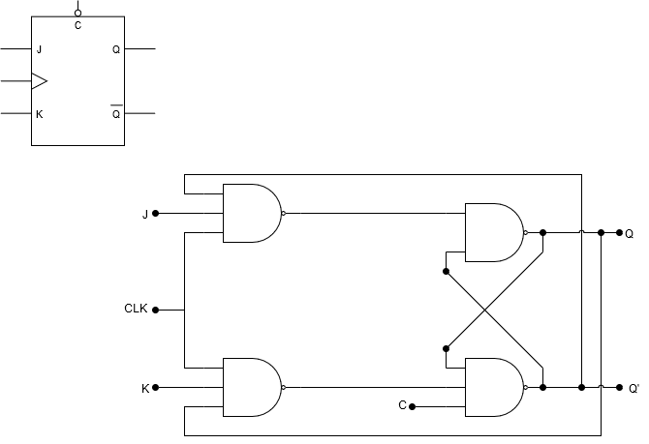
Block Diagram

Slide 4

Truth Table
Inputs |  |  |  | Outputs |  | Action
J | K | CLK | CLR | Q | Q’
0 | 0 | Fall-Edge | 1 | Last Q | Last Q’ | Retain State
0 | 1 | Fall-Edge | 1 | 0 | 1 | Reset Q
1 | 0 | Fall-Edge | 1 | 1 | 0 | Set Q
1 | 1 | Fall-Edge | 1 | Last Q’ | Last Q | Toggle
0 or 1 | 0 or 1 | 0 or 1 | 0 | 0 | 1 | Asynchronously Reset Q
0 or 1 | 0 or 1 | 0 or 1 | 1 | 1 | 1 | Illegal State
$$Q_{next} = J\overline{\overline{Q}}+\overline{\overline{K}}Q$$

Slide 5
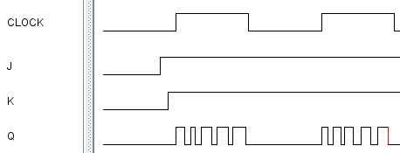
JK Flip-Flop Issues
Uncontrolled toggling when clock is high
Minimized features

Slide 6
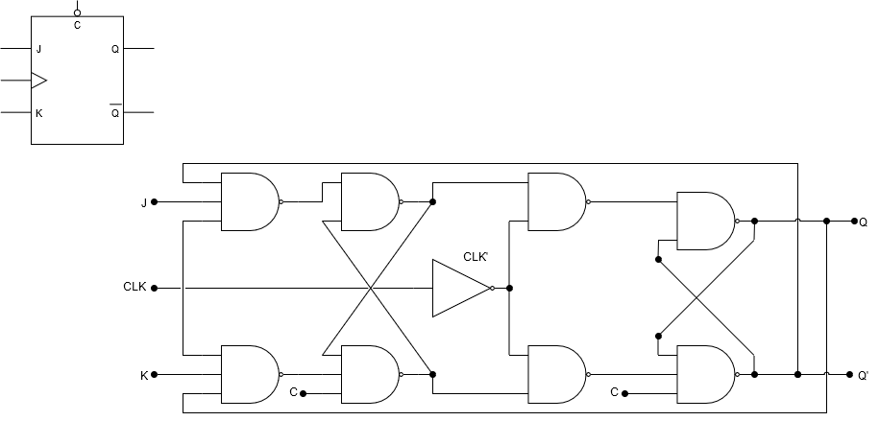
Master/Slave Flip-Flop
Master Latch
Slave Latch
Solves this “race” timing problem with a fast clock
Race timing occurs if the output Q changes state before the timing pulse of the clock input has time to go “OFF”.

Slide 7
Master/Slave Flip-Flop
Master Latch
Slave Latch
Two latch stages in a cascaded configuration
Activated with opposite clock phases
Eliminates uncontrolled oscillations since only one stage is active at any given time

Slide 8
Design Overview
POSSIBILITY 1: NAND Logic Gate
PROS:
Simple design
Smallest design area
Uses simple gates
CONS:
Notable output timing errors
Minimized features
Limited in pulse width for the clock and inputs

Slide 9
Design Overview
POSSIBILITY 2: Master-Slave NAND Logic Gate
PROS:
Simple design doubled
Fixes race error
CONS:
Uneven design with clear
Large amount of transistors
Minimized features (no PRESET)
Some constraints on the clock pulse width
Delay on Slave latch (1/2 clock period)

Slide 10
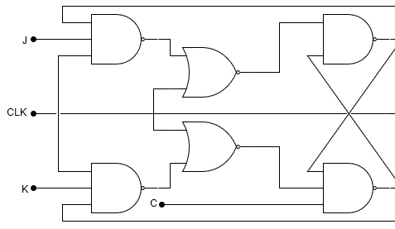
Design Overview
POSSIBILITY 3 Continuous JK Flip-Flop
PROS:
Fixes the SR Latch with the 3 input NANDs so all inputs are allowed.
CONS:
Inputs must be stable for some time before clock goes low.
The output will oscillate continuously until the or one of the input signals goes low
Larger design area than NAND only (+2 NOR +2 NOT)
Highest number of transistors required

Slide 11
Design Overview Comparison
Design | Major Concern | # of Transistors | # of stages
1 - Simple | Run time error | 22 | 2
2 - MastSlav | Higher Delay/ Clock limitation | 46 | 4
3 - NOR | Inputs must be stable | 54 | 5

Slide 12
Design Choice
POSSIBILITY 2: Master-Slave NAND Logic Gate
Fixes race error
Faster than NOR design

Slide 13
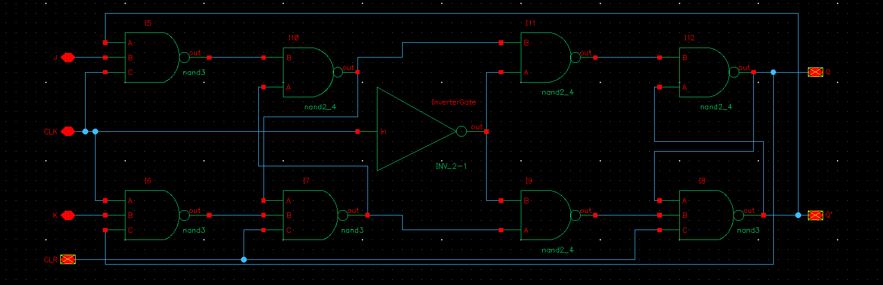
Logic Design

Slide 14
Logic Design

Slide 15
Logic Design

Slide 16
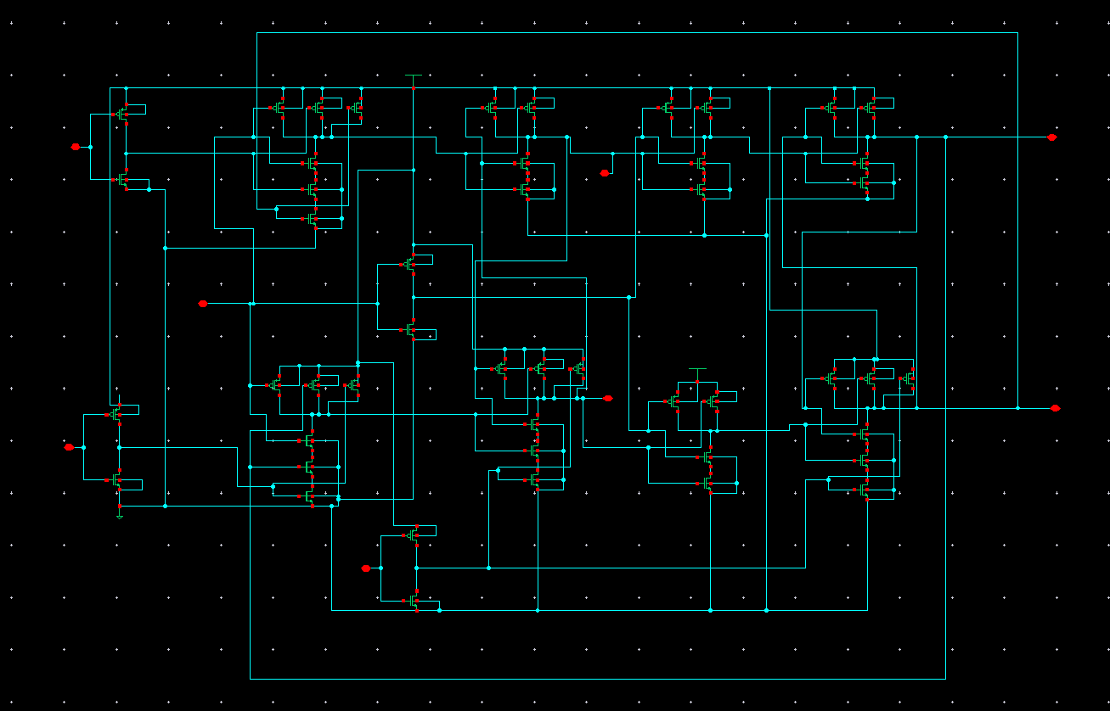
Transistor Design

Slide 17
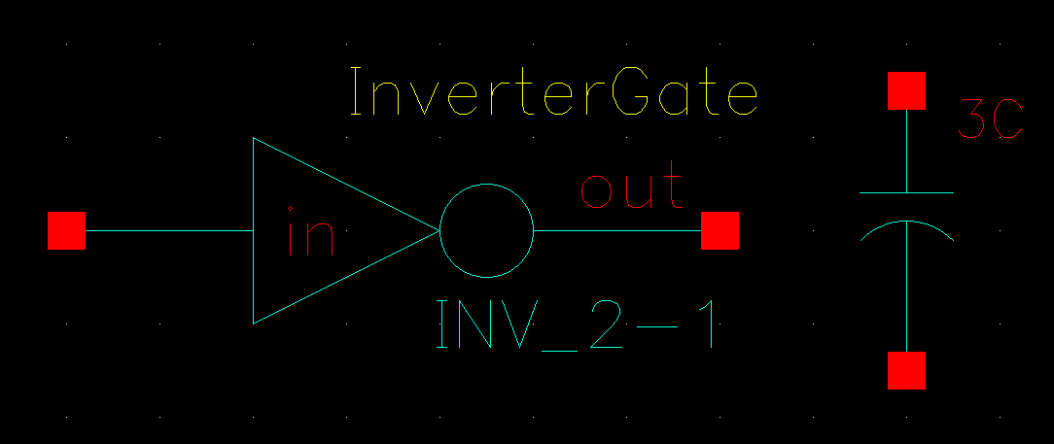
3C

Slide 18
3C

Slide 19
Transistor Design

Slide 20
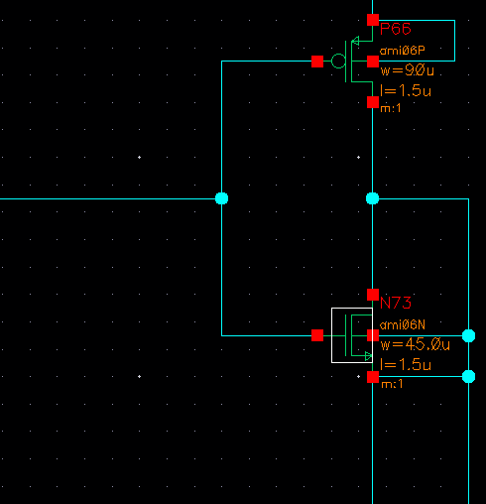

Slide 21
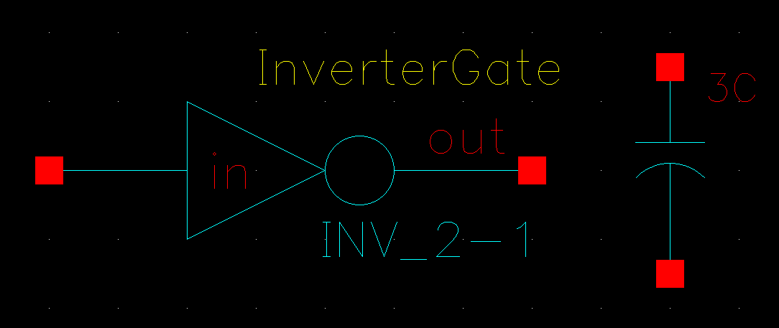
90C

Slide 23
Transistor Design

Slide 24
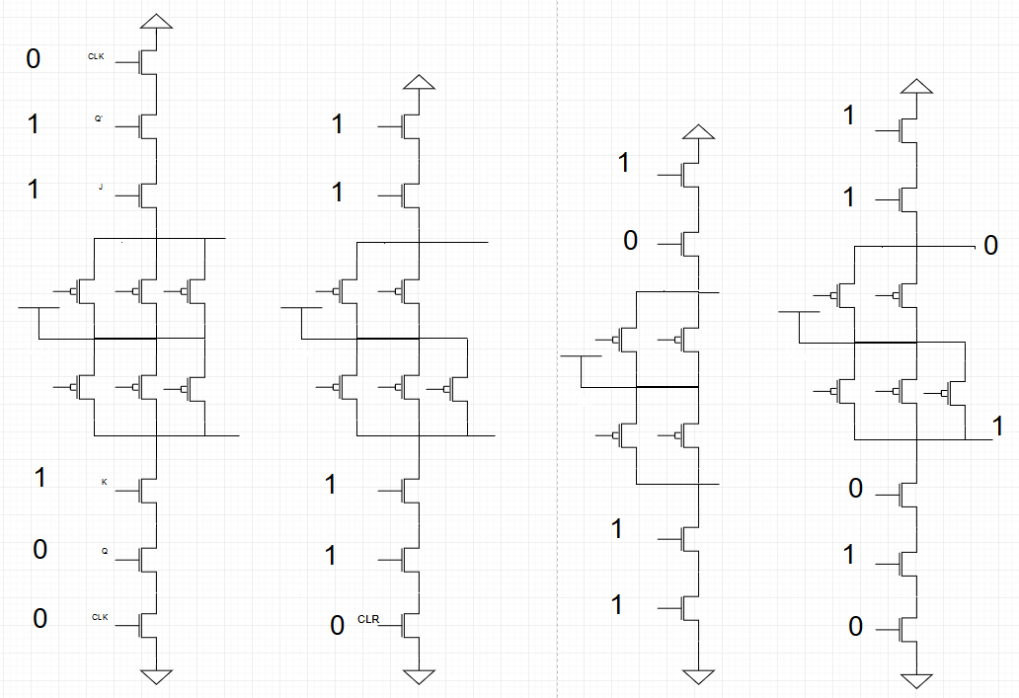
Worst Case Logical Path

Slide 25
Worst Case Logical Path

Slide 26
Worst Case Logical Path

Slide 27
Worst Case Logical Path
J
Q’
CLK
CLK
Q
K

Slide 28
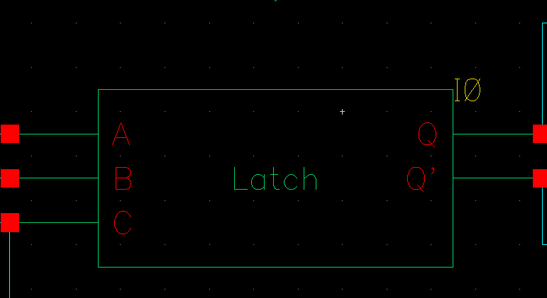
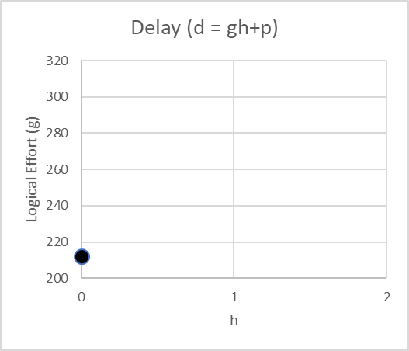
Latch Delay Calculation
The logical effort of the flip-flop must be characterized in Cadence due to the feedback path on each latch.
Use d = gh + p to find latch parameters

Slide 29
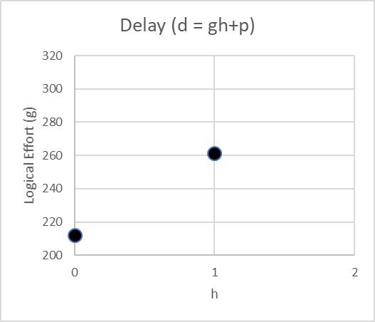
Latch Delay Calculation
The logical effort of the flip-flop must be characterized in Cadence due to the feedback path on each latch.
Use d = gh + p to find latch parameters

Slide 30
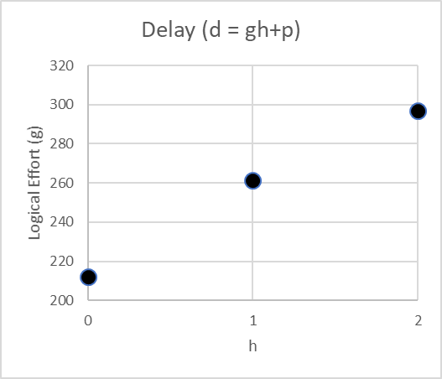
Latch Delay Calculation
The logical effort of the flip-flop must be characterized in Cadence due to the feedback path on each latch.
Use d = gh + p to find latch parameters

Slide 31
Effective Latch Stages & Normalization
Due to its dependence on feedback path, the latch may not be best described by a single stage.
The parasitic delay of the latch was divided by that of a similar-sized inverter.
Assigned 2 stages to the latch.

Slide 32
Latch Delay Calculation
h | g
0 | 212.105
1 | 261.3
2 | 297.012
d = gh+p
= 42.45h + 214.35
g = 42.45
p = 212.105

Slide 33
Inverter Delay Calculation
h | g
0 | 49.9
1 | 73.2
2 | 109
d = gh+p
= 29.55h + 49.9
g = 29.55
p = 49.9
Normalized Average
g = 1
p = 1

Slide 34
Latch Delay Calculation
h | g
0 | 212.105
1 | 261.3
2 | 297.012
d = gh+p
= 42.45h + 214.35
g = 42.45
p = 212.105
Normalized Average
g = 1.4367 p = 4.2506

Slide 35
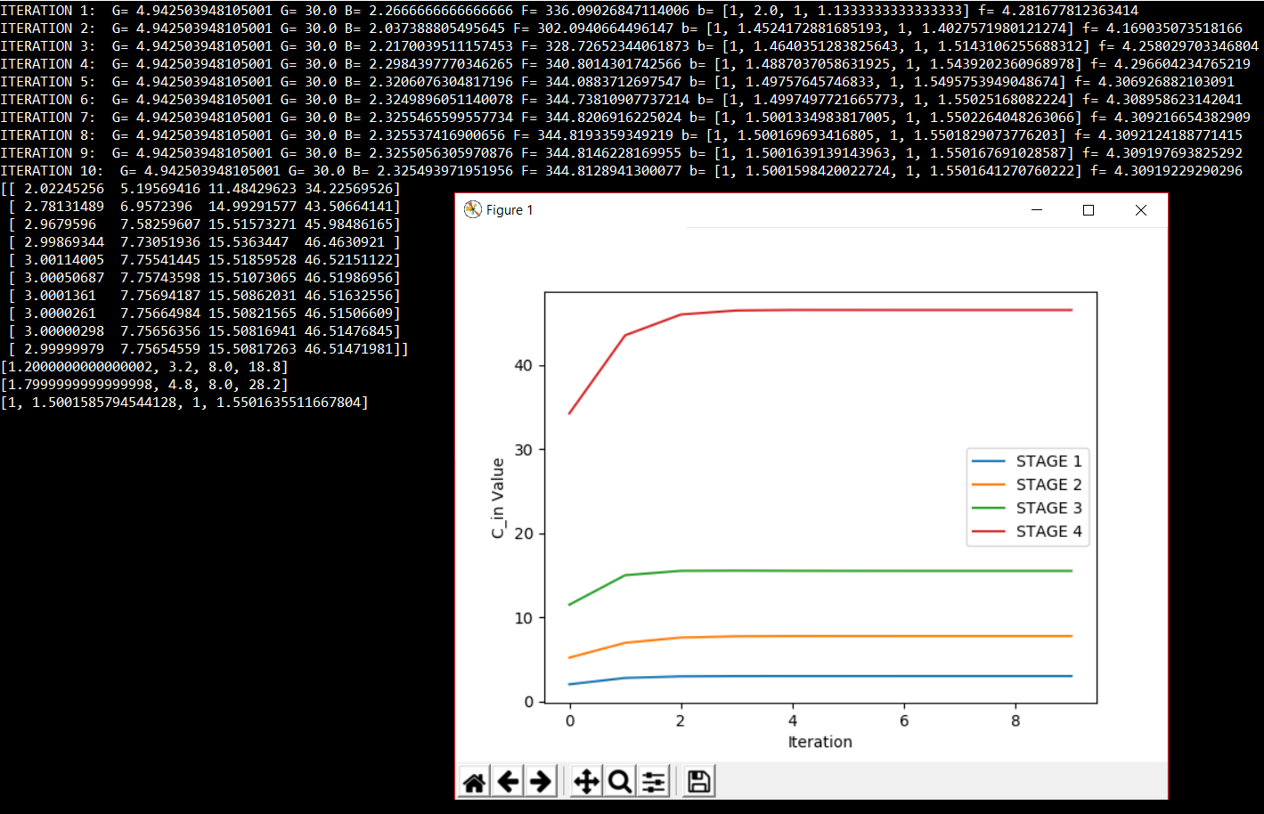
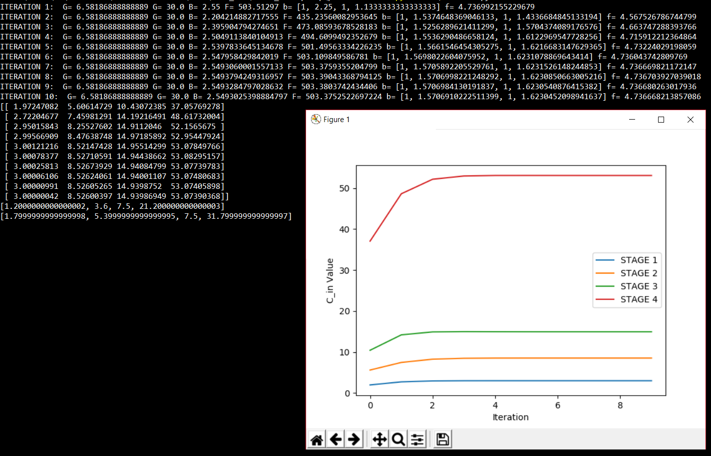
Gate Sizes for Optimized Design
Top Logic
Bottom Logic

Slide 36
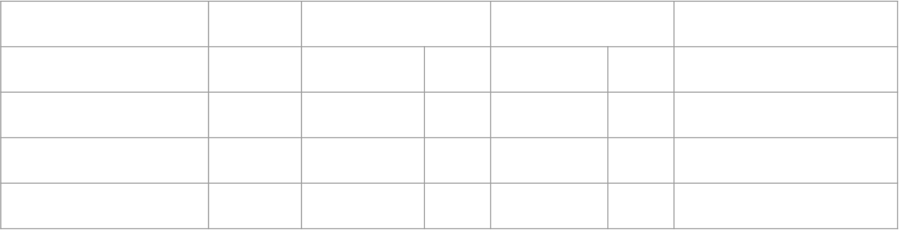
Gate Sizes for Optimized Design
R
S
T
U
V
W
X
Y
Stage | Size | Width pMOS |  | Width nMOS |  | Length ($μ$m)
R,V | 3.00 | 1.8 | 1.8 | 2.7 | 1.8 | 1.5
S | 7.757 | 3.2 | 3.3 | 4.8 | 4.8 | 1.5
T | 15.508 | 8 | 8.1 | 8 | 8.1 | 1.5
U | 46.515 | 18.8 | 18.9 | 28.2 | 28.2 | 1.5

Slide 37
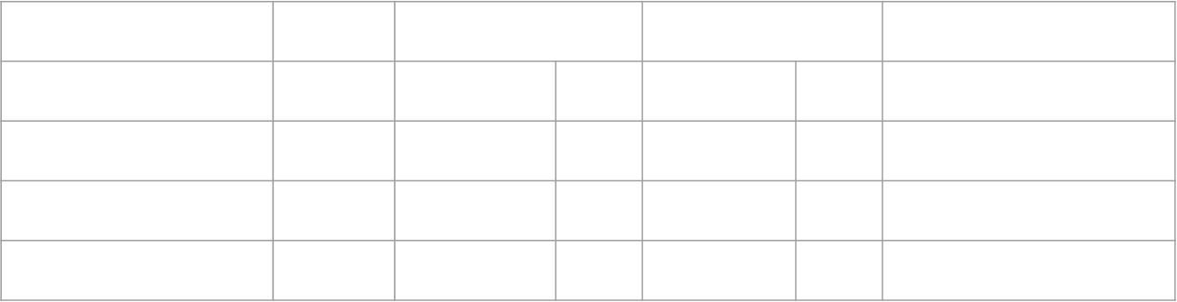
Gate Sizes for Optimized Design
R
S
T
U
V
W
X
Y
Stage | Size | Width pMOS |  | Width nMOS |  | Length ($μ$m)
R,V | 3.00 | 1.8 | 1.8 | 2.7 | 1.8 | 1.5
W | 8.52 | 3.6 | 3.6 | 5.4 | 5.4 | 1.5
X | 14.940 | 7.5 | 7.5 | 7.5 | 7.5 | 1.5
Y | 53.074 | 21.2 | 21.3 | 31.8 | 31.8 | 1.5

Slide 38

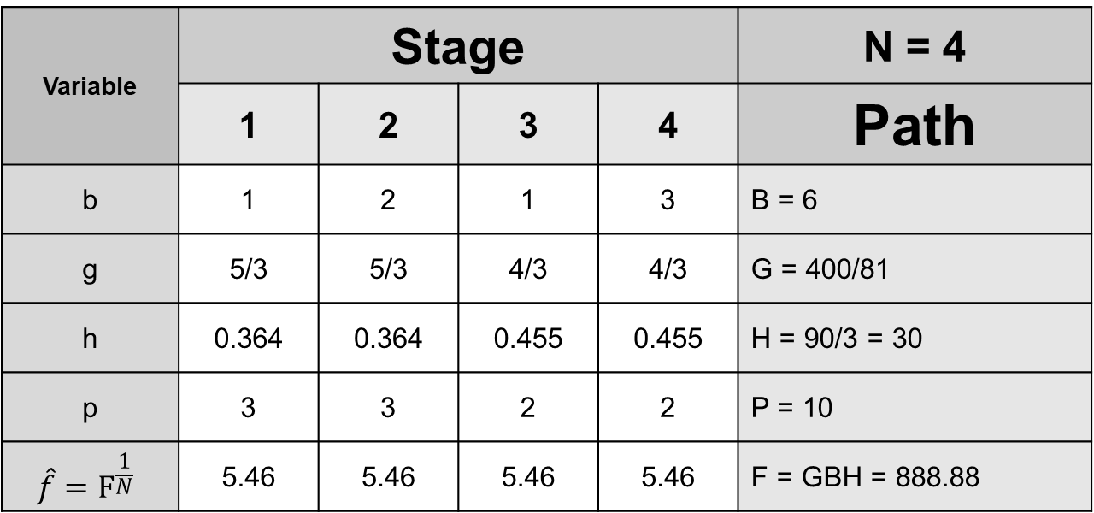
Logical Effort, Number of Stages, Delay
Variable | Stage |  |  |  | N = 4
 | 1 | 2 | 3 | 4 | Path
b | 1 | 1.51 | 1 | 1.5619 | B = 5.0719
g | 1.6667 | 1.4367 | 1.3334 | 1.4367 | G = 4.5869042
h | 3.276 | 3.8004 | 4.095 | 3.8004 | H = 90/3 = 30
p | 3 | 4.2506 | 2 | 4.2506 | P = 13.5012
 | 5.46 | 5.46 | 5.46 | 5.46 | F = GBH = 697.93
$$D=N\hat{f}+P$$ $=4∙5.1398+13.5=\text{34.06}$

Slide 39
Logical Effort, Number of Stages, Delay
Variable | Stage |  |  |  | N = 4
 | 1 | 2 | 3 | 4 | Path
b | 1 | 1.51 | 1 | 1.5619 | B = 5.0719
g | 1.6667 | 1.4367 | 1.3334 | 1.4367 | G = 4.5869042
h | 3.276 | 3.8004 | 4.095 | 3.8004 | H = 90/3 = 30
p | 3 | 4.2506 | 2 | 4.2506 | P = 13.5012
 | 5.46 | 5.46 | 5.46 | 5.46 | F = GBH = 697.93
$D ∗τ$ $=\text{34.0612}∗80ps=2.725 ns$

Slide 40
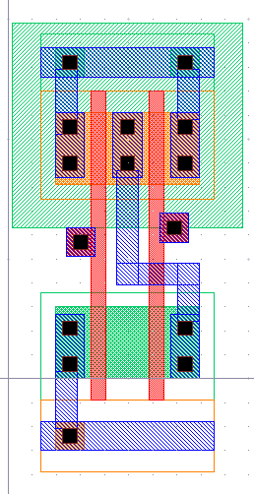
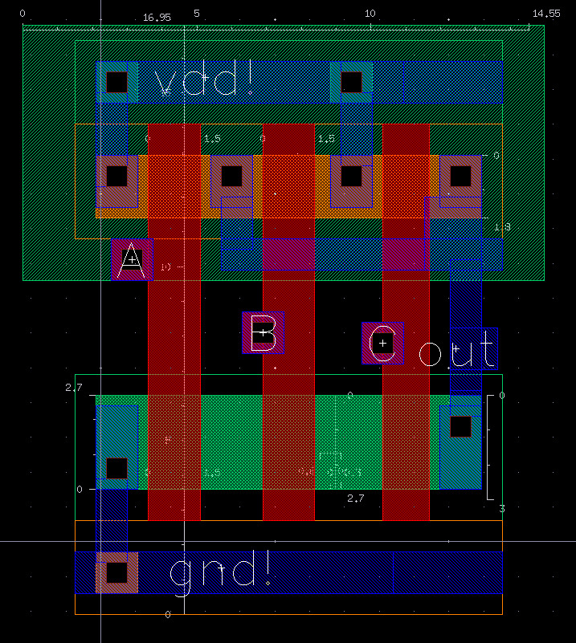
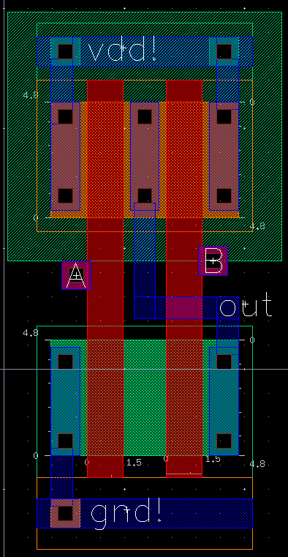
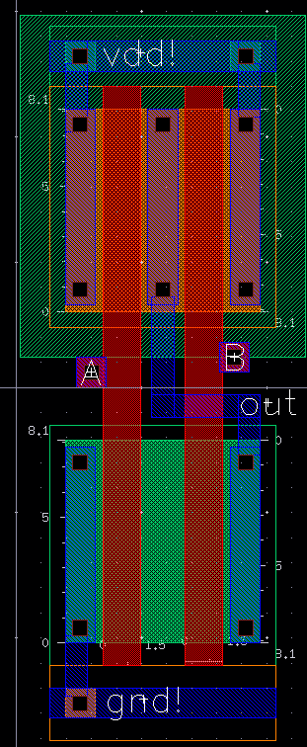
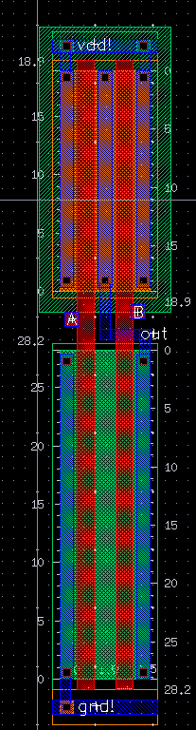
Standard Cell Library
R
S
T
U
U
V
W
X
Y
R
S
T
U

Slide 41
Standard Cell Library

Slide 42
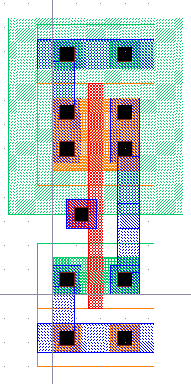
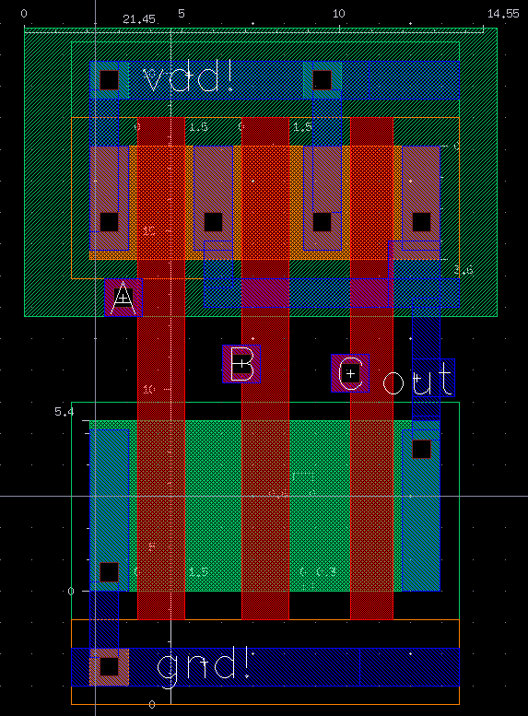
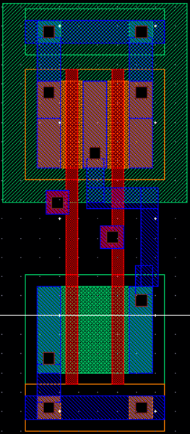
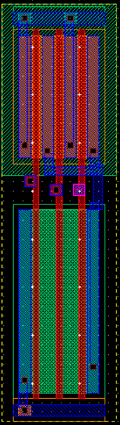
Standard Cell Library
R
S
T
U
INV
V
W
X
Y
V
W
X
Y

Slide 44
Pre-Layout Simulations
Consider MASTER to SLAVE Delay
Consider clock speed
Size of gates vary the input to output and can alter inputs as the bottom path is slower than the top.
Master and Slave have a delay between each other of a half clock cycle (clock pulse width)
4n Clock period behavior

Slide 45
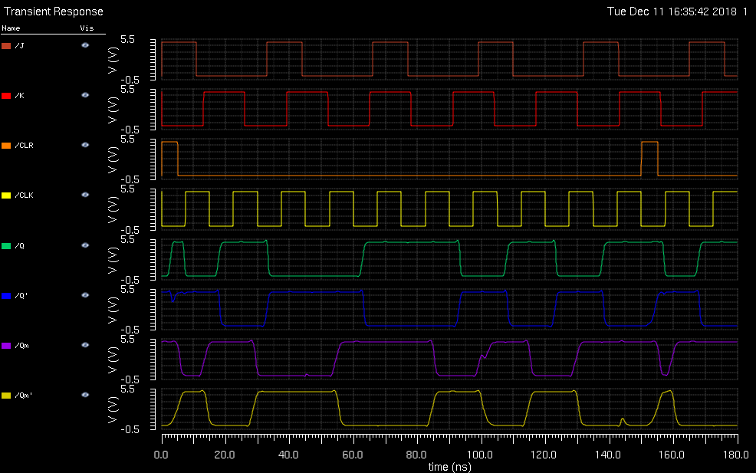

Slide 46
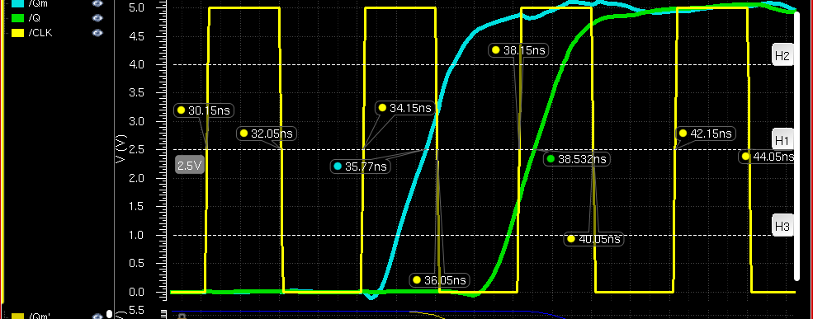
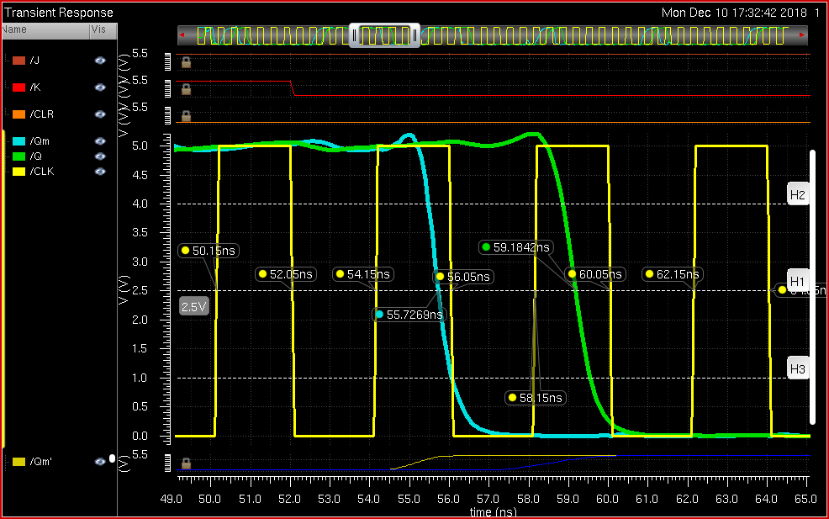
Pre-Layout Simulations
Falling Clock Q Rising Delay = tpdr = 2.5132 ns
Slave output rising time is about 0.8932 ns behind the master

Slide 47
Pre-Layout Simulations
Falling Clock Q Falling Delay = tpdf = 3.1342 ns

Slide 48
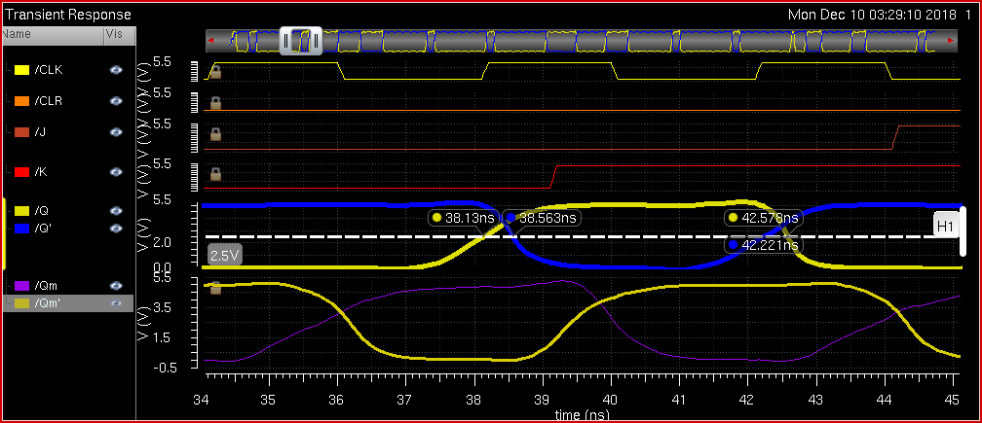
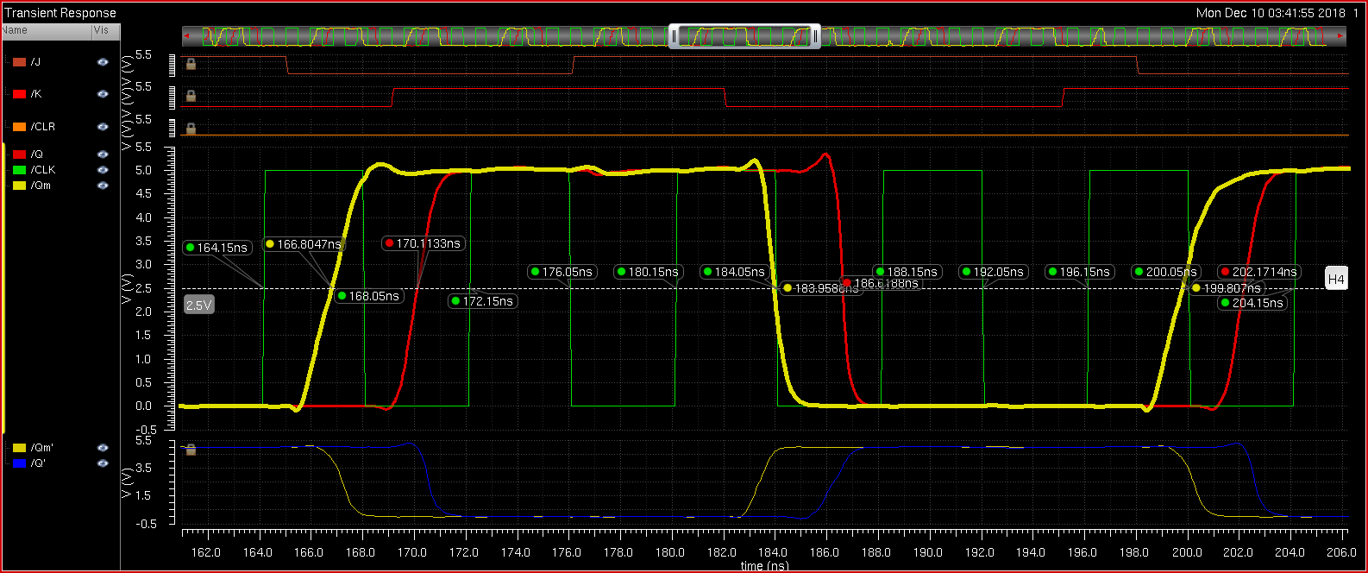
Pre-Layout Simulations
Simulated Slave Output Delay = 2.8237 ns where clock cycle is 4 ns

Slide 49
Pre-Layout Simulations
Simulated Slave Output Delay = 2.8237 ns where clock cycle is 4 ns
Recall the delay 2.0437 ns

Slide 50
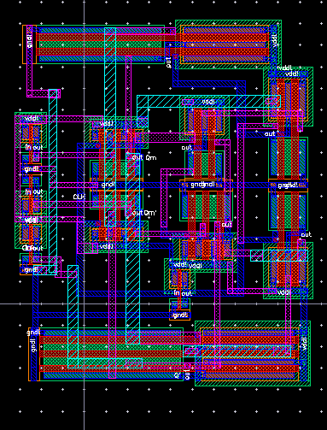
JK Flip-Flop Layout Design

Slide 51

65.55 X 90.75
196.65$λ$ x 272.25$λ$

Slide 52
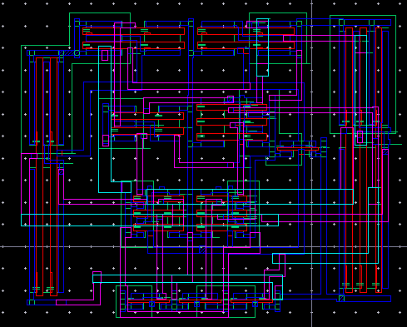

Slide 53
Spectre Netlist
N69 (net43 CLR 0 0) ami06N w=1.5u l=600n as=2.25e-12 ad=2.25e-12 ps=6u \
pd=6u m=1 region=sat
N68 (net18 K 0 0) ami06N w=1.5u l=600n as=2.25e-12 ad=2.25e-12 ps=6u pd=6u \
m=1 region=sat
N67 (net27 J 0 0) ami06N w=1.5u l=600n as=2.25e-12 ad=2.25e-12 ps=6u pd=6u \
m=1 region=sat
N0 (net57 CLK 0 0) ami06N w=1.5u l=600n as=2.25e-12 ad=2.25e-12 ps=6u \
pd=6u m=1 region=sat
N66 (Q\' Q net129 0) ami06N w=31.8u l=1.5u as=4.77e-11 ad=4.77e-11 \
ps=66.6u pd=66.6u m=1 region=sat
N65 (net129 net059 net130 0) ami06N w=31.8u l=1.5u as=4.77e-11 ad=4.77e-11 \
ps=66.6u pd=66.6u m=1 region=sat
N64 (net130 net43 0 0) ami06N w=31.8u l=1.5u as=4.77e-11 ad=4.77e-11 \
ps=66.6u pd=66.6u m=1 region=sat
N4 (net33 CLK net139 0) ami06N w=2.7u l=600n as=4.05e-12 ad=4.05e-12 \
ps=8.4u pd=8.4u m=1 region=sat
N71 (net0133 net055 0 0) ami06N w=28.2u l=1.5u as=4.23e-11 ad=4.23e-11 \
ps=59.4u pd=59.4u m=1 region=sat
N3 (net136 net33 0 0) ami06N w=4.8u l=1.5u as=7.2e-12 ad=7.2e-12 ps=12.6u \
pd=12.6u m=1 region=sat
N61 (net133 Qm\' 0 0) ami06N w=7.5u l=1.5u as=1.125e-11 ad=1.125e-11 \
ps=18.0u pd=18.0u m=1 region=sat
N8 (net140 Q\' 0 0) ami06N w=2.7u l=600n as=4.05e-12 ad=4.05e-12 ps=8.4u \
pd=8.4u m=1 region=sat
N7 (net139 net27 net140 0) ami06N w=2.7u l=600n as=4.05e-12 ad=4.05e-12 \
ps=8.4u pd=8.4u m=1 region=sat
N63 (Qm\' Qm net131 0) ami06N w=5.4u l=600n as=8.1e-12 ad=8.1e-12 ps=13.8u \
pd=13.8u m=1 region=sat
N5 (net131 net32 net132 0) ami06N w=5.4u l=600n as=8.1e-12 ad=8.1e-12 \
ps=13.8u pd=13.8u m=1 region=sat
N6 (net132 net43 0 0) ami06N w=5.4u l=600n as=8.1e-12 ad=8.1e-12 ps=13.8u \
pd=13.8u m=1 region=sat
N58 (net32 CLK net138 0) ami06N w=2.7u l=1.5u as=4.05e-12 ad=4.05e-12 \
ps=8.4u pd=8.4u m=1 region=sat
N57 (net138 Q net137 0) ami06N w=2.7u l=1.5u as=4.05e-12 ad=4.05e-12 \
ps=8.4u pd=8.4u m=1 region=sat
N62 (net059 net57 net133 0) ami06N w=7.5u l=1.5u as=1.125e-11 ad=1.125e-11 \
ps=18.0u pd=18.0u m=1 region=sat
N70 (Q Q\' net0133 0) ami06N w=28.2u l=1.5u as=4.23e-11 ad=4.23e-11 \
ps=59.4u pd=59.4u m=1 region=sat
N59 (net135 Qm 0 0) ami06N w=8.1u l=1.5u as=1.215e-11 ad=1.215e-11 \
ps=19.2u pd=19.2u m=1 region=sat
N1 (Qm Qm\' net136 0) ami06N w=4.8u l=1.5u as=7.2e-12 ad=7.2e-12 ps=12.6u \
pd=12.6u m=1 region=sat
N56 (net137 net18 0 0) ami06N w=2.7u l=1.5u as=4.05e-12 ad=4.05e-12 \
ps=8.4u pd=8.4u m=1 region=sat
N60 (net055 net57 net135 0) ami06N w=8.1u l=1.5u as=1.215e-11 ad=1.215e-11 \
ps=19.2u pd=19.2u m=1 region=sat
P62 (net43 CLR vdd! vdd!) ami06P w=3u l=600n as=4.5e-12 ad=4.5e-12 ps=9u \
pd=9u m=1 region=sat
P61 (net18 K vdd! vdd!) ami06P w=3u l=600n as=4.5e-12 ad=4.5e-12 ps=9u \
pd=9u m=1 region=sat
P60 (net27 J vdd! vdd!) ami06P w=3u l=600n as=4.5e-12 ad=4.5e-12 ps=9u \
pd=9u m=1 region=sat
P59 (net57 CLK vdd! vdd!) ami06P w=3u l=600n as=4.5e-12 ad=4.5e-12 ps=9u \
pd=9u m=1 region=sat
P58 (Q\' net059 vdd! vdd!) ami06P w=21.3u l=1.5u as=3.195e-11 ad=3.195e-11 \
ps=45.6u pd=45.6u m=1 region=sat
P57 (Q\' Q vdd! vdd!) ami06P w=21.3u l=1.5u as=3.195e-11 ad=3.195e-11 \
ps=45.6u pd=45.6u m=1 region=sat
P56 (Q\' net43 vdd! vdd!) ami06P w=21.3u l=1.5u as=3.195e-11 ad=3.195e-11 \
ps=45.6u pd=45.6u m=1 region=sat
P6 (Qm\' net43 vdd! vdd!) ami06P w=3.6u l=600n as=5.4e-12 ad=5.4e-12 \
ps=10.2u pd=10.2u m=1 region=sat
P7 (net33 CLK vdd! vdd!) ami06P w=1.8u l=600n as=2.7e-12 ad=2.7e-12 \
ps=6.6u pd=6.6u m=1 region=sat
P8 (net33 Q\' vdd! vdd!) ami06P w=1.8u l=600n as=2.7e-12 ad=2.7e-12 \
ps=6.6u pd=6.6u m=1 region=sat
P5 (net33 net27 vdd! vdd!) ami06P w=1.8u l=600n as=2.7e-12 ad=2.7e-12 \
ps=6.6u pd=6.6u m=1 region=sat
P54 (Qm\' net32 vdd! vdd!) ami06P w=3.6u l=600n as=5.4e-12 ad=5.4e-12 \
ps=10.2u pd=10.2u m=1 region=sat
P51 (Q net055 vdd! vdd!) ami06P w=18.9u l=1.5u as=2.835e-11 ad=2.835e-11 \
ps=40.8u pd=40.8u m=1 region=sat
P47 (net32 CLK vdd! vdd!) ami06P w=1.8u l=1.5u as=2.7e-12 ad=2.7e-12 \
ps=6.6u pd=6.6u m=1 region=sat
P46 (net32 net18 vdd! vdd!) ami06P w=1.8u l=1.5u as=2.7e-12 ad=2.7e-12 \
ps=6.6u pd=6.6u m=1 region=sat
P53 (net059 Qm\' vdd! vdd!) ami06P w=7.5u l=1.5u as=1.125e-11 ad=1.125e-11 \
ps=18.0u pd=18.0u m=1 region=sat
P45 (net32 Q vdd! vdd!) ami06P w=1.8u l=1.5u as=2.7e-12 ad=2.7e-12 ps=6.6u \
pd=6.6u m=1 region=sat
P3 (Qm net33 vdd! vdd!) ami06P w=3.3u l=1.5u as=4.95e-12 ad=4.95e-12 \
ps=9.6u pd=9.6u m=1 region=sat
P0 (Qm Qm\' vdd! vdd!) ami06P w=3.3u l=1.5u as=4.95e-12 ad=4.95e-12 \
ps=9.6u pd=9.6u m=1 region=sat
P52 (net059 net57 vdd! vdd!) ami06P w=7.5u l=1.5u as=1.125e-11 \
ad=1.125e-11 ps=18.0u pd=18.0u m=1 region=sat
P50 (Q Q\' vdd! vdd!) ami06P w=18.9u l=1.5u as=2.835e-11 ad=2.835e-11 \
ps=40.8u pd=40.8u m=1 region=sat
P2 (net055 Qm vdd! vdd!) ami06P w=8.1u l=1.5u as=1.215e-11 ad=1.215e-11 \
ps=19.2u pd=19.2u m=1 region=sat
P55 (Qm\' Qm vdd! vdd!) ami06P w=3.6u l=600n as=5.4e-12 ad=5.4e-12 \
ps=10.2u pd=10.2u m=1 region=sat
P48 (net055 net57 vdd! vdd!) ami06P w=8.1u l=1.5u as=1.215e-11 \
ad=1.215e-11 ps=19.2u pd=19.2u m=1 region=sat
include "./_graphical_stimuli.scs"
simulatorOptions options reltol=1e-3 vabstol=1e-6 iabstol=1e-12 temp=27 \
tnom=27 scalem=1.0 scale=1.0 gmin=1e-12 rforce=1 maxnotes=5 maxwarns=5 \
digits=5 cols=80 pivrel=1e-3 sensfile="../psf/sens.output" \
checklimitdest=psf
tran tran stop=380n errpreset=moderate write="spectre.ic" \
writefinal="spectre.fc" annotate=status maxiters=5
finalTimeOP info what=oppoint where=rawfile
modelParameter info what=models where=rawfile
element info what=inst where=rawfile
outputParameter info what=output where=rawfile
designParamVals info what=parameters where=rawfile
primitives info what=primitives where=rawfile
subckts info what=subckts where=rawfile
saveOptions options save=allpub

Slide 54
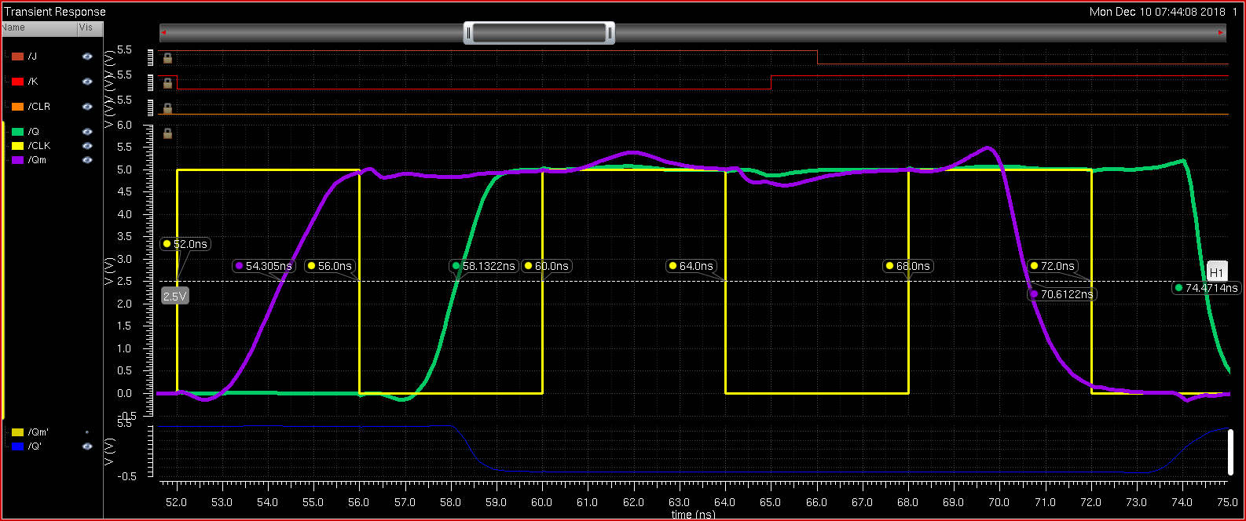
Post-Layout Simulation Input / Output Waveform
Falling Clock Q Rising Delay = tpdr = 2.5132 ns
Slave output rising time is about 0.8932 ns behind the master

Slide 55
Post-Layout Simulation Input / Output Waveform
Falling Clock Q Rising Delay = tpdr = 2.5132 ns
Slave output rising time is about 0.8932 ns behind the master

Slide 56
Post-Layout Simulation Input / Output Waveform
Falling Clock Q falling Delay = tpdf = 2.5132 ns

Slide 57
Post-Layout Simulation Input / Output Waveform
Propagation Delay = tpd = 2.3011 ns where clock cycle is 4 ns
Compared to Simulated Slave Output Delay = 2.8237 ns
And the logical effort calculation of 2.0437 ns

Slide 58
Delay Comparison
 | Time | Units
Layout | 2.3011 | ns
Schematic | 2.8237 | ns
Calculation | 2.0437 | ns
%DIFF | Percent
Layout | -12.87%
Schematic | -39%
Lay -> Schem | +26.13%

Slide 59
Delay Comparison
 | Time | Units
Layout | 2.3011 | ns
Schematic | 2.8237 | ns
Calculation | 2.0437 | ns
%DIFF | Percent
Layout | -12.87%
Schematic | -39%
Lay -> Schem | +26.13%

Slide 60
Delay Comparison
 | Time | Units
Layout | 2.3011 | ns
Schematic | 2.8237 | ns
Calculation | 2.0437 | ns
%DIFF | Percent
Layout | -12.87%
Schematic | -39%
Lay -> Schem | +26.13%

Slide 61
Conclusion
JK Flip-Flops are limited by the speed of the clock.
If the clock is slow, the system delay will increase by the pulse width
At a fast-enough clock, the system will present timing issues other then race
There is a balance between clock and system performance / delay
System delay can be improved with decreased transistors, faster clock, output stabilization, or layout design compacting.

