Slide 1
ML Overview
Generate business value from data
Dr. Fernando Perez Tellez – Spring 2023

Slide 2
Four functions work together
Data Science
Data Engineering
Data Analytics
Business Intelligence

Slide 3
Data Science
DS is the systematic study of the structure and behaviour of data in order to quantifiably understand past and current occurrences, as we as predict the future behaviour of that data.
Typical Traits
Degree in quantitative field, programmers (usually R or Python, SQL)
Curious and tenacious individuals. Interested in why over how
Previous experience: BI reporting, data analysis and data-driven decision making
Uncover correlations and causations in business data
Derive insights from data, including big data
Generate predictions from data (data visualisation)

Slide 4
Data Engineering
DE is the design, construction, and maintenance of data systems
Typical Traits
Programmers (java, C++, Python) with experience in DB architect, ETL developer, etc
Good in maths but not use much statistics
Prefer to design and build IT systems rather than to analyse data
Interested in how over why
Design systems to collect, handle and store datasets
Build modular, scalable platforms for data processing
Design, build and maintain systems that store and move big data

Slide 5
Data Analytics
DA are data products that describe data and how it behaves. The data products are generated from data analysis and visualisation processes.
Typical Traits
Use applications to analyse data
Solid in basic math
Understand the business processes
Use data insights to improve business
Not into deep analysis
Generate predictive, prescriptive, and descriptive data insights
Uncover co-orelations and causations in business data
Deploys analytics technologies

Slide 6
Why to use Python?
It is a high-level, interpreted coding language which is useful for variety of applications
It is easy to learn, human readable
Very well-supported libraries
Very popular programming language (No 1 in google trends)
Alternatives: R, Julia, Go

Slide 7
Machine Learning
Formal definition (Prof. Tom Mitchell 1997):
"A computer program is said to learn from experience E with respect to some class of tasks T and performance measure P, if its performance at task in T , as measured by P improves with experience E"
Improve their performance P
At executing some task T
Over time with experience E

Slide 8
Defining T (Task)
T is the real-world problem to be solved. In ML is best if you define the task as concretely as possible.
A T task can usually be defined as a ML task based on the process or workflow that the system should follow to operate on data points of samples (usually multiple data attributes).
Typical tasks:
Classification or categorisation – classifying images
Regression – predicting house prices
Anomaly detection –find service attacks from logs
Structured annotation – Annotate specific areas of images
Translation, Clustering and Transcriptions

Slide 9
Defining E (Experience)
A learning algorithm typically needs data to learn over time and perform a specific task (T).
The process of consuming a dataset (data samples) such that a learning algorithm or model learns inherent patterns is defined as experience (E) which is gained by the learning algorithm.
Any experience that the algorithm gains is from data samples at any point of time, and it is an iterative process.
The model is an entity just like a human being which gains knowledge or experience through data points by observing and learning more and more.

Slide 10
Defining P (Performance)
ML is supposed to perform a task T, and is gaining experience E, with data points over a period of time. But how do we know if it's performing well ?
Performance P is usually a quantitative measure or metric that's used to see how well the algorithm, or the model is performing the task T, with experience E.
Typical performance measures include accuracy, precision, recall, F1 score, sensitivity, specificity, error rate, misclassification rate between others.

Slide 11
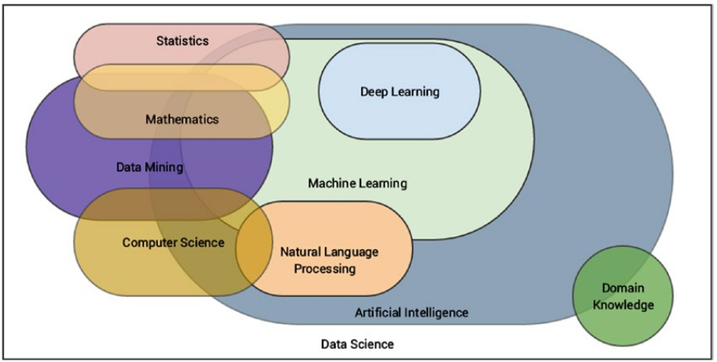
Multi-disciplinary Field
D. Sarkar et al

Slide 12
Machine Learning Methods
Some of the major broad areas of ML methods
Based on amount of human supervision in the learning process
Supervised learning
Unsupervised learning
Semi-supervised learning
Reinforcement learning
Based on the ability to learn from incremental data samples
Batch learning
Online learning
Based on their approach to generalisation from data samples *
Instance based learning
Model based learning

Slide 13
Supervised Learning
They include learning algorithms take in data samples (known as training data) and associated outputs (labels or responses) with each data sample during the model training process.
The main objective is to learn a mapping or association between input data samples X and their corresponding outputs Y based on multiple training data instances.
This knowledge can be used to predict an output Y' for any new input data sample X' which was previously unknown or unseen during the training process.
Supervised Learning methods are of two classes: Classification and Regression.

Slide 14
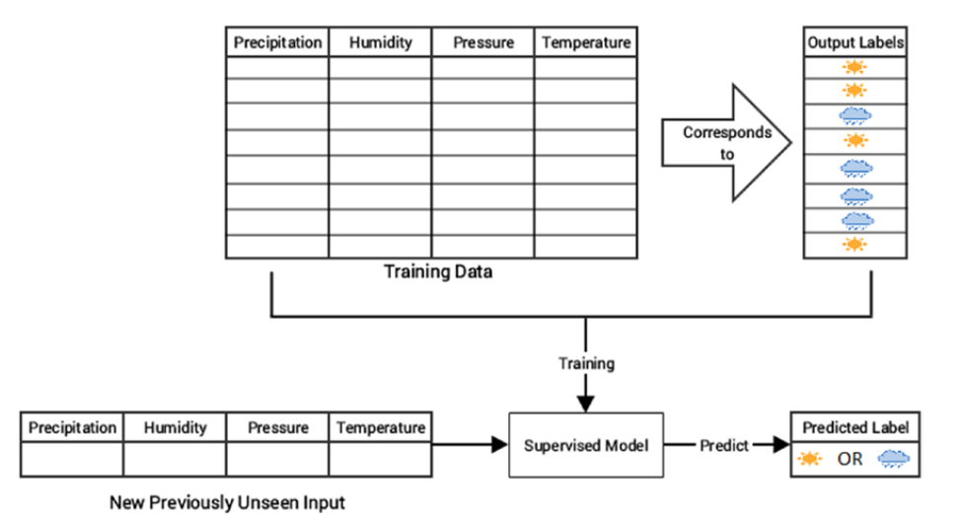
Classification
The key objective of a classification-based task is to predict output labels or responses that are categorical in nature for input data based on what the model has learned in the training phase.

Slide 15
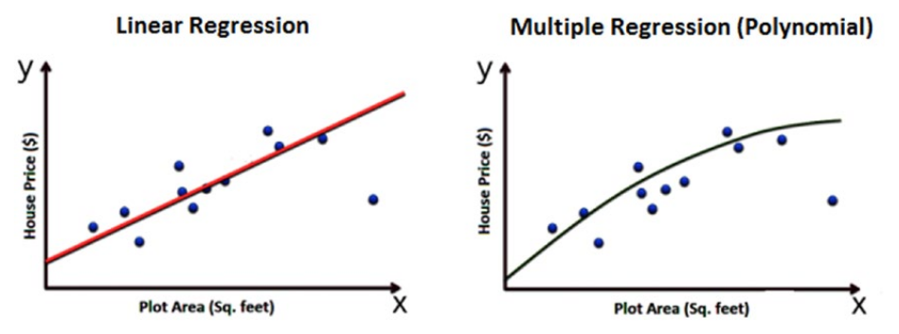
Regression
ML tasks where the main objective is value estimation can be termed as regression tasks.
Regression methods are trained on input data samples having output responses that are continuous numeric values unlike classification, where we have discrete categories or classes.

Slide 16
Unsupervised Learning
Often, we do not have the liberty or advantage of having labelled training data and we still want to extract useful insights or patterns form data. Unsupervised learning methods are extremely useful.
These algorithms try to learn inherent latent structures, patterns and relationships from given data without any help or supervision.
Unsupervised learning methods can be categorised under these broad areas: Clustering, Dimensionality reduction, Anomaly detection, Association rule-mining.

Slide 17
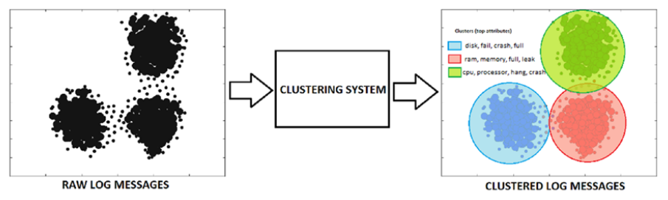
Clustering
These methods try to find patterns of similarity and relationships among data samples in a dataset and then cluster these samples into various groups, such that each group of data has some similarity, based on the inherent attributes or features.
Clustering methods are completely unsupervised, they try to cluster data by looking at the data features without any prior training, supervision, or knowledge about data attributes, associations or relationships.

Slide 18
Dimensionality Reduction
Extracting attributes or features from raw data samples, sometimes the feature space gets bloated up with a huge number of features. This can cause multiple challenges including analysing and visualising data.
Thousands or millions of features makes the feature space extremely complex posing problems with regard to training models, memory and space constraints.
These methods reduce the number of feature variables by extracting or selecting a set of principal or representative features.

Slide 19
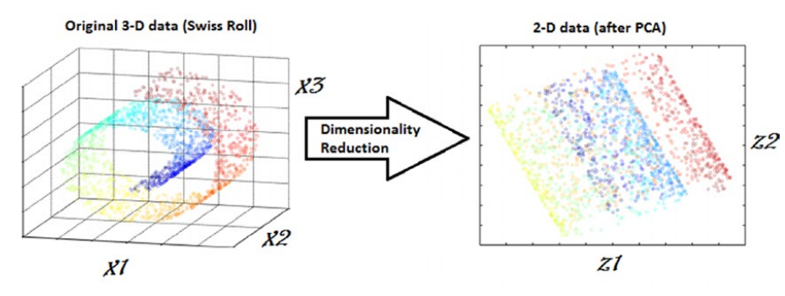
Dimensionality Reduction
Popular algorithms: Principal Component Analysis, Discriminat analysis, etc.
Dimensionality reduction techniques can be classified in two major approaches as follows:
Feature Selection Methods
Feature Extraction Methods

Slide 20
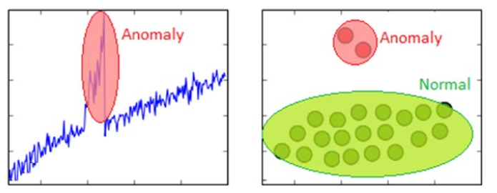
Anomaly Detection
Also known as outlier detection, where we are interested in finding out occurrences of rare events or observations that do not occur normally based on historical data.

Slide 21
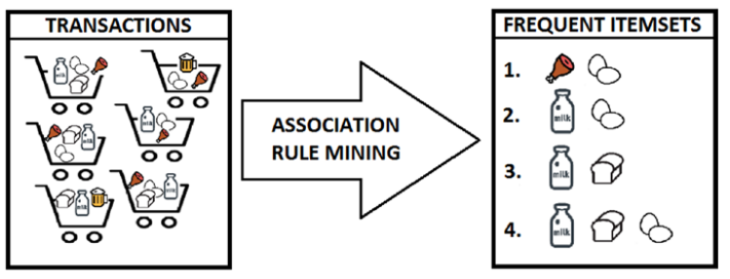
Association Rule-mining
It is a data mining method used to examine and analyse large transactional datasets to find patterns and rules of interest. These patterns represent interesting relationships and associations, among various items across transactions.
It is also known as market basket analysis, which is used to analyse customer shopping patterns.

Slide 22
Semi-supervised Learning
These methods usually use a lot of training data that is unlabelled (unsupervised learning component) and a small amount of pre-labelled data (supervised learning component).
Many techniques are available in the form of generative methods, graph-based methods, and heuristic based methods.
This approach is used in many image tagging systems.

Slide 23
Reinforcement Learning
In this case, there is an agent that is trained over a period of time to interact with a specific environment and improves its performance over a period of time with regards to the type of actions it performs on the environment.
The agent starts with a set of strategies or policies for interacting with the environment then on observing the environment, it takes a particular action based on a rule or policy.
Based on the action, the agent gets a reward which could be beneficial or detrimental in the form of a penalty.

Slide 24
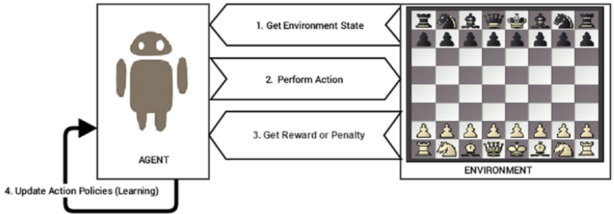
Reinforcement Learning
The main steps of a reinforcement learning method are:
Prepare agent with set of initial policies and strategy
Observe environment and current state
Select optimal policy and perform action
Get corresponding reward or penalty
Update policies if needed
Repeat step 2-5 iteratively until agent learns the most optimal policies

Slide 25
Batch Learning
Usually known as offline learning methods, these methods are used in end-to-end ML systems where the model is trained using all the available training data in one go. The model is trained in one batch.
When the training is done, the model is deployed into production where it predicts outputs for new data samples.
The model does not keep learning over a period of time with the new data.

Slide 26
Online Learning
The training data is usually fed in multiple incremental batches to the algorithm (also known as mini batches).
The training process keeps learning over a period of time based on new data samples which are sent to it for prediction.
It predicts and learns in the process with new data on the fly without having to re-run the whole model on previous examples.
One of the challenges of online learning methods is the fact that bad data samples can affect the model performance adversely. It can start learning relationships and patterns that have no real significance.

Slide 27
The CRISP-DM Process Model
CRoss Industy Standard Process for Data Mining

Slide 28
CRISP-DM
A robust industry standard process model followed for data mining and analytics projects.
It depicts necessary steps, processes, and workflows for executing any project right from formalising business requirements to testing and deploying a solution to transform data into insights.
There are six major steps or phases for building an end-to-end solution for any analytics project or system

Slide 29
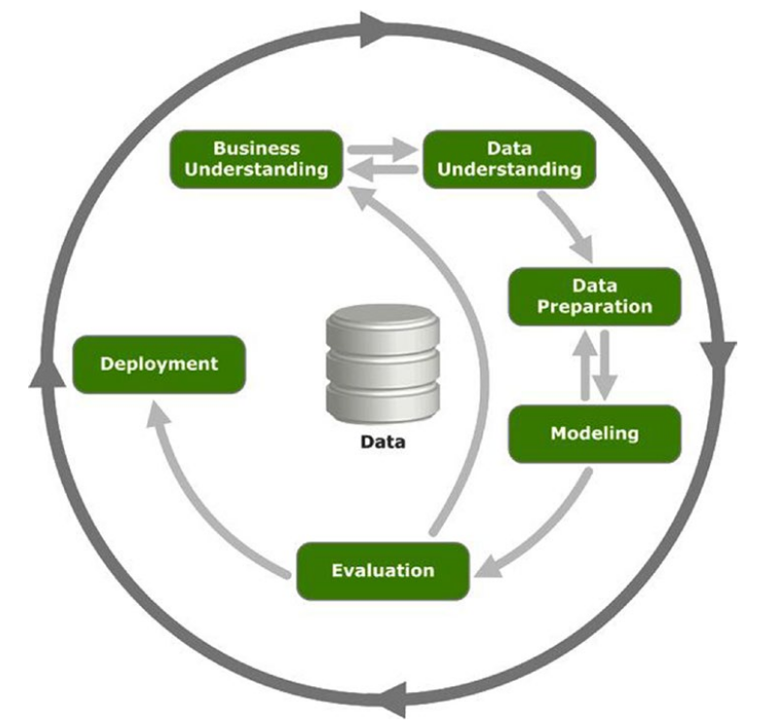
CRISP-DM
D. Sarkar et al
Notes:
Business Understanding: Define Business Problem, Asses and Analyse Scenarios, Define Data Mining Problem, Project Plan
Data Understanding: Data Collection, Data Description, Exploratory Data Analysis, Data Quality Analysis
Data Preparation: Data Integration, Data Wrangling, Attribute Generation and Selection
Modelling: Selecting Modelling Techniques, Model Building, Model Evaluation and Tuning, Model assessment
Evaluation
Deployment

Slide 30
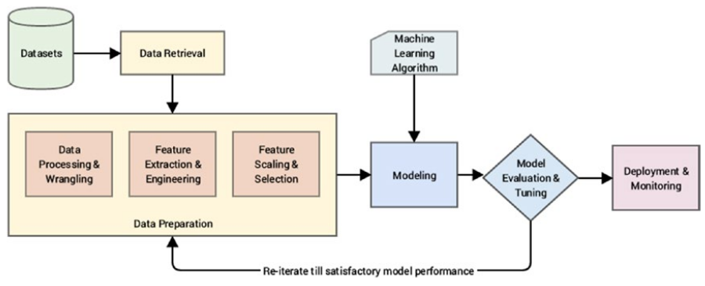
Standard ML Pipeline
Usually, a good way to solve a real-world ML problem is to use a ML pipeline:
D. Sarkar et al

Slide 31
Questions?
fernando.pereztellez@tudublin.ie

