Slide 1
Group 15: The Babybels THE GRANDE PICTURE By: Zaur*, Sean, Bo, Oscar
Welcome to our presentation for our Dublin Bustlin’ App!
*Author of Presentation 1: Big Picture

Slide 2
TABLE OF CONTENTS
01
03
02
04
Overview
Implementation
Our idea
Further Thoughts

Slide 3
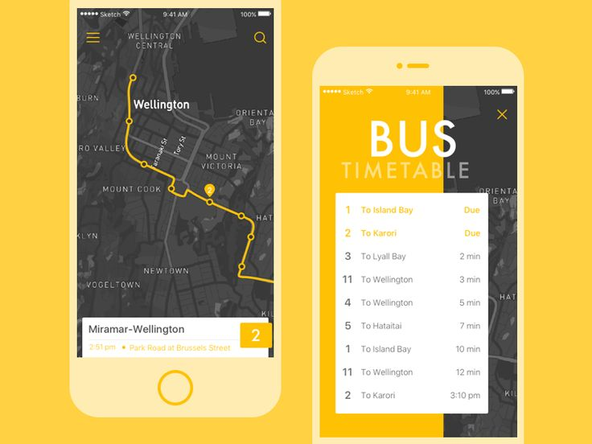
INTRODUCTION
Bus travel time is determined by several factors such as day, weather and time
Current models are not as accurate as can be, and new interventions in ML allow for better optimised modelling
The everchanging variables can make it hard for urban planners to accurate predict things
Current models do integrate GPS and weather, and we plan to also utilize these in order to develop a better travel predictor application
Our aim is to reduce anxieties and stress related to missing bus routes and arriving late

Slide 4
—Peter Drucker
“The best way to predict the future, is to create it”

Slide 5
01
OVERVIEW

Slide 6
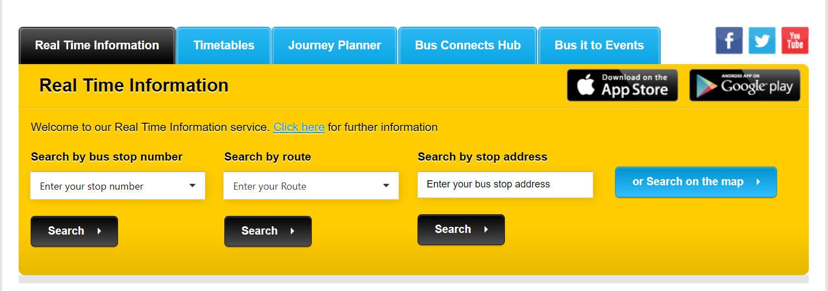
Overview
217 million passenger journeys were provided by Dublin Bus in 2017 (CSO 2019)
Our goal is to analyze bus routes and combine with weather data to create a model that will give us some estimates. This will be done for every start-to-stop route/journey, e.g., 17 bus route from UCD to Citywest.
The design of the app will be simple, accessible and contain minimal features necessary to get the user an accurate estimate of how long bus X will arrive at stop Y. Any extra features will be documented in our LaTeX report.
https://www.cso.ie/en/releasesandpublications/ep/p-tranom/transportomnibus2017/publictransport/

Slide 7
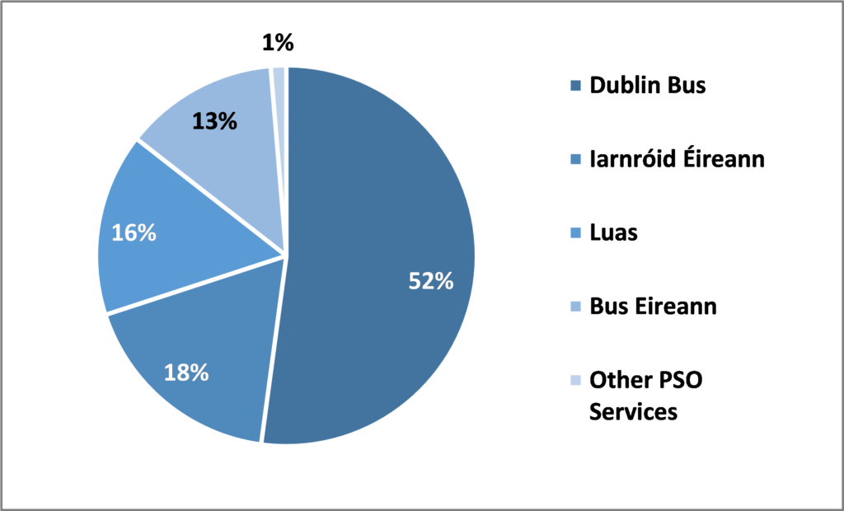
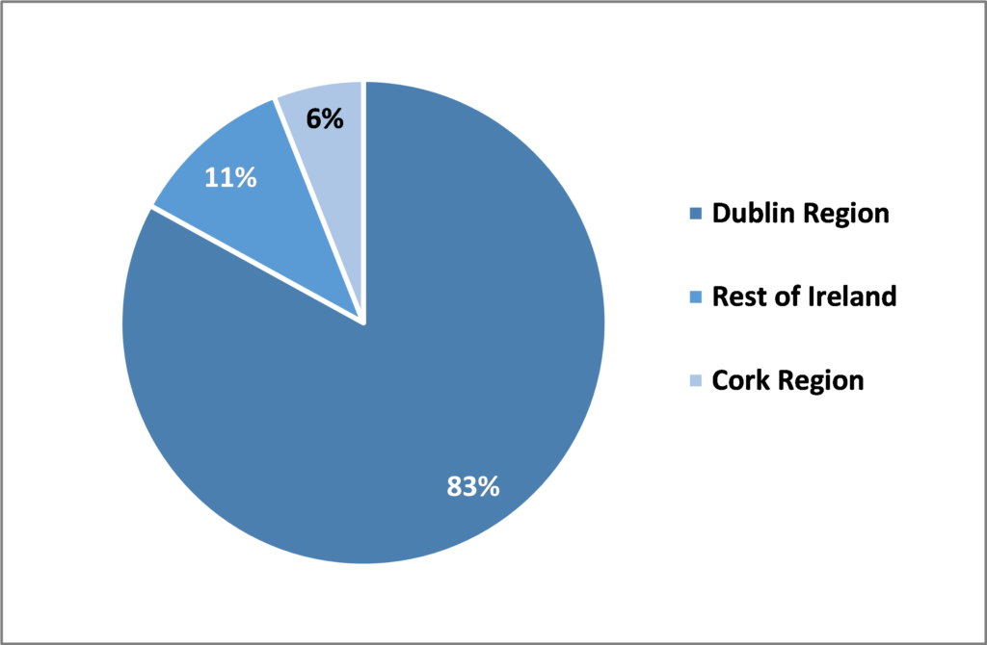
How popular is Dublin Bus?
Figure 1: PSO Passenger Journeys by Operator, 2018
Figure 2: PSO Passenger Journeys by Region, 2018
https://publicpolicy.ie/papers/the-utility-of-public-transport-in-ireland-post-covid-19-lockdown-and-beyond/

Slide 8
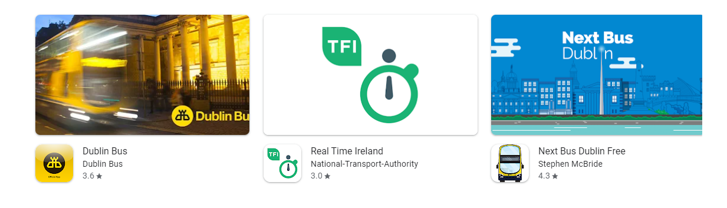
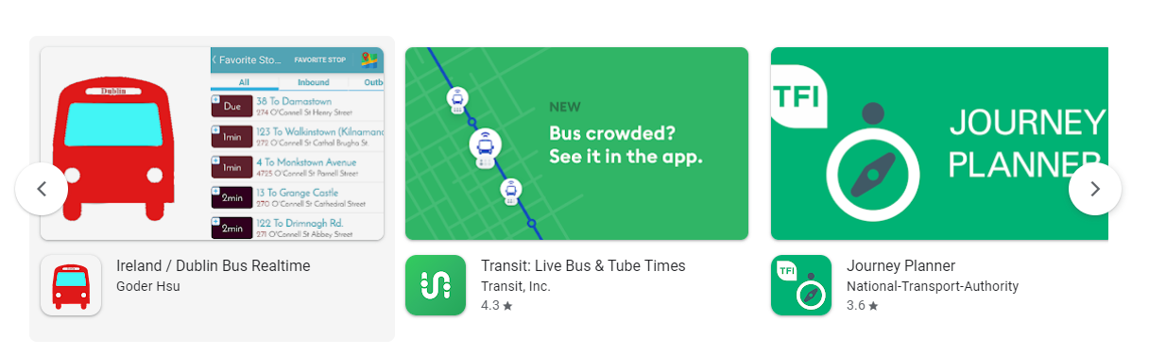
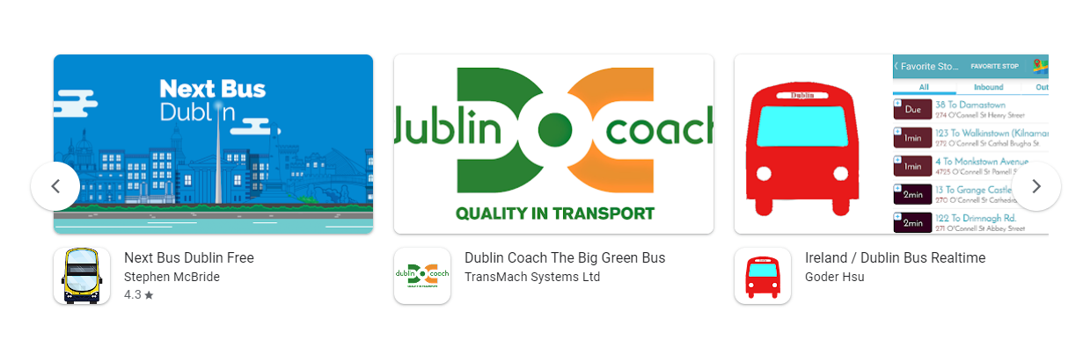
Current Apps in Market:
SS taken from Play Store (2022)
Features
GPS location tracking
Favourite route/bus select/save option
Gives estimate in minutes
Plans journeys in advance
Syncs to phone locally

Slide 9
Proposed Idea (Not Finalised)
Step 1
Step 2
Step 3
Step 4
Step 5
Step 6
User opens the web app
Automatic capture of location, displaying nearest stop (and buses at stop)
User enters the stop they wish to go to
Information displays 1) time of arrival of bus, 2) time to go from A to B
User can save as fav stop or bus number
User can reset the search

Slide 10

Work Channels
Work style
GitHub, Trello, WhatsApp, Discord, Zoom, Meet & YouTrack
Scrum meetings every 2nd day and an AGILE metholodgy

Slide 11

A PICTURE IS WORTH A THOUSAND WORDS

Slide 12
02
Our Idea

Slide 13
OVERVIEW DIAGRAM
User Interaction
Flask
Architecture
Data Analytics
APIs
Web Application
mySQL, JavaScript, Python, CSS/HTML5
Proposed*
Machine Learning Models (Random Forest + Linear Regression)
Google Maps, OpenWeather

Slide 14





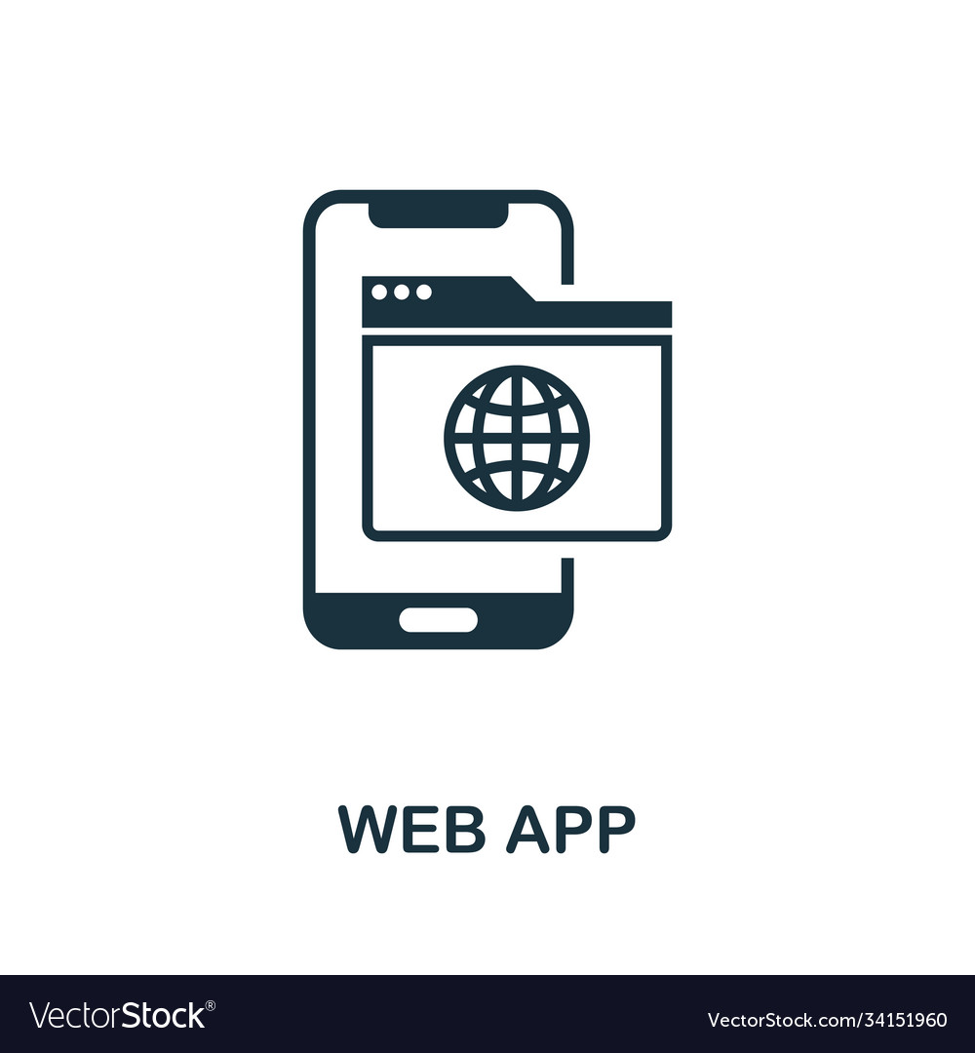



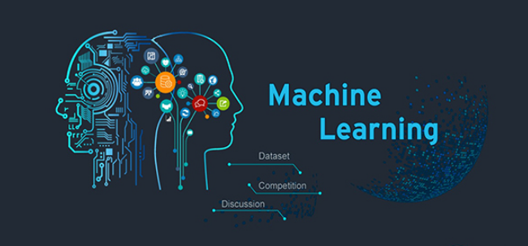




Roadmap
Front End: FLASK/JS/CSS/HTML
Back End: Python/ML/JupyterNotebooks
Infrastructure: mySQL/UCD VM/APIs/Scrapers
End User

Slide 15
Scrum (SPRINTS) – Proposed Timelines
Sprint 2
Sprint 4
06/05 – 21/05
21/05-10/06
10/06-31/06
31/06-15/07
Sprint 1
Sprint 3

Slide 16
03
Implementation

Slide 17
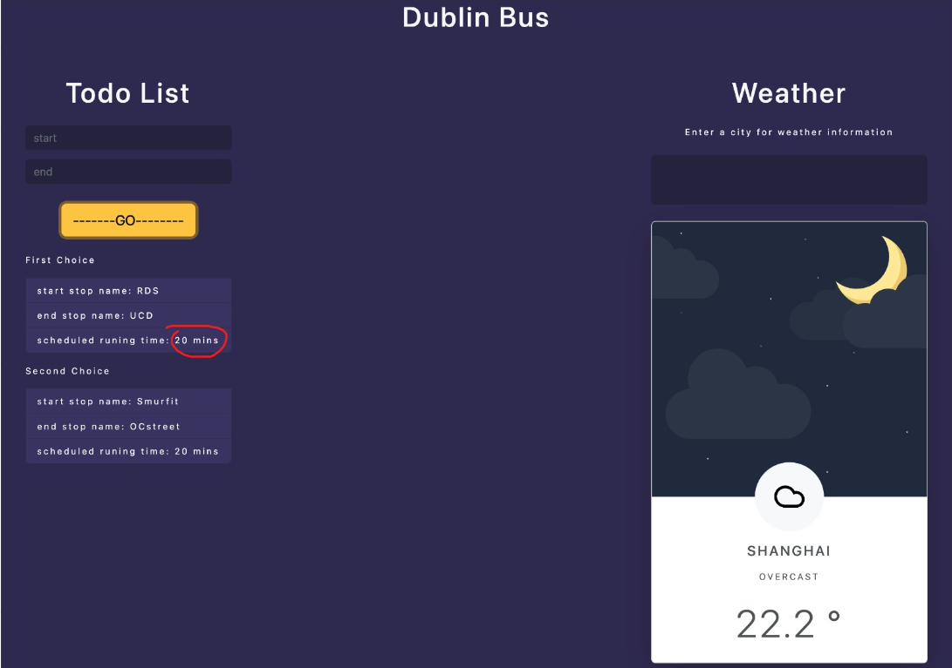
UI prototypes

Slide 18
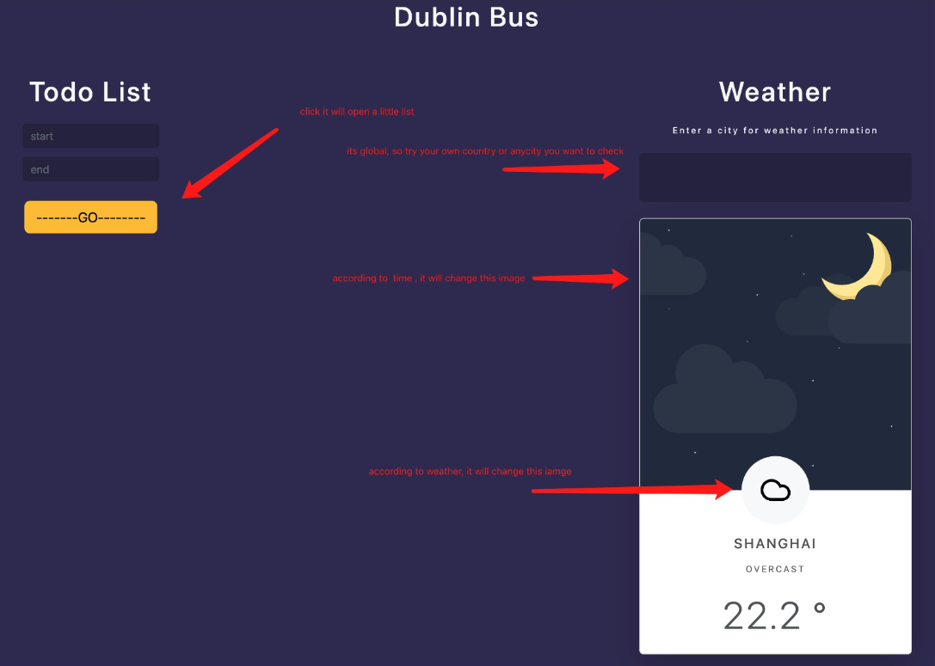
UI prototypes

Slide 19
04
Further Thoughts

