Slide 1

Bulud Texnologiyaları
Rovshan Musayev
NN Group, DevOps Engineer in AWS
Cari proyekt: Serverless SelfService framework

Slide 2
Ümumi baxış
Cloud computing is the delivery of on-demand computing services -- from applications to storage and processing power -- typically over the internet and on a pay-as-you-go basis.
Cloud computing advantages and disadvantages
Cloud computing is not necessarily cheaper than other forms of computing, just as renting is not always cheaper than buying in the long term.
Cloud computing migration costs
For start-ups who plan to run all their systems in the cloud getting started is pretty simple. But the majority of companies it is not so simple: with existing applications and data they need to work out which systems are best left running as they, and which to start moving them to cloud infrastructure. This is a potentially risky and expensive move, and migrating to the cloud could cost companies more if they underestimate the scale of such projects.

Slide 3
Əsas xüsusiyyətləri
Security
On demand self-service
Compatibility
Better team work
Elasticity
Reliability
Nil investment
Disaster Recovery
Updates

Slide 4
Müqayisə
Süd içmək üçün gedib inək alıb saxlayırsan? ☺

Slide 5
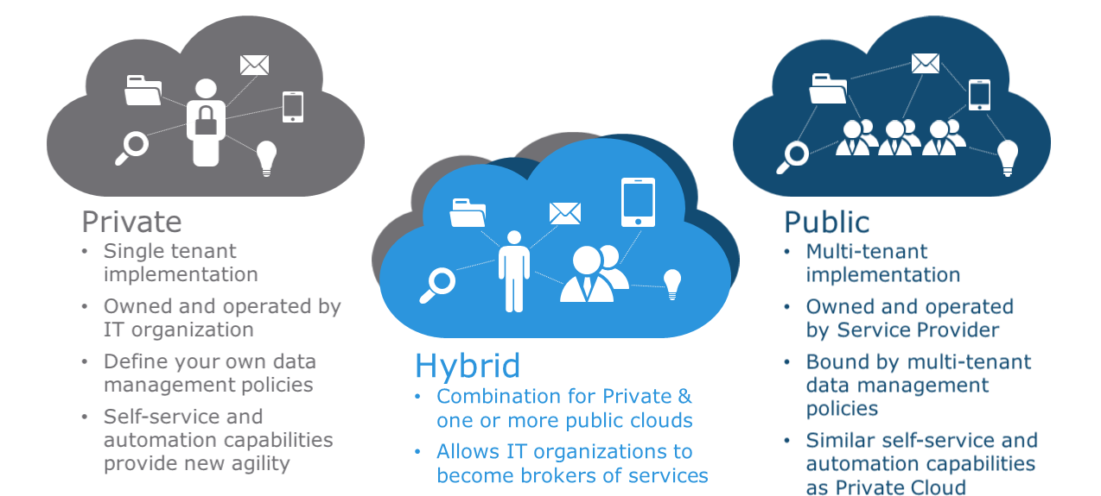
Tipləri

Slide 6
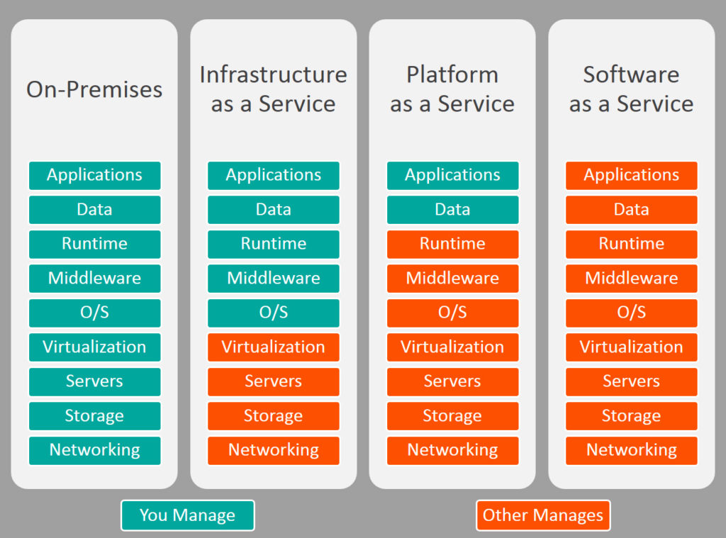
Kateqoriyaları

Slide 7
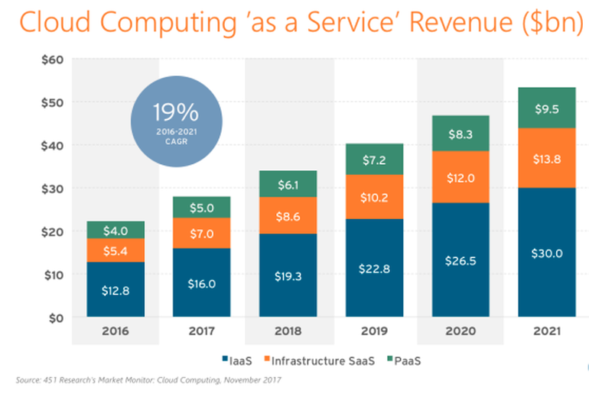
Tendensiya

Slide 8
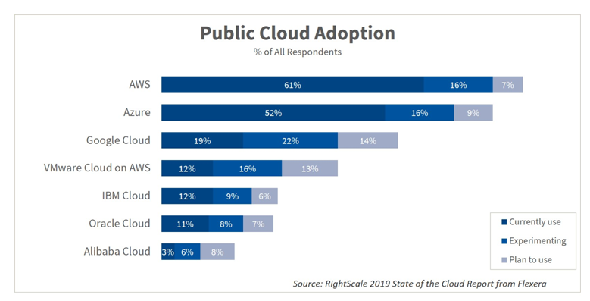
Tendensiya

