Slide 1
0-to-hero
08/10 Mentors <> 08/10 Sessions

Slide 2



Vugar Gasimov
Software developer
Notes:
1. https://www.linkedin.com/in/vugargasimov/
2. https://www.helmes.com/careers/
3. https://medium.com/codestoyevsky-az
4. https://www.facebook.com/Codestoyevsky/

Slide 3



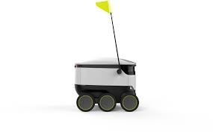






Relocate to Estonia
https://www.workinestonia.com/
https://studyinestonia.ee/en
Notes:
https://www.lift99.co/blog/fastest-growing-estonian-startups-2018
https://devhunt.ee/
http://cv.ee
https://jobbatical.com/
https://meetfrank.com/
https://www.youtube.com/channel/UCWVjpu-NkHTaQW1dNanFseA
https://www.linkedin.com/pulse/c%C9%99nn%C9%99ti-estoniya-vuqar-qasimov/

Slide 4
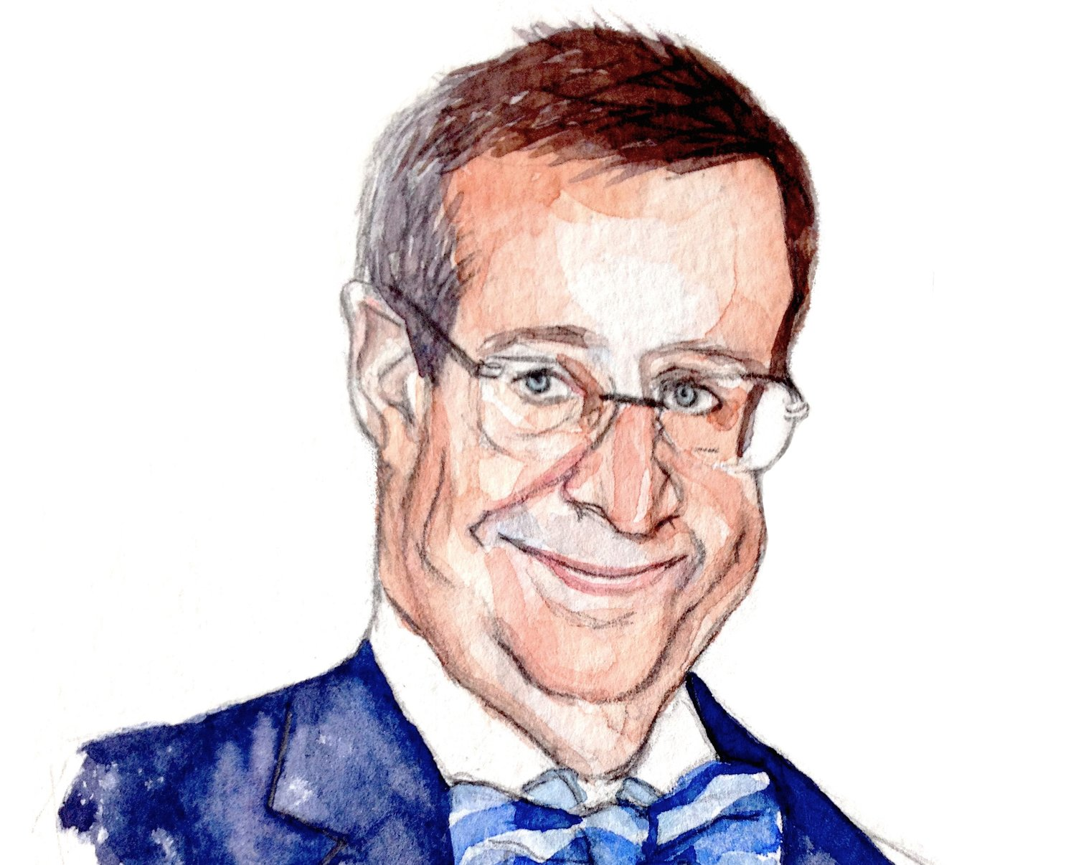
The Most Digitally Savvy Country on Earth
Notes:
https://www.youtube.com/watch?v=a5dRiEYtmHo
https://en.wikipedia.org/wiki/Toomas_Hendrik_Ilves
Savvy = fərasət

Slide 5
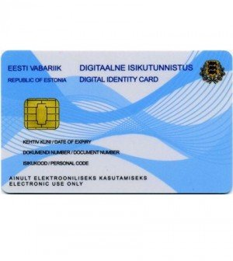
E-Residency
Notes:
https://e-resident.gov.ee/
https://www.facebook.com/eResidentsInAzerbaijan/

Slide 6
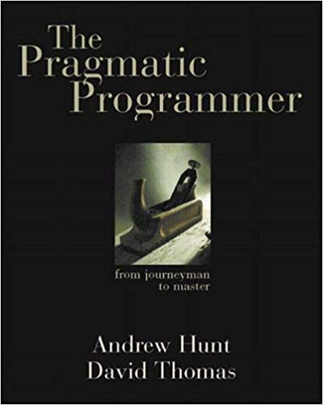
The Pragmatic Programmer: From Journeyman to Master
Notes:
https://www.amazon.com/Pragmatic-Programmer-Journeyman-Master/dp/020161622X
https://blog.codinghorror.com/a-pragmatic-quick-reference/
https://pragprog.com/book/tpp20/the-pragmatic-programmer-20th-anniversary-edition

Slide 7
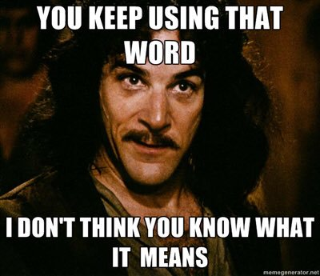
Pragmatic (adjective) dictionary meaning
Dealing with things sensibly and realistically in a way that is based on practical rather than theoretical considerations.

Slide 8
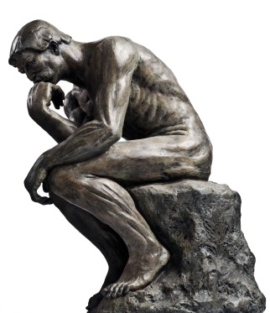
A Pragmatic Philosophy

Slide 9

Think
Ponder the problem before jumping in
Research
Plan
Discuss
Estimate
Don’t be a slave to formal methods
Notes:
Ponder = fikirləşmək
https://toggl.com/developer-methods-infographic/

Slide 10
Care about your craft
Take pride in your work
If you don’t enjoy your profession, you’ll never be great in it
If you do enjoy your work, you’ll also enjoy the process of getting better at it (mostly!)
Learning never ends!
Notes:
https://www.goodreads.com/author/quotes/1791.Seth_Godin
https://en.wikipedia.org/wiki/Seth_Godin

Slide 11
Provide options, don’t lame excuses
Some things can’t be done on time, others can’t be done at all
Don’t focus on what cannot be done
Concentrate on what can be done instead
Find solutions to problems
In “The War Against the Chtorr,” David Gerrold distinguishes between “guests” and “hosts”
A “host” does whatever needs to be done
A “guest” figures that it’s someone else’s job
Notes:
Host = ev sahibi
Guest = Qonaq
Lame = topal

Slide 12
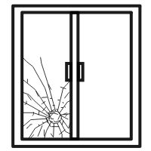
Don’t live with broken windows
If something is wrong, fix it
If you can’t get to it immediately, at least mark it for future work
Take some action to prevent further damage
Small problems accumulate and turn your code into crap

Slide 13
Software entropy
Entropy: Amount of disorder in system.
Law of thermodynamics: Entropy tends to increase in system. Similar thing happens in software system, in result software rot happens. How to stop it ?
A spoonful of wine in a barrel of sewage gives you a barrel of sewage
A spoonful of sewage in a barrel of wine gives you a barrel of sewage
Notes:
Rot = çürümək

Slide 14

Take responsibility
One of the cornerstones of the pragmatic philosophy is the idea of taking responsibility for yourself and your actions in terms of your career advancement, your project, and your day-to-day work.
A Pragmatic Programmer takes charge of his or her own career, and isn't afraid to admit ignorance or error.
It's not the most pleasant aspect of programming, to be sure, but it will happen—even on the best of projects.
Despite thorough testing, good documentation, and solid automation, things go wrong. Deliveries are late. Unforeseen technical problems come up.

Slide 15
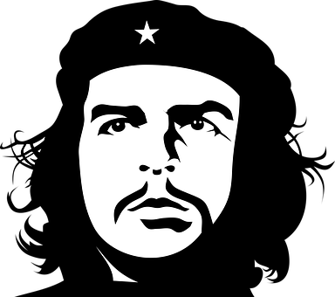
Be a Catalyst for Change
You can't force change on people. Instead, show them how the future might be and help them participate in creating it.

Slide 16

Remember the Big Picture
Don't get so engrossed in the details that you forget to check what's happening around you.
Don't be like the frog. Keep an eye on the big picture. Constantly review what's happening around you, not just what you personally are doing
Notes:
https://en.wikipedia.org/wiki/Boiling_frog

Slide 17

Invest regularly in your knowledge portfolio
Learn at least one new language every year
Read a technical book each quarter
Read nontechnical books, too
Take classes
Participate in local user groups
Experiment with different environments
Stay current
Get wired
Notes:
https://www.udemy.com/
https://www.pluralsight.com
https://acloud.guru/
https://www.infoq.com/
https://www.quora.com/
https://www.glassdoor.com
https://www.brentozar.com/
https://www.hanselman.com/

Slide 18
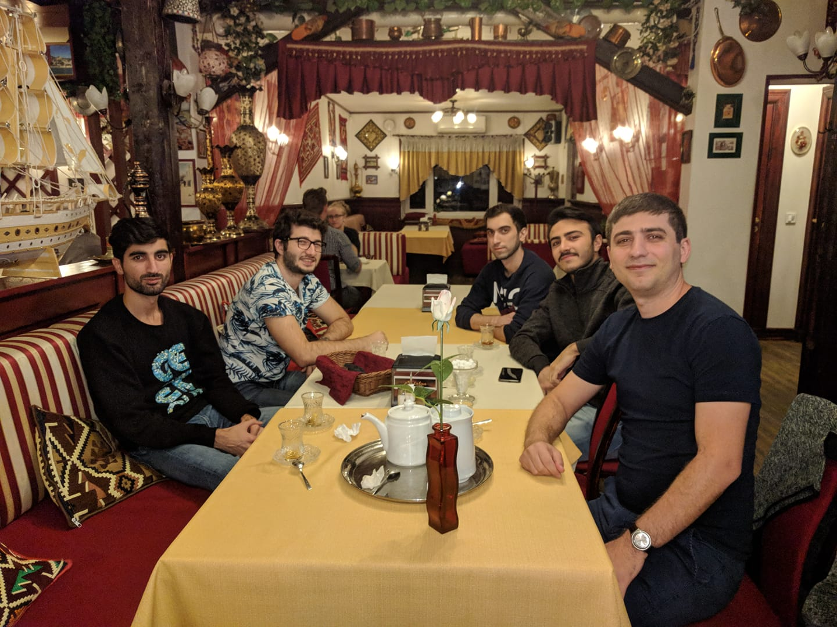
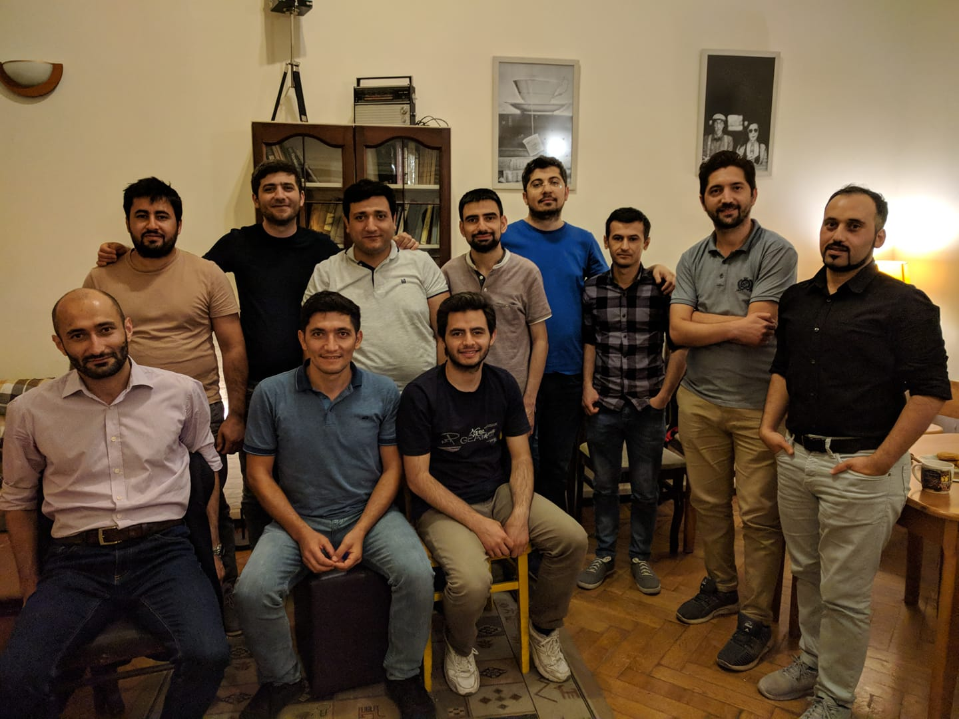
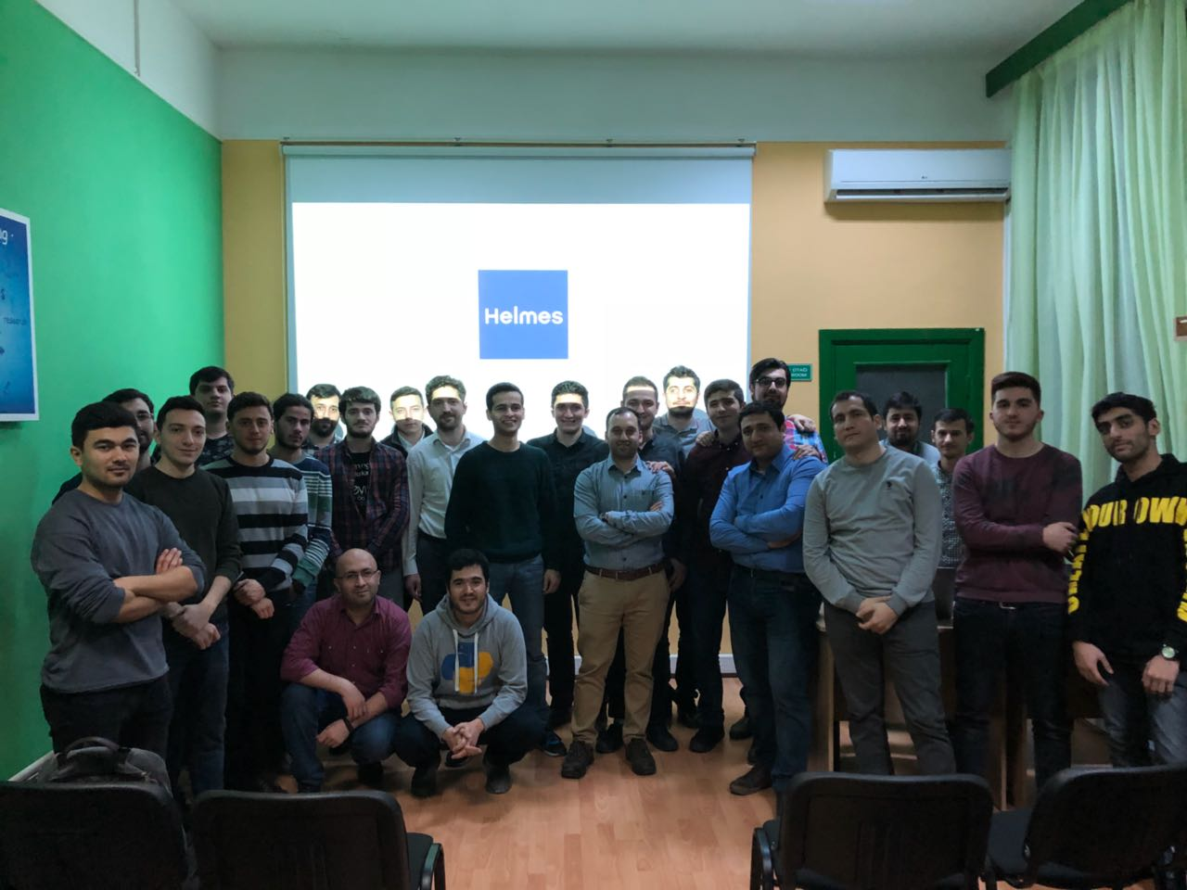
Notes:
Participate in local user groups

Slide 19

Coding
Participate in open-source
10,000 hours rule (~416 days)
Modify and learn from other people’s code
Teach
Notes:
https://www.nopcommerce.com/

Slide 20
Egoless programming
Software belongs to the organization, not the individual
You don’t “own” your code
The idea is that if you have an emotional interest in your code, you will resist criticism
Don’t take criticism of your program as personal criticism

Slide 21

Basic tools
Keep knowledge in plain text
Use the power of command shells
Use single editor well
Always use source code control
Learn branching strategies
Don’t fear code generation
Know your tools well, try to use shortcuts
Use Bug, issue, project tracking tools
Databases
Use dual monitors
Take care of your posture
CI/CD
Notes:
https://docs.microsoft.com/en-us/visualstudio/ide/default-keyboard-shortcuts-in-visual-studio?view=vs-2019
https://www.jetbrains.com/student/
https://github.github.com/training-kit/downloads/github-git-cheat-sheet.pdf

Slide 22
Bend, Or Break
Minimize coupling
Configure, don’t integrate
Separate views from models
Make it easy to reuse
Reversibility: There are no final decision!
Domain languages: Program close to the domain language
Estimate to avoid surprises
Learn OOP, SOLID, DRY, YANGI principles
Learn design patterns
Notes:
https://en.wikipedia.org/wiki/SOLID
https://en.wikipedia.org/wiki/You_aren%27t_gonna_need_it
Bend = əymək

Slide 23
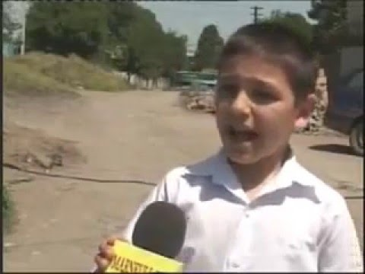
When you should refactor
Duplication
Non-Orthogonal design
Outdated knowledge – Things change, code needs to keep up
Don’t repeat yourself
Write -500 lines of code
Refactor for reuse
Notes:
https://youtu.be/nmxjhIcNFP8

Slide 24

Any program can be improved
There are few, if any, perfect programs
Always be ready to rewrite your program to make it better
But know when to stop!
Rewriting and re-designing your program is sometimes called refactoring
Perfect is enemy of good
80% of IT Software Projects FAIL

Slide 25
Test Early, Test Often
Unit tests
Integration tests
Performance tests
Usability tests
Nobody does enough
“SELECT” is not broken!!!

Slide 26
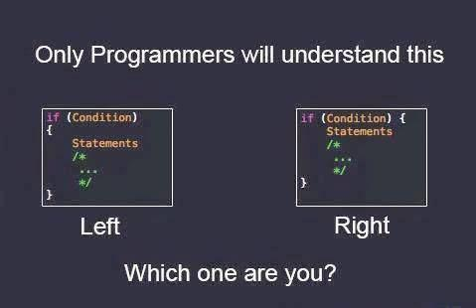
Opinionated Programming
Naming conventions and coding standards
Use Editor Config
Good naming
Use enumeration
If vs. Select Case
Be m master debugger
Use exception
Comment effectively
Shy code
Test coverage
Notes:
https://editorconfig.org/

Slide 27

Write
English* is just programming language
Documentation
Communication
Notes:
https://www.cambly.com/english?lang=en
https://youwillspeak.az/

Slide 28
It’s both what you say and the way you say it
Communication is important—more important than programming itself
How you present your program usually matters more than how good your program is
Make it look good
Use spell checkers
Learn something about good design
Good communication (and documentation) is essential for working in a team
Every piece of e-mail is a permanent record
Notes:
https://www.twilio.com/docs/api

Slide 29
What makes a Pragmatic programmer?
Easy adopter / fast adapter
Inquisitive – You tend to ask questions
Critical thinker – You rarely takes the things as given
Realistic – This gives you a good feel for how difficult things are
Jack of all trades – You try to be familiar with a broad range of techs and environments
Notes:
Inquisitive = hər şeyi bilmək istəyən

Slide 30
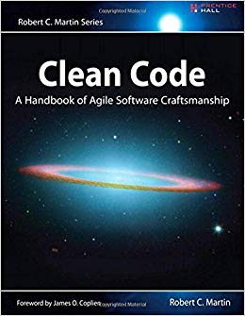
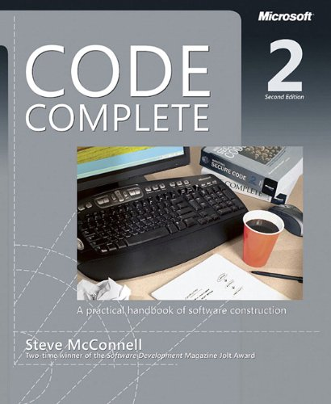
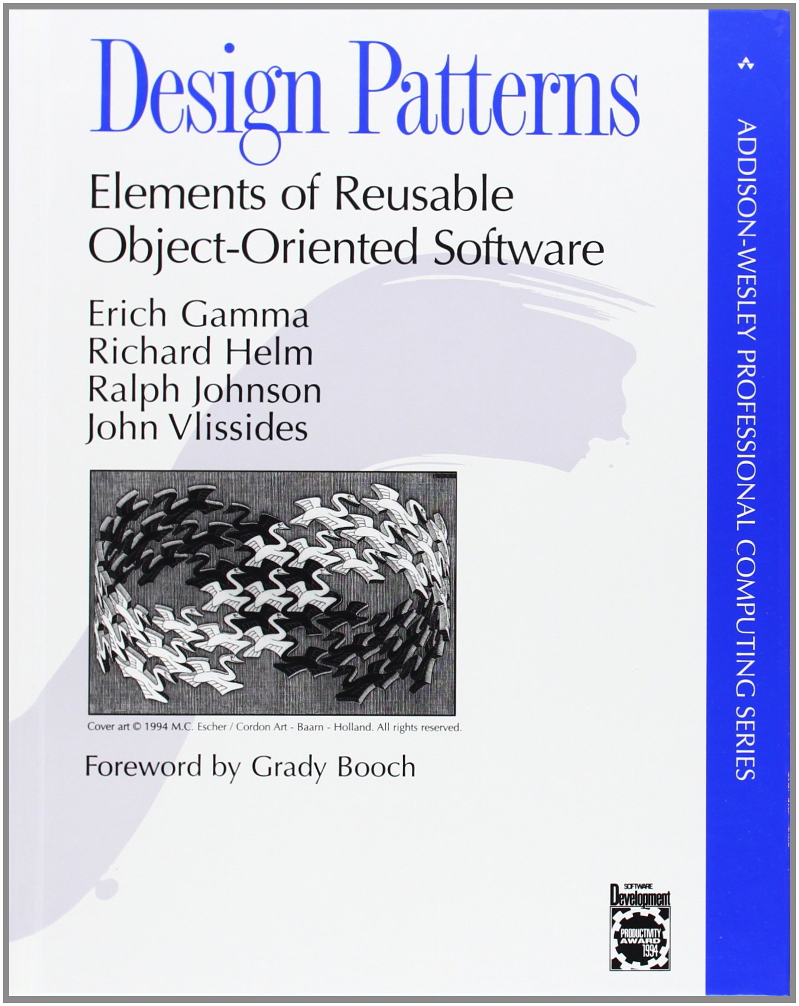
Books to read
Notes:
https://refactoring.guru/design-patterns/csharp

Slide 31

END

