Slide 1
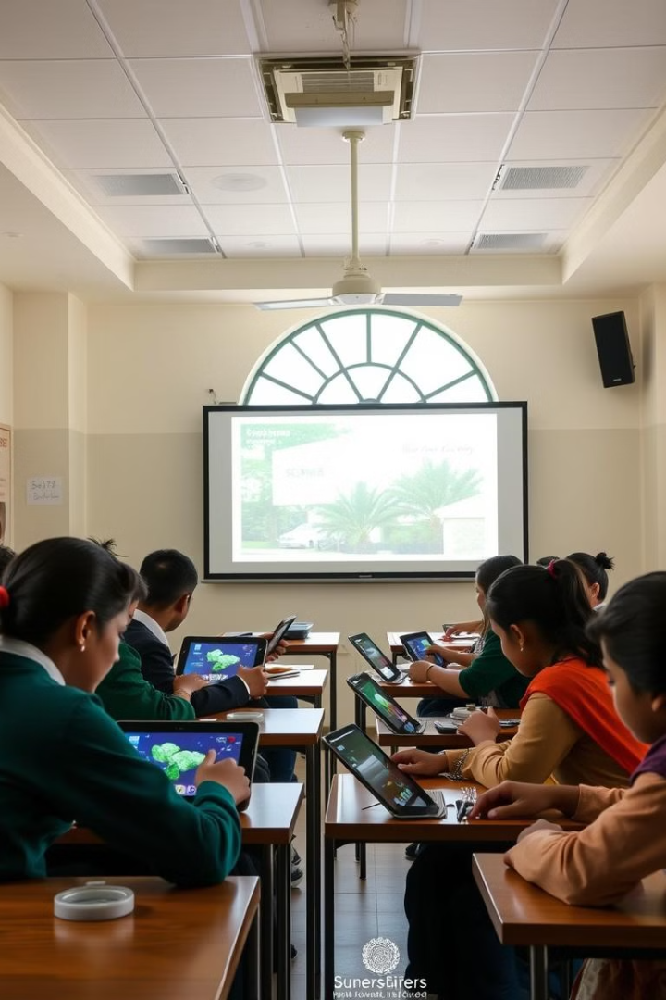

AI-Powered Educational Content Generation System for Karnataka State Board Science Syllabus
This presentation outlines the development of an AI-driven system to generate comprehensive educational content tailored for 6th and 7th-grade students following the Karnataka State Board Science syllabus. The system addresses the need for efficiently creating syllabus plans, question papers, assignments, and in-depth topic explanations, ensuring alignment with NCERT standards and providing educators with a valuable resource to enhance teaching and learning. This AI-powered tool aims to streamline content creation, making it more accessible and adaptable to individual student needs.
by Gourab Singh

Slide 2
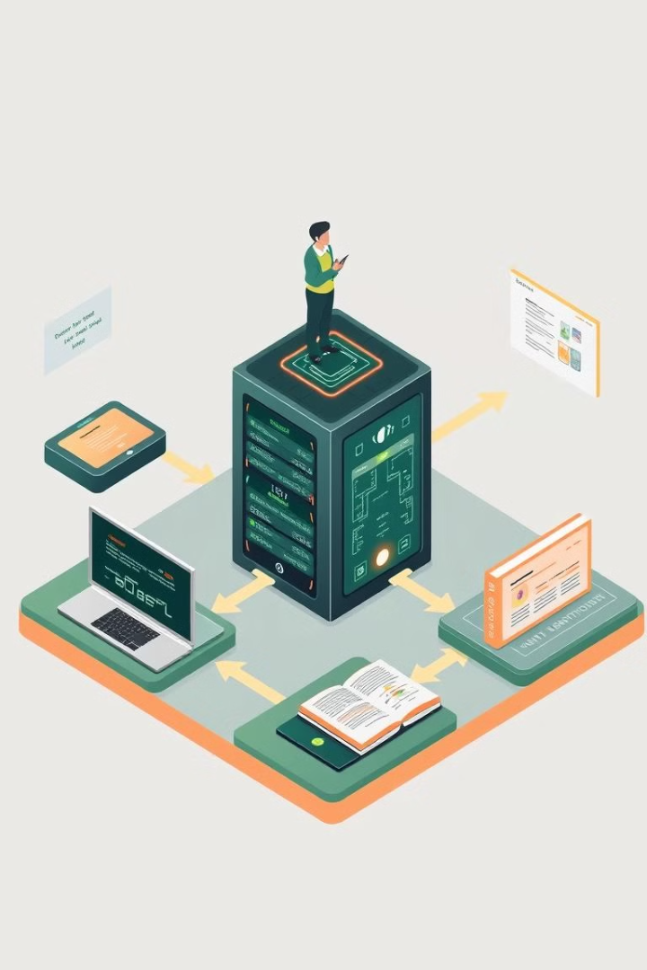
Solution Approach: AI-Driven Content Generation Workflow
1
Textbook Upload & Extraction
The process begins with uploading the textbook in PDF format. The system extracts text, divides it into manageable chunks, and stores it in a vector database for efficient retrieval.
2
Content Type Selection
Users specify the type of content needed—syllabus plan, question paper, assignment, or topic explanation—tailoring the output to their specific requirements.
3
Difficulty Level Assignment
For assignments and question papers, users can select the difficulty level (Easy, Medium, Hard), ensuring the content is appropriately challenging for the students.
4
Content Retrieval & Generation
Relevant content is retrieved using embeddings, and Gemini AI generates structured educational content, which can then be displayed and downloaded by the user.

Slide 3
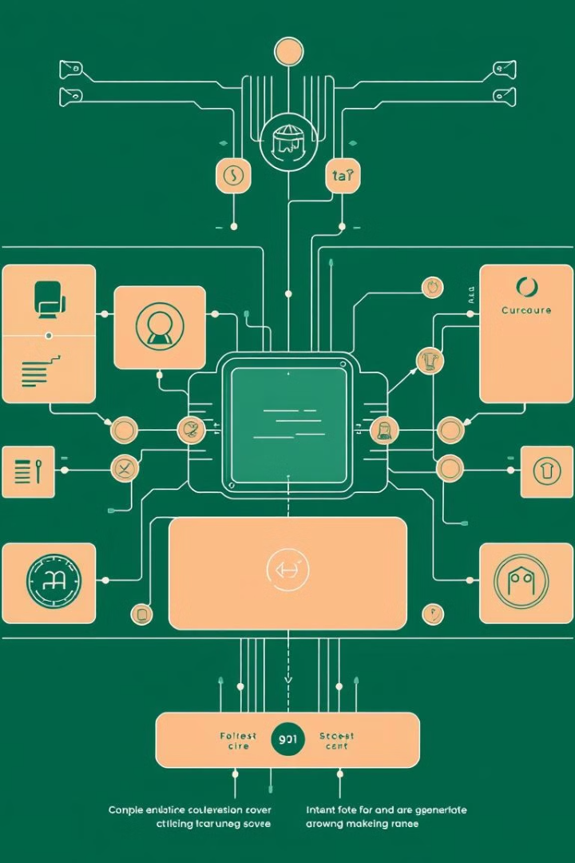
System Architecture: A Modular Design for Scalability
User Interface (Streamlit)
A user-friendly interface built with Streamlit allows educators to effortlessly upload PDFs and select content generation options.
Text Processing
This module extracts and chunks text from uploaded PDFs, subsequently storing embeddings for efficient information retrieval.
Vector Database
Leveraging FAISS or ChromaDB, the system ensures rapid content retrieval, enhancing overall performance.
AI Content Generation
Powered by Gemini AI, this module is responsible for generating high-quality, structured educational materials aligned with syllabus requirements.

Slide 4





Data Flow: From Upload to Downloadable Content
PDF Upload
Text extraction & chunking
Vector Database Storage
(FAISS/ChromaDB)
User Query Processing
& Embedding Matching
Gemini AI Generation
Educational Content
Display & Download
Output in Streamlit

Slide 5

Vector Database
Or
Embedding store
Text Book
Chunking and Embedding Generation
Semantic search for user’s embedding in our database
User’s Query
Embedding Generation
Similar chunk’s embedding related to user’s query
LLM
LLM Response
Or
Output
Embedding + Similar chunks(Single/Multi Page)

Slide 6
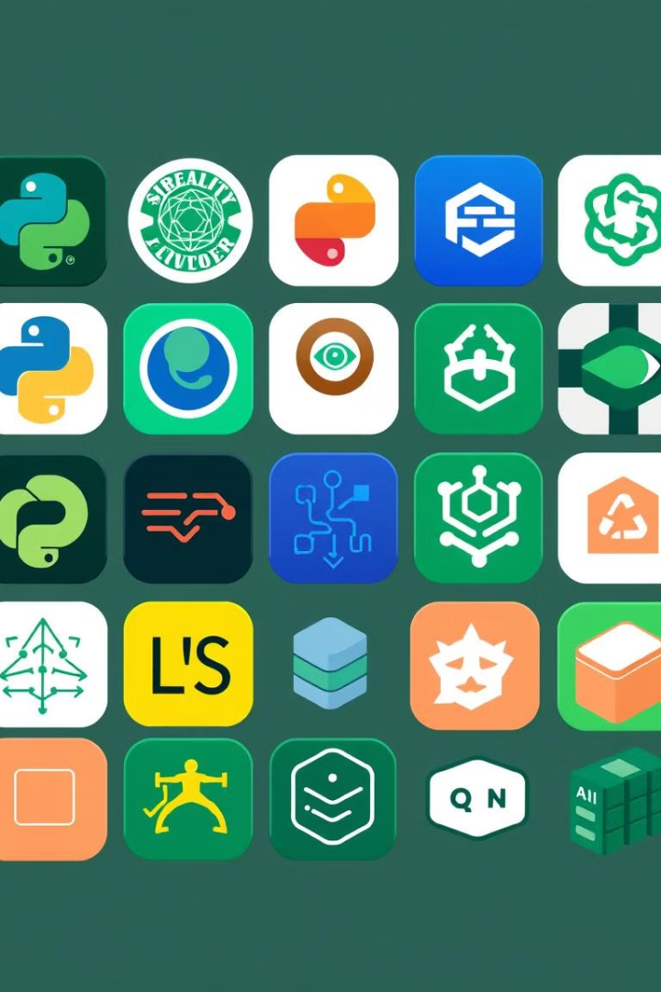




Technology Stack: Combining Cutting-Edge Tools
Python
Streamlit
PyPDF2
Backend processing and system logic
Intuitive User Interface
PDF text extraction
FAISS / ChromaDB
Fast vector search
The system leverages a robust technology stack to ensure optimal performance and scalability. Python forms the backbone, providing the necessary tools for backend processing. Streamlit enables a user-friendly interface, while PyPDF2 facilitates efficient text extraction from PDFs. FAISS and ChromaDB provide fast vector search capabilities.

Slide 7
Expected Outputs and Key Features
Auto-Generated Content
AI-Powered Explanations
Customizable Difficulty
Syllabus plans
In-depth topic elucidations
Easy, Medium, Hard levels
Questions
Clear and concise language
Adaptable to student needs
Assignments
The system is designed to generate high-quality syllabus plans, questions, and assignments automatically. It provides AI-generated topic explanations that are clear and easy to understand. The difficulty levels can be customized to suit different student needs, and the user-friendly UI ensures seamless file uploads and content selection.

Slide 8
Workflow Visualization: From PDF to Download
User Uploads PDF
& Selects Content Type
Extract & Chunk Text
Convert to Embeddings
4
Store in Vector Database
(FAISS/ChromaDB)
Process User Query
& Retrieve Relevant Content
Send Data to Gemini AI
for Content Generation
Display Output
in Streamlit UI
User Reviews & Customizes
Download
Structured Educational Content

