Slide 1
Internship Presentation
Performed at DreamAspect Software

Slide 2
01
A Brief Introduction About DreamAspect Software
02
Office & My Participations
Table of Content
03
My Professional Growth
04
Conclusion

Slide 3
About DreamAspect
USA-Based Company
All the products modules is in the R & D Stages
StartUp Company
To Develop A Platform-based Software
Lack of
Functional History

Slide 4

Platform (Gable Game)
Chess
C
C
Checker
A Brainstorming Game
World’s Oldest Game
Ludo
L
C
Carrom
Easy to Play
Interesting Game

Slide 5
The Remote Office
Working Hours
Daily Scrums
From
12.00 PM
to
9.00 PM
At
2.30 PM
for
30 Minutes
Working Days
Weekly Presentation
From Monday
to
Friday
Presenting Knowledge about various Topics

Slide 6
My Participation in Timeline
Chess Game
Make Board size Flexible and Various Modification
The First Day
End of First Month
The First Week
Chess Game
A New Chess Game
Going through a full Code-base of Chess Game
A New Implementation of Chess Game
Initial Phase

Slide 7
My Participation in Timeline Cons.
Learning Phase
Ludo Game
Implementing Rules and Regulations with International Standards
Custom Elegant UI Designing
Implementing those on Chess Game
Implicit-Explicit Animation
Before Last Month
In the Middle of months of my internship
Last Month
Ludo Game
Assigned to A Mentor & Building Ludo Game From the Scratch
Middle Phase
Final Phase

Slide 8
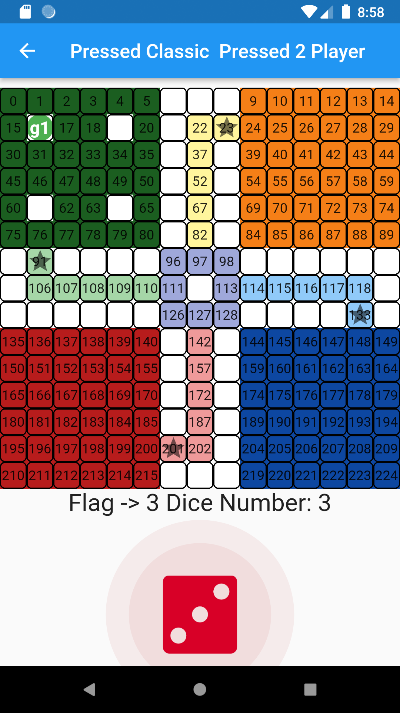
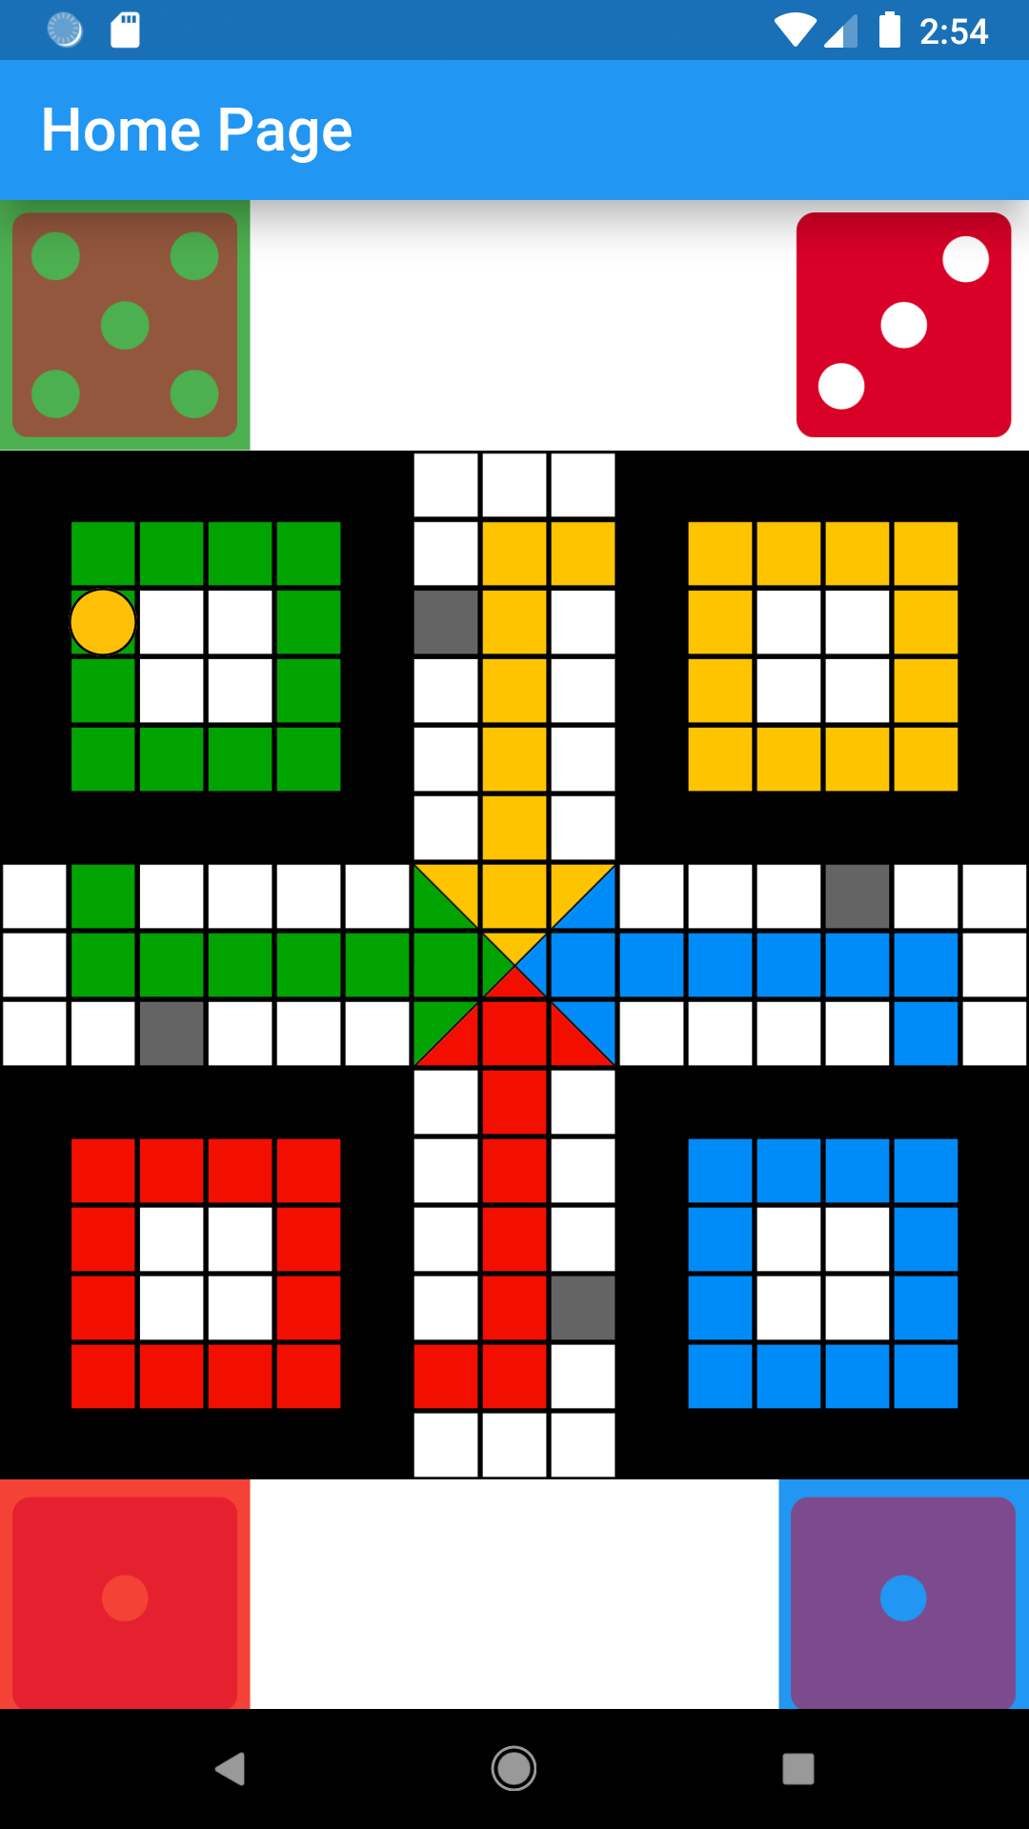
My Projects Demo

Slide 9
Challenges I Faced
Understanding Codebase
Understanding the codebase of another developer
Without Mentor
Modifying codebase without any assistance
Without SRS
Doing task without clear idea
Remote Internship
Managing all my tasks from home

Slide 10
Tools & Technologies
Dart Language
GitHub
Android & IOS Emulator
Object Oriented
C-style Syntax
Offers null Safety
Source Code management tools
Version Control
Enables a computer system to behave like Android/IOS System
Flutter
Visual Studio Code
Open-Source Framework
Cross Platform
Offers “Hot Reload”
Source-code editor with various extensions and features

Slide 11
Professional Learning
Communication Skills
Work Ethics
Asking questions
Giving presentations
Seeking feedback
Punctuality
Respect
Positive attitude
Accountability
Time Management
Taking Criticism
Make a routine
Prioritizing tasks
Write down everything
Receiving criticism in a positive attitude
Correcting my mistakes
Adaptability
Using new tools & technologies
Maintains office hours
Working under high pressure
Confidence
Leadership
Responsibility

Slide 12

Conclusion
Working in DreamAspect Software Company has been a mixed experience for me. Undoubtedly in that period, I have learned a lot.
I am hoping that this experience will inspire and teach me how to facing the upcoming challenges of my career.
Gourab Saha
2017831004

Slide 13
Thank You
Any Questions??

