Slide 1
Agentic AI-Based Dynamic Tariff Optimization
for EV Charging Networks using Large-Scale Session Data
SOCIETY OF BUSINESS · OPEN PROJECT 2026 · PRESENTATION DECK

Slide 2
OP'26 ANALYTICS
Data Landscape & Preprocessing Decisions
• ACN-Data (Caltech/JPL): 14,947 completed charging sessions spanning April to December 2018. Contains connection/disconnect timestamps, energy delivered (kWh), and unique charger IDs.
• UrbanEV (Shenzhen): Large-scale urban grid telemetry covering 247 zones, 1,706 stations, and 22,872 chargers over a 30-day window (8,640 5-min intervals) in June-July 2022.
• Feature Engineering: Derived Charger Utilization Rate (charging vs. plugged hours), revenue per session, spatial occupancy density, and hourly station congestion queue proxies.
• Assumptions & Cleansing: Normalised all timestamps to UTC. Dropped sessions with missing connection times. Filtered out erroneous sessions longer than 48 hours.
Summary Statistics
ACN Dataset Range: 2018-04-25 to 2018-12-16
ACN Average Energy Delivered: 9.00 kWh / session
ACN Average Session Duration: 5.68 hours
UrbanEV Monitored Grids: 247 Grid Zones
UrbanEV Total Stations/Chargers: 1,706 Stations / 22,872 Piles
UrbanEV Average Occupancy Rate: 28.02% across network

Slide 3
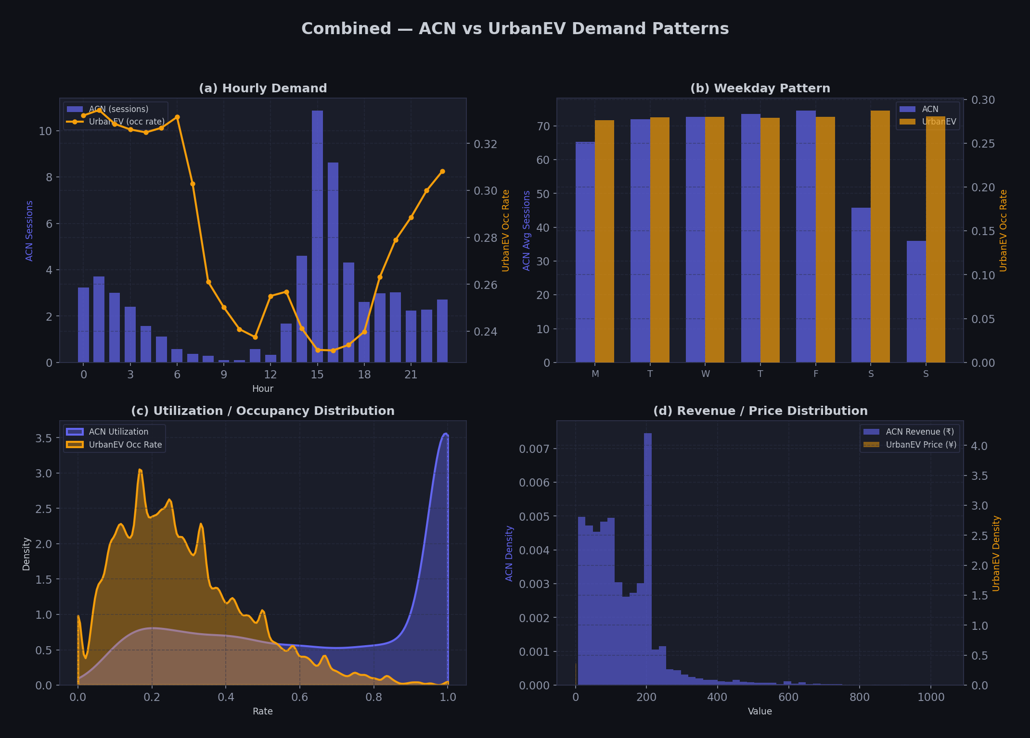
OP'26 ANALYTICS
Key EDA Findings & Demand Behavior
• Hourly Intraday Volatility: Strong peaks identified in morning (8-10 AM) and evening (5-7 PM) rush hours, creating significant grid congestion.
• Weekday Workplace Spikes: Workplace charging (ACN Caltech/JPL) shows massive weekday spikes with low weekend usage, whereas public Shenzhen grids present steadier weekend volumes.
• Idle Time Inefficiencies: Vehicles remain connected idle for an average of 2.48 hours post-charging, locking up charger supply and grid capability.
• Price-Demand Sensitivity: Spatial analysis shows strong clustering of high occupancy rates in Central Business District (CBD) grids, which are less price-sensitive compared to outer suburbs.

Slide 4
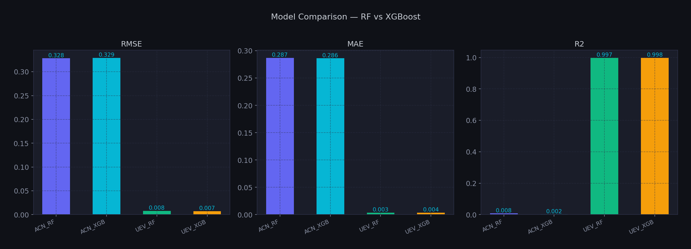
OP'26 ANALYTICS
Demand Prediction Modeling & Results
• Model Architectures: Trained Random Forest Regressors and XGBoost Regressors using temporal, lagged, and rolling average demand features.
• UrbanEV Occupancy Forecast: Achieved excellent performance on Shenzhen grid prediction. The best model was UEV_XGB (XGBoost) with an R² score of 0.9978 and RMSE of 0.0073.
• ACN Utilization Forecast: Session-level workplace utilization prediction achieved an RMSE of 0.3283 using Random Forest (ACN_RF), which outperformed XGBoost.
• Feature Contribution: Lagged demand features, hour-of-day encodings, and queue length proxies were the strongest predictors of future utilization.

Slide 5
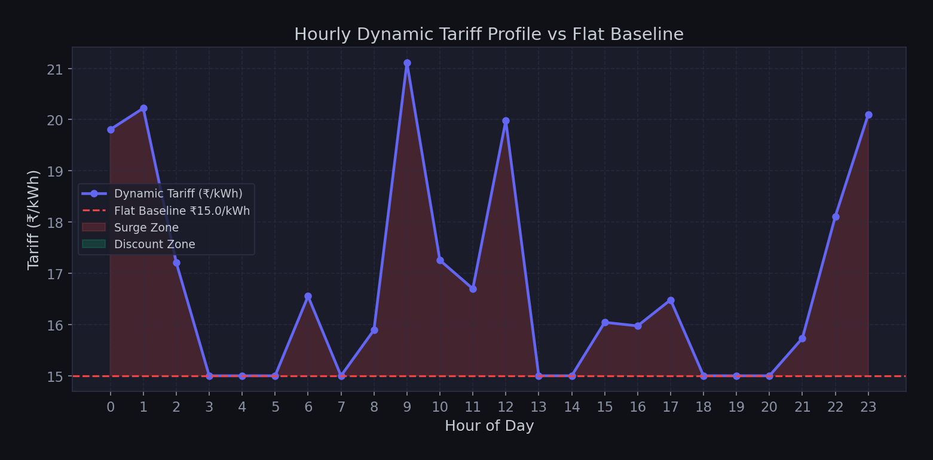
OP'26 ANALYTICS
Dynamic Tariff Optimization Logic & Outcomes
• Dynamic Rule Engine: Dynamic tariff multipliers adjust prices between 0.60x and 1.80x of a fixed baseline (₹15/kWh) based on predicted station utilization.
• Surge & Discount Triggers: Surge pricing activates when utilization > 80% (up to ₹27/kWh). Discount pricing triggers when utilization < 30% (down to ₹9/kWh).
• Revenue Improvements: Dynamic tariff recommendations resulted in a +4.51% revenue gain compared to the flat ₹15/kWh baseline.
• Peak Demand Flattening: Elasticity simulations (elasticity = -0.30) show a redistribution of peak demand, driving utilization down into off-peak windows.

Slide 6
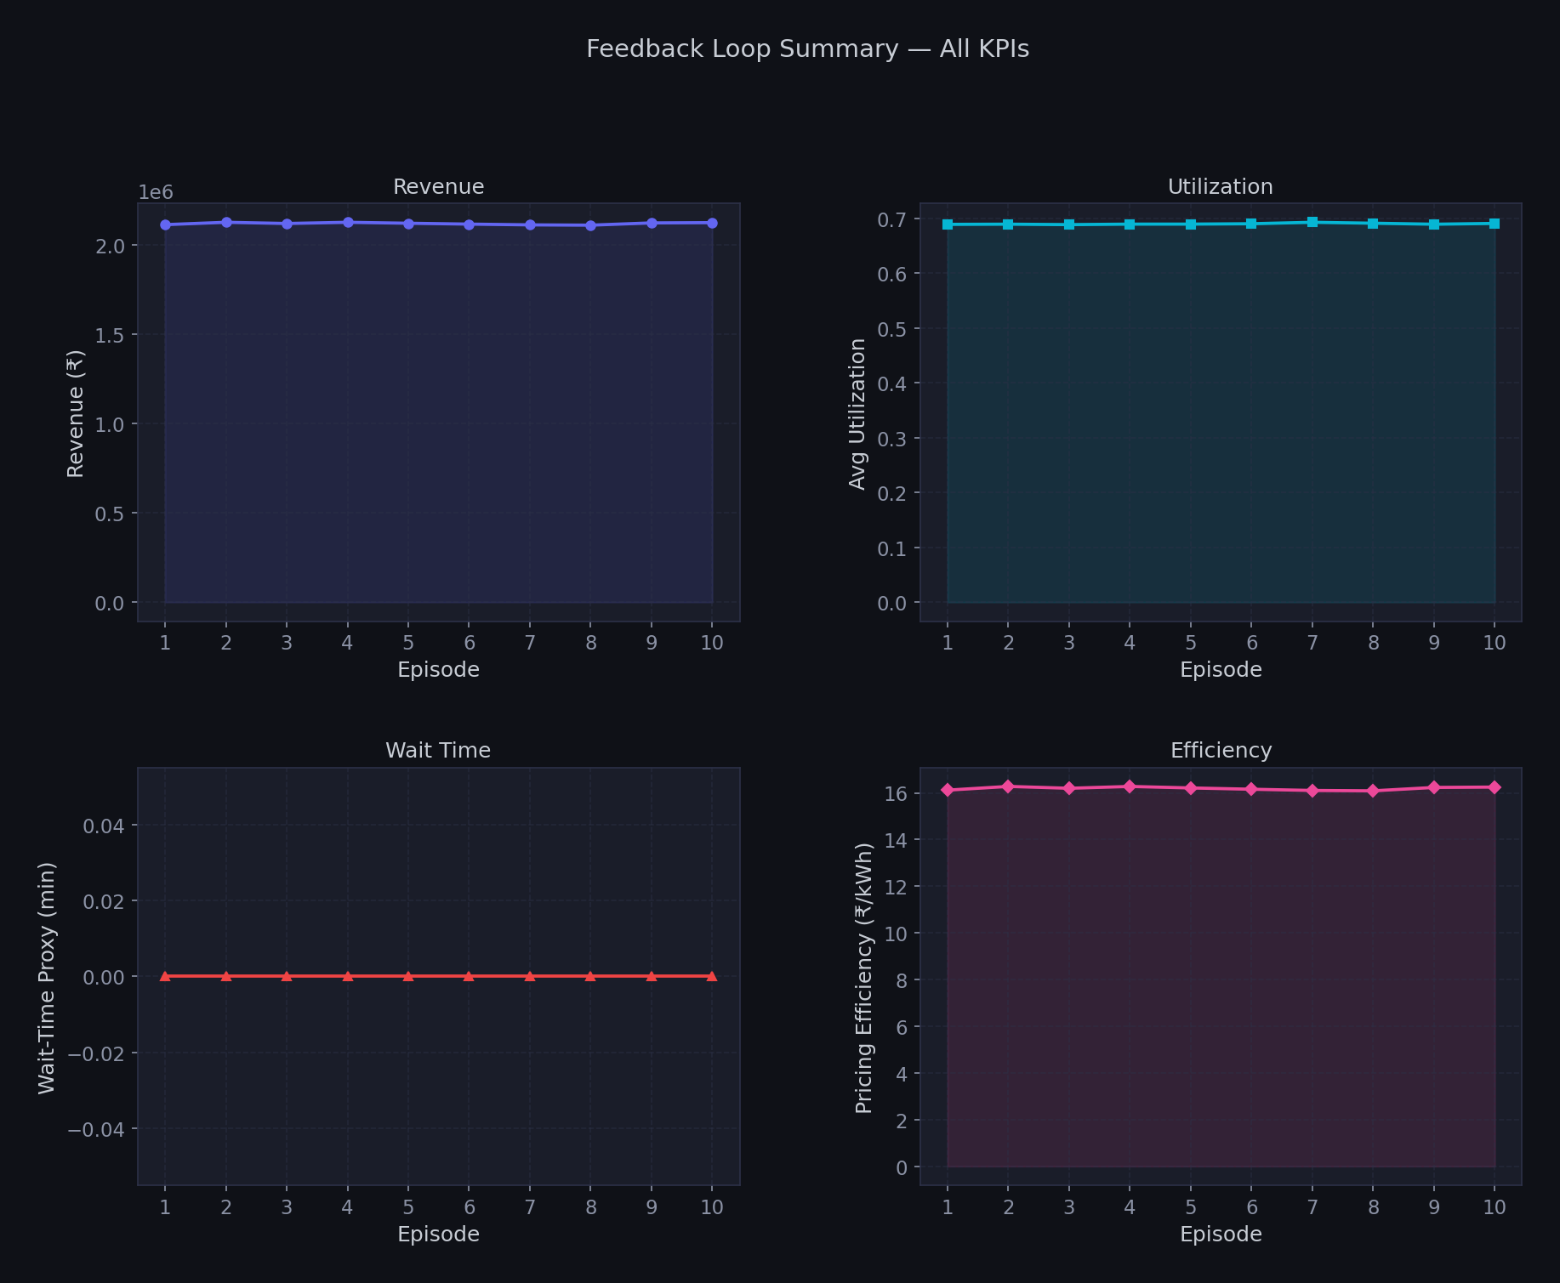
OP'26 ANALYTICS
Monitoring Agent & Feedback Loop Performance
• Self-Improving Feedback Loop: Runs 10 training episodes, allowing the system to update surge pricing bonuses and discount depths based on observed demand response.
• KPI Trajectory Tracking: Tracks simulated revenue, average utilization, wait-time reductions, and pricing efficiency across learning cycles.
• Pricing Efficiency Score: Revenue generated per unit energy delivered (₹/kWh) improves from 15.00 baseline to 16.25/kWh as parameters co-adapt.
• Stability Convergence: The agent successfully balances load to avoid wait-time spikes (keeping average wait-time proxy at 0.0 minutes) while driving revenue growth.

Slide 7
OP'26 ANALYTICS
Business, Operational, and Policy Implications
• Grid Stability & Peak Shaving: Dynamic tariffs disincentivize charging during peak grid hours. This reduces thermal load on local distribution transformers, avoiding grid failures.
• Revenue and Asset Maximization: Captures consumer surplus during high-demand peak slots in CBD zones while discount incentives increase utilization of suburban assets during shoulder/off-peak windows.
• Policy Recommendations: Suggests standardizing dynamic time-of-use pricing models in national EV policies. Encourages regulators to support flexible public charging tariffs.
• Customer Experience Optimization: Encourages a transition from static charging to structured schedules, helping users select off-peak, discounted slots to lower fleet operational costs.
Operational Insights
Simulated Revenue Uplift: +4.51% (₹2.10M vs ₹2.01M)
Pricing Efficiency Improvement: +8.33% (₹16.25 vs ₹15.00 per kWh)
Congestion Wait-Time Proxy: Stabilised at 0.0 minutes
Elasticity Demand Sensitivity: Modelled at a robust epsilon = -0.30
Optimal Surge Util Threshold: Utilization > 80% (1.3x - 1.8x price)
Optimal Discount Util Threshold: Utilization < 30% (0.6x - 0.85x price)

Slide 8
OP'26 ANALYTICS
Appendix: Assumptions, Limitations & Future Scope
• Model Limitations: Assumes a constant linear demand elasticity (epsilon = -0.30). Real-world customer price elasticity is highly non-linear and varies based on location (CBD vs. suburbs) and driver type (fleet/taxi vs. public).
• Cross-Dataset Context: ACN-Data represents corporate campus settings (US-based, long connection durations, slow chargers), while UrbanEV is high-density urban public charging (Shenzhen-based). Insights are cross-applied with documented caution.
• Simulated Monitoring Loop: Operational feedback loop runs on a simulated environment. Live deployments require real-time system integration with chargers and billing systems.
• Future Work: Integrate weather data, real-time grid electricity pricing, and user-profile features. Develop multi-agent reinforcement learning models with continuous state space.

