Slide 1
Resource Less Testing
With Robot Framework

Slide 2
Contents
WHY Robot Framework is useful ?
HOW Robot Framework will work?
WHAT will be the result of using Robot Framework?
FUTUER SCOPE on Robot Framework

Slide 3
Why Robot Framework is useful
Provide guarantee on Customer Satisfaction
Reduce UI Testing cost and time more than 95%

Slide 4






How Robot Framework will work?
Robot Framework
Generate Automation Script
Execute Automation Script
Write Manual Test Case /Scenario
Capture Screenshot

Slide 5
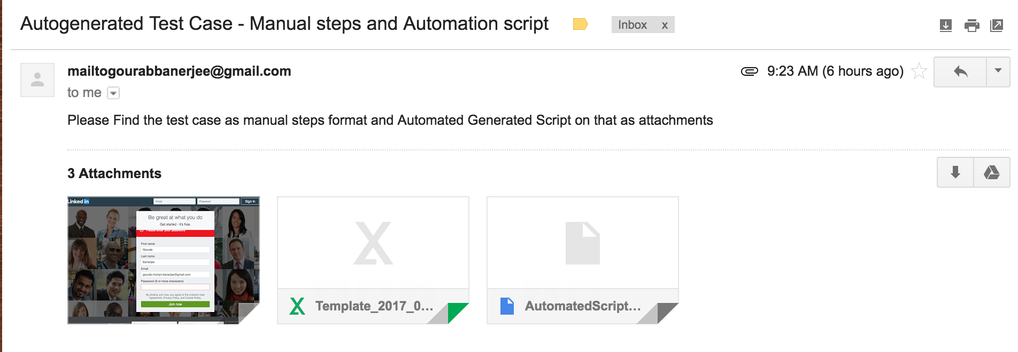
What will be the result of using Robot Framework

Slide 6
Future Scope on Robot Framework
Use Artificial Intelligence for Validating business logic and expected output
First product in the planet for Resource Less UI testing for manual and automation both.

Slide 7


Slide 8


