Slide 1
POTS Spend Analyzer
Your mission
As an XYZ customer, customer wants to track his spends from time to time and improve on the budget planning as well as goal towards savings by viewing a nice graphical representation of the spends on a month-by-month basis.
To enable this, we need to create a platform that gives the customer a full view of his incoming & outgoing details at a level like loan repayments, credit card payments, grocery shopping that’s done from the account.
Target Audience – Frontend Engineers only UI with Navigation or Backend Engineers with Swagger
Use case 1 – Make and receive payments
For a given customer they need to be able to make and receive payments. For the purpose of this exercise, we won’t be building an integrated payment system but instead will just record a transaction in the specific account when the payment details are entered on screen.
Details to collect are:
Customer ID
Transaction Description
Amount
Payment Type
Making a Payment
Receiving a Payment
Date/Time
Build a user interface where people can just enter the fields above, with some validation, and have it save to the database through a make payment service.
Mandatory
Transactions can be credits or debits
Credits are applied when the user selects “Receive a Payment”
Debits are applied when the user selects “Make a Payment”
Validation of user inputs

Slide 2
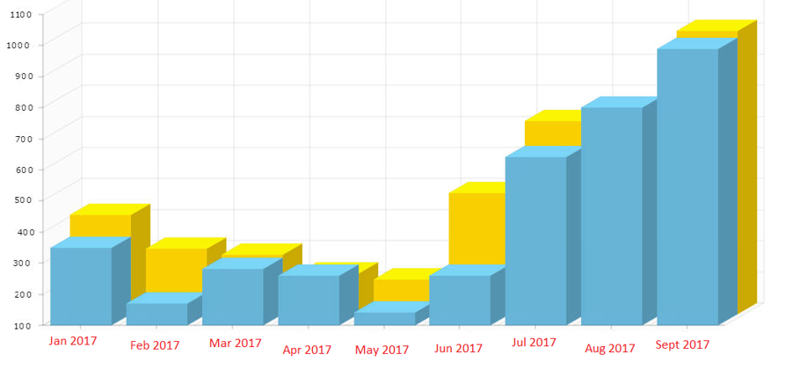
Use Case 4: Financial Spend Analyzer
Use case 2 – Create aggregated transaction data
The goal of this use case is to represent the data in a table grouping the data by month and payment type.
Below is a sample of what the output could look like.
Note, you will need to edit the data in your database to backdate some transactions to previous months. It’s okay for this exercise to do this manually.
Use case mandatory requirements
1. Grouping by month and payment type
At least three months displayed for at least one customer number
Use case 2 – Graphical representation of the data from use case 2
Display a graphical representation of the monthly data in use case 3. Similar to the chart listed below.
Monthly Spend View
Month | Customer Number | Total Incoming | Total Outgoing | Closing Balance
Jan-18 | 45785456 | $00.00 | $50.00 | $1,250.00
Feb-18 | 45785456 | $450.00 | $123.00 | $1,577.00
Mar-18 | 45785456 | $1,047.00 | $2,386.00 | $238.00

