Slide 1
Automation Testing With Selenium Java
Gourav
11904486

Slide 2

Project Details
conducted a UI test for Spotify
focusing on the login process
playlist creation
adding songs
playing, and pausing songs
deleting both songs and playlists

Slide 3

Framework Details: ---WebDriver manager for managing browser connectors. ---Page object model for page abstractions ---Property files with test data ---XML suites for Test Management ---Parallel Testing to save Time. ---Use TestNg

Slide 4
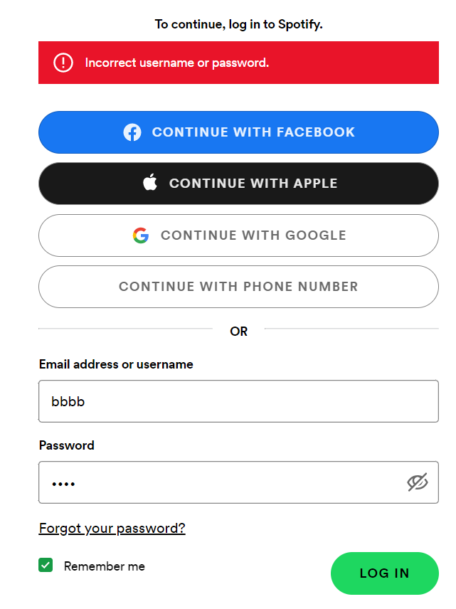
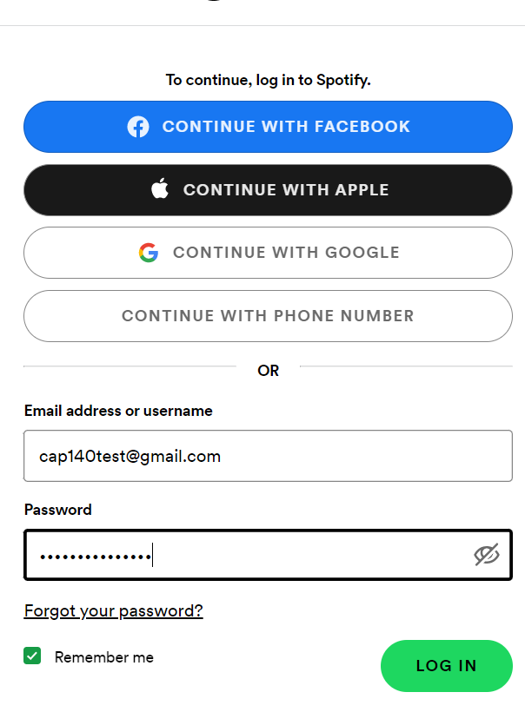
Login process: ---Tested the login process of Spotify. ---Making sure that users can enter their username and password correctly and access their account. ---Also checked for any error messages or bugs that may occur during the login process.

Slide 5
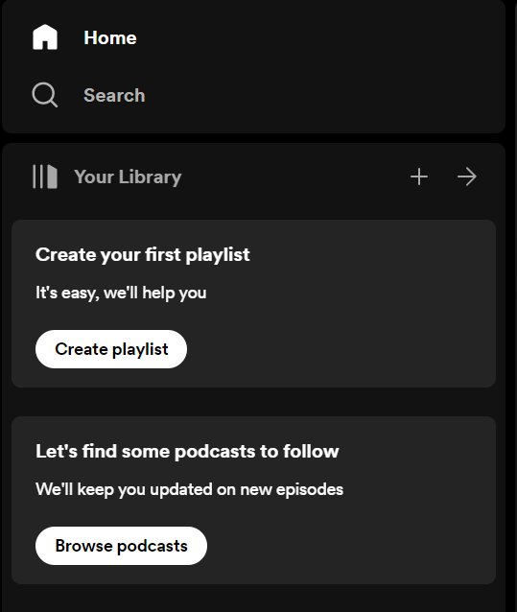
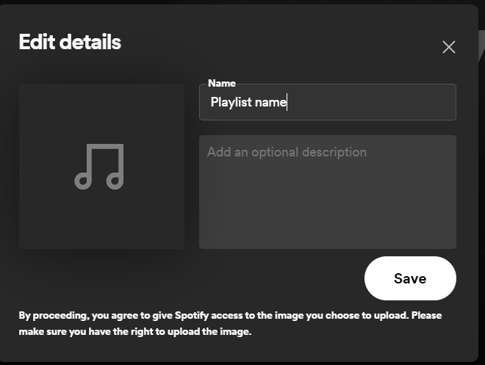
Playlist creation: ---After login created new playlist ---Given a name to a playlist ---Checked playlist is visible in User library

Slide 6

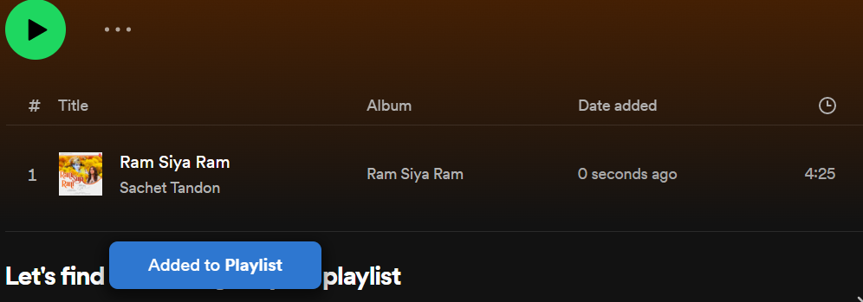
Adding songs: ---Next, tested the ability to add songs to a playlist. ---Search & selected a song and added it to the newly created playlist. ---Then checked that the song was added correctly and appeared in the playlist.

Slide 7
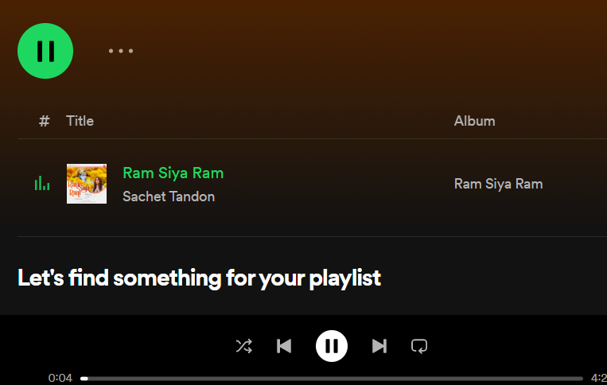
Play and pause : ---Tested the play and pause feature of Spotify. Clicked on the play button to start playing. ---The song and then clicked on the pause button to stop the song. ---Then checked that the play and pause buttons worked correctly and the song played and paused as expected.

Slide 8
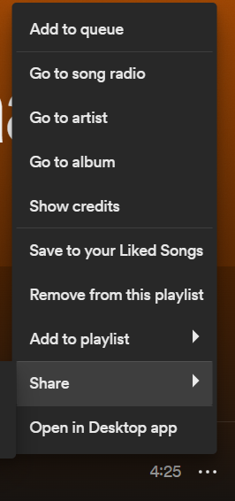
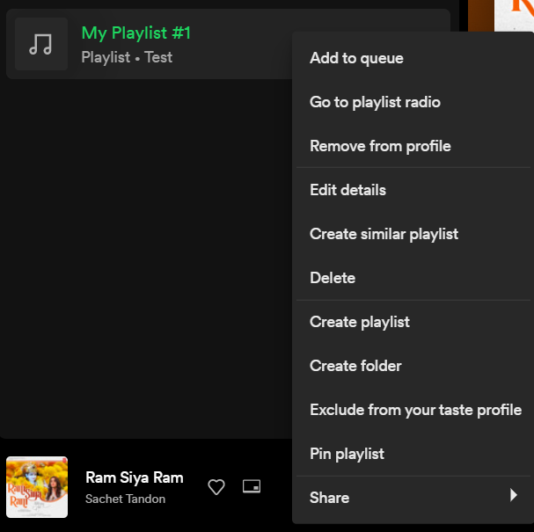


Deletion of song and playlist: ---Tested the ability to delete both songs and playlists. ---Removed a song from the playlist and checked that it was no longer in the playlist. ---Then deleted the playlist entirely and ensured that it was removed from the user's library.

Slide 9
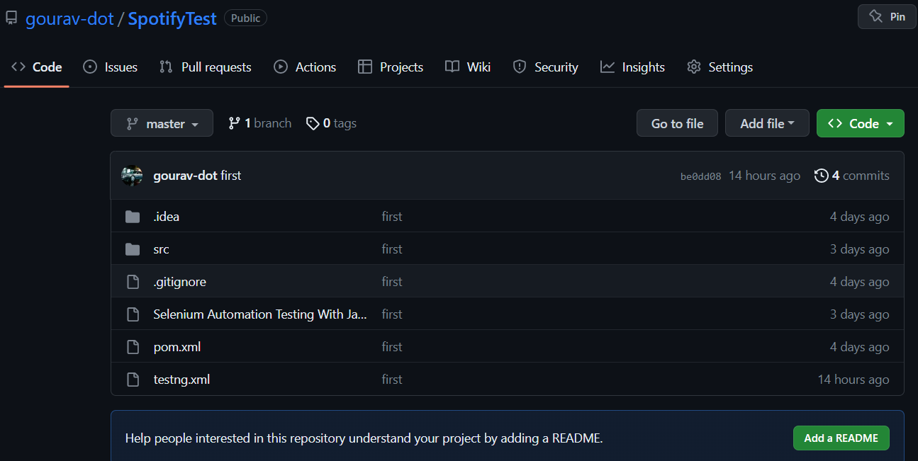
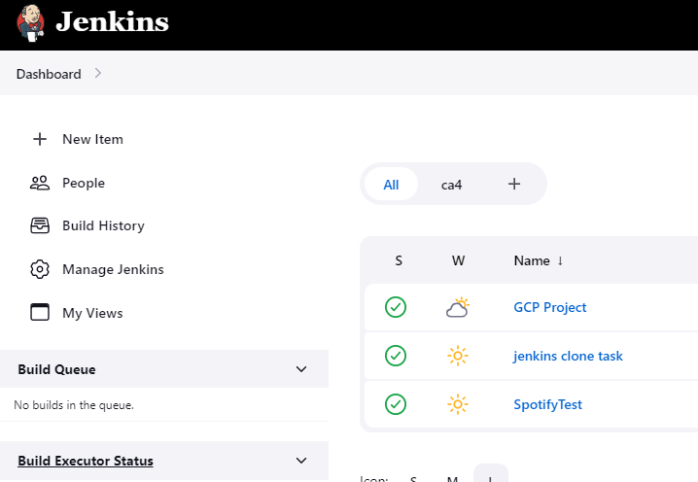

Git & Jenkins Used git for version control. Build a job in Jenkins using git link and used triggers for job scheduling

Slide 10
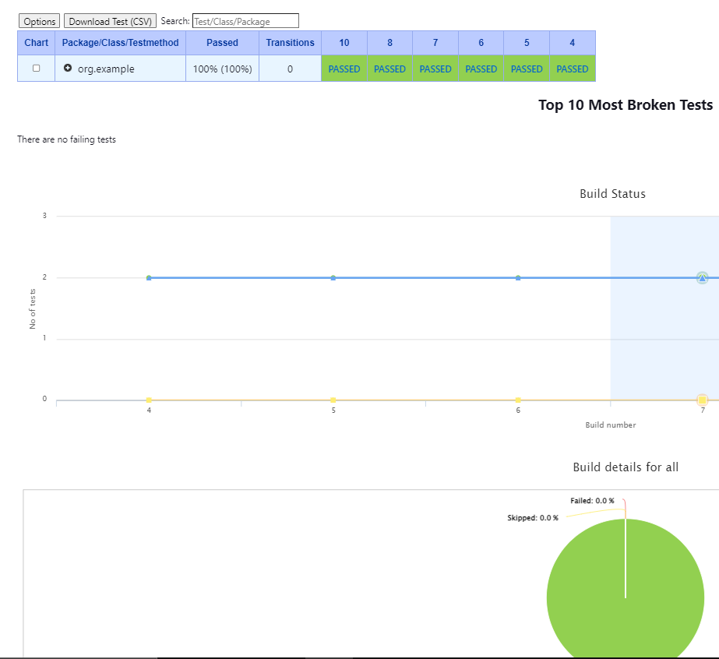
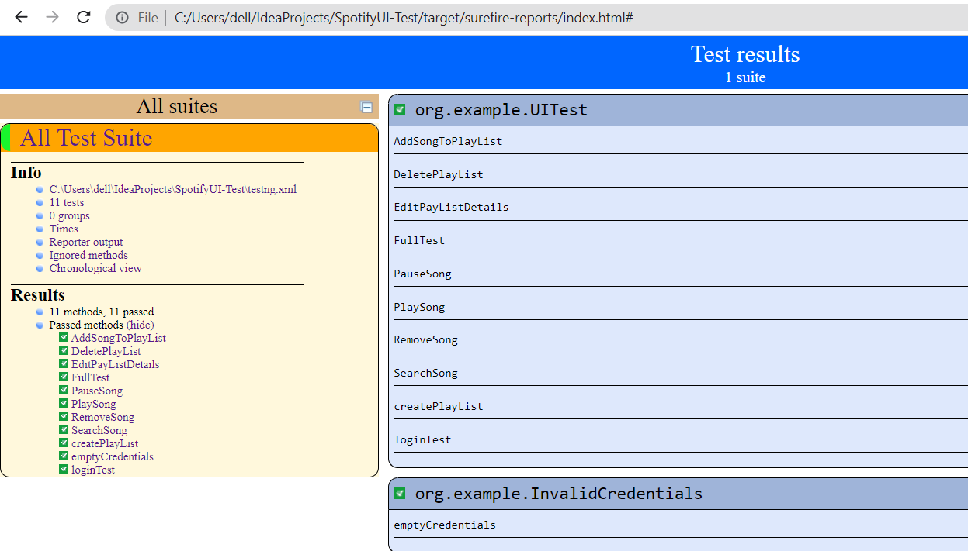
Reports and Result In Jenkins TestNg Results TestNg Results Analyzer Html Reports

Slide 11

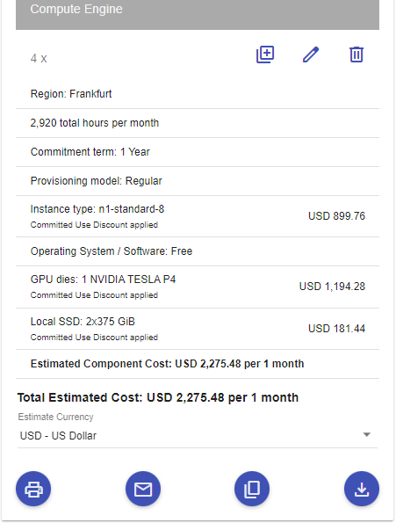
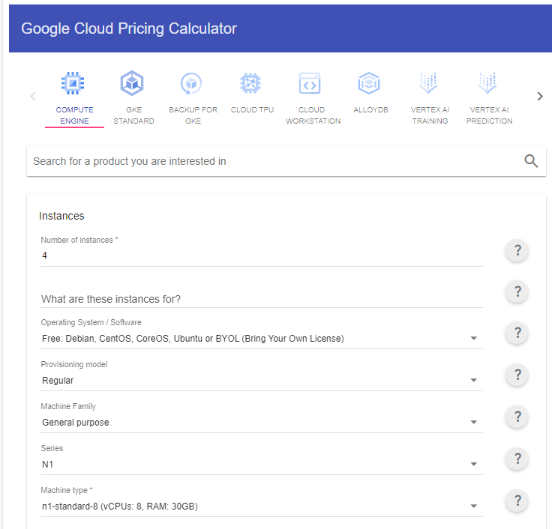
Individual Tasks
Write Test Cases for “Google Cloud Platform Pricing”
Test cases:
Check monthly rent.
Check instance type.
Check local SSD.
Check region.
Check commitment term.
Check selected series.
Automate pasteBin.com.

Slide 12
Framework Details: ---WebDriver manager for managing browser connectors. ---Page Factory for page abstractions ---Property files with test data ---TestNg suites for Test Management ---Parallel Testing to save Time.

Slide 13
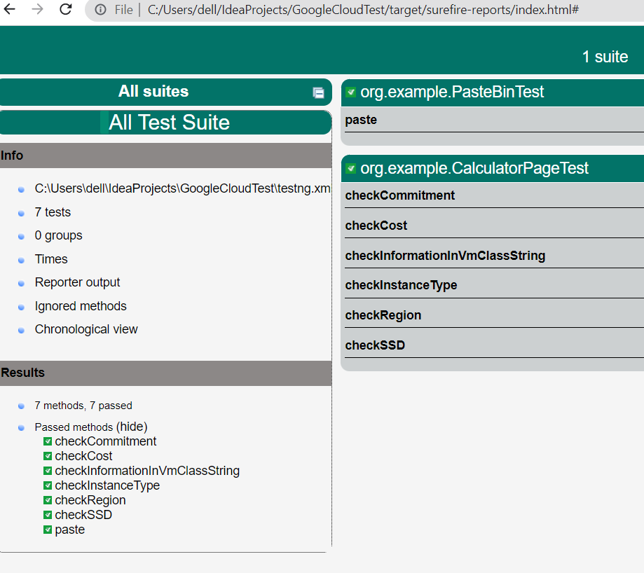
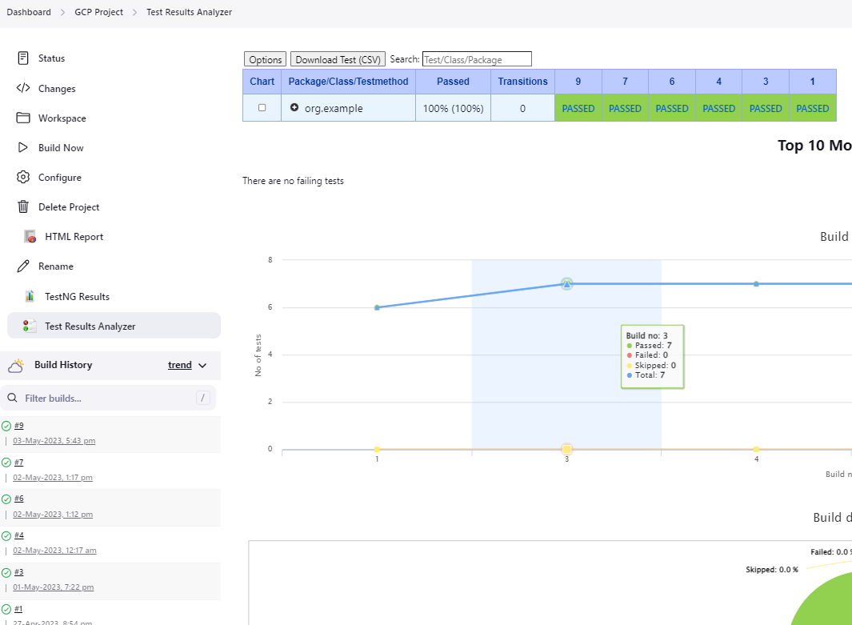
Git & Jenkins ---Used git for version control. ---Build a job in Jenkins using git link ---Used triggers for job scheduling Reports and Result In Jenkins ---TestNg Results ---TestNg Results Analyzer ---Html Reports

Slide 14
Thanks

