Slide 1

Data Analysis Portfolio project on Hotel Data Analysis
Goal
Develop a database to analyze & visualize hotel booking data

Slide 2
Building a visual data story or Dashboard using power Bi and MYSQL to present to stakeholders.
Is hotel revenue growing by year?
Should they increase parking lot size?
What trend can be seen in data?
Segment revenue on the basis of hotel type
Understanding the trend of guest with personal car and their choices.
Daily average rate and guest to explore seasonality.

Slide 3
TO BE WORKED IN HIGHLIGHTED POINT
Build a Database
Develop the SQL Query
Connect Power BI to the Database
Visualize
Summary Findings

Slide 4
Imported Data in MYSQL
Transform the data using power query and using various function of excel to clean and extract useful data.
Saved the excel file in csv.
Create database Hotel_Reports;
mysql –u root –p hotel_reports < “path of the file”.csv

Slide 5
Aggregate Function – Union and Group by
rename table `hotel_revenue_historical_full-2` to T1; rename table `2019` to T2; rename table `2020` to T3;
select * from T1 union select * from T2 union select * from T3
with hotels as(select * from T1 union select * from T2 union select * from T3) select arrival_date_year ,hote,round( sum((stays_in_weekend_nights + stays_in_week_nights)*adr),2) as revenue from hotels group by arrival_date_year,hotel;

Slide 6
Joins
with hotels as(select * from T1 union select * from T2 union select * from T3) select * from hotels left join mkts on hotels.market_segment = mkts.market_segment left join ms on ms.meal = hotels.meal

Slide 7
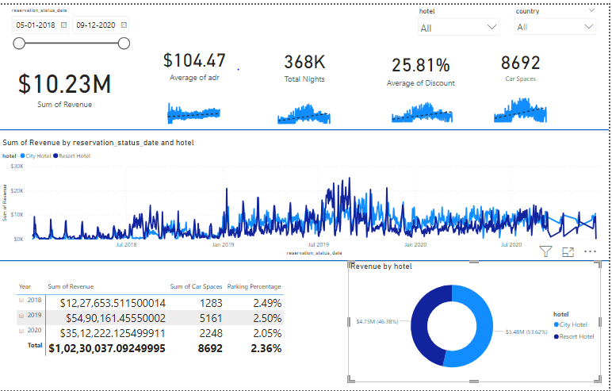

Slide 8
https://github.com/gourav0019/My-Projects/blob/master/SQL%20Project.pbix

