Slide 1
JDBC
Lesson 3 : Performing Basic CRUD Operations
Using JDBC

Slide 2
Lesson Objectives
After completing this lesson, participants will be able to
Execute Static SQL statements
Understand Result Set
Understand Prepared Statements
Retrieve(Select)
Insert(Create)
Update
Remove(Delete)

Slide 3
Executing SQL Statements in JDBC
Once connection is established with database, statement object can be used to execute different types of SQL queries
JDBC API support different statement interfaces depending upon type of query to be executed
DDL and Static Select
Statement
DML and Dynamic Select
PreparedStatement
Procedures and Functions
CallableStatement
Notes:
Using Statements:
java.sql.Statement interface in JDBC enables to send the SQL queries to database and retrieve data. Statement interface is suitable for executing DDL queries and Select queries which has no input.
Statement interface is further extended as PreparedStatement, which is recommended for DML and select queries that involves input parameters.
PreparedStatement is in turn extended as CallableStatement, which is suitable for calling database stored procedures and functions.

Slide 4
Statement Interface
Used for executing a static SQL statement
Methods :
ResultSet executeQuery(String SQL)
int executeUpdate(String SQL)
boolean execute (String SQL)

Slide 5
Executing Static SQL using Statement Interface
Statement st=conn.createStatement();
ResultSet rs=st.executeQuery(“SELECT * FROM emp”);
while(rs.next()){
System.out.println(“Emo No = ”+rs.getInt(“eno”));
System.out.println(“Emo Name = ”+rs.getString(“ename”));
}

Slide 6
Iterating Through ResultSets
Java.sql.ResultSet interface represents the result set of a database query
Empid | Name | Salary | Job
112 | John | 12000 | Accountant
132 | Sakina | 43008 | Manager
232 | Neha | 23452 | Teacher
136 | Sharad | 51121 | Professor
372 | Madhu | 45005 | Sr Professor
247 | Deepa | 54342 | HOD
Database
When the ResultSet is first returned,the starting cursor position is before the first row of data.

Slide 7
Methods of ResultSet
Methods of ResultSet are divided into 3 Categories
1.Navigational Methods
beforeFirst() previous () afterLast() next()
first() absolute() last() getRow()
2.Get Methods
get() method for each data type
Each get method has 2 version :
1.one that takes column name
2.one that takes column index
3.Update Methods : will discuss later

Slide 8
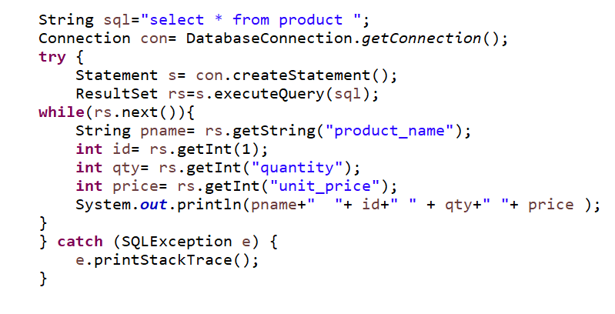
Iterating Through ResultSet - Example
Retrieve data from table
Notes:
Retrieve data from table:
Once your statement object is ready, you need to execute that statement to get the records from the database.
The executeQuery() method of the Statement returns the ResultSet object which represent the front end table of database records.
Further, you can traverse/iterate through ResultSet to retrieve the records one by one.
Use getXXX() methods to retrieve each data field value, for example rs.getInt(“eno”) will retrieve the employee number of the current record from rs.
Types of ResultSet: Resultset contains results of the SQL query. There are three basic types of resultset.
Forward-only As the name suggests, this type can only move forward and are non-scrollable.
Scroll-insensitive This type is scrollable which means the cursor can move in any direction. It is insensitive which means any change to the database will not show change in the resultset while it opens.
Scroll-sensitive This type allows cursor to move in any direction and also propagates the changes done to the database.

Slide 9
Demo
Execute the :
Select.java

Slide 10
Understanding Scrollable ResultSets
The Result set is by default read only in forward direction.
Many times we need to navigate on resultset
ResultSet Types :
1.Type_Forward_only : result set can be navigated only in forward direction
2.Type_Scroll_Insensative : The cursor can scroll forward and backward and result set is not sensitive to the changes done by others.
3.Type_Scroll_Sensative : cursor can scroll forward and backward and result set is sensitive to the changes done by others.
ResultSet Concurrency Types
1.Concur_Read_Only : It create the resultset read-only
2.Concur_Updatable : It create the updatable resultset

Slide 11
ResultSet - Example

Slide 12
Demo
Execute the Demo on Scrollable ResultSet

Slide 13
Understanding Updatable ResultSets
Updatable ResultSet allows modification to data in a table through ResultSet.
Update method is available for doing updates in table for each data type.
1.One that takes in a column name
2.One that takes in a column index
To update String column value of current row
public void updateString(int columnindex,String value)
public void updateString(String columnname,String value)
All the update methods throw SQLException

Slide 14
Understanding Updatable ResultSet
rs.updateString(“EmpName”,”Smith”) : will update the value in resultset and not In the underlying Database.
ResultSet Object
To update the value in database ,we need to call updateRow() method on resultset.
Id | Name
101 | Smit
102 | Neha
Database

Slide 15
Understanding Updatable ResultSet - Methods
updateRow() : updates the row in Database
deleteRow () : deletes the current row from Database
refrestRow() : refreshes the data in resultset to reflect any recent changes in the database.
cancelRowUpdate() : cancels any updated made to the current row .
insertRow() : insert new row in database

Slide 16
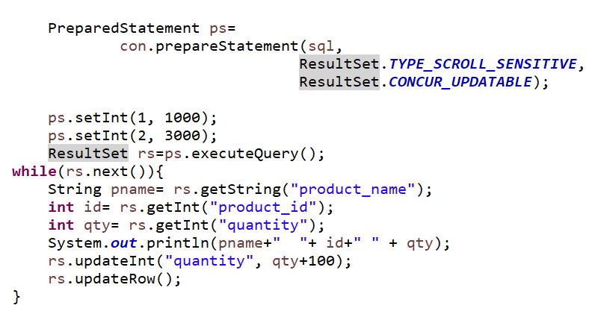
Updatable ResultSet – Example

Slide 17
Demo
Demo on Updatable ResultSets

Slide 18
Understanding PreparedStatement
Benefits PreparedStatement :
Since the SQL statements are precompiled one, it improves performance of Application.
Easy to Set SQL Parameter value
Prevents SQL Dependency Injection Attacks

Slide 19
Understanding PreparedStatement Methods
PreparedStatement ps =connection.prepareStatement(“Select * from emp
where salary > ? And department_code= ? “ );
To Bind the values in this PreparedStatement
setXXX() methods are available.
XXX can be replaced by any java datatypes .
e.g. setInt(P1,P2) ( P1 -> position ,P2 -> value)
setInt(1,1000);
setString(“emp_name”,”Neha”);
setDouble(“salary”,23000.22);

Slide 20
Retrieving Data Using PreparedStatement
Selecting Data :
String sql="select product_name, quantity , product_id "
+ " from product where unit_price between ? and ? ";
PreparedStatement ps= con.prepareStatement(sql);
ps.setInt(1, 1000);
ps.setInt(2, 3000);
ResultSet rs=ps.executeQuery();
while(rs.next()){
String pname= rs.getString("product_name");
int id= rs.getInt("product_id");
int qty= rs.getInt("quantity");
System.out.println(pname+" "+ id+" " + qty);
}

Slide 21
Updating Record
Update table data
PreparedStatement:
String query = “update emp set ecity=? where eno<?”
PreparedStatement st=conn.prepareStatement(query);
st.setString(1,”Mumbai”);
st.setInt(2,1000);
int res = st.executeUpdate);
System.out.println(red + “ records updated”));
Notes:
Update Table Data:
The executeUpdate() method is used to update records from the database table.
This method returns integer type value indicating the number of records affected in the database table.

Slide 22
Removing Record
Delete table data
PreparedStatement:
String query = “delete from emp where eno<?”
PreparedStatement st=conn.prepareStatement(query);
st.setInt(2,1000);
int res = st.executeUpdate);
System.out.println(red + “ records deleted”));
Notes:
Update Table Data:
The executeUpdate() method is also used to delete records from the database table.
This method returns integer type value indicating the number of records affected in the database table.

Slide 23
Best Practices
Some of the best practices in JDBC:
Selection of Driver
Close resources as soon as you’re done with them
Turn-Off Auto-Commit – group updates into a transaction
Business identifiers as a String instead of number
Do not perform database tasks in code
Use JDBC’s PreparedStatement instead of Statement when possible
Notes:
JDBC Best Practices:
Following are some of the best practices used in JDBC:
Selection of Driver Select a certified, high performance type 2 (Thin) JDBC driver and use the latest drivers release.
Close resources as soon as you are done with them (in finally) For example: Statements, Connections, Resultsets, and so on. Failure to do so will eventually cause the application to “hang”, and fail to respond to user actions.
Turn-Off Auto-Commit It is best practice to execute the group of the statement together which are the part of the same transaction. It helps to avoid the overhead of data inconsistency.

Slide 24
Best Practices
Notes:
JDBC Best Practices:
4. Business identifiers as a String instead of number
Many problem domains use numbers as business identifiers. Credit card numbers, bank account numbers, and the like, are often simply that - numbers. It should always be kept in mind, however, that such items are primarily identifiers, and their numeric character is usually completely secondary. Their primary function is to identify items in the problem domain, not to represent quantities of any sort.
For example: It almost never makes sense to operate on numeric business identifiers as true numbers - adding two account numbers, or multiplying an account number by -1, are meaningless operations. That is, one can strongly argue that modeling an account number as a Integer is inappropriate, simply because it does not behave as an Integer.
Furthermore, new business rules can occasionally force numeric business identifiers to be abandoned in favor of alphanumeric ones. It seems prudent to treat the content of such a business identifier as a business rule, subject to change. As usual, a program should minimize the ripple effects of such changes.
In addition, Strings can contain leading zeros, while numeric fields will remove them.
5. Do not perform database tasks in code
Databases are a mature technology, and they should be used to do as much work as possible. Do not do the following in code, if it can be done in SQL instead:
ordering (ORDER BY)
filtering based on criteria (WHERE)
joining tables (WHERE, JOIN)
summarizing (GROUP BY, COUNT, AVG, STDDEV)
Any corresponding task implemented entirely in code would very likely:
be much less robust and efficient
take longer to implement
require more maintenance effort
6. Use JDBC’s PreparedStatement instead of Statement when possible for the following reasons:
It is in general more secure. When a Statement is constructed dynamically from user input, it is vulnerable to SQL injection attacks. PreparedStatement is not vulnerable in this way.
There is usually no need to worry about escaping special characters if repeated compilation is avoided, its performance is usually better.
In general, it seems safest to use a Statement only when the SQL is of fixed, known form, with no parameters

Slide 25
Lab : JDBC
Lab : JDBC 4.0

Slide 26
Summary
In this lesson, you have learnt:
Establishing the connection with database to perform database operations
Different types of statement creation
Different ways of executing statements
And best practices for JDBC applications

Slide 27
Review Question
Question 1 : Which Statement is used when you want to pass parameter to the query?
Option 1 : Statement
Option 2 : PreparedStatement
Option 3 : CallableStatement
Question 2 : ____ method is best suited to execute DDL Queries.
Question 3 : By default, a connection object is in auto-commit mode
True/False

