Slide 1
BDSN PROJECT
Gourav ray
A21013
Under the guidance of:-
Priithwis Mukherjee

Slide 2
Why To go through this work
In todays world, when most of thing is getting online, how study can be in backfoot. With the opening of many MOOCs platform like Udemy, it gives many opportunities to student as well as to educator. Here we will try to investigate the Udemy dataset. We will make use of Exploratory Data Analysis through various Visualization techniques, many concepts of Text Analytics , and obviously the backbone of this project Python, Machine Learning, Spark.
This project can be a one stop solution for many, like:-
one who wants to launch his own course, which one should be preferred
Someone who plans to have second source of income, this work can be helpful
For predicting the subject/Genre label of an unknown course
Viewership Analysis
Well, these are some of the application scope but not limited to this.

Slide 3
What we will try to Answer
We will try to answer the following things:-
Whether the author are releasing their courses more on online MOOC platform like Udemy or not?
Distribution Of content?
Duration Distribution Across Type of Course?
Top 25 free and paid course in Udemy
We will see WordCloud of popular term in the course subject of udemy and also most common word out of that.
We will try to see whether through the given data, is it possible to predict the number of subscribers? We will try to make use of p-value to make our feature selection.
We will perform text classification so as to predict Genre/Subject.

Slide 4
Dataset Description
course_id - id field for courses
course_title - title field for courses
url - url field to course page
is_paid - boolean field - True for Paid / False for Free
price - price field for course fee
num_subscribers - demand field for each courses
num_reviews - review number for each courses
num_lectures - lecture per course
level - course level by trainee experience
content_duration - course duration in hours
published_timestamp - timestamp field for publication
subject - course type field

Slide 5
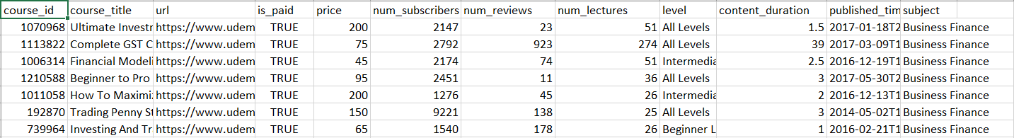
DATA SET

Slide 6
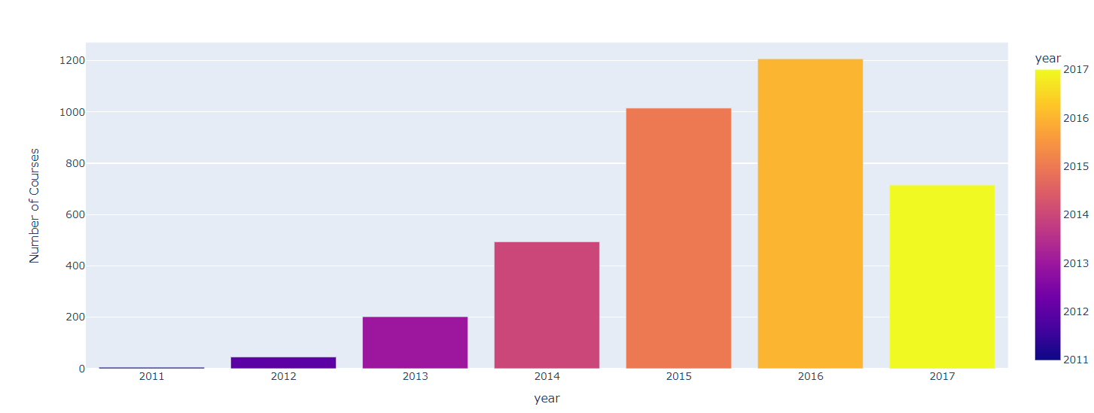
EDA & Visualization
We can see a gradual Increase in people releasing their Courses over the period of time. Especially there has been a sudden rise in the number of courses from 2014 to 2015.

Slide 7
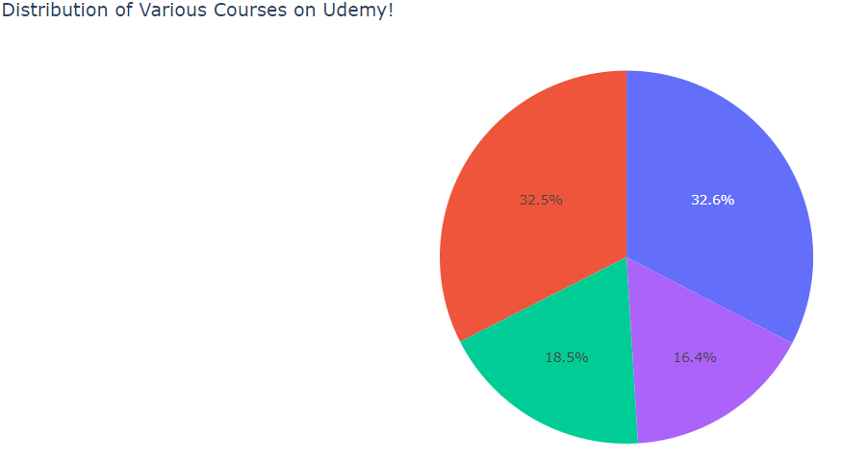
32.6% courses on the Udemy is for WEB DEVELOPMENT
32.5% courses on the Udemy is for BUSINESS FINANCE
18.5% courses on the Udemy is for MUSICAL INSTRUMENT
16.4% course on the Udemy is for GRAPHIC DESIGN

Slide 8
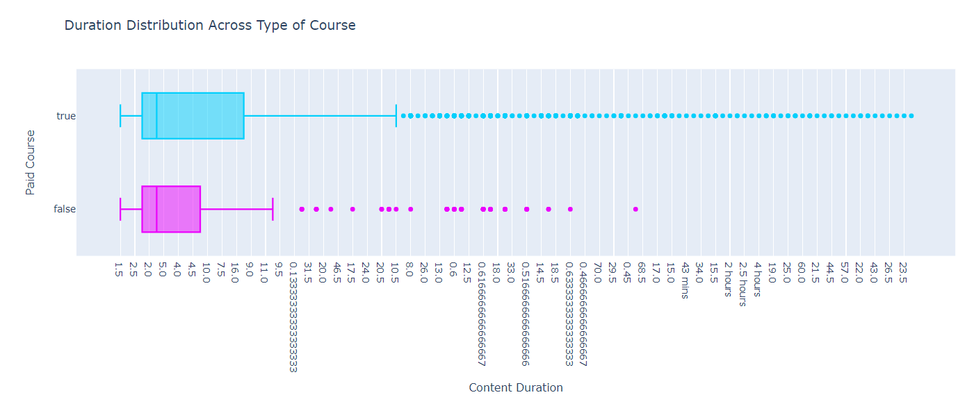
We can see that paid courses have a higher duration. It is also worth noting that duration varies considerably more on paid courses as well.

Slide 9
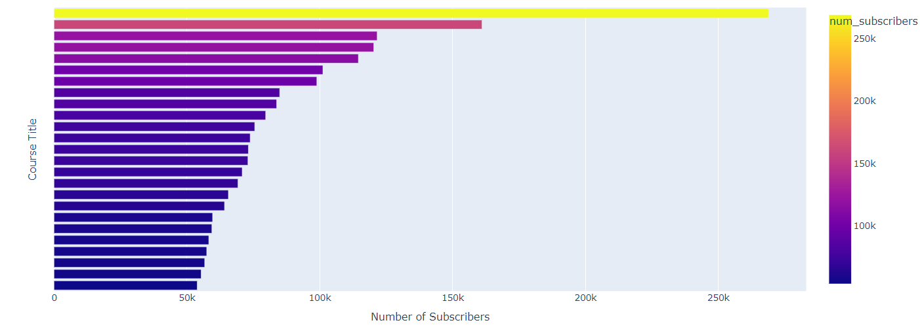
We saw that around 20 course out of top 25 are related to coding in paid section.

Slide 10
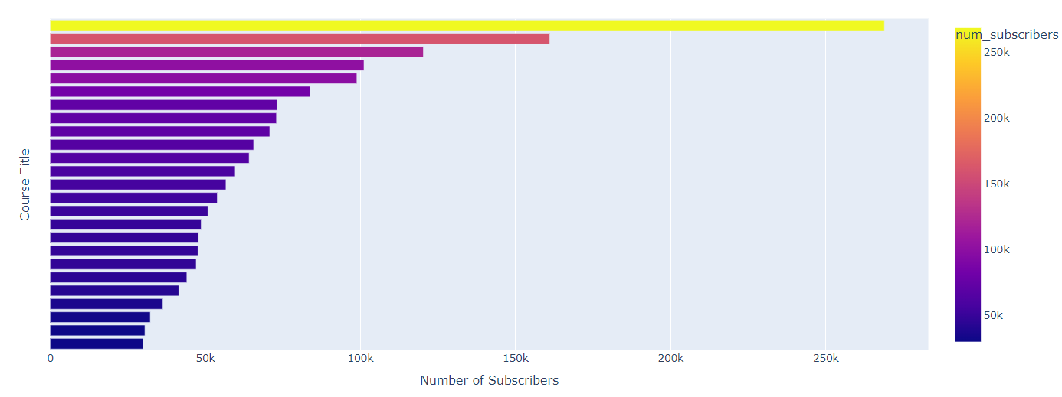
We are seeing the same trend in Free section as well.

Slide 11
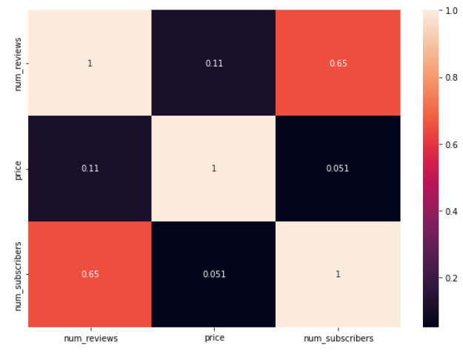
Correlation is a statistical term describing the degree to which two variables move in coordination with one another
We dont see much high correlation among the variables

Slide 12
Text Analytics & Word Cloud
TfidfVectorizer:-Convert a collection of raw documents to a matrix of TF-IDF features.
CountVectorizer:Convert a collection of text documents to a matrix of token counts. This implementation produces a sparse representation of the counts using scipy.sparse.csr_matrix.
Word Clouds are a powerful way to visualize what your audience really thinks about a topic.
A combination of above three concept and it was followed by making use of regex, so as to filter out all letter other than capital and small a to z and after that making it to lowercase and storing in corpus.
We are implementing all this on the title column of the course.
Then all the corpus is been joined and made a single text and then we made it into token.
Our next attempt was to take out all stopwords out of token
Stopwords are the most common words in any natural language. For the purpose of analyzing text data and building NLP models, these stopwords might not add much value to the meaning of the document.

Slide 13
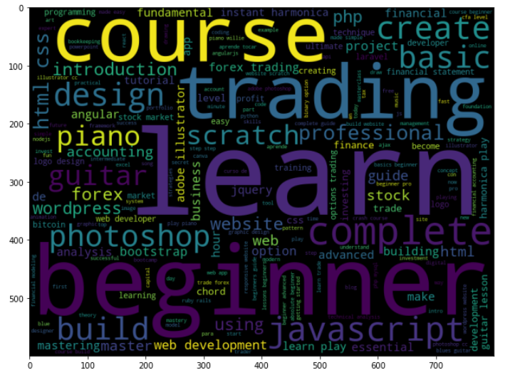
We created a word cloud on the tokens where we filter out all the stopwords.
We can see the words like Beginner, trading, photoshop, JavaScript etc. are having high dominancy
Then we found out the most common words out of our generated Token
We made a word cloud of common words as well

Slide 14
Machine learning & P-value hypothesis
We made use of numeric columns like 'price', 'num_reviews’, 'num_lectures’ and categorical columns like 'is_paid', 'level', 'subject’ to predict number of subscribers.
We did dummification of categorical variables and also scaling, so that all variables will be in same scale.
We made use of Ensemble model called Random Forest, and the Rmse was not that good.
So as to improve model, since it's a regression, we can verify which are having p-values less than 0.05 and we can built new model on that variable. P-value more than 0.05 indicates that null hypothesis is accepted and that variable has no contribution in model.
So we went with new features of p-value less than 0.05, still the result was not that great.
While our MSE is quite high, it seems that we haven't really overfit the data. It is likely that we will need better features in order to build predictive power, which we don't have currently.
So the prediction of the number of subscribers may not yield that much current stage, because of the constraint in better features.

Slide 15
Data Transformation, Feature Engineering , Pipelining, Machine learning
Tokenizer does Tokenization. Tokenization is the process of tokenizing or splitting a string, text into a list of tokens.
CountVectorizer:Convert a collection of text documents to a matrix of token counts. This implementation produces a sparse representation of the counts using scipy.sparse.csr_matrix.
TfidfVectorizer:-Convert a collection of raw documents to a matrix of TF-IDF features
String Indexer encodes a string column of labels to a column of label indices. StringIndexer can encode multiple columns
So we got subject as output with is label encoded, where:-
Web Development is 0 , Business Finance is 1, Musical Instruments is 2 and Graphic Design is 3.
We performed Train Test split at 70:30.
The vectorized feature was made as input to our logistic Regression model

Slide 16
We Made our pipeline ready, which has been discussed earlier and our spark data frames goes through 5 stages
1. Tokenizer
2. Stopwords-remover
3. vectorizer
4. Inverse Document Frequency:- The inverse document frequency is a measure of whether a term is common or rare in a given document corpus. It is obtained by dividing the total number of documents by the number of documents containing the term in the corpus
5. Logistic Regression
After this we get to see our model prediction outcomes

Slide 17
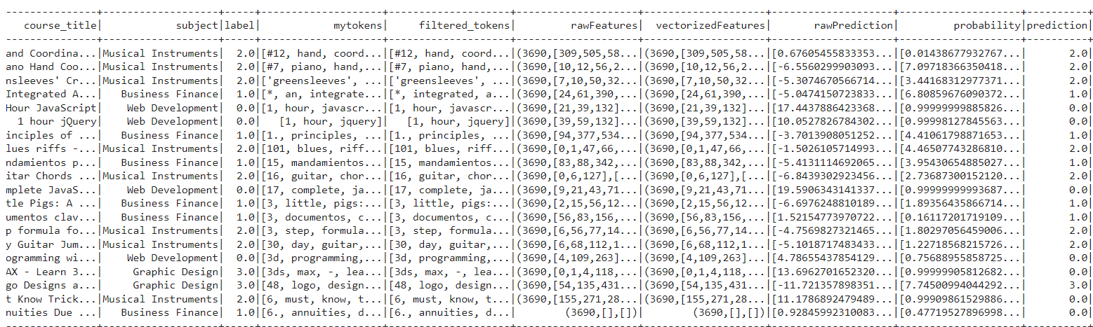
Here in naked eye only we can see that the label and prediction of most of the data points are getting matched except last two. On checking evaluation parameters only we can say, how good the Model is performing.

Slide 18
Model Evaluation
Precision and recall are two crucial yet misunderstood topics in machine learning
The recall is the measure of our model correctly identifying True Positives.
Precision is the ratio between the True Positives and all the Positives.
we need a tradeoff between Precision and Recall. For that F1-score is being calculated.F1-score is the Harmonic mean of the Precision and Recall.
So if all this results out good percentage, then we can say that the model has performed well. And we are getting all our evaluationn parameters of model as more than 90%. Which means the model is able to perform well.
We got an accuracy of above 92%
We Made use of Different Multiclass metrics for Evaluation
we use precision recall and f1 score to evaluate the model.
The recall is the measure of our model correctly identifying True Positives.
Precision is the ratio between the True Positives and all the Positives.
we need a tradeoff between Precision and Recall. For that F1-score is being calculated.F1-score is the Harmonic mean of the Precision and Recall.
we are getting all our evaluation parameters of model as more than 90%. Which means the model is able to perform well.

Slide 19
Summary
Whether the author are releasing their courses more on online MOOC platform like Udemy or not?
We can see a gradual Increase in people releasing their Courses over the period of time. Especially there has been a sudden rise in the number of courses from 2014 to 2015.
Distribution Of content?
32.6% courses on the Udemy is for WEB DEVELOPMENT
32.5% courses on the Udemy is for BUSINESS FINANCE
18.5% courses on the Udemy is for MUSICAL INSTRUMENT
16.4% course on the Udemy is for GRAPHIC DESIGN
Duration Distribution Across Type of Course?
We can see that paid courses have a higher duration. It is also worth noting that duration varies considerably more on paid courses as well.

Slide 20
Summary cont.:-
Top 25 free and paid course in Udemy
We saw that around 20 course out of top 25 are related to coding.
We will see WordCloud of popular term in the course subject of Udemy and also most common word out of that.
Achieved
We will try to see whether through the given data, is it possible to predict the number of subscribers? We will try to make use of p-value to make our feature selection.
So the prediction of the number of subscribers may not yield that much current stage, because of the constraint in better features.
We will perform text classification so as to predict Genre/Subject.
we are getting all our evaluation parameters of model as more than 90%(f1, accuracy etc.). Which means the model is able to perform well.

Slide 21
Last Few Words
We did a full Fledged Data science Project where we try to perform EDA and different types of Visualization
We saw Text Analytics different concept of regex, token, stop words, tf-idf, vectorizer, corpus, tokenizer and all followed by word cloud.
We did a machine learning implementation on pandas data frame as well
We did different type of feature transformation and data preparation using spark data frame
We use spark + Machine learning to design a model to predict subject/Genre label with a very good accuracy.
Code :-https://colab.research.google.com/drive/1am8z1w_hUv28omYKVqgbiztgv7g6cEAA?usp=sharing
THANK YOU

