Slide 1


INDUSTRIAL TRAINING PRESENTATION
PROJECT SNAPSHOT
6-Week Web
Development Internship
Datamon. — practical web development project
BeeSkilled • Web Development (HTML / CSS / JS)
Kalpesh Sharma
B.Tech – Artificial Intelligence & Data Science
Arya College of Engineering
BeeSkilled • Industrial Training | Kalpesh Sharma
1

Slide 2
01 | TRAINING OVERVIEW
About the Internship
A concise overview of the training completed at BeeSkilled.
Organization
Duration
Domain
BeeSkilled — Tech and Internships
6-week online internship program
Web Development
HTML / CSS / JS
• Completed practical web-development learning
• Worked toward a complete website project
• Certificate issued on 28 August 2026
BeeSkilled • Industrial Training | Kalpesh Sharma
2

Slide 3
02 | OBJECTIVES
Training Objectives
The main goals of the internship.
• Build a foundation in front-end web development
• Understand how HTML, CSS and JavaScript work together
• Practice creating structured and responsive web pages
• Apply learning through a practical website project
• Improve debugging, problem-solving and development workflow
LEARN
Understand core concepts
PRACTICE
Convert concepts into pages
APPLY
Build and refine a project
BeeSkilled • Industrial Training | Kalpesh Sharma
3

Slide 4
03 | TECHNOLOGY
Technologies & Development Skills
Core technologies identified on the internship certificate.
HTML
CSS
JavaScript
Page structure
Semantic content
Sections & navigation
Layout & styling
Typography
Responsive presentation
Interactivity
Basic dynamic behavior
User interactions
• Supporting concepts: UI/UX, responsive design, debugging and testing
BeeSkilled • Industrial Training | Kalpesh Sharma
4

Slide 5
04 | LEARNING
What I Learned
Key skills developed during the internship.
TECHNICAL LEARNING
PRACTICAL LEARNING
• Creating structured webpages with HTML
• Styling layouts and visual components with CSS
• Using JavaScript for interactive elements
• Organizing content into clear website sections
• Understanding responsive design principles
• Debugging layout and interaction issues
• Following a step-by-step development workflow
• Turning a design idea into a working webpage
BeeSkilled • Industrial Training | Kalpesh Sharma
5

Slide 6
05 | WORKFLOW
Training & Development Process
A simple flow from learning to project completion.
01
02
03
04
05
Learn
Practice
Build
Test
Refine
Understand concepts
Work on exercises
Create website sections
Check layout & behavior
Fix and improve
→
→
→
→
BeeSkilled • Industrial Training | Kalpesh Sharma
6

Slide 7

06 | PRACTICAL WORK
Project Overview
A brief look at the practical website developed during the internship.
Datamon.
• Professional landing page
• Service and project presentation
• Technology and process sections
• Contact / consultation section
A professional website concept for a Data & AI engineering agency.
The project was used to apply HTML, CSS and JavaScript skills in a complete website structure.
BeeSkilled • Industrial Training | Kalpesh Sharma
7

Slide 8
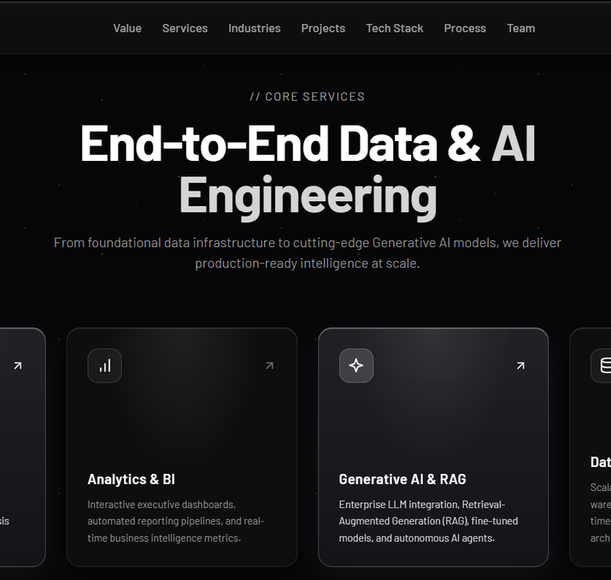
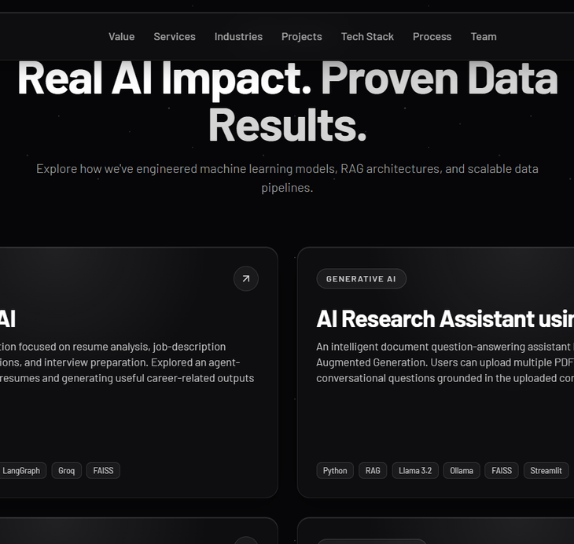
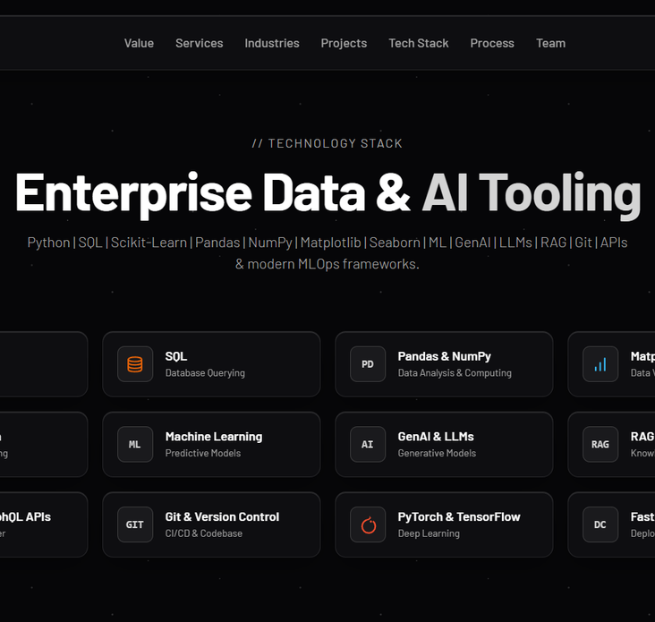
07 | PROJECT EVIDENCE
Selected Project Screenshots
A brief demonstration of the practical work.
Services
Projects
Technology Stack
BeeSkilled • Industrial Training | Kalpesh Sharma
8

Slide 9
08 | CHALLENGES
Challenges Faced During Training
Areas that required practice and refinement.
Responsive Layouts
Visual Consistency
Maintaining a clean layout across different screen sizes.
Keeping spacing, typography and cards consistent.
Interactive Elements
Debugging
Connecting page elements with basic JavaScript behavior.
Finding and correcting layout or code issues during development.
BeeSkilled • Industrial Training | Kalpesh Sharma
9

Slide 10
09 | SKILLS
Skills Gained
Technical and professional skills developed during the internship.
TECHNICAL SKILLS
PROFESSIONAL SKILLS
• HTML & page structure
• CSS & responsive layouts
• JavaScript fundamentals
• UI/UX implementation
• Website testing and debugging
• Problem solving
• Attention to detail
• Project organization
• Learning through practice
• Completing a project workflow
BeeSkilled • Industrial Training | Kalpesh Sharma
10

Slide 11
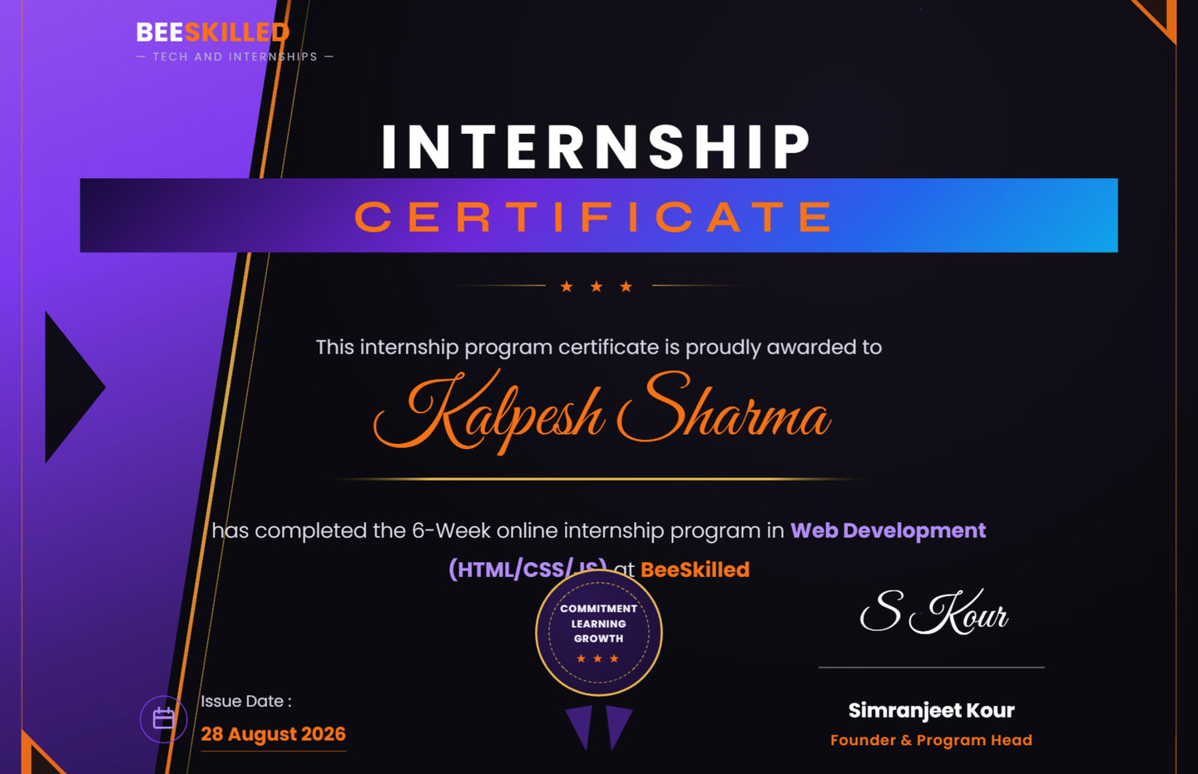
10 | CERTIFICATE
Internship Certificate
Certificate awarded by BeeSkilled after completion of the 6-week online internship.
PROGRAM
6-Week Online Internship
DOMAIN
Web Development
HTML / CSS / JS
ISSUE DATE
28 August 2026
BeeSkilled • Industrial Training | Kalpesh Sharma
11

Slide 12
11 | CONCLUSION
Training Summary
• Completed a 6-week online Web Development internship at BeeSkilled.
• Developed practical understanding of HTML, CSS and JavaScript.
• Applied the learning to build and refine a complete website project.
• Improved practical development, debugging and problem-solving skills.
THANK YOU
Questions & Answers
BeeSkilled • Industrial Training | Kalpesh Sharma
12

