Slide 1
Crop
File created on: 7/23/2021 2:28:17 PM

Slide 2
Crop Production Details
The Crop production dataset contains information about the production of each crop in different districts of individual states.
For each district it contains information such as area required for production, season in which the crop was produced for respective years and total production.
The dataset contains information from year 1997 to 2015. It contains information on 33 states and their respective districts.
There are 1.5% null values in production feature that can either be dropped or filled with the mean values of production for the respective crop of respective state depending on area.
Area required for cultivation varies from 0 to 8.5 * 10^6 sq ft.
The mean area required is 12*10^3 sq ft. There are outliers in the area for different crops which can be capped to extreme values.
Production of crops ranges from 0 to 1.2 * 10^9 tons for each instance.
The mean crop production is recorded as 5.82 * 10^5 ton.

Slide 3
Rainfall Details
The Rainfall Dataset contains information about the historical rainfall for every month from 1997 to 2015.
The data is recorded for 36 states and union territories.
It also has information of annual rainfall and rainfall in different seasons in each year for all state and union territories.
The average annual rainfall for all the years is 1358 mm. The average annual rainfall varies from 92 to 4229 mm.
The highest average rainfall is recorded between June to Sep month. Jun to Sep can be termed as seasonal rainfall month or rainy season.
The average seasonal rainfall varies from 67 to 3727mm.
The rainfall features have outliers which can be treated by capping with extreme values.

Slide 4
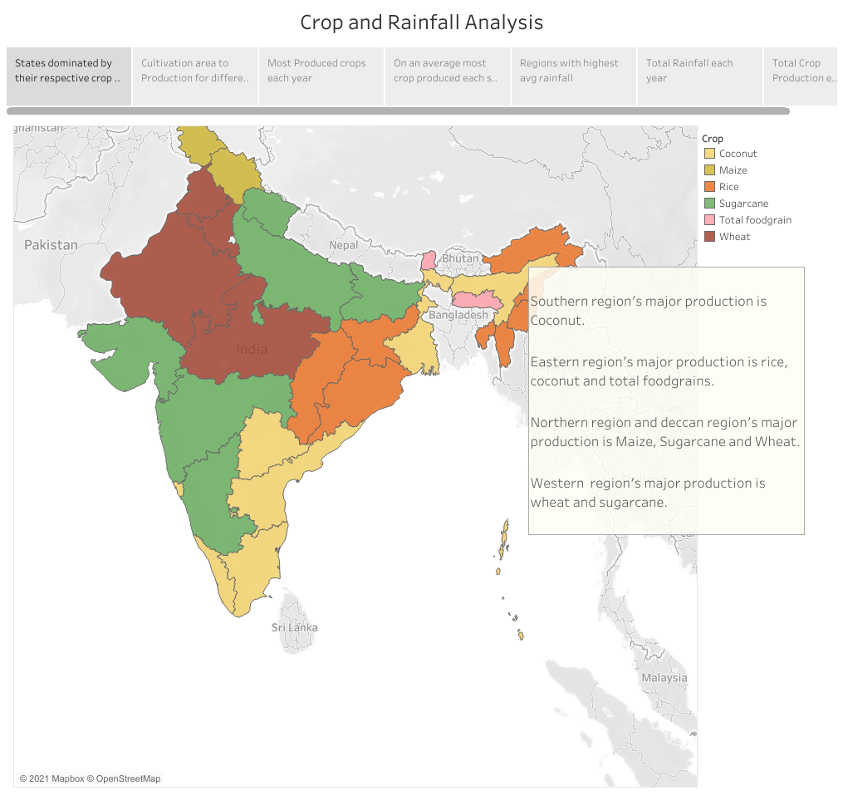
States dominated by their respective crop.

Slide 5
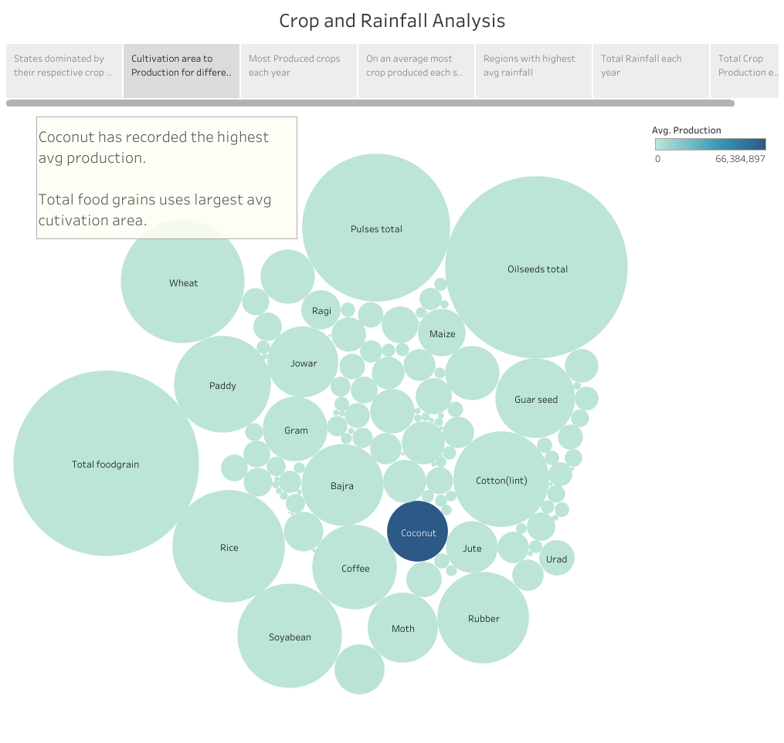
Larger the size of circle more the area.
Deeper the color more the production.
Crop Production with respect to its cultivation area.

Slide 6
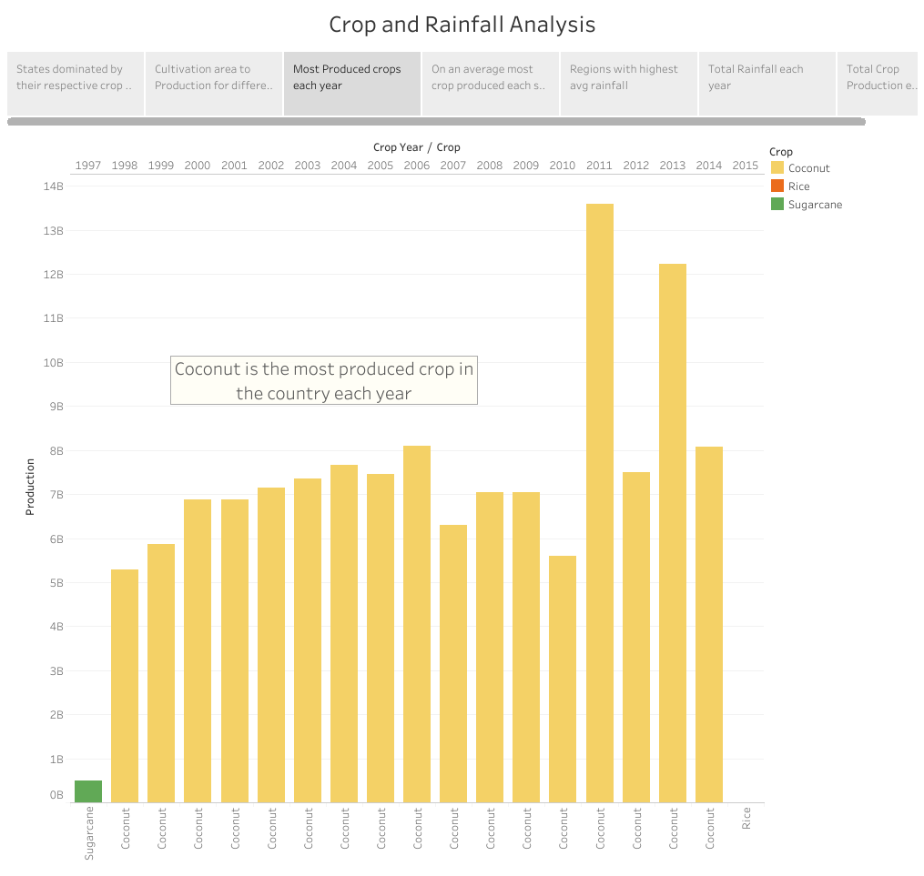

Slide 7
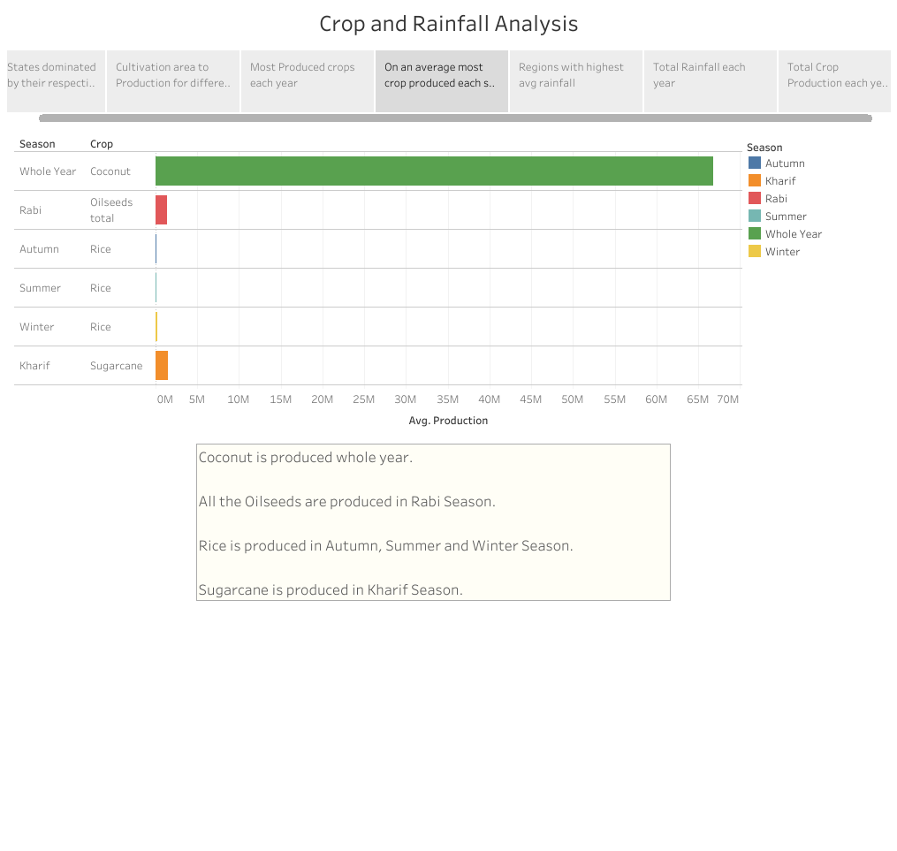
Most produced crop each season.

Slide 8
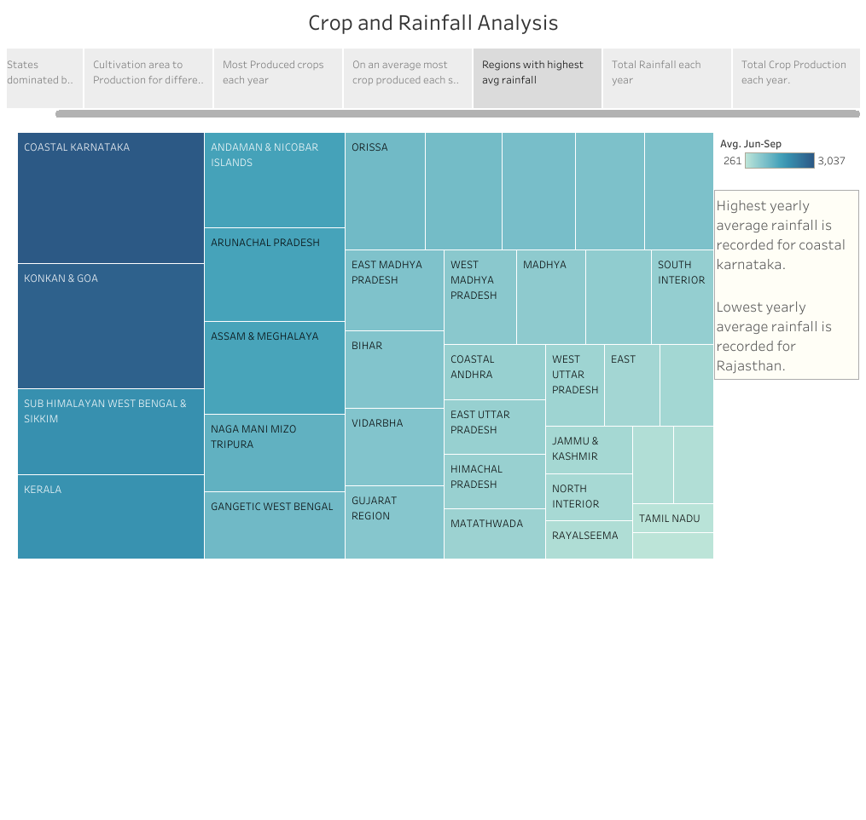
Regions with highest average rainfall

Slide 9
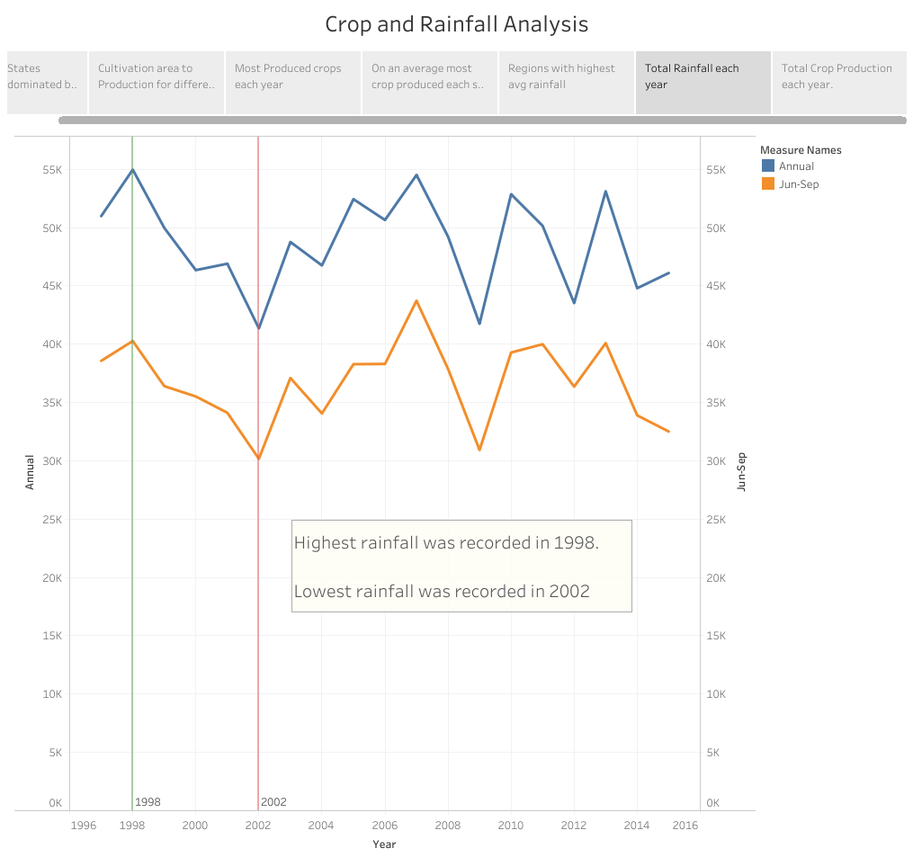

Slide 10
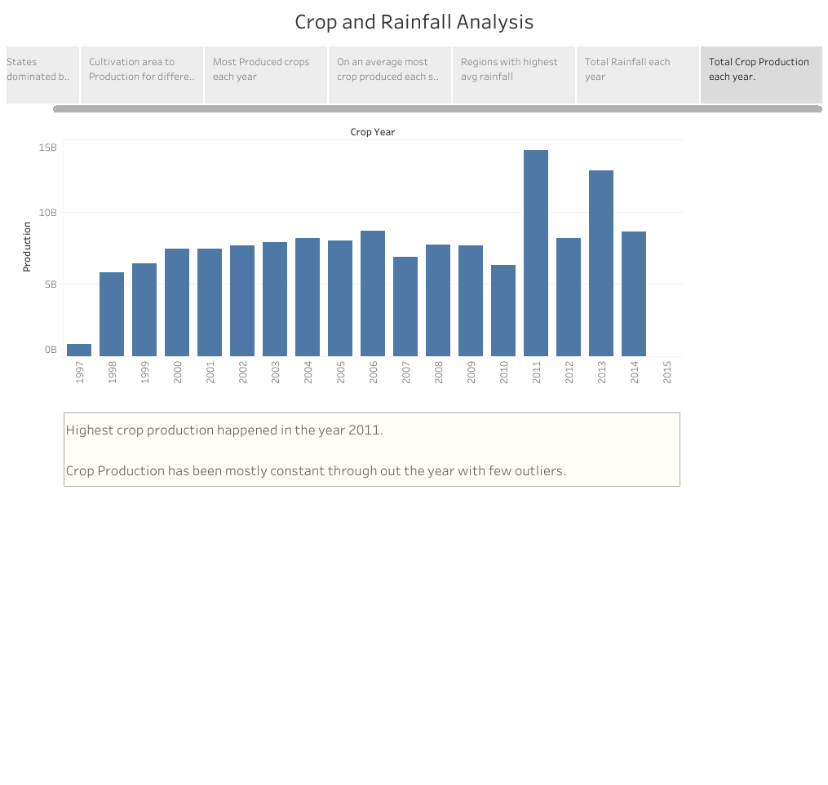
Total crop produced each year.

Slide 11
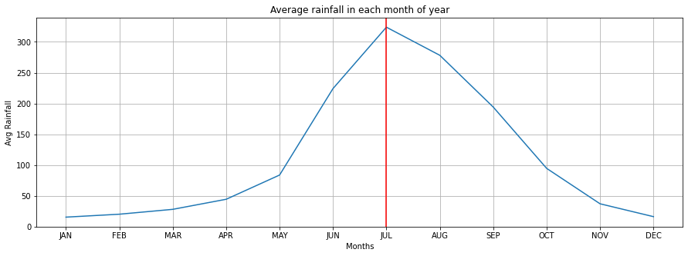
July receives the highest rainfall in a year.

