Slide 1

















Today’s challenges: why go-lives slip.
HOW DELIVERY RUNS TODAY
Delivery director
Resource manager
Customer sponsor
Implementation lead
VP of customer success
Hears a project is at risk close to its go-live date.
Books consultants already on too many projects at once.
Signs off stage deliverables after they are due.
Writes each weekly status report by hand, about an hour each.
Needs headline numbers and what changed, every Monday.
WHERE IT BREAKS DOWN
THE RESULT
Migration runs late
Sign-offs stall
=
Data migration takes longer than planned.
Customers sign off a stage after its due date.
Go-lives slip
People overbooked
Reporting by hand
Warning comes too late
Consultants are booked on too many projects at once.
Status reports take about an hour each.
Notes:
ClickUp's own brief names three causes of late go-lives: data migration running long, customers signing off late, and consultants booked on too many projects. Status reports also take about an hour each.

Slide 2



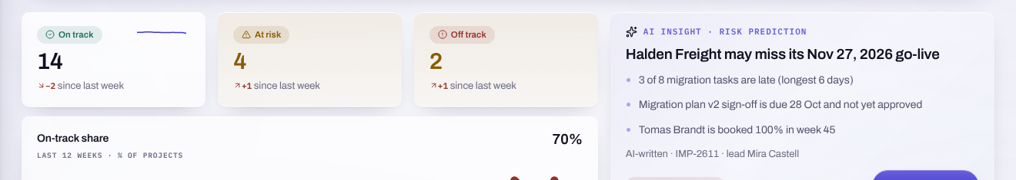



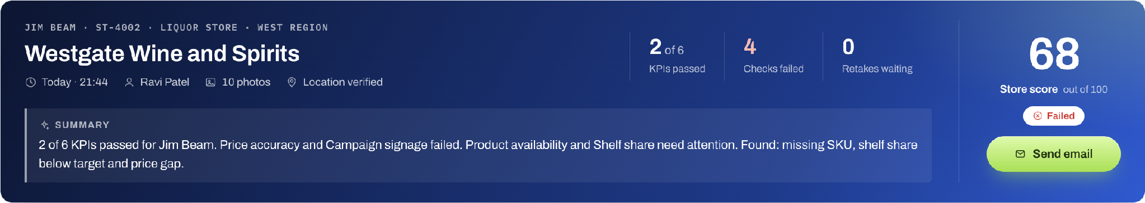
Reinvented: one record, from risk to report.
FROM PORTFOLIO RISK TO PUBLISHED REPORT
Risk flagged on Portfolio
Capacity checked first
Report drafted by AI
AI-written, with confidence and evidence
Over 100% refused before saving
The lead edits, then publishes
39 sec
48 h
120%
From question to an AI-written status draft
Change routed to director, then finance
Booking refused before saving, with the weeks and hours over
Notes:
One story runs through the demo: Halden Freight, at risk of missing its 27 November go-live. The Copilot's status draft came back in 39 seconds in the demo; the booking that would have taken Tomas Brandt to 120 percent was refused before it saved.

Slide 3
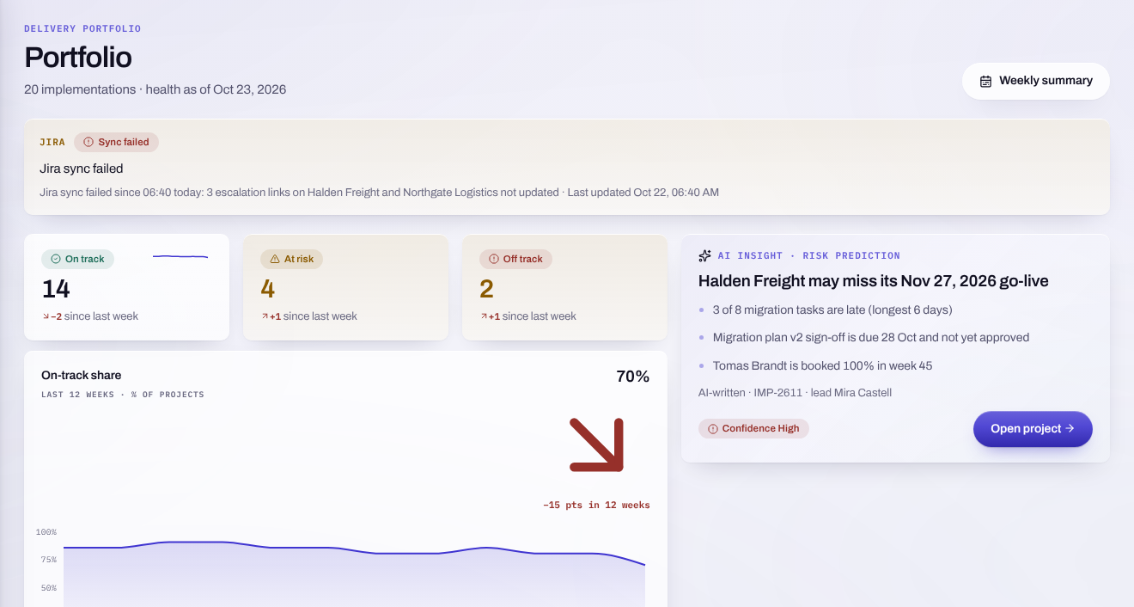



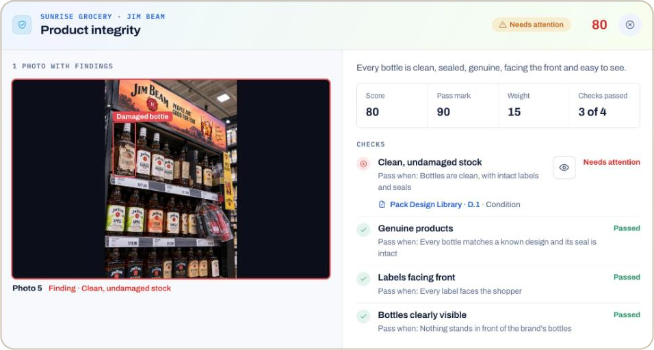




Every project’s health, with the risk named.
WHAT THE DELIVERY DIRECTOR GETS
Health at a glance
On track, At risk and Off track, with the change since last week.
Risk flagged early
An AI-written risk card with a confidence level and the evidence behind it.
Risks by likelihood and impact
A grid of the open risks, RSK-1183 at likelihood 4.
Portfolio, as the director sees it
Filters that stick
From the demo: 14 on track, 4 at risk and 2 off track, with Halden Freight flagged High.
Region, stage, health and lead as removable chips.
Notes:
Portfolio shows every implementation's health and names the project most likely to slip, with its evidence.

Slide 4
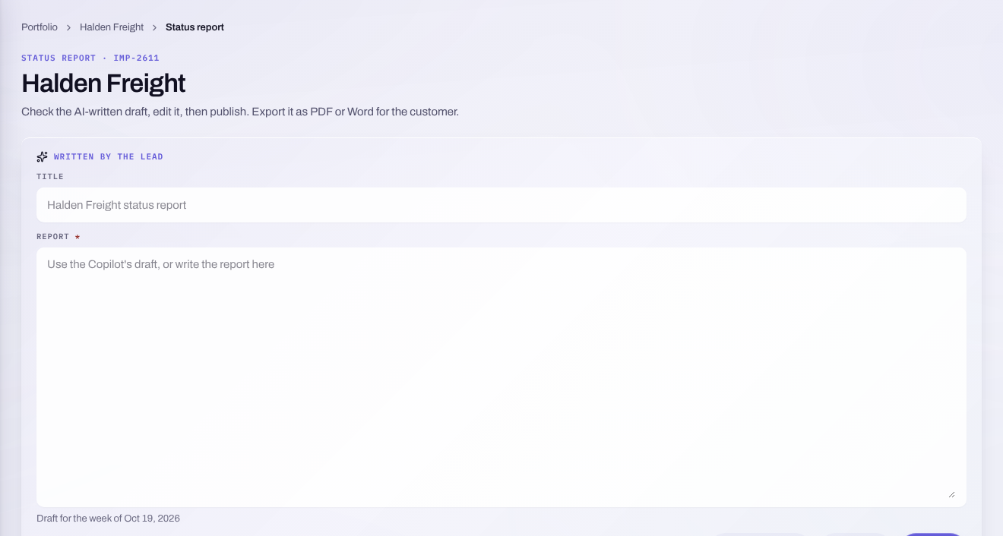



The weekly report, drafted for you.
WHAT THE IMPLEMENTATION LEAD GETS
Board by stage
Seven stages, a column limit, and a keyboard path for every move.
Scope changes with a diff
Before and after plans side by side, routed to the right approvers.
AI-written draft
Delivery Copilot drafts the status report from tasks, risks and time.
The status report editor
Nothing published unseen
From the demo: the editor where the lead edits and publishes Halden Freight's report.
The lead edits the draft and publishes it; the Copilot cannot write.
Notes:
The lead runs the project on one screen and gets the weekly report drafted from the project's own records.

Slide 5
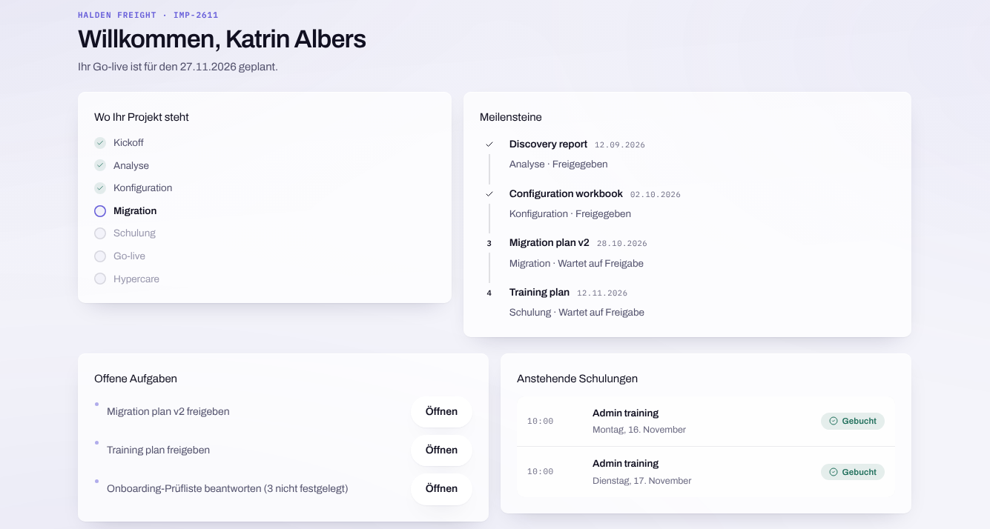



Their rollout, in their language.
WHAT THE CUSTOMER SPONSOR GETS
Only their project
Stage, milestones, sessions, open actions and shared documents.
In German
Portal screens and dates the German way, like 28.10.2026.
Sign-off with a record
Sign off a deliverable; who approved and when is kept.
The portal in German
Internal health stays inside
From the demo: Katrin Albers sees Halden Freight only, with Migration plan v2 due 28.10.2026.
Internal health scores are never shown to the customer.
Notes:
The sponsor follows the rollout and signs off in her own language.

Slide 6
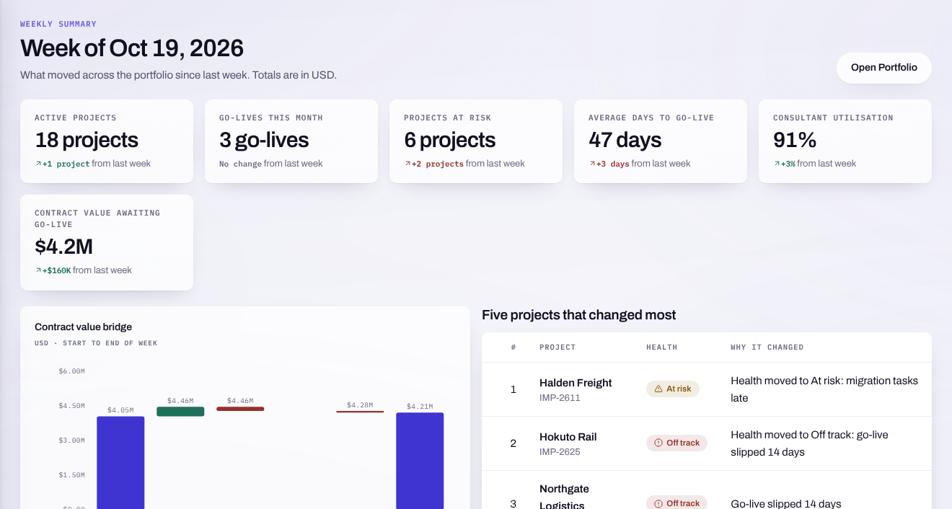



Monday’s numbers, and what moved.
WHAT THE VP OF CUSTOMER SUCCESS GETS
Six headline numbers
Each with its change from last week, coloured good or bad for the business.
Contract value bridge
From 4.05 million at the start to 4.21 million at the end, in USD.
What changed most
The five projects that moved most, each with its reason.
The weekly summary
Monday 08:00 email
From the demo: 6 projects at risk, 2 more than last week, shown as bad.
A sample of the summary each region receives at 08:00 local time.
Notes:
One page every Monday. In the demo the numbers are a seeded weekly snapshot.

Slide 7
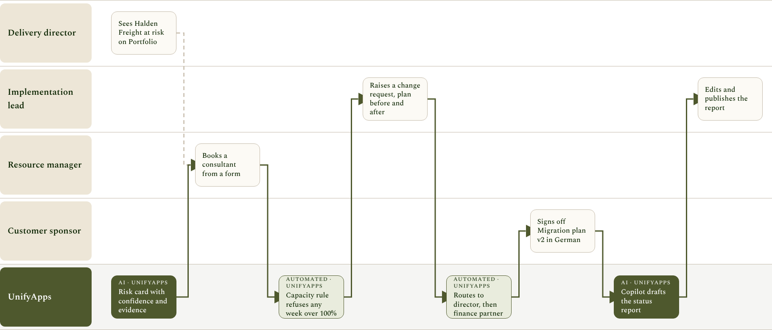
With UnifyApps: from risk to report on one record.
HOW IT WORKS WITH UNIFYAPPS
Notes:
Each step maps to a scene in the demo video and script.

Slide 8
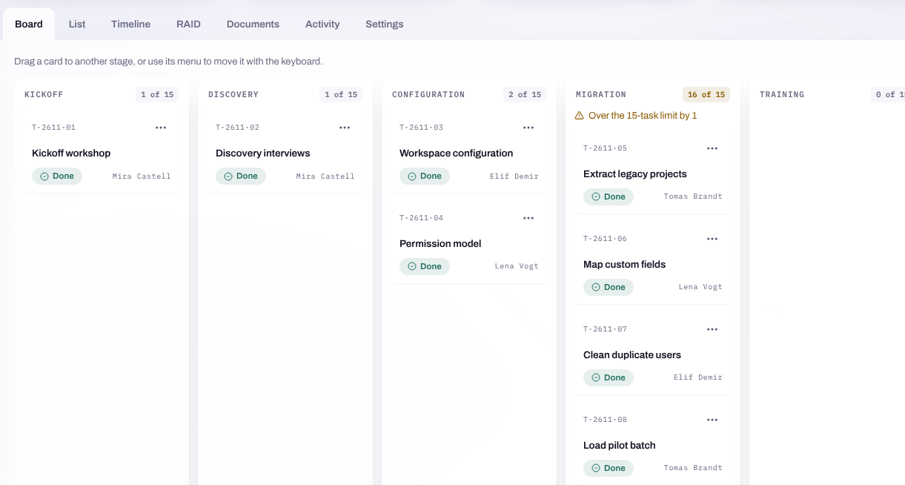



From proof of concept to a pilot.
NEXT STEPS
Agree the pilot
Pick a delivery region and its live projects.
Connect your systems
Salesforce, Slack, Google Drive and Jira, connected at go-live.
Customer sign-ins
Sponsors sign in to see only their own project.
Halden Freight's board
Roll out by region
From the demo: the board by stage, with Migration over its 15-task limit.
Region by region, with the weekly summary as the measure.
Notes:
The path from this proof of concept to a pilot with one delivery region.

