Slide 1
Electrical Laboratory Simulation(ELab)
By:
Abhinav Puri(2011CS1001)
Arbaaz Singh(2011CS1004)
Gurasis Singh(2011CS1008)
Harsimran Singh(2011CS1009)
Sahil Dabra(2011CS1033)
Gourav Bansal(2011CS1057)

Slide 2
Business Logic
Errors in an Electrical Circuit can have adverse effects.
Loss can be in form of:
Money
Time
Therefore, need for a Simulation Software.

Slide 3
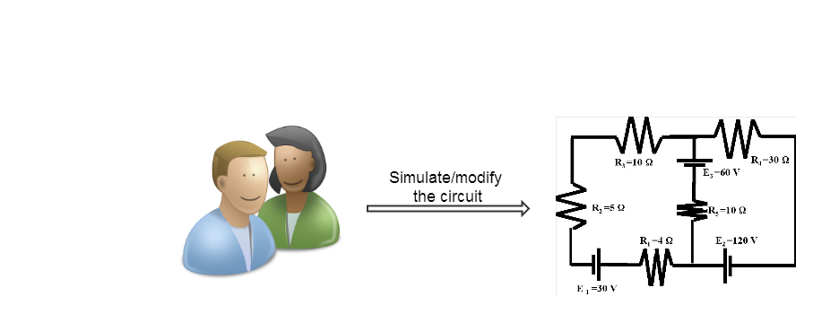
Use Case: Simulate/Modify
Simulate an Electric Circuit.
Modifying the Electric circuit.

Slide 4
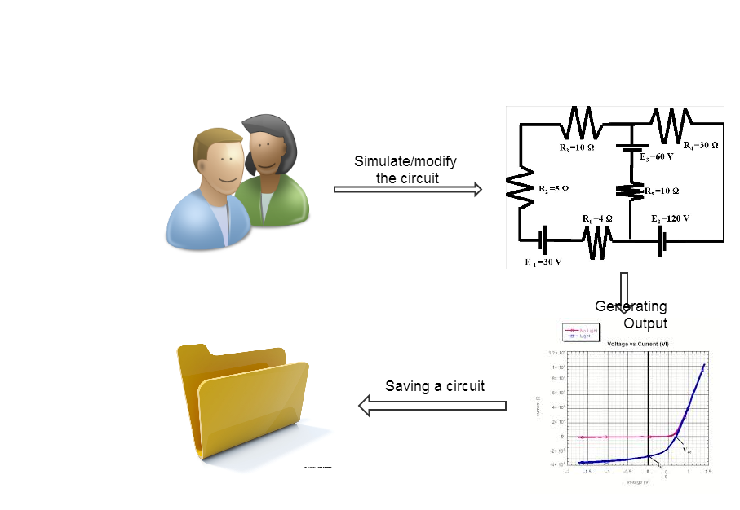
Use Case: Output/Save/Retrieve
Getting Relevant Output or Graph.
Saving an Electric Circuit.
Retrieving a saved Electric Circuit.

Slide 5
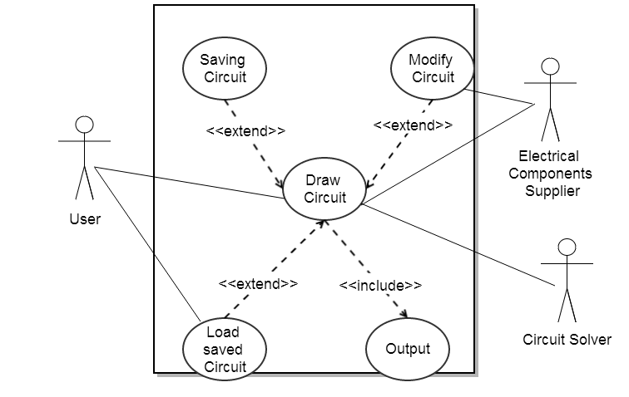
Use Case Diagram

Slide 6
Use Case Diagrams
Saving a circuit, Modify the circuit and Retrieve a saved circuit are extensions of Drawing a circuit. (extend)
Output/Draw Graph includes Drawing a circuit as a subtask. (include)

Slide 7
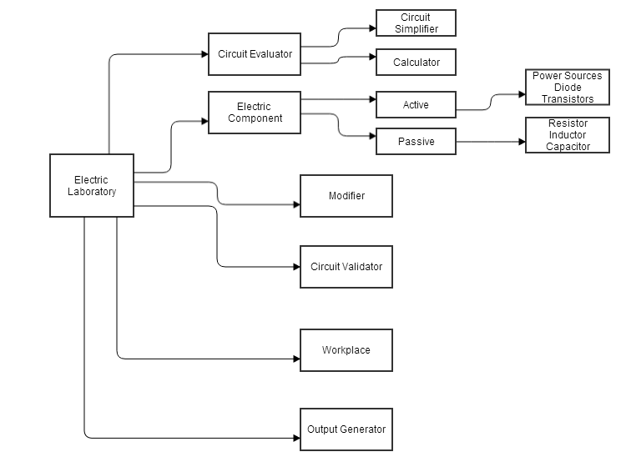
Logical View

Slide 8
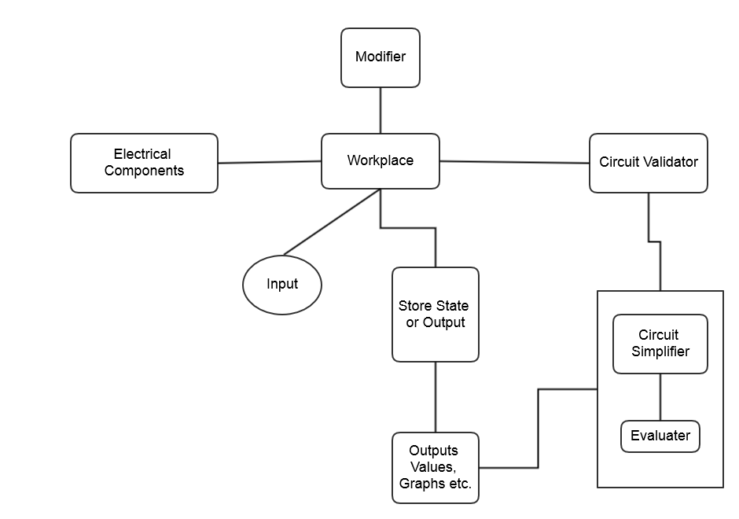
Process View

Slide 9
Architectural Pattern (MVC)
Model : Various electrical components such as resistors, power sources are created as objects acting as models.
View: contains various draw functions like drawResistor(), drawWire(), etc.
Controller: contains various events handlers taking input from user via mouse/keyboard and updating the model and view accordingly.

Slide 10
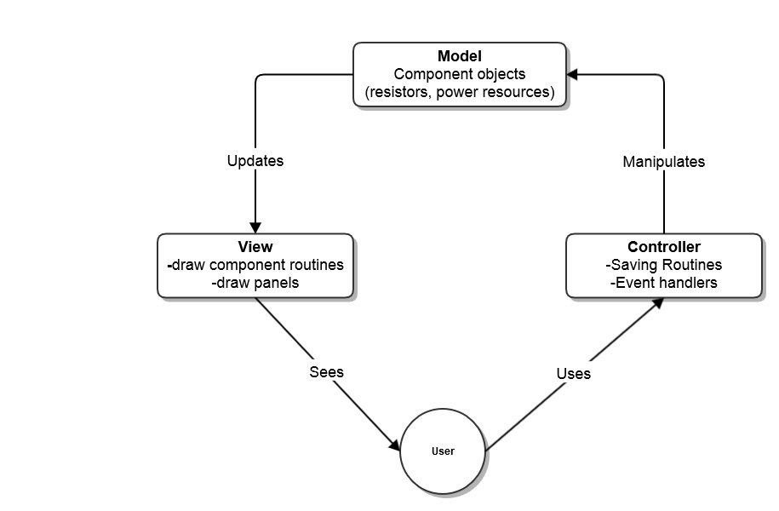
Model View Controller

Slide 11
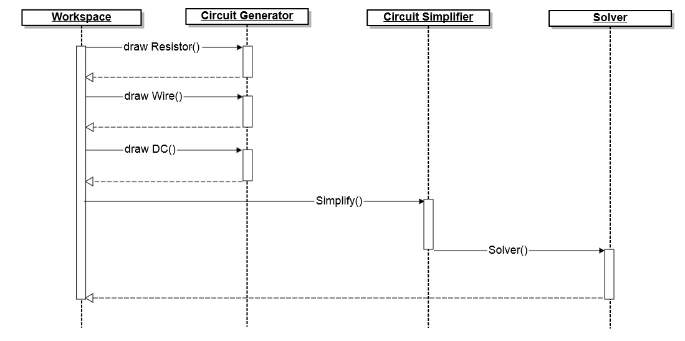
Sequence Diagram of Resistive Circuit

Slide 12
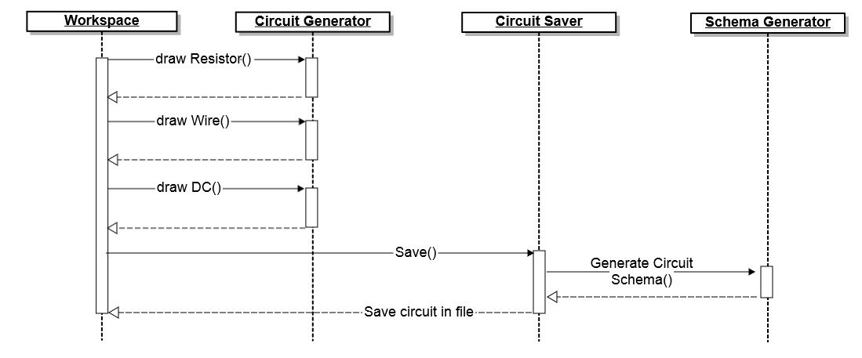
Sequence Diagram of Saving Circuit

Slide 13
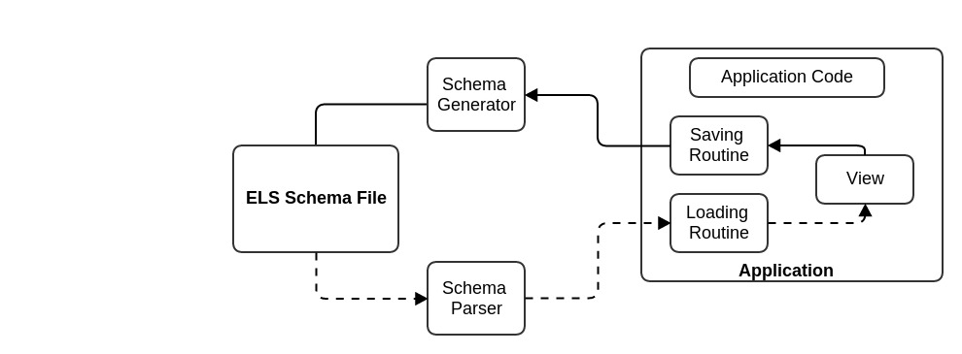
Parser Architectural Overview
Dotted Line represents Schema to Java
Complete Line represents Java to Schema

Slide 14
ELS Schema Mapping
ELS Schema | Java Bindings
<circuit> | ELS.Model.Junction.Java
<resistor> <rvalue> </rvalue> . . </resistor> | ELS.Model.Resistor.Java
<wire> <wx1> </wx1> . . </wire> | ELS.Model.Resistor.Java
<dc> <dcvalue> </dcvalue> . . </dc> | ELS.Model.DCsource.Java

Slide 15
ELS Schema Example
$$ ELS v1.0 @iitropar $$
<Project Name : proj\>
<Circuit>
<cid : 1>
<Resistor>
<rvalue> 5.0 </rvalue>
<rx1> 2 </rx1> <ry1> 5 </ry1> <rx2> 5 </rx2> <ry2> 2 </ry2>
</Resistor>
<Wire>
<wx1> 2 </wx1> <wy1> 5 </wy1> <wx2> 2 </wx2> <wy2> 8 </wy2>
</Wire>
.
.
.
.
</Circuit>

Slide 16
Technologies Used
JAVA
Javax.swing.*
Java.awt.*
JavaOctave runtime environment
Eclipse IDE

Slide 17
External Links:
Our term project can be found at Git Version Control system.
Link: https://github.com/abhinavp13/Elab
Java octave package libraries (Project Kenai)
Link: https://kenai.com/projects/javaoctave

Slide 18
Future Advancements
To include more components such as ICs, diodes, transistors etc.
To include more analytical features such as graphs of required output.
Setting operating temperature for the analysis.
To include further type of analysis, i.e. DC Analysis, Transient Analysis, AC Analysis.

Slide 19
THANK YOU

