Slide 1
CSE - Section B Subject - CS504D Quiz Management System
Group Number – B1.3
Submitted By:
Madhulika Ghosh - 13000117097
Gourav Khator - 13000117104
Bhumika Jindal - 13000117112
Debojyoti Das - 13000118019

Slide 2
Table Of Contents
Problem Statement
Scope
Project Requirements
Design – Class Diagram
Design Logic
Test Cases
Opportunities for improvement

Slide 3
Project Statement
Multiple Choice question format.
Includes a converter in Java for processing question texts in 3-4 different variations into a specified text file format.
GUI interface.
Result is displayed as a message box at the end of exam.

Slide 4
Scope
Educational institutions as well as in corporate world. Ex- Can be used at fest’s in college for quiz contest.
It may also be linked with database to manage different accounts.
Hall of Fame feature can be given.
Can be made online by making a webpage.
Project Requirements
The software used for the development of the project:
Java Runtime Environment (JRE)
Java IDE - Eclipse.(Optional)

Slide 5
Design – Class Diagram
MainQuiz
+ feedbackReq : static boolean
+ main(args[] : String) : static void
OutputFile
+ questionsList : List<String> + answersList : List<String> + feedbacksList : List<String> + optionsList : List<List<String>>
+ writeToFile (questions : List<String>, answers : List<String> , feedbacks : List<String> , options : List<List<String>>, feedbackReq : boolean ) : static void
QuizGUI
+ answerBtn : JButton +submitBtn : JButton + panel : JPanel + mainPanel : JPanel + questionLabel : JLabel + WINDOW_WIDTH : final int + WINDOW_HEIGHT : final int + c : int + x : int + y: int + temp2 : List<String>
--
Sample1 / Sample2 / Sample3 / Sample4
+ sc : static Scanner + feedbackReq : static boolean
+ process(feedReq : boolean) : static void + fetch() : static void
All the Sample1, Sample2, Sample3, Sample4 are having same data members and methods.

Slide 6
Design logic
The MainQuiz Class is having the main method of managing the quiz system.
Read the command line arguments and if –f is there then no feedback needs to be displayed, thus feedbackReq=false else it will be true.
Now, we process that file which has been entered by the user at the time of execution.
While processing the input file, we are separating questions, options of every questions, answers and the feedback or explanation of every question and storing them in class members of OutputFile class.
Now we are starting the quiz. We will take all the questions in the file and display them one by one to the participant or user.
Then QuizGUI class will display the questions with options in GUI using java swing.
User plays the quiz. Now it will check this answer with the correct answer stored in file. If he chooses the correct answer, then the count incremented.
At last, it will display the score via a message dialog box.

Slide 7
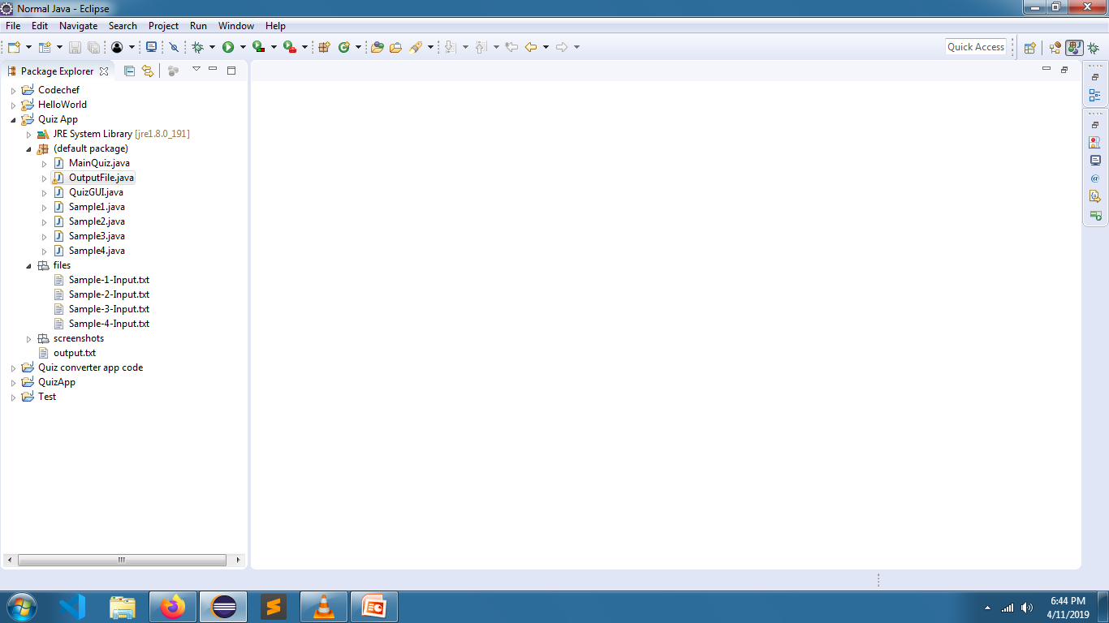
Test Cases
Snapshot of Directory Structure

Slide 8
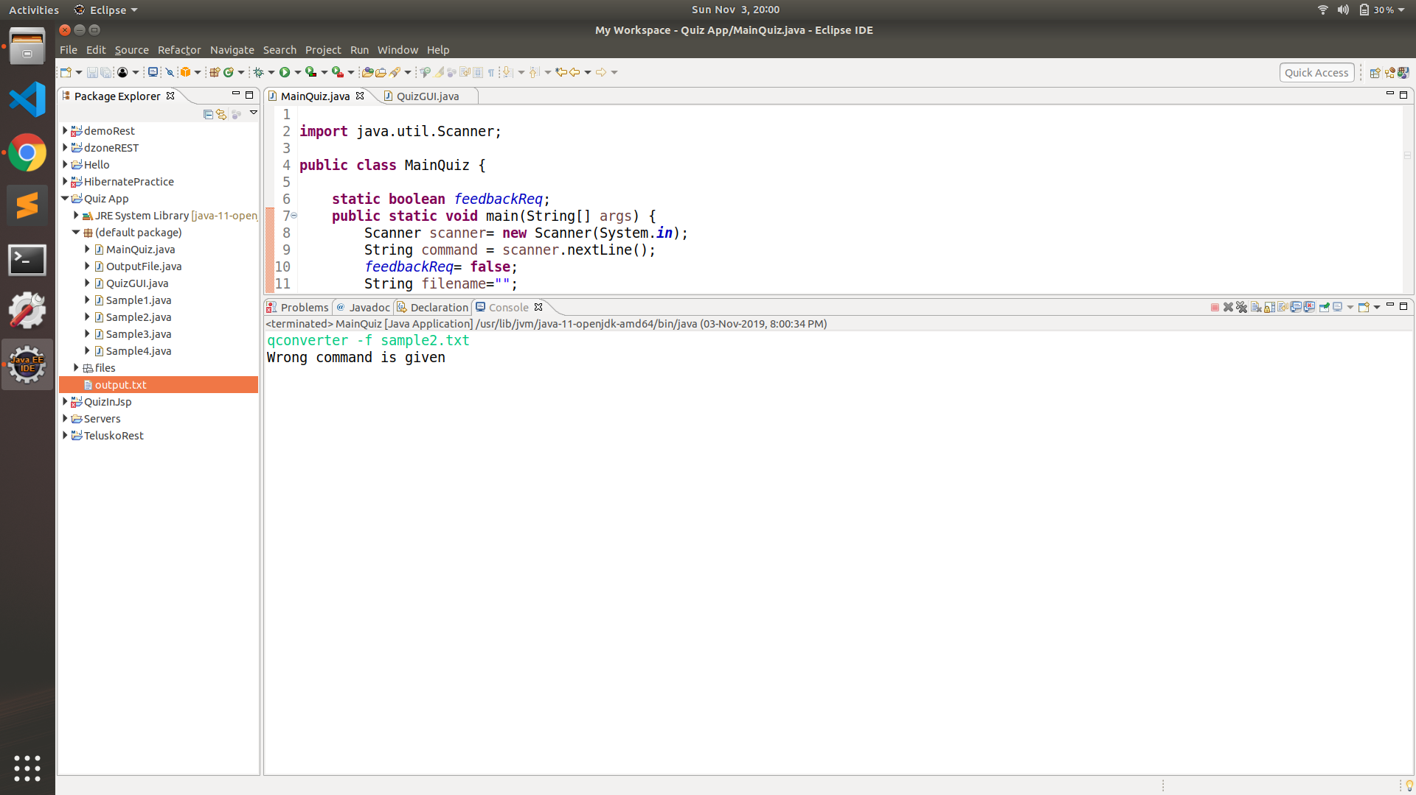



Slide 9
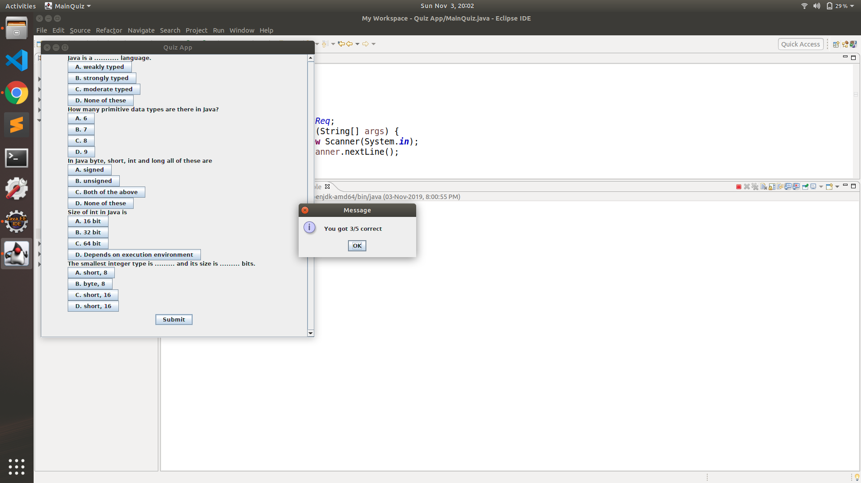

Slide 10
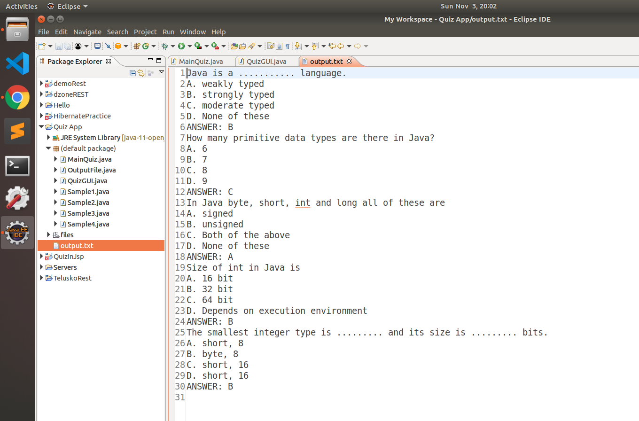
Output file after converter processing

Slide 11
Opportunities for improvement
Quiz management System has many advantages. With few more improvements to our project, it may be used in different places.
Help to create quizzes/surveys freely and manage them efficiently.
Help to track quiz results and generate insightful reports.
The creator can set a timer for the whole quiz or for each question
Randomizing of questions.
This may be linked with a database to maintain the record of various students. Login functionality can be given.
Moreover, the student’s performance may be graphically represented.
The project may even be converted in an online web app for attempting quizzes in various fields as per users choice.

Slide 12
Conclusion
This project has helped us in getting a clearer understanding of real world application development.
It has provided us a deeper insight into connecting files for input and output with java to make converter.
The entire learning outcome of this project has proved to be immensely beneficial for our future application development.
With our Java teacher, Prof. Utpal Das support we have successfully completed this project.

