Slide 1
Optimal Deep Learning Algorithm for DSP
Presented By:
Gourav Modi(G1502147L)
School of Computer engineering, Nanyang Technological University

Slide 2
Objective
To implement deep learning algorithm in Embedded platforms.
Exploiting the hardware and software features of the DSP to get maximal performance with optimum power consumption.
Benchmarking the results using 28x28 MNIST images against other embedded platforms like GPUs, Soft Vector processors.

Slide 3
Introduction
Supervised learning – Output/Labels for the training dataset are known. System is trained to predict similar but un-labelled data.
Example: Handwritten digit recognition, spam detection
Deep learning - Comprises of several layers of feature extraction process before making prediction on label.
Example: Object classification

Slide 4
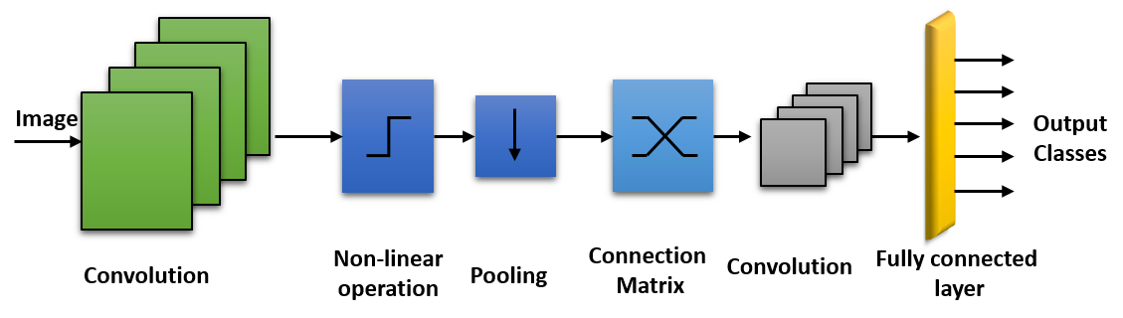
Example Architecture

Slide 5
Computation
Complexity
Image convolution/filtering operations
Matrix multiplication
Matrix inverse OR cost minimization using iterative method
Nonlinear activations – ReLU, tanh, sigmoid
Memory
Large buffer requirements
More DMA operations with small on-chip memory

Slide 6
Embedded System ?
Reduction on reliance on high-performance server machines at the back-end
Reduction in network dependency
Improve the overall response time for soft-real time applications such as Voice Assistant Systems, Image Recognition Systems, to name a few
Challenges -> Memory, Power

Slide 7

Example: Handwritten Digit Recognition
layer 1 feature maps
layer 1 feature maps
Feature extraction layer 1
Feature extraction layer 2
0
1
2
Fully connected layer

Slide 8
Methodology
Hardware
TMS320C6678 – Keystone 1 DSP board
Software
Libraries – Imglib, Dsplib
OS – sysbios
Language C
Input Parameters
Image Size – 28x28
L1 Maps – 50 with 7x7 kernel (6-7 maps per core)
L2 Maps – 128 with 5x5 kernel (16 maps per core)
L1-L2 connections - 10
Data Location
Image, Temp. Images, Kernel -> On chip memory (L2)
L1 & L2 Maps -> MSMC
Data pointer -> DDR

Slide 9
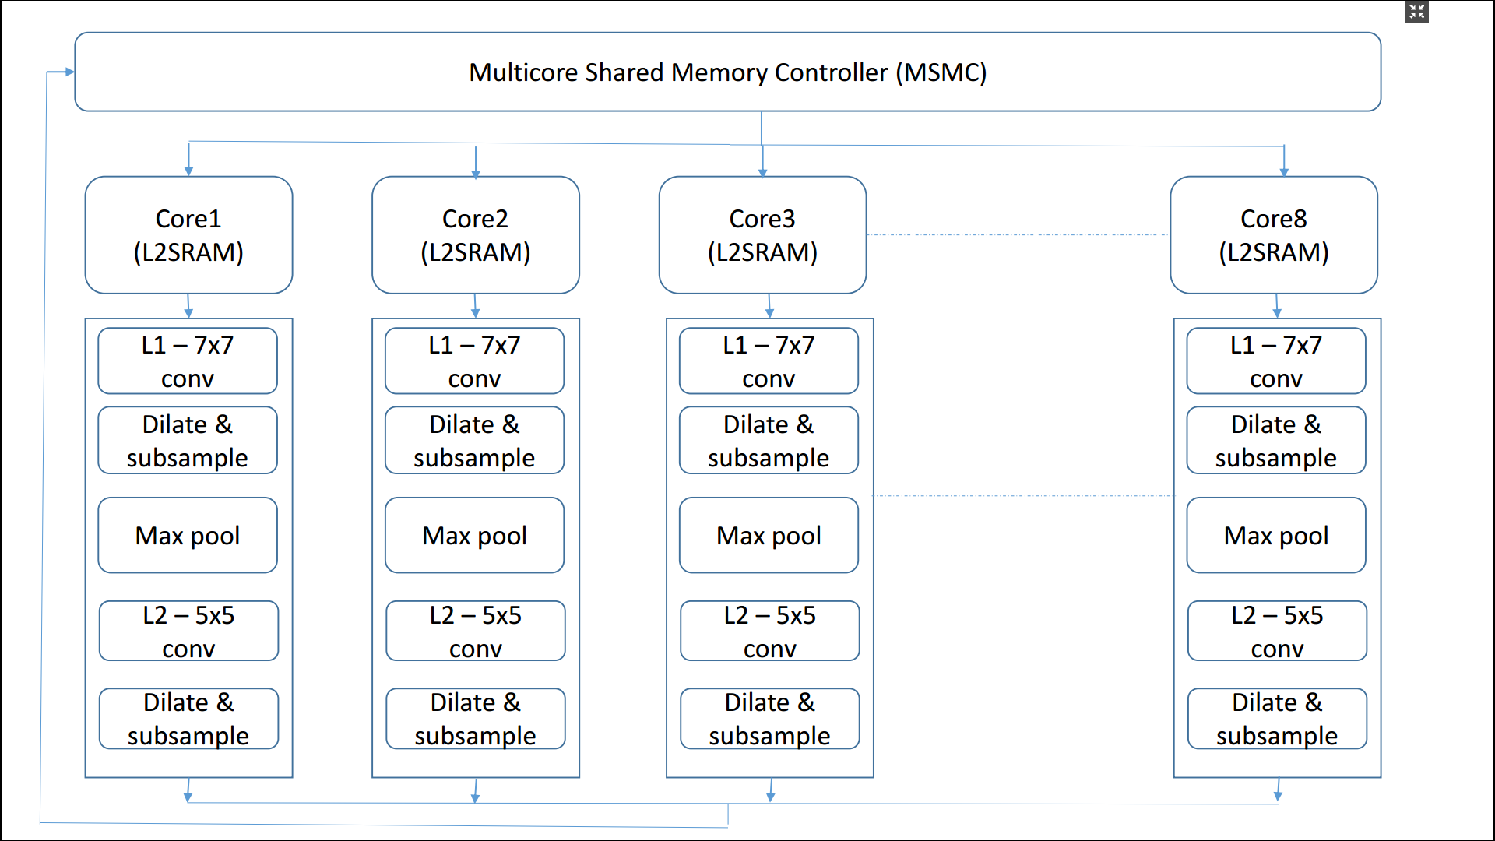
System Description
ReLU
ReLU
ReLU
ReLU

Slide 10
DSP Performance

Slide 11
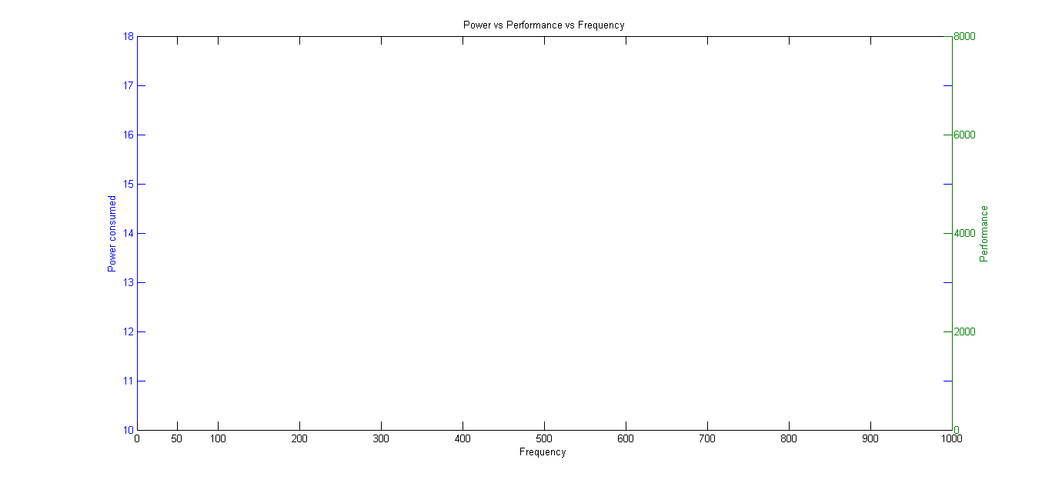
Power vs Frequency vs Performance

Slide 12
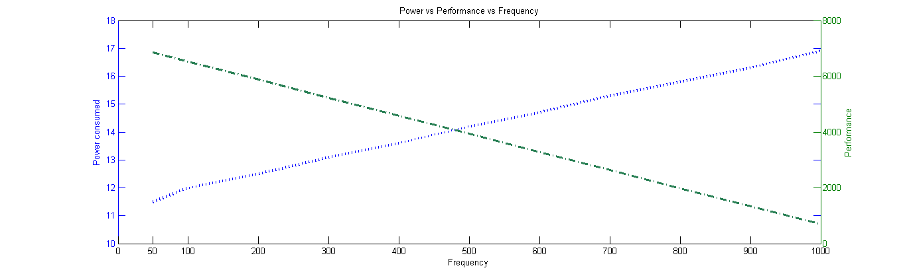
Power vs Frequency vs Performance

Slide 13
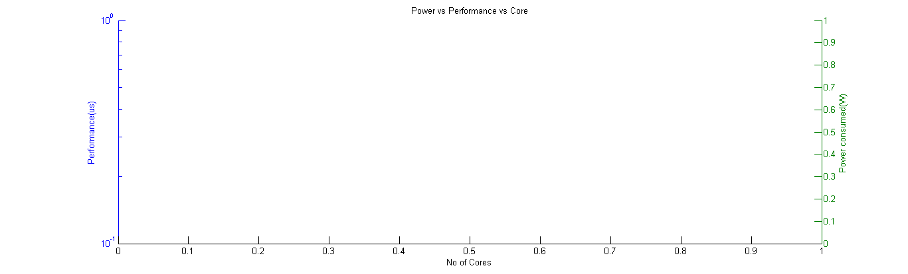
Power vs No. of cores vs Performance

Slide 14
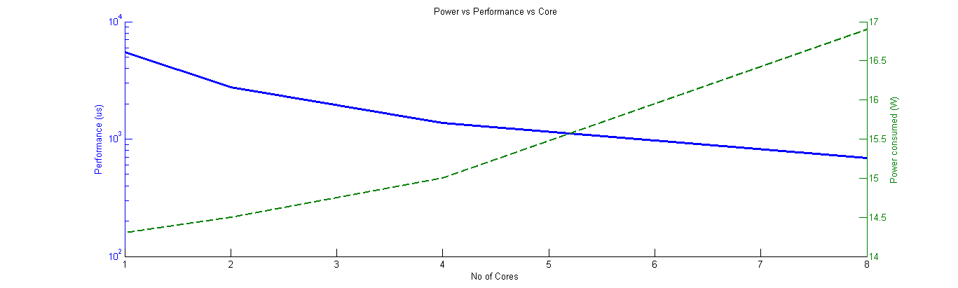
Power vs No. of cores vs Performance

Slide 15
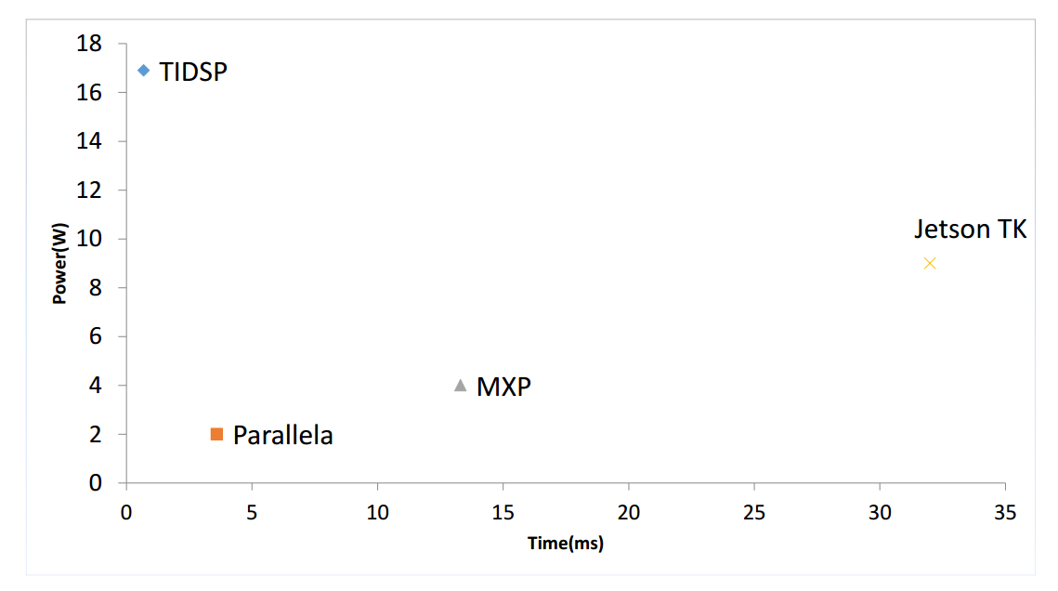
Conclusion

Slide 16
Future scope
Extrapolating the algorithm for higher resolution images.
Extending the algorithm for streaming inputs like videos.

Slide 17
Q & A

