Slide 1
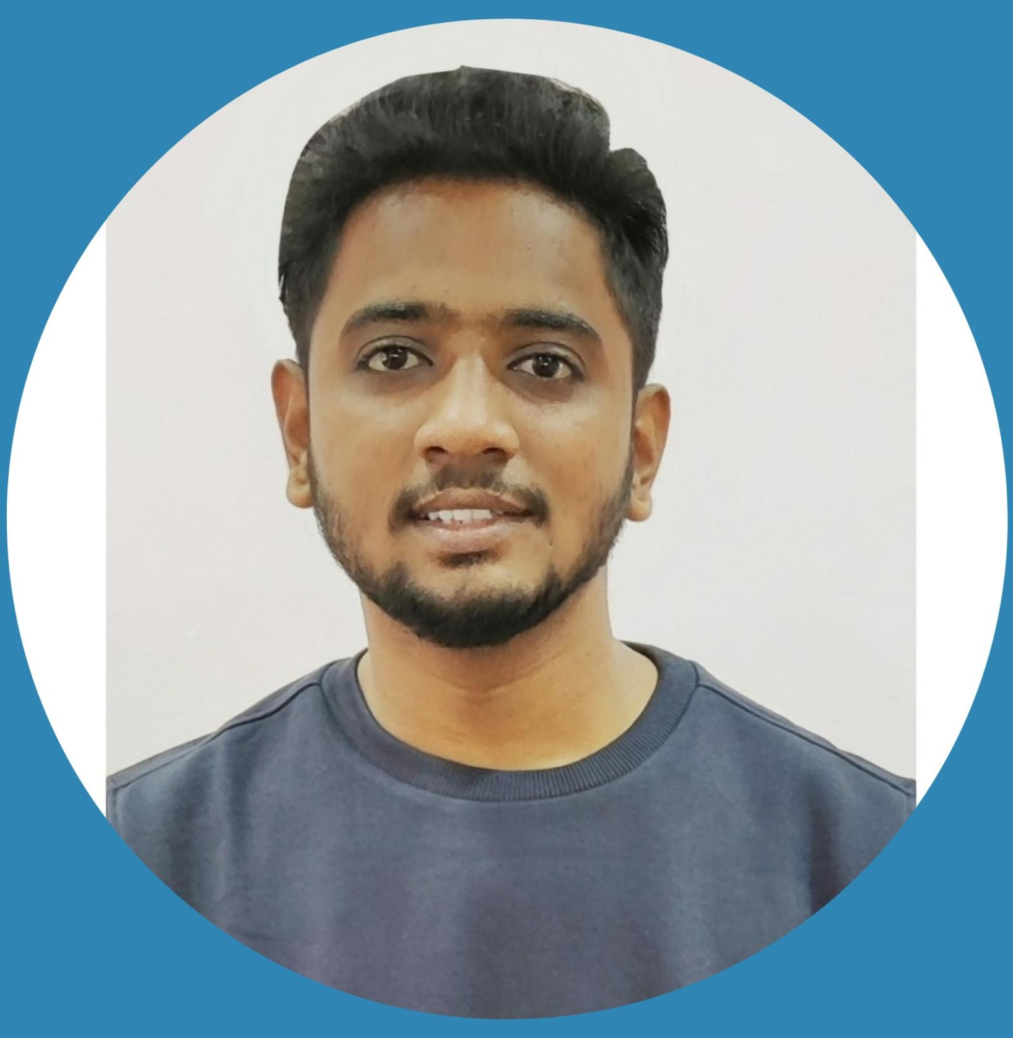



Gaourav Rajendra Pawar
Bachelor of Engineering
Computer Science(2021)
Analyst/Software Engineer
Skills
Pune
gaourav.pawar@capgemini.com
Java 8 /J2EE | Java Basics, OOPS, Generics, Collections, Arrays, Loops, Junit, Mockito, Servlets
Spring core | Dependency Injection, Autowire, Spring Security
Spring REST | REST controllers, Implementation of GET, POST, PUT & DELETE, Bean Validation
Spring Boot Microservices | Spring Boot Starters, annotations, Eureka Server’ Swagger API documents
Spring Cloud | Eureka, Netflix, Hystrix, Zuul & Config Server
Angular & React | Components, Services, Modules, Routing, Forms & Validation,
Database | MongoDB, Sql Basics
UI Tech | HTML 5 & CSS 3,JavaScript, ES6 & TypeScript Angular, React
Tools | Git, Postman, Swagger, Maven, IDE
Add On skills | Communications, Team management. Peer learning
+91 9960263022
A4
Having 2.9+ years of IT/Professional experience in analysis, design and development.
Able to motivate and perform well under pressure.
Has working knowledge on Java Microservice Development using Spring framework on a proficient level.
Hands on experience in creating microservices with Spring boot, REST API, Eureka server, API Gateway, Test Application using Swagger & Postman.
Has working experience on deploying spring boot applications in DEV QA and PROD environment by using AWS Solution architect framework
Flight Booking System Application
Completed end to end case study of Flight Booking Application along with Swagger, Eureka registration, HTML, CSS and Angular used for user interface.
Completed ” Full Stack Angular, Spring Boot MS & MongoDB & React” courses at Degreed flatform
Working experience
Developed Restful API’s using request methods and response structure. Writing business logic within service classes and analysing business rules and coordinate between the DAO & controller
Written & executed Unit Tests for maintaining code quality.
Supported multiple lower and prod environment’s deployment.
Check out my work on GitHub & Video Profile

