Slide 1

Improving Passenger Experience at Airports Using Generative AI
How GenAI can support passenger-service activities while acknowledging limits and the need for human review.

Slide 2

Problem Statement
Repetitive Queries
IRROPS Communication
High volumes of routine passenger questions overwhelm service teams.
Delays and irregular operations create delayed, inconsistent messaging.
Multilingual Feedback
Manual translation and policy interpretation create bottlenecks.

Slide 3

Target Audience & Objective
Audience
Airport management team
Objective
Explain how Generative AI can support passenger services while identifying risks and governance needs.

Slide 4

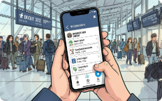
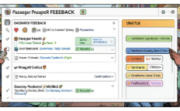

GenAI Use Cases for Passenger Services
Drafting Messages
Multilingual Support
Summaries & Triage
Self-Service Assistance
Generate clear, standardized drafts for delay and disruption notices.
Translate messages and passenger feedback at scale.
Condense feedback into operationally useful summaries for staff.
First-line chat responders for routine queries, freeing agents for complex cases.

Slide 5

Mechanism-First Workflow
Draft Generation
Human Review
GenAI composes a message draft.
Safety and compliance approval gate.
Data Ingestion
Dispatch & Monitor
Collect flight status and policy inputs.
Send messages and track responses.
Design emphasizes human approval gates and verified data inputs before dispatch.

Slide 6


Flight-Delay Communication Example
Notes
Use only verified flight data (API-bound) — do not rely on unverified sources.
Drafts are preparatory: human agent must confirm timelines and safety info.
Remove any specific operational metrics unless verified — mark with [VERIFY] when needed.
Draft Message
Prepare clear, consistent passenger notice
Review & Send
Detect Delay
Human agent confirms then dispatches
Use verified API flight data

Slide 7
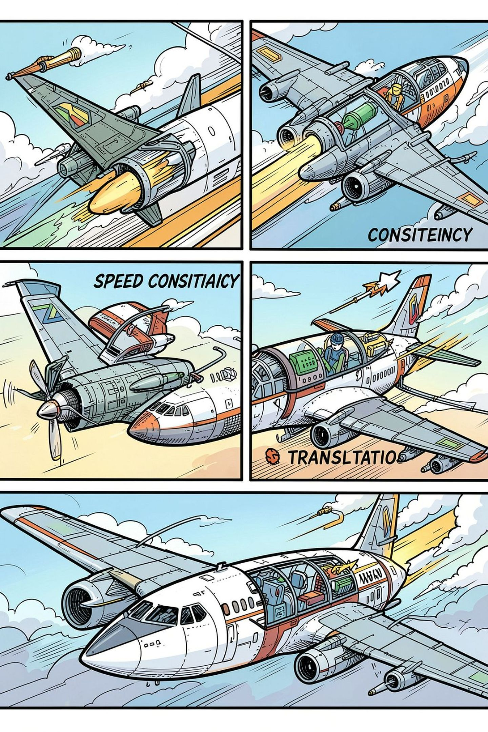
Expected Benefits (Responsible Framing)
Faster Drafts
Consistency
Accelerates preparation of initial messages and summaries.
Standardized structure and tone across passenger communications.
Multilingual Reach
Support for multiple languages to reduce manual translation load.

Slide 8



Risks & Limitations
Hallucinations
Privacy & Compliance
GenAI can produce incorrect or fabricated facts; human verification required.
Passenger data handling must meet GDPR and local data protection standards.
Bias & Accuracy
Language and cultural bias risks; monitor outputs for fairness and clarity.

Slide 9


Human Governance & Implementation Recommendations
Pilot low-risk cases first (e.g., FAQs, basic drafts).
Implement mandatory human approval gates for operational messages.
Bind systems to verified flight/APIs and audited data sources.
Document review logs and maintain an approval audit trail.
Avoid claims of guaranteed accuracy or guaranteed headcount reductions.

Slide 10

Summary, Audit Flags & Next Steps
Summary
GenAI can accelerate drafts, improve consistency, and scale multilingual support — with required human oversight.
Audit Flags
Mark unverified metrics [VERIFY], ensure data-source compliance, remove branded imagery that lacks permission.
Next Steps
Run an approved pilot, define approval gates, and compile verified reference list for final deck.

