Slide 1



KOLHAPUR’S INSTITUTE OF TECHNOLOGY,COLLEGE OF ENGINEERING,KOHAPUR
COMPUTER SCIENCE & ENGINEERING DEPARTMENT
Alumni Connect
Team Members
1.Siddhi Shah : C_47
2.Anisha Shelake : C_48
3.Gouri Ingale : C_59
4.Vaibhavi Bhope : C_75

Slide 2

Table of Contents
1️⃣ Introduction & Problem Statement
2️⃣ Objectives
3️⃣ User View
4️⃣ System View
5️⃣ Methodology
6️⃣ Research Paper References
7️⃣ Future Scope and Conclusion

Slide 3
Introduction and Problem Statement
PS: Implementation of the Alumni Association platform for the University/Institute.
1.Lack of Structured Alumni Engagement.
2.Challenges in Alumni Data Management.
3.Limited Interaction and Networking.
4.Enhancing Institutional Collaboration.

Slide 4
Objectives
1. Strengthen Connections and Engagement
Facilitate seamless interaction between alumni and students for mentorship, career opportunities, and events.
2. Enhance Career Support
Provide a platform for alumni to share job opportunities, internships, and industry insights with students.
3. Maintain an Updated Alumni Database
Create and manage an efficient alumni database for effective communication and outreach.

Slide 5
User View
1. Student Users
- Create profiles showcasing academic and career interests.
- Connect with alumni for mentorship and career advice.
- Access job listings and internships shared by alumni.
- Register for events, webinars, and networking sessions.
2. Alumni Users
- Manage profiles with career details and expertise.
- Offer mentorship and career guidance to students.
- Share job openings and internship opportunities.
- Participate in or organize events and webinars.

Slide 6
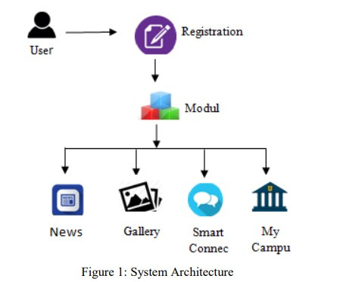
System View
1. Frontend (User Interface)
Mobile App
Flutter
2. Backend (Server-side)
API Integration
Flutter
3. Database
PostgreSQL / MongoDB
User Authentication (Firebase)

Slide 7


Methodology
Problem Identification
System Design
Development and Implementation
Future scope: Scale up for broader use

Slide 8

Future Scope & Conclusion
Future Scope
1. AI-driven mentorship and event recommendations.
2. Mobile app features like push notifications and chatbots.
3. Data analytics for user engagement and event insights.
4. Expanding to global alumni networks.
Conclusion
The Alumni Association Platform will enhance connections, career opportunities, and lifelong learning by using modern technology. Continuous updates will ensure active alumni engagement and long-term benefits for both students and graduates.

