Slide 1
Pharma Retailer Power BI Dashboard
Addressing Revenue Loss & Market Share Decline
🚀 Advanced Analytics with Power BI

Slide 2
📉 Business Problem
The Pharma Retailer faced significant challenges:
- Declining revenue over the last 3 months
- Loss in market share to competitors
- Frequent stock shortages causing customer dissatisfaction
⚠ Needed a data-driven solution to recover performance.

Slide 3
🛠️ Our Approach
We designed a comprehensive dashboard in Power BI by:
1. Collecting and cleaning 3 months of sales & inventory data
2. Creating KPIs using DAX (Revenue, Units Sold, Stock Levels)
3. Designing interactive charts for trend & shortage predictions
4. Building visual insights for quick decision-making

Slide 4
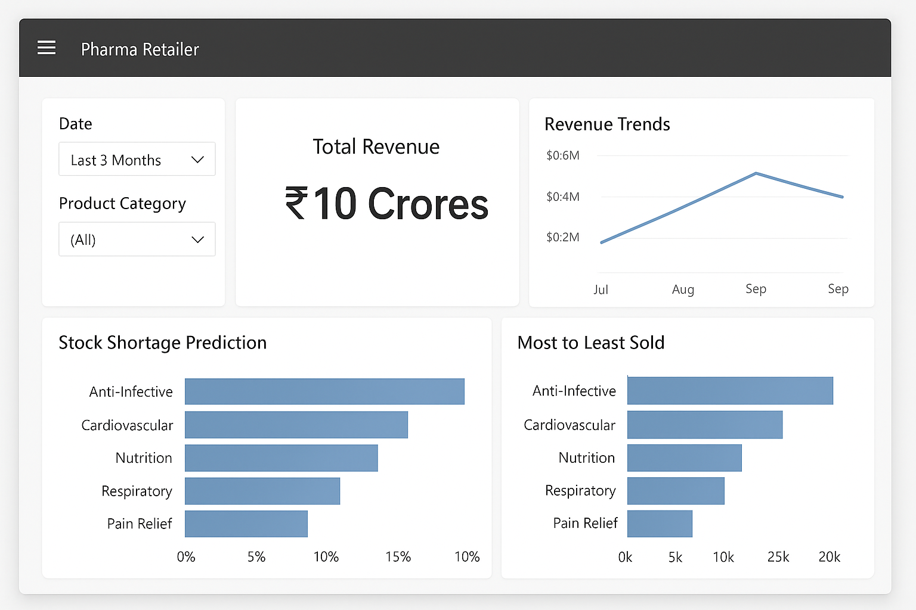
📊 Power BI Dashboard Preview

Slide 5
🔑 Dashboard Features
- Total Revenue (₹) card for last 3 months
- Revenue Trends line chart
- Stock Shortage Prediction bar chart
- Most to Least Sold products ranking
- Interactive filters by Date & Product Category

Slide 6
💡 Business Impact
✔ Helped the Revenue team spot falling sales trends early
✔ Prevented stock-out situations with shortage predictions
✔ Improved focus on high-selling products
✔ Data-driven strategy to regain market share
📈 Demonstrates how analytics + visualization drive business recovery.

Slide 7
🚀 Next Steps
- Extend dashboard to include competitor analysis
- Automate data refresh for real-time monitoring
- Integrate machine learning for demand forecasting
- Scale dashboard across multiple retail branches

Slide 8
🙏 Thank You! Pharma Retailer Analytics Dashboard

