Slide 1

MNIST HANDWRITTEN DIGIT CLASSIFICATION
Using Convolutional Neural Network (CNN) with Real-Time Data Augmentation
Presented by: Gouri Rewanwar

Slide 2
Project Overview
Handwritten digit recognition is one of the most foundational problems in computer vision. Its real-world impact spans across many critical industries every single day:
Postal Automation — Reading handwritten ZIP codes on envelopes
Banking — Processing handwritten amounts on cheques
Healthcare & Government — Digitizing paper forms and records
Document Archiving — Converting historical handwritten documents to searchable text
Traditional approaches relied on manually engineered features (HOG, SIFT) which required domain expertise and failed to generalize. This project uses a Convolutional Neural Network (CNN) that learns directly from raw pixel data — no manual feature design required.
Result: 99.52% Test Accuracy on 10,000 unseen handwritten digit images — matching state-of-the-art results on this benchmark.

Slide 3
PROBLEM STATEMENT & OBJECTIVES
Problem Statement: Given a 28×28 grayscale image of a handwritten digit, build a deep learning model that correctly identifies the digit as one of 10 classes — 0 through 9. The model must:
Generalize to unseen handwriting styles in the test set
Classify digit images uploaded by users from outside the dataset
Handle real-world variation in image format, brightness, and stroke style
Project Objectives:
Load and explore MNIST — analyze class distribution and pixel statistics
Normalize pixel values from [0–255] to [0.0–1.0] and reshape for CNN compatibility
Design a two-block CNN with Batch Normalization, MaxPooling, and Dropout
Apply real-time Data Augmentation (rotation, zoom, horizontal & vertical shifts)
Train using EarlyStopping and ReduceLROnPlateau callbacks for optimal convergence
Evaluate using accuracy, per-class classification report, and a 10×10 confusion matrix
Analyze misclassified examples and per-digit error rates
Build a dual-mode predictive system: test set images + user-uploaded custom images
Save the trained model as mnist_cnn_model.h5 for future deployment

Slide 4
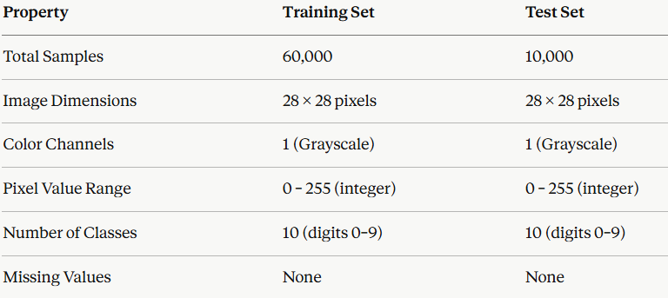
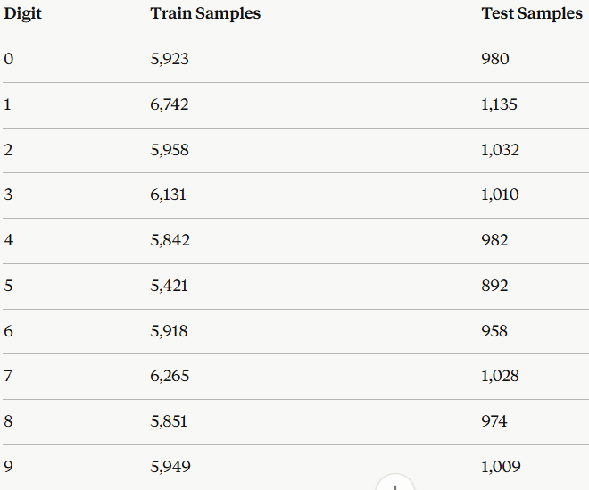
The MNIST Dataset
Source: keras.datasets.mnist — Created by Yann LeCun, Corinna Cortes & Christopher Burges, 1998 Access: Directly via Keras — no external file download, perfect reproducibility
Dataset Statistics:
Class Distribution (Training Set):

Slide 5

EDA Insights
1. Sample Image Visualization A 4×10 grid was displayed showing 4 examples of each digit (0–9) — revealing the natural variation in handwriting styles: different stroke thickness, proportions, tilt angles, and pen pressure across different writers.
2. Class Distribution Verification Bar charts for both training and test sets confirmed near-uniform distribution across all 10 classes — no class imbalance requiring special handling.
3. Raw Pixel Value Inspection Individual images inspected as 28×28 integer matrices (values 0–255). Key observations:
Background pixels cluster near 0 (black)
Ink stroke pixels cluster near 200–255 (white/light grey)
Each image is a sparse matrix — most pixels are background
4. Group-Level Digit Inspection Visual comparison across digit classes confirms the challenge: digits like 4/9, 3/5, 7/1, and 8/3 share structural features that form the model's hardest classification cases.

Slide 6
DATA PREPROCESSING
Step 1 — Pixel Normalization All pixel values divided by 255.0 → scaled from integer [0, 255] to float [0.0, 1.0]
Why this matters:
Ensures all inputs fall within a consistent scale
Prevents any single pixel from dominating gradient updates during backpropagation
Significantly accelerates convergence by matching scale to weight initialization
Before: min=0, max=255 → After: min=0.0, max=1.0
Step 2 — Tensor Reshaping for CNN Input Raw MNIST images are 2D arrays of shape (28, 28). CNN layers require 4D input: (samples, height, width, channels)
Since MNIST is grayscale → 1 channel added:
(28, 28) → (28, 28, 1) per image
Full training tensor: (60,000, 28, 28, 1)
Full test tensor: (10,000, 28, 28, 1)
This channel dimension is mandatory — CNN filter operations are defined over 3D volumes (height × width × channels), not 2D planes.

Slide 7

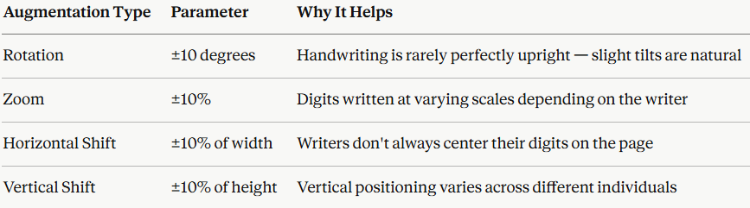
DATA AUGMENTATION
What is Data Augmentation?
A regularization technique that artificially expands the effective training dataset by applying random transformations to training images during each epoch — exposing the model to more variation without collecting new data.
Augmentation Parameters Applied (ImageDataGenerator):
Critical Rule: Augmentation is applied ONLY to the training data in real-time during model.fit() via datagen.flow(). The test set is evaluated on clean, original, unaugmented images — ensuring a fair and unbiased performance measurement.
Personal Insight: Without data augmentation, the model started overfitting quickly. After applying augmentation and dropout, validation accuracy became much more stable — demonstrating the direct impact of generalization techniques on real performance.

Slide 8
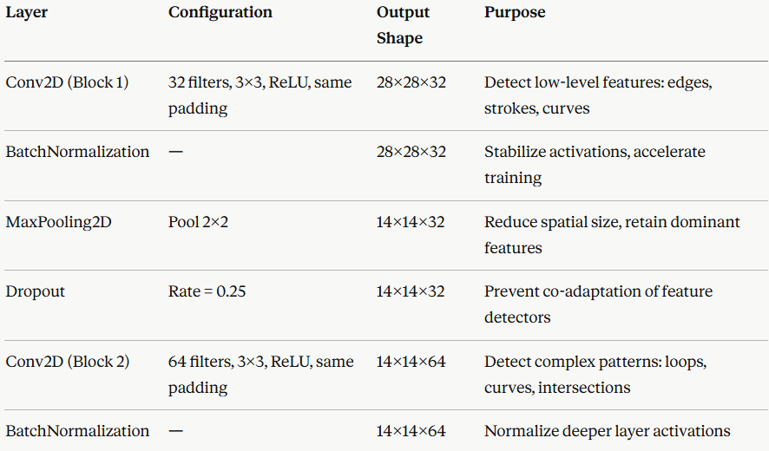

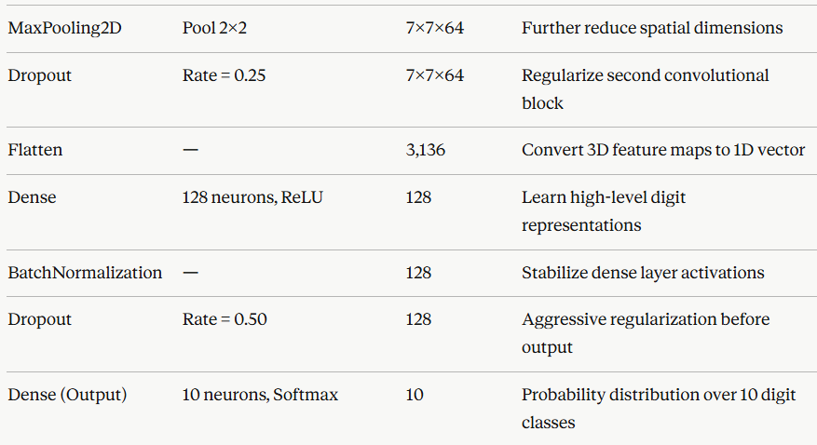

CNN ARCHITECTURE
Architecture: Two-Block Sequential CNN Input (28×28×1) → Block 1 (32 filters) → Block 2 (64 filters) → Dense(128) → Output(10)

Slide 9
How the CNN Actually Works
Convolutional Layers — Automatic Feature Learning Each filter slides across the image computing dot products with local pixel patches — producing feature maps that highlight where specific patterns appear. Block 1 (32 filters) learns primitive visual features: edges, stroke endpoints, simple curves. Block 2 (64 filters) combines these into digit-specific patterns: closed loops (0, 8), vertical strokes (1), angular patterns (4, 7).
MaxPooling — Spatial Compression with Invariance Selects the maximum value within each 2×2 region. Two benefits: reduces computational cost by shrinking feature maps (28→14→7), and introduces spatial invariance — small translations of a digit produce the same pooled output, making the model less sensitive to exact digit position.
Batch Normalization — Stable Training Normalizes layer activations across each mini-batch (zero mean, unit variance) then applies learnable scale and shift. Stabilizes training, allows higher learning rates, and acts as a mild regularizer — reducing reliance on aggressive dropout.
Dropout — Forced Robustness Randomly disables a fraction of neurons during each training step — preventing co-adaptation (neurons depending on specific other neurons). Rates of 0.25 after conv blocks (light, preserves spatial learning) and 0.50 after Dense layer (aggressive — highest overfitting risk point).
Softmax Output — Probability Distribution 10 output neurons → Softmax converts raw scores to probabilities summing to 1.0. Predicted digit = argmax(output vector). Also gives a confidence score — 99.8% for digit '3' is far more reliable than 52% for digit '5'.

Slide 10
TRAINING STRATEGY & CALLBACKS
Training Configuration:
Maximum Epochs: 20 | Batch Size: 64
Training data fed via datagen.flow() for real-time augmentation
Validation: full unaugmented test set evaluated after each epoch
Callback 1 — EarlyStopping
Monitors: val_accuracy
Patience: 5 epochs (stops if no improvement for 5 consecutive epochs)
restore_best_weights = True (loads best checkpoint, not last epoch)
Effect: Prevents wasted training time and overfitting past the accuracy peak
Outcome: Model stopped well before epoch 20, indicating efficient convergence
Callback 2 — ReduceLROnPlateau
Monitors: val_accuracy
Patience: 3 epochs
Factor: 0.5 (halves the learning rate when triggered)
Minimum LR: 1e-6
Effect: Adaptive learning rate allows finer gradient steps near convergence — often yields the final accuracy push from 99.3% to 99.5%+
Training Outcome: Training and validation accuracy curves rose sharply in early epochs and converged tightly with minimal divergence — confirming data augmentation and dropout effectively prevented overfitting. Validation loss decreased smoothly throughout.

Slide 11
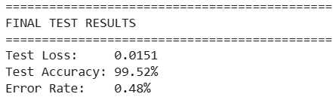
RESULTS & EVALUATION
Final Test Set Results:
Only 48 out of 10,000 test images were misclassified — matching state-of-the-art CNN results on MNIST.
Per-Class Performance: All 10 digit classes achieve precision, recall, and F1-scores above 0.98 — strong and consistent performance across every digit without any class-specific weakness.
Confusion Matrix Key Findings (10×10 Matrix):
The vast majority of predictions fall on the main diagonal (correct classifications)
Most frequent confusions occur between visually similar digit pairs:
4 vs. 9 — share a similar upper loop structure
3 vs. 5 — share similar curved strokes
7 vs. 1 — share a strong vertical stroke
8 vs. 3 — share curved vertical structure
Digit 1 achieves near-perfect classification due to its uniquely simple vertical stroke
Digits 5, 8, and 9 show marginally higher error rates due to greater visual ambiguity

Slide 12
MISCLASSIFICATION ANALYSIS
What the Errors Tell Us
20 misclassified examples were visualized from the 10,000 test images. Each was displayed with its true label and the model's wrong prediction.
Key Insight from the Errors: The vast majority of errors occur on genuinely ambiguous images — digits that would also challenge human readers. Characteristics of these hard cases:
Unusual stroke thickness (very thin or very bold ink)
Unusual proportions (a '7' written very short and wide)
Strokes that anatomically resemble another digit (a '9' with no upper loop, looking like a '4')
Heavy ink blobs or incomplete strokes
What This Confirms: The model is NOT making systematic architectural mistakes. It has learned meaningful visual representations — it fails only where the visual signal itself is genuinely ambiguous. This is the hallmark of a well-trained model.
Per-Digit Error Rate Summary: Digits with highest error rates: 5, 8, 9 (structurally complex, more ambiguous) Digits with lowest error rates: 1, 0, 7 (structurally simple and visually distinct)

Slide 13
PREDICTIVE SYSTEM
Mode 1 — Test Set Prediction For any MNIST test image, the trained model produces a Softmax probability vector of length 10. The output includes:
Predicted digit (argmax of probability vector)
Confidence score (probability of predicted class × 100)
A bar chart showing all 10 class probabilities — visualizing how confidently the model distinguishes between alternative digits (e.g., 99.8% for '3' vs 0.1% for '8')
Mode 2 — Custom Image Prediction The predict_digit_from_image() function classifies handwritten digit images from OUTSIDE the MNIST dataset. The full preprocessing pipeline:
Image Loading — cv2.imread() supporting PNG, JPG, BMP formats
Grayscale Conversion — BGR to grayscale via cv2.cvtColor()
Resize to 28×28 — cv2.resize() for dimensional compatibility
Normalization — Pixel values scaled [0, 255] → [0.0, 1.0]
Tensor Reshape — (28, 28) → (1, 28, 28, 1) for CNN batch input
Prediction — model.predict() returns Softmax vector → digit + confidence score
Why This Matters: This dual-mode system transforms the trained benchmark model into a practically deployable digit recognition tool — capable of working on any handwritten input image, not just MNIST test data.

Slide 14
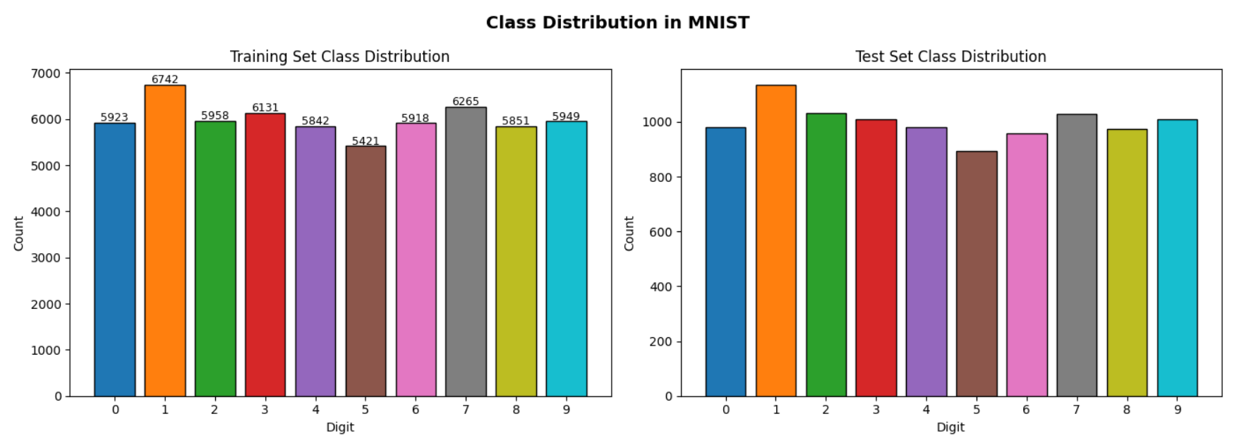
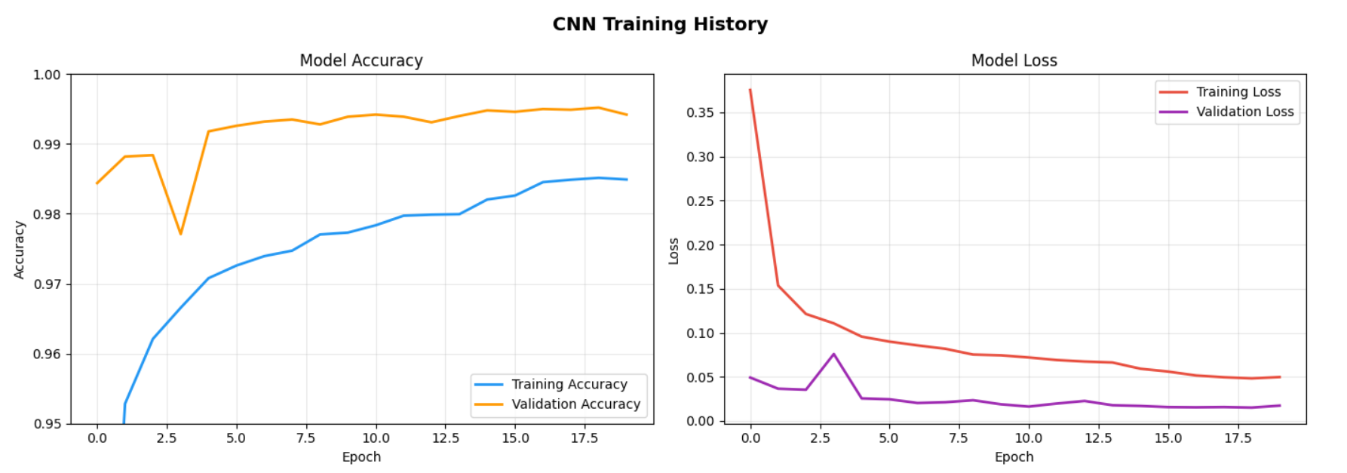
VISUALISATION

Slide 15
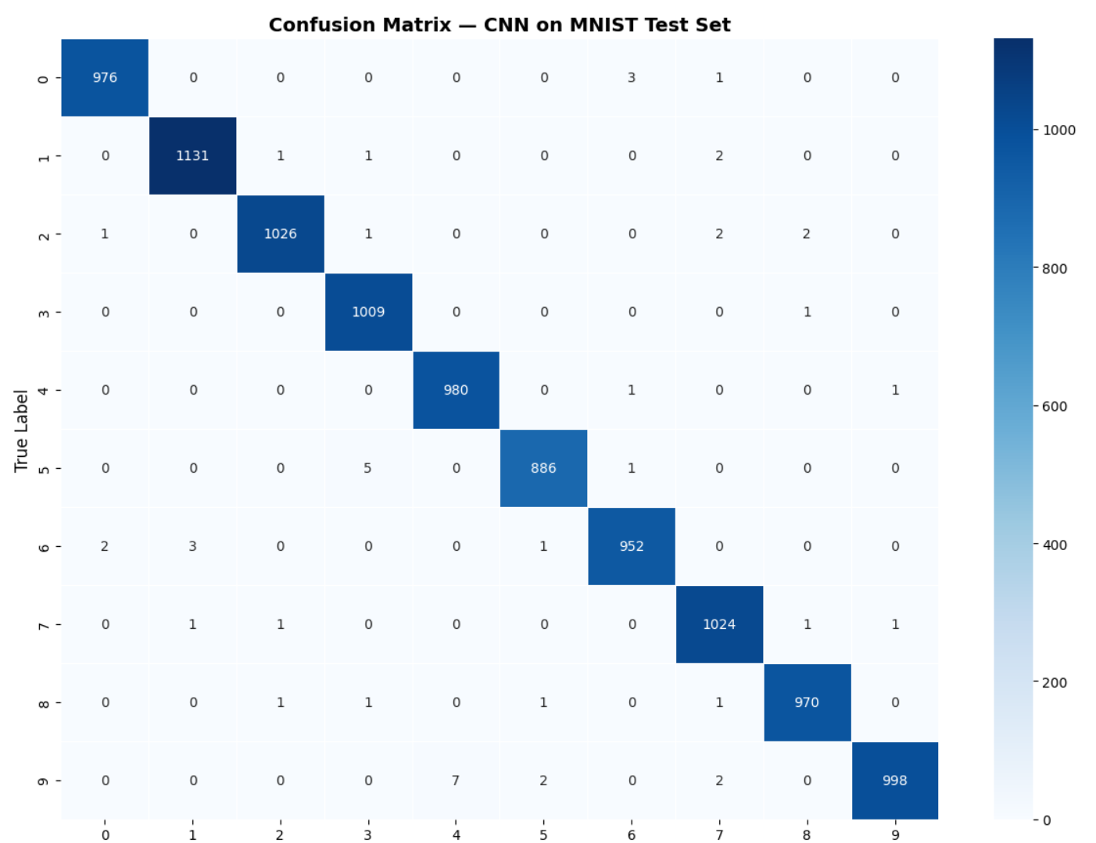
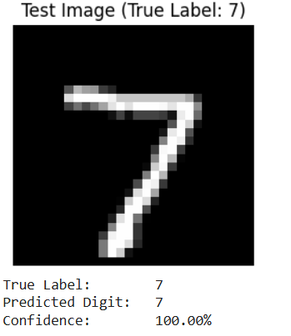
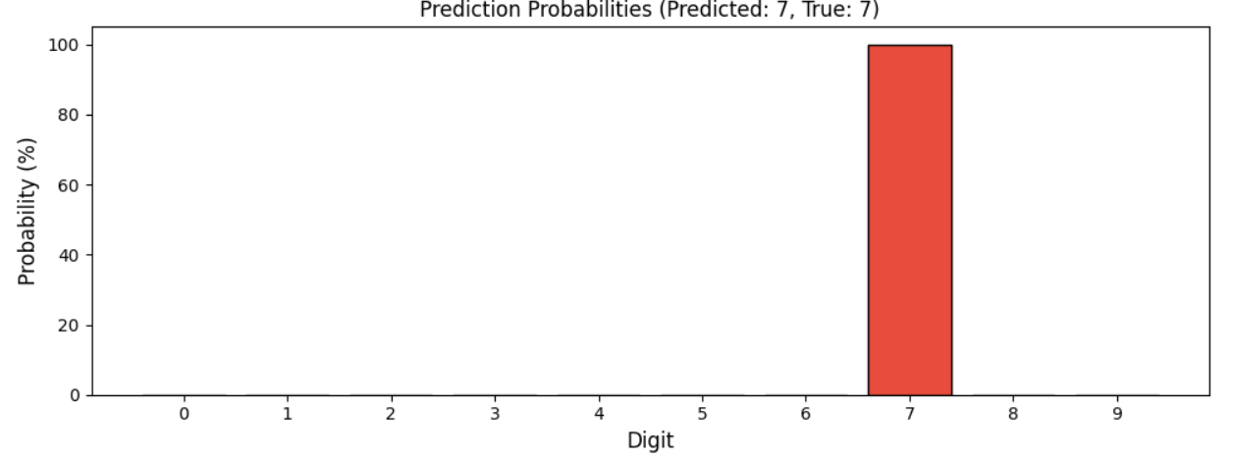
VISUALISATION

Slide 16
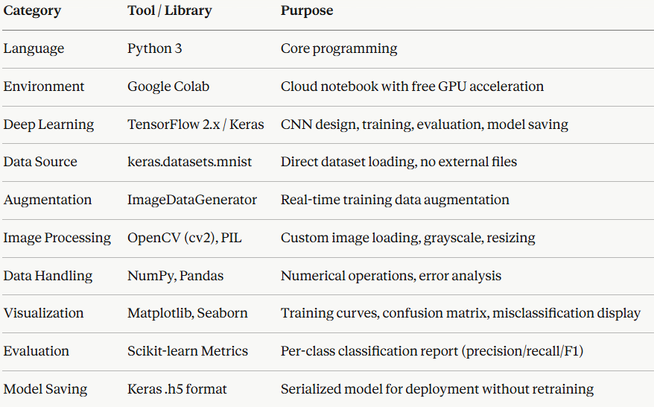
TECHNOLOGY STACK & PROJECT WORKFLOW
Technology Stack:
Project Workflow (12 Phases): Dataset Loading → EDA → Preprocessing (Normalize + Reshape) → Data Augmentation Setup → CNN Architecture Design → Callback Configuration → Model Training → Training Visualization → Model Evaluation → Error Analysis → Predictive System → Model Serialization

Slide 17
LIMITATIONS & FUTURE SCOPE
Current Limitations:
MNIST is a clean, pre-centered, perfectly cropped benchmark — real-world digits appear on lined paper, in poor lighting, at skewed angles, with noisy backgrounds, and overlapping textures
Single digit per image — the system cannot read sequences (phone numbers, ZIP codes, cheque amounts) — would need segmentation + sequence modeling (LSTM/CTC)
Grayscale only — custom color images are converted to grayscale, which may lose subtle contrast information in borderline cases
No automatic preprocessing for custom images — assumes digit is reasonably centered and not heavily skewed; no auto-detection, cropping, or deskewing
Static model — not updated incrementally; periodic retraining needed if deployment handwriting styles differ from MNIST distribution
Future Scope:
Web App Deployment — Streamlit/Flask app with a canvas widget where users draw digits directly in the browser and receive real-time predictions
Multi-Digit Sequence Recognition — Integrate digit detection + segmentation pipeline or adopt an end-to-end sequence architecture (CTC) for reading full numbers
Real-World Dataset Transfer — Fine-tune on SVHN (Street View House Numbers) or custom organizational data (bank forms, survey sheets) for beyond-MNIST robustness
Smarter Custom Image Preprocessing — Add contour-based digit detection, perspective correction, background removal, and auto-centering for real-world inputs
Deeper Architectures — ResNet, EfficientNet, MobileNet via transfer learning for improved accuracy on noisy or distorted inputs
ONNX / TFLite Conversion — Deploy on mobile devices and edge hardware for offline digit recognition on smartphones and embedded systems

Slide 18
Conclusion
What Was Achieved:
Designed, trained, and evaluated a full CNN pipeline on 70,000 handwritten digit images
Achieved 99.52% test accuracy — only 48 errors out of 10,000 test images
Matched state-of-the-art performance on the MNIST benchmark
Successfully applied real-time Data Augmentation + Batch Normalization + Dropout to prevent overfitting
Performed deep error analysis including 10×10 confusion matrix and per-digit error rates
Built a dual-mode predictive system handling both MNIST test images and real-world custom uploads
Serialized the model as mnist_cnn_model.h5 for immediate deployment
Key Learnings:
Without Data Augmentation, the model overfit quickly — adding augmentation and dropout made validation accuracy significantly more stable. Real hands-on proof of why generalization techniques matter.
Learned how CNNs automatically build hierarchical visual representations: edges → curves → digit-specific shapes — without any manual feature engineering
Gained experience in multi-class evaluation beyond simple accuracy — per-class precision, recall, F1, and confusion matrix analysis
Understood the full pipeline from raw benchmark data to a deployment-ready custom image prediction system using OpenCV

Slide 19
THANK YOU
Submitted by: Gouri Rewanwar

