Slide 1
Customer segmentation with Spark MLlib
By:
Gouri Dumale

Slide 2
Introduction
Goal
Use clustering techniques in Spark MLlib to analyze customer data to identify distinct segments based on purchasing behavior, demographics, and preferences.
Expected Outcomes
•Proficiency in using Spark for customer segmentation and clustering tasks.
•Insights into retail customer behavior and segmentation strategies.

Slide 3
Dataset
Lisbon, Portugal Hotel customer (2015 - 2018)
Source: Kaggle
Description: ScienceDirect
Data: Each row is a record of individual customers (over 80k rows)
Numerical | Boolean | Categorical
Age AverageLeadTime Revenue Bookings Nights | Floors (High, Medium, Low) Facilities (Bathtub, Crib) Special rooms (Quiet, Accessible) | Nationality Distribution channel Market segment

Slide 4
Features
Names | Description
AverageLeadTime | The average number of days elapsed between the customer’s booking date and arrival date
LodgingRevenue | Total amount spent on lodging expenses by the customer
OtherRevenues | Total amount spent on other expenses by the customer
PersonsNights | The total number of persons/nights that the customer stayed at the hotel.
RoomNights | Total of room/nights the customer stayed at the hotel
BookingsNoShowed | Number of bookings the customer made but subsequently made a “no-show”
BookingsCanceled | Number of bookings the customer made but subsequently canceled
BookingsCheckedIn | Number of bookings the customer made, and which end up with a staying
MarketSegment | Current market segment of the customer
HighFloor | Indication if the customer usually asks for a room on a higher floor (0: No, 1: Yes)

Slide 5
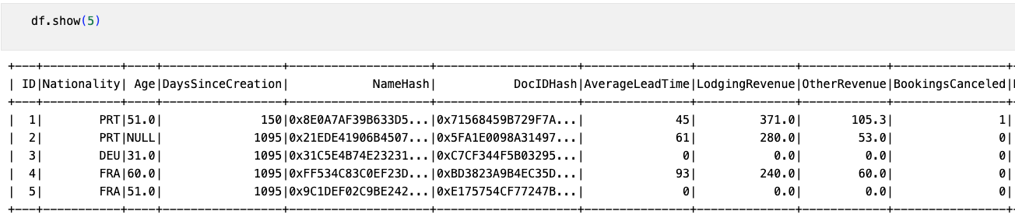
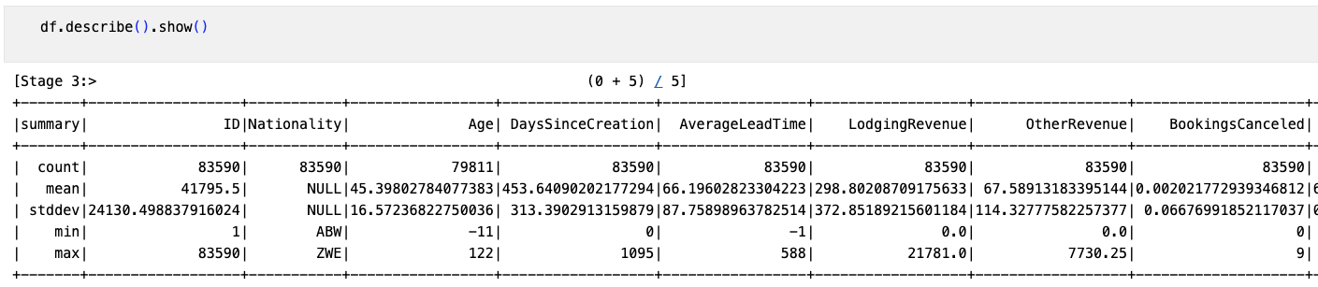
Data preprocessing

Slide 6
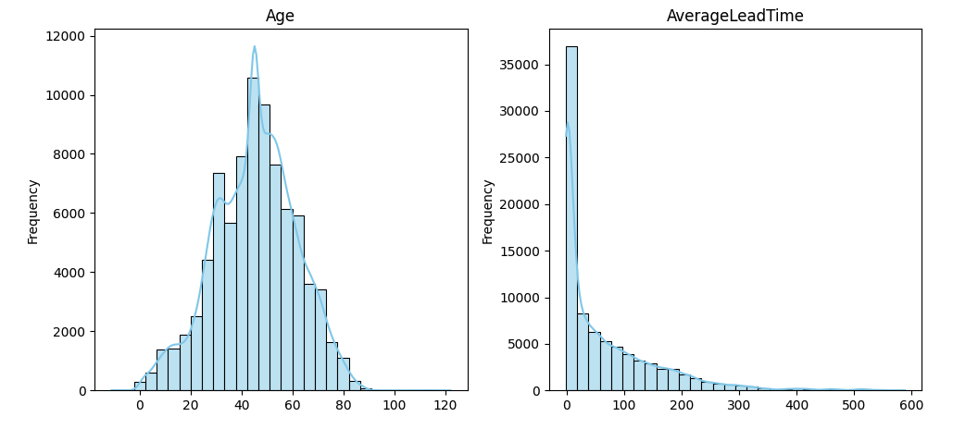
Age and AverageLeadTime

Slide 7
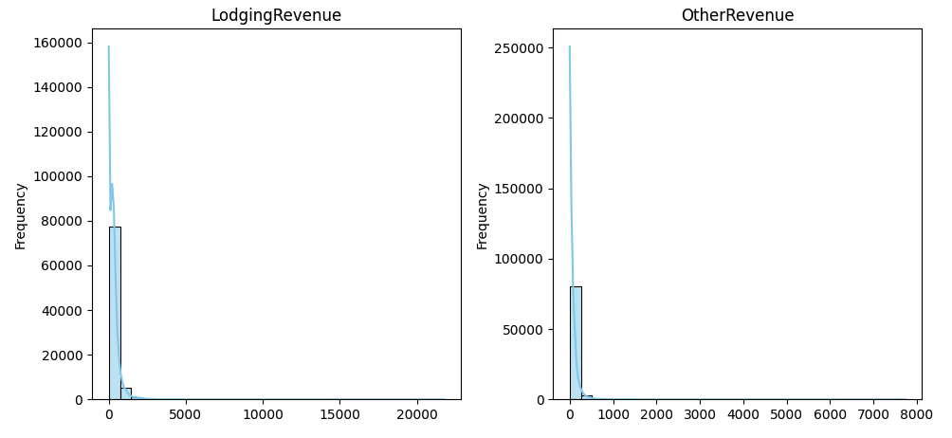
Revenue (Lodging, Other)

Slide 8
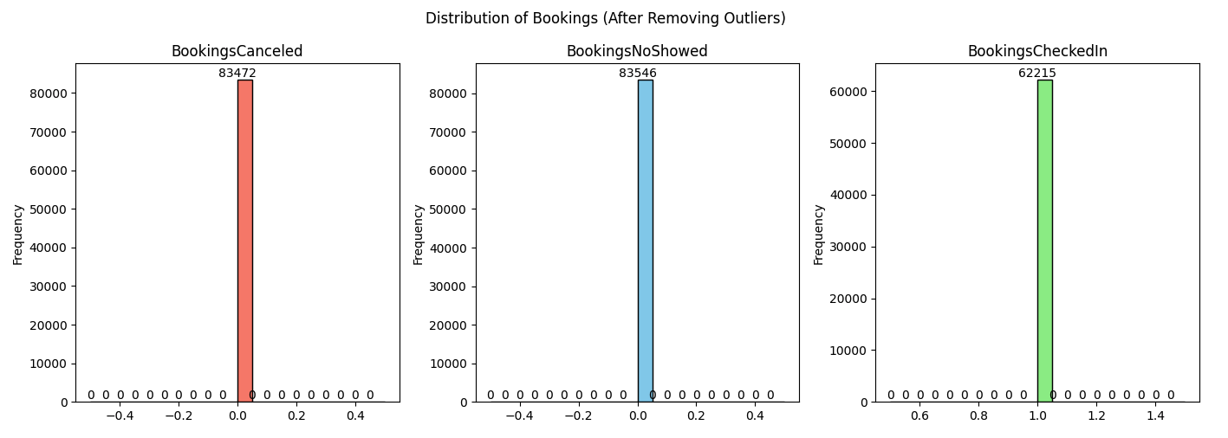
Bookings (cancelled, no show, check in)
Check-in bookings are the most frequent, followed by no-shows and then cancelled bookings. There are around 83,546 checked-in bookings, 80,000 cancellations and 83,472 no-shows.
The distribution of bookings is fairly similar for cancelled and no-showed bookings.

Slide 9
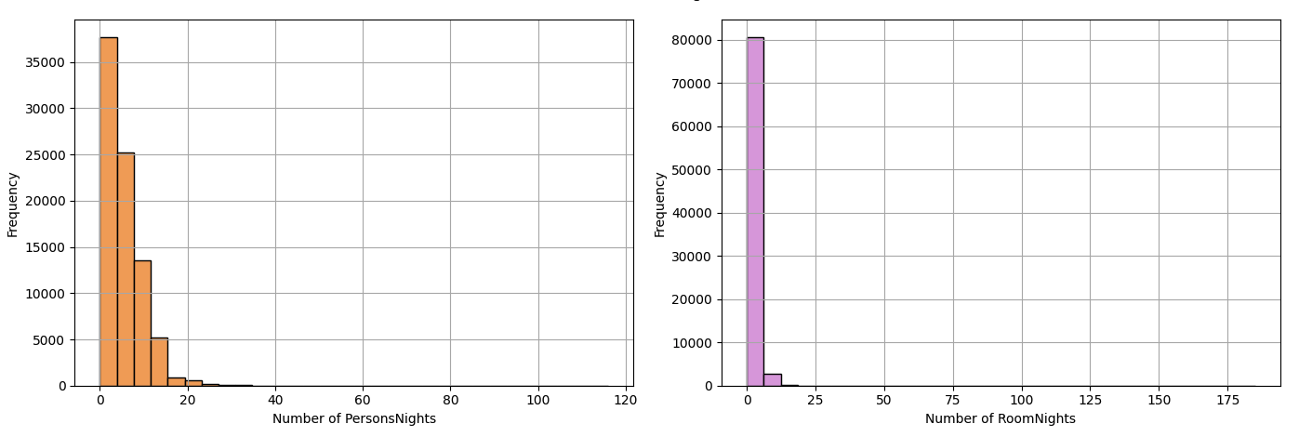
Nights (Persons, Rooms)

Slide 10
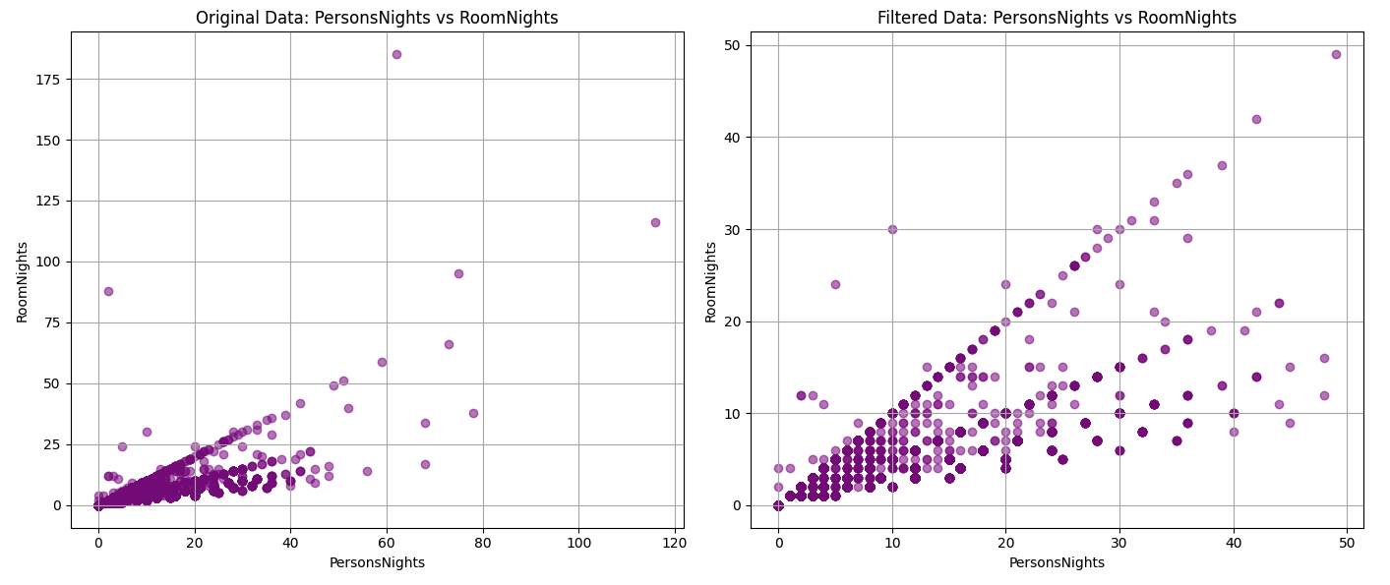
PersonNights vs RoomNights

Slide 11
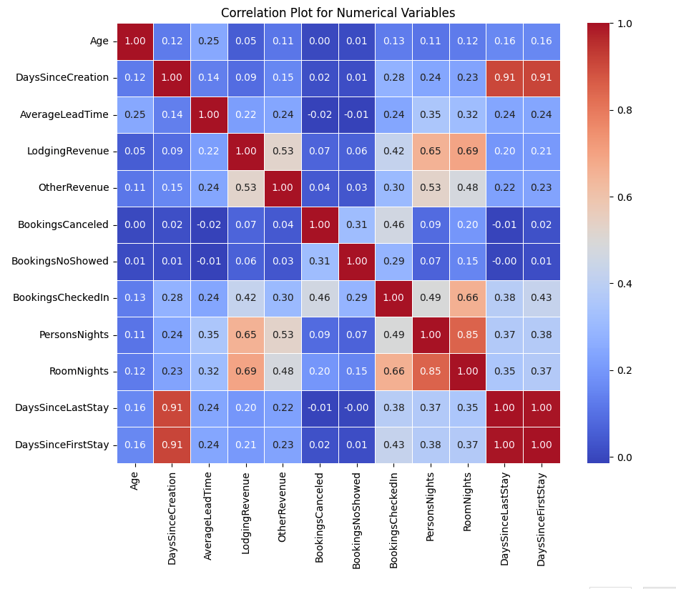
Correlation Plot
There is a strong positive correlation between Days Since Last Stay and Days Since First Stay.
There is a strong positive correlation between RoomNights and PersonsNights.
There is a strong positive correlation between BookingsCheckedin and BookingsNoShowed.
There is a weak positive correlation between Age and DaysSinceCreation.
There is a positive correlation between Lodging Revenue and most other revenue related variables such as Other Revenue and PersonsNights.

Slide 12
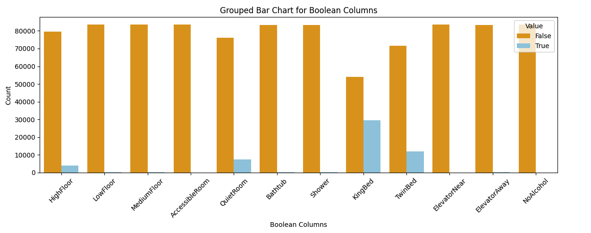
Boolean variables

Slide 13
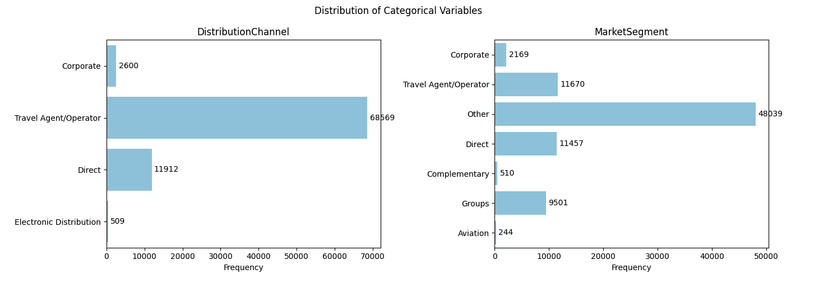
Categorical variables

Slide 14
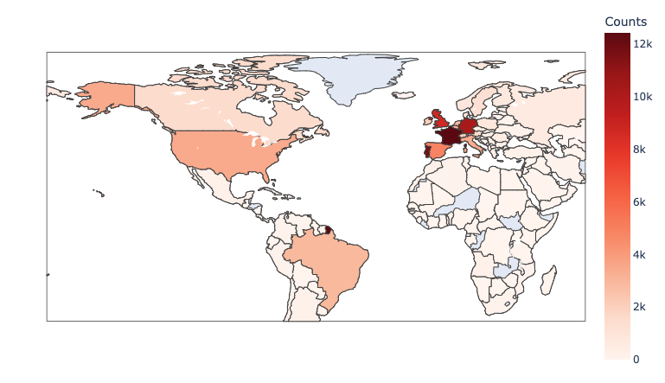
Nationality
Top 5:
France (12k)
Portugal (11k)
Germany (10k)
UK (8k)
Spain (5k)

Slide 15
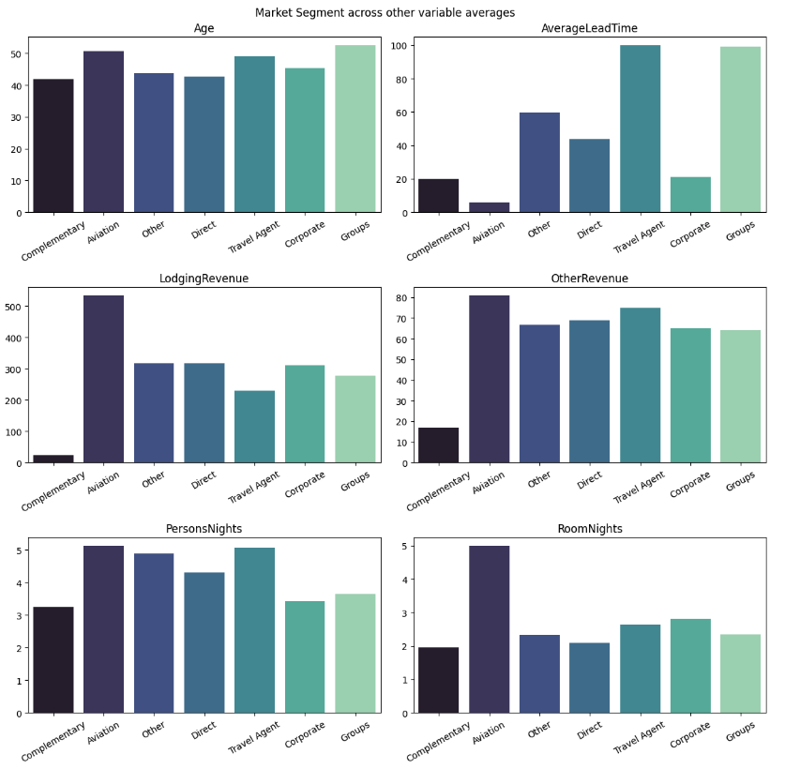
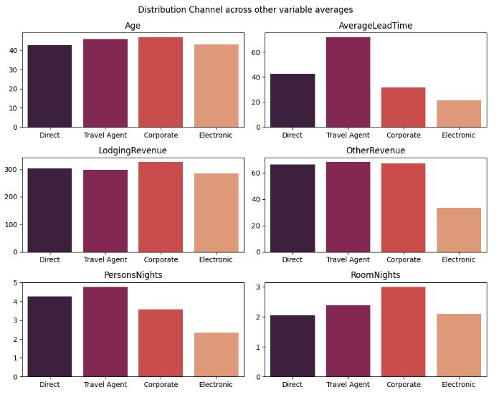
Market Segment
Distribution Channel

Slide 16
Further analysis:
Highest revenue from “Others”
Highest cancellations and no shows from “Corporate”
Most Medium Floors requested by “Corporate”
Next to “Others” since they are huge in numbers, facilities like shower, crib are requested by “Direct”

Slide 17
Clustering Analysis
K-Means
Gaussian Mixture Model
For customer segmentation

Slide 18
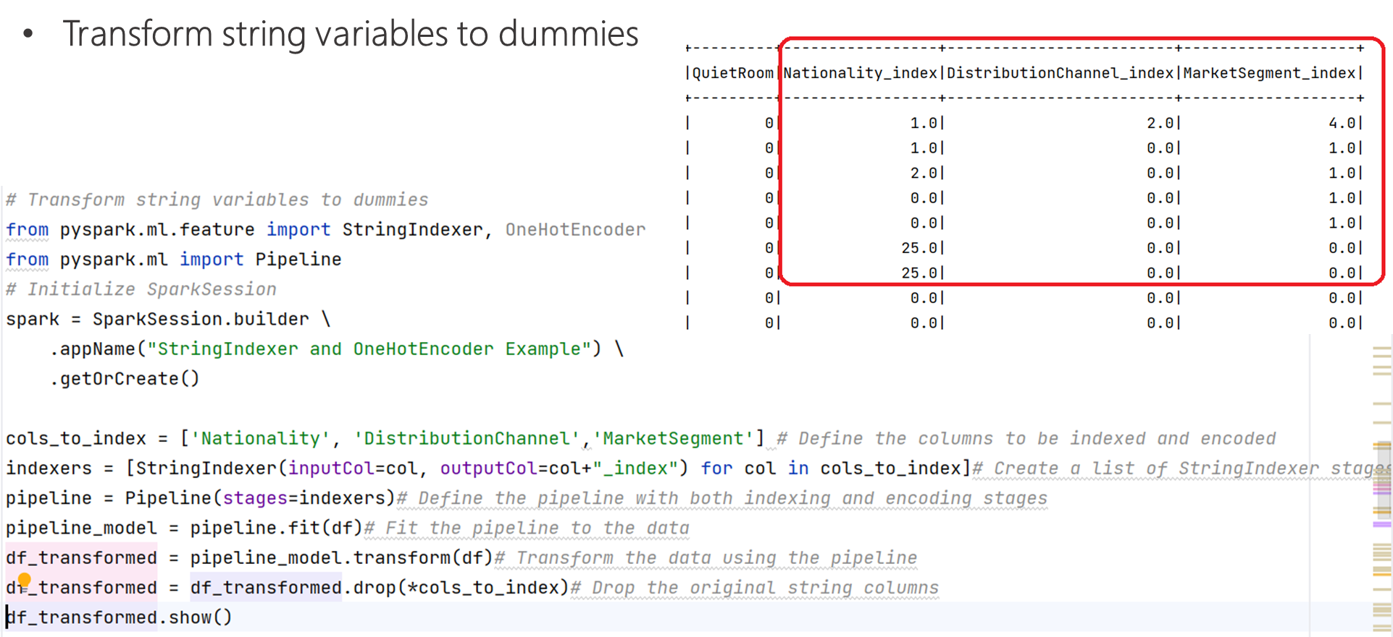
K-Means Clustering Model

Slide 19
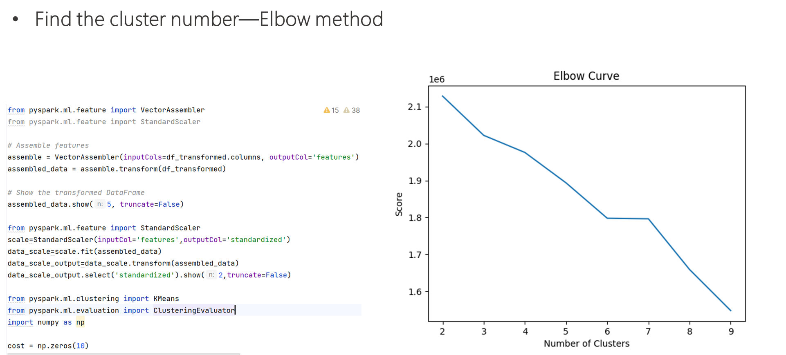
K-Means Clustering Model

Slide 20
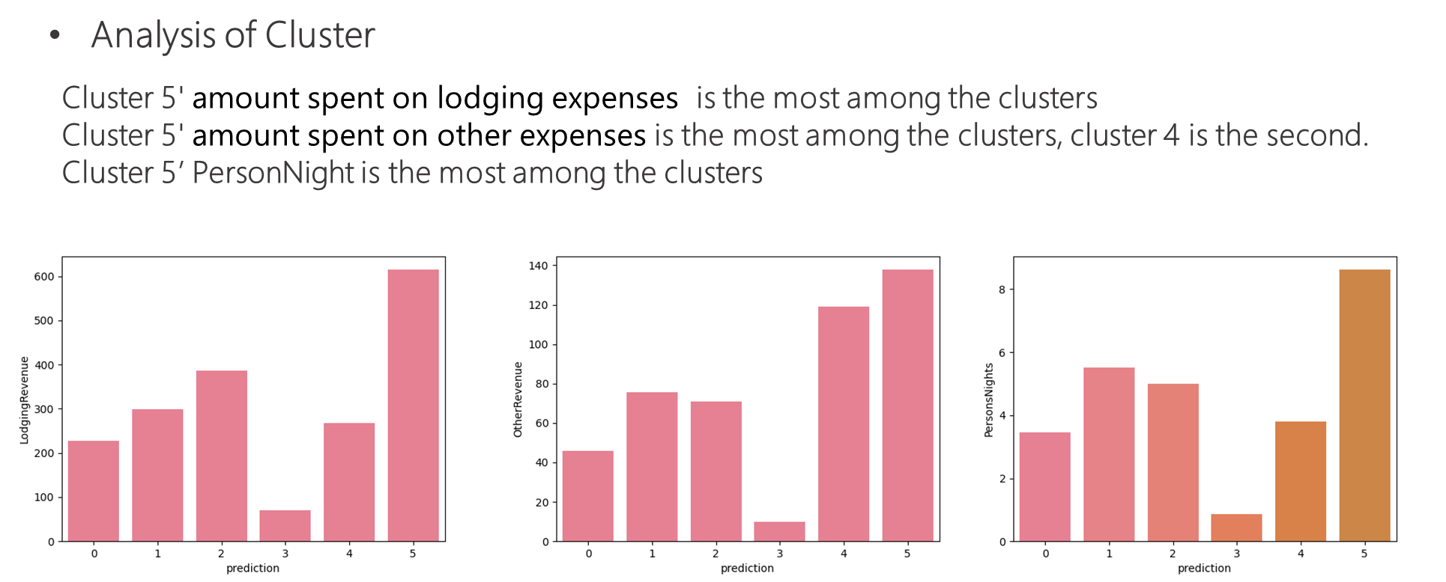
K-Means Clustering Model

Slide 21
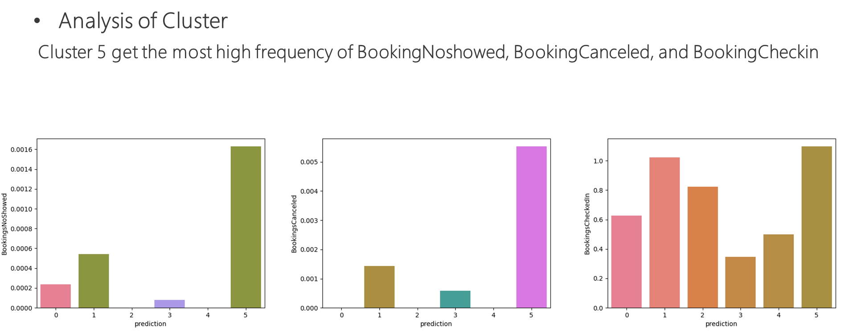
K-Means Clustering Model

Slide 22
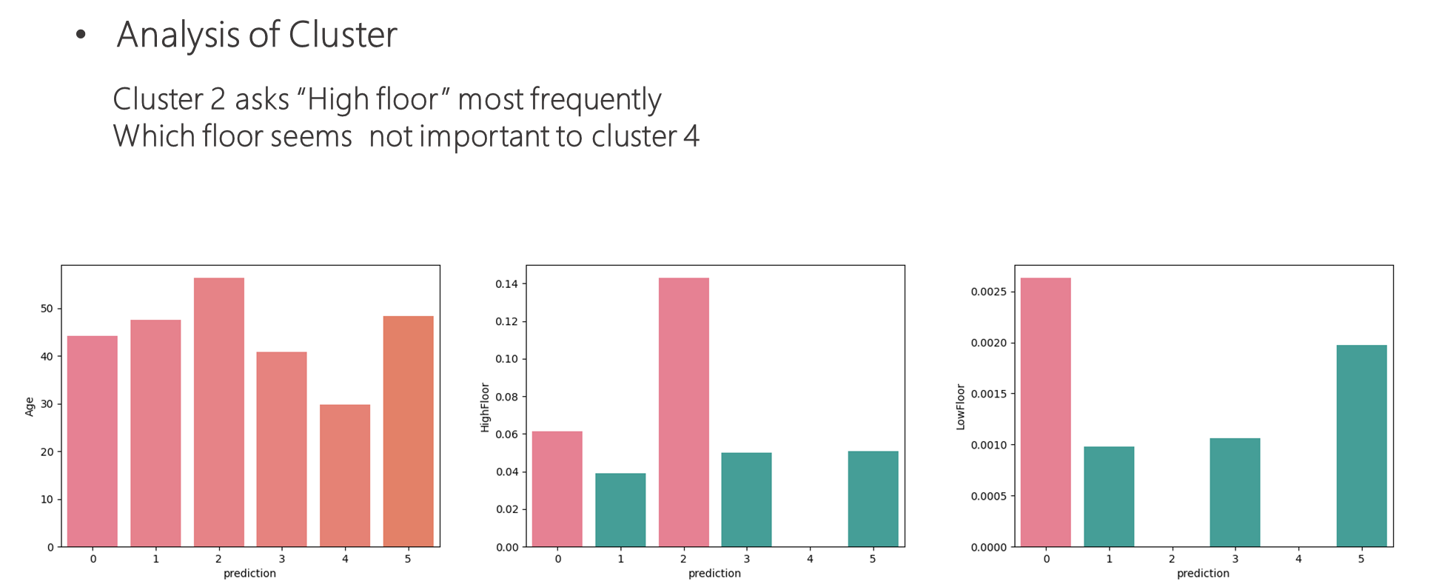
K-Means Clustering Model

Slide 23
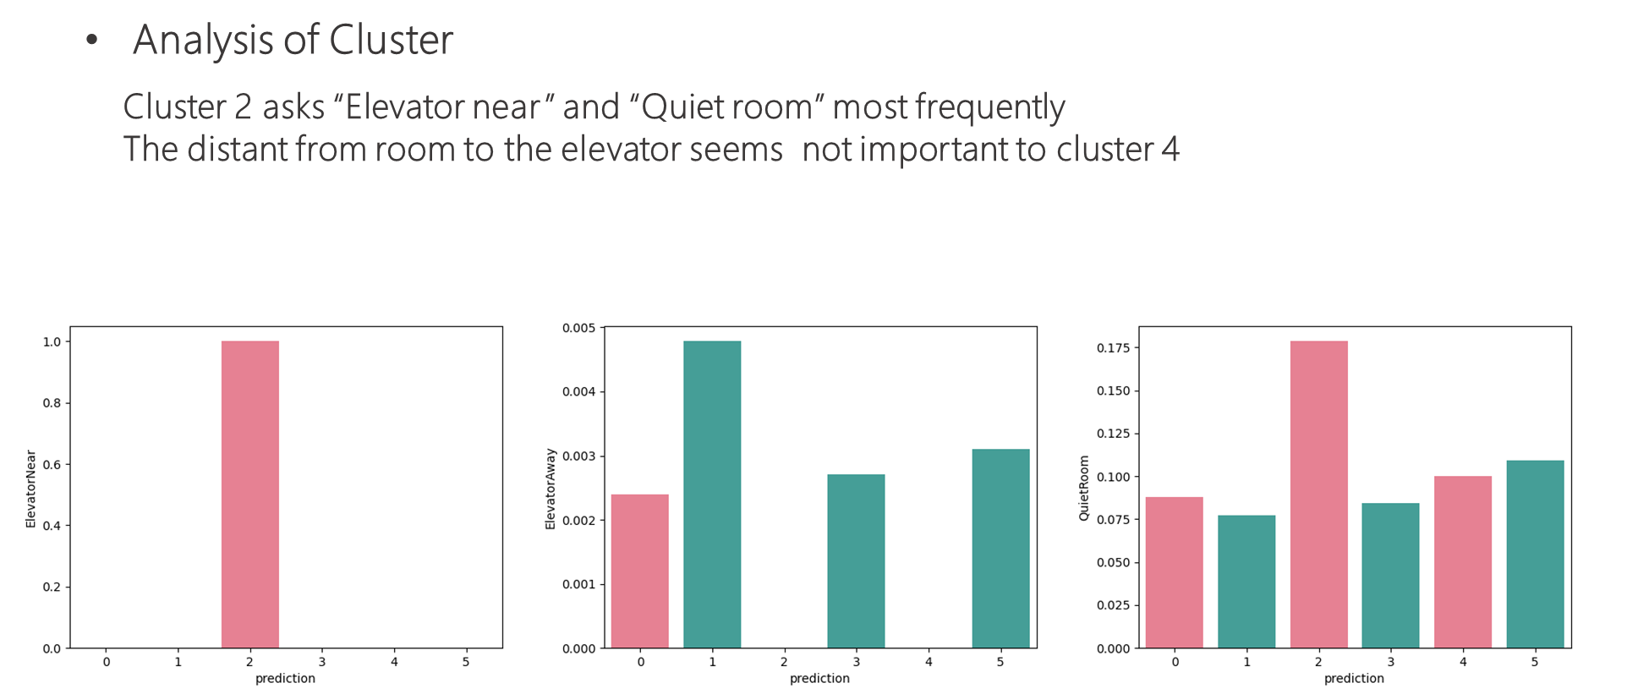
K-Means Clustering Model

Slide 24
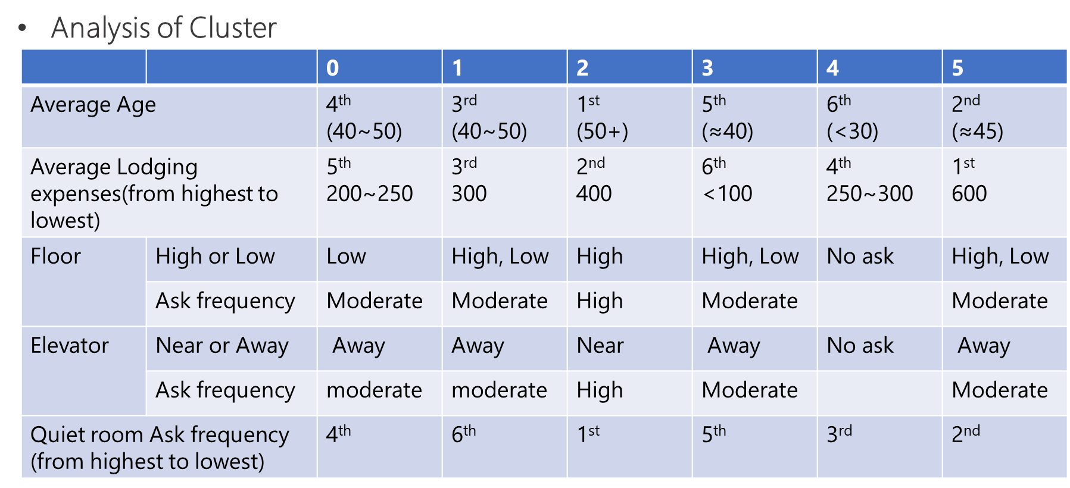
K-Means Clustering Model

Slide 25
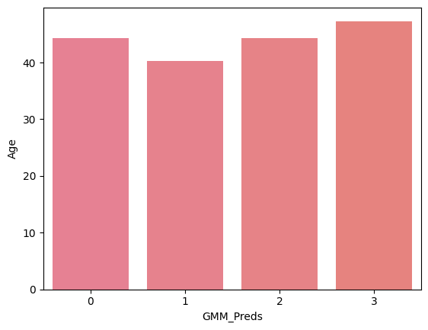
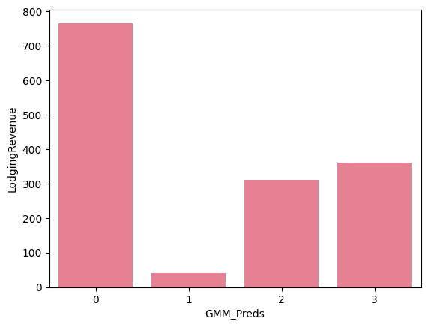
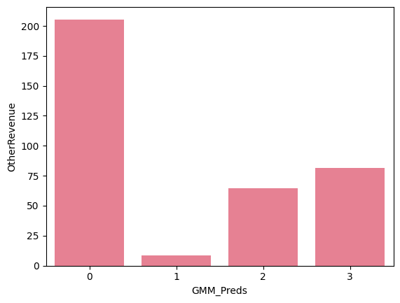
GMM Clustering Model
Analysis of Cluster

Slide 26
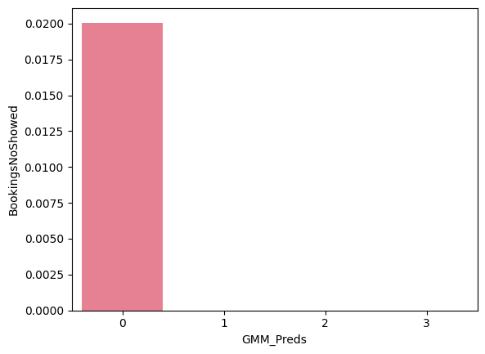
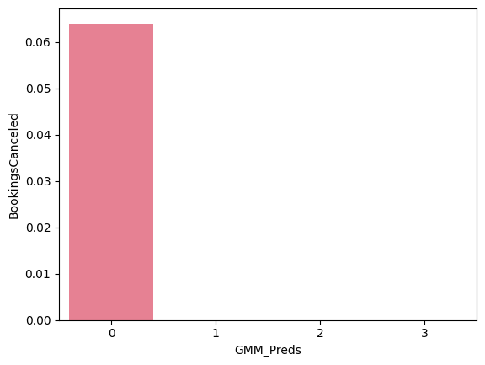
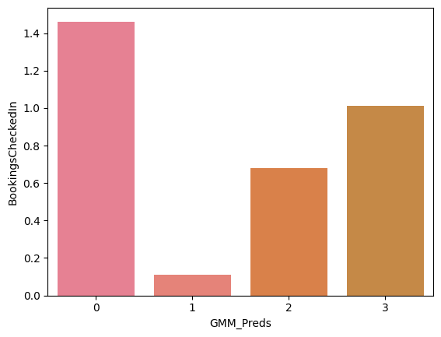
GMM Clustering Model
Analysis of Cluster

Slide 27
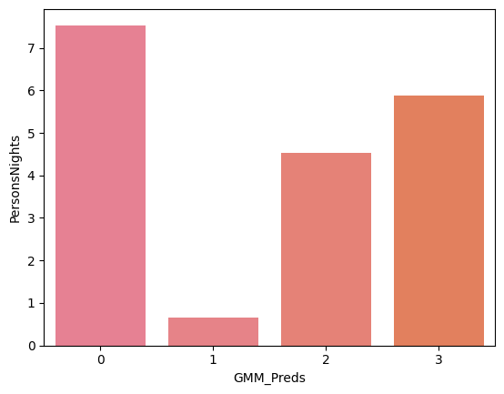
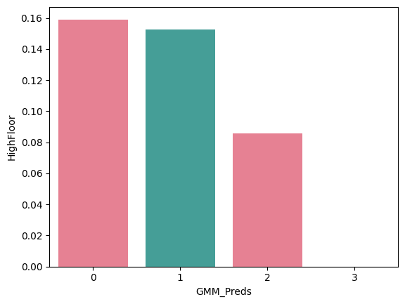
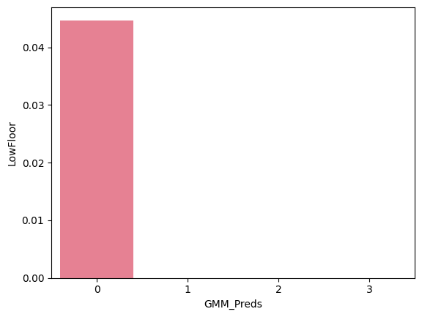
GMM Clustering Model
Analysis of Cluster

Slide 28
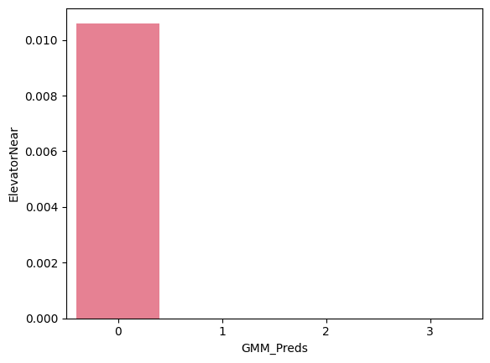

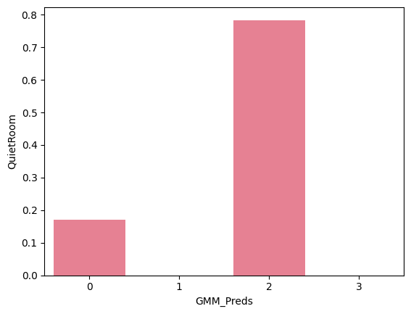
GMM Clustering Model
Analysis of Cluster

Slide 29
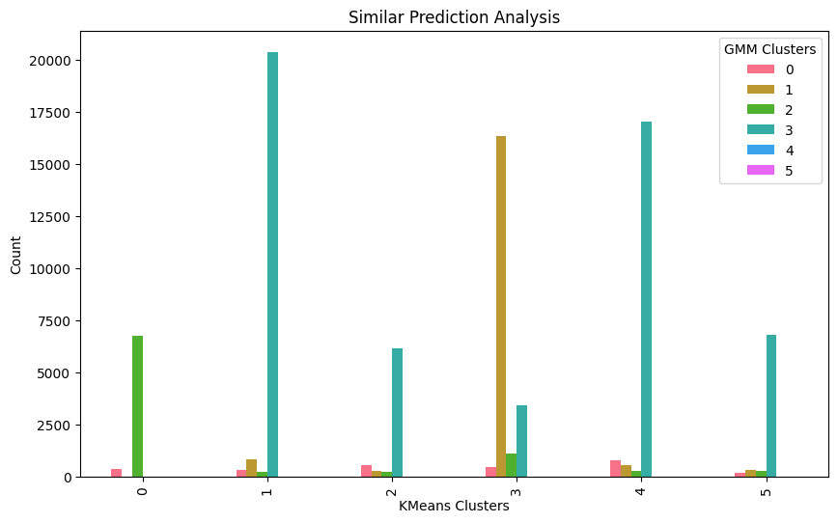
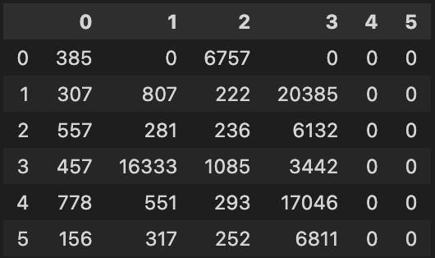
Comparison of Predictions – GMM vs K Means
GMM predictions
K Means predictions

Slide 30
Conclusion
K Means:
Since Cluster 5 and cluster 4 spend higher other expenses than other cluster, hotels can consider these two clusters as their other service targets.
For groups with different characteristics, hotels can provide different services, such as providing high-rise rooms, quiet rooms and rooms near elevators to older groups, while younger groups may market other hotel services.
GMM:
Clusters 0 has all the extra requested customers

