Slide 1
More Data, More Problems A Practical Guide to Testing on Hadoop
Michael Miklavcic
2015

Slide 2
Who Am I?
Michael Miklavcic - Systems Architect at Hortonworks
Coach teams through their journey to using Hadoop
ETL
Workflow automation
Optimization training
SDLC with Hadoop
Custom processing of structured/unstructured data
Everything between
In short, I help people make sense of Hadoop

Slide 3
What Are We Trying to Accomplish?
Code reliability
Ability to deploy with shorter turnaround
Reusable components, e.g. Pig UDFs, Hive SerDes, etc.
Change tracking
Ultimately, data we can trust

Slide 4
Tools of the Trade
MapReduce
MRUnit
http://mrunit.apache.org/
Java-based
Use with Junit
Runs MapReduce in local mode
Apache Pig
PigUnit
http://pig.apache.org/docs/r0.11.1/test.html#pigunitJava-based
Use with Junit
Runs in local mode

Slide 5
Tools of the Trade
Apache Hive
HiveRunner - https://github.com/klarna/HiveRunner
Java-based
HiveTest - https://github.com/edwardcapriolo/hive_test
Java-based
Beetest (Facebook) - https://github.com/kawaa/Beetest
SQL-like – uses HiveQL
Need Hadoop setup to run this
Other
Java, Eclipse, Maven, Mockito, JUnit

Slide 6
Primary Testing Scopes
Unit tests
Integration tests
Acceptance tests

Slide 7
Unit Testing

Slide 8
Wait, Unit Testing with Hadoop?
Yes!
How are you defining a ‘unit test’?
Encapsulates small nuggets of functionality
Generally not interacting with the filesystem, databases, containers, etc.
Overlaps a bit with integration test definition
We use the local filesystem and local mode, not a cluster to run our tests.
But...
We can test some components as “true” isolated unit tests

Slide 9
Things We Can Unit Test
MapReduce
Mappers
Reducers
Counters
HCatalog
Pig
Pig scripts
Loaders
UDFs
Hive
UDFs
SerDes
Queries

Slide 10
MRUnit
Benefits
Fast, lightweight
Catch basic errors much more quickly
Easy to get up and running quickly, even without a cluster
Pain Points
Won’t catch performance problems
Access to test data? PHI?
Need to create your schema for HCatalog testing – tries to talk to HCatalog, but this is not preferable for testing
MS Windows will give you drama...
http://blog.michaelmiklavcic.com/hadoop/pig/pigunit/testing/2014/04/06/pigunit-on-hadoop2.html

Slide 11
MRUnit Test Setup
Use Maven for test dependencies
Mappers
Create a MapDriver
Create input records
Create expected output records
Run test!
Reducers
Create a ReduceDriver
Create input records
Create expected output records
Run test!

Slide 12
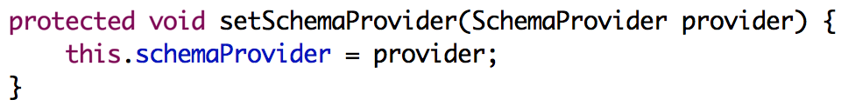
MRUnit Test Setup - HCatalog
Don’t want to setup a testing metastore
More complicated build process
External dependencies
This is more like an Acceptance/System test – we handle this testing scope in a different way
How to get around the Hive metastore dependency?
Dependency Injection!
Set default to HCatalog provider
Inject a schema provider in your mapper when you need one for testing
Can use ordinal or column name as means to get values via HCatalog.

Slide 13
MRUnit Example
Eclipse example

Slide 14
PigUnit
Benefits
Fast, lightweight
Catch basic logic errors quickly
Easy to get up and running quickly, even without a cluster
Pain Points
Still need system level tests to catch performance problems
Need to gin up a schema for Hcatalog
Documentation is mostly through referencing PigUnit’s tests
http://svn.apache.org/viewvc/pig/trunk/test/org/apache/pig/test/pigunit/TestPigTest.java
MS Windows will give you drama...
http://blog.michaelmiklavcic.com/hadoop/pig/pigunit/testing/2014/04/06/pigunit-on-hadoop2.html

Slide 15
PigUnit Test Setup
Use Maven for deps
Custom loaders
Write unit tests in Java with JUnit (no pigunit except integration tests)
UDFs
Also can write normal unit tests (no need for pigunit except integration tests)
Scripts
Setup inputs
Reference script to run
Setup expected outputs
Assert

Slide 16
PigUnit Test Setup
Hcatalog again...
Same issues as MapReduce and MRUnit
Manually setup a schema
Use “override” to override the default behavior of loaders like HCatLoader();

Slide 17
PigUnit Example
Eclipse example – DatestampLoaderTest

Slide 18
Integration Testing

Slide 19
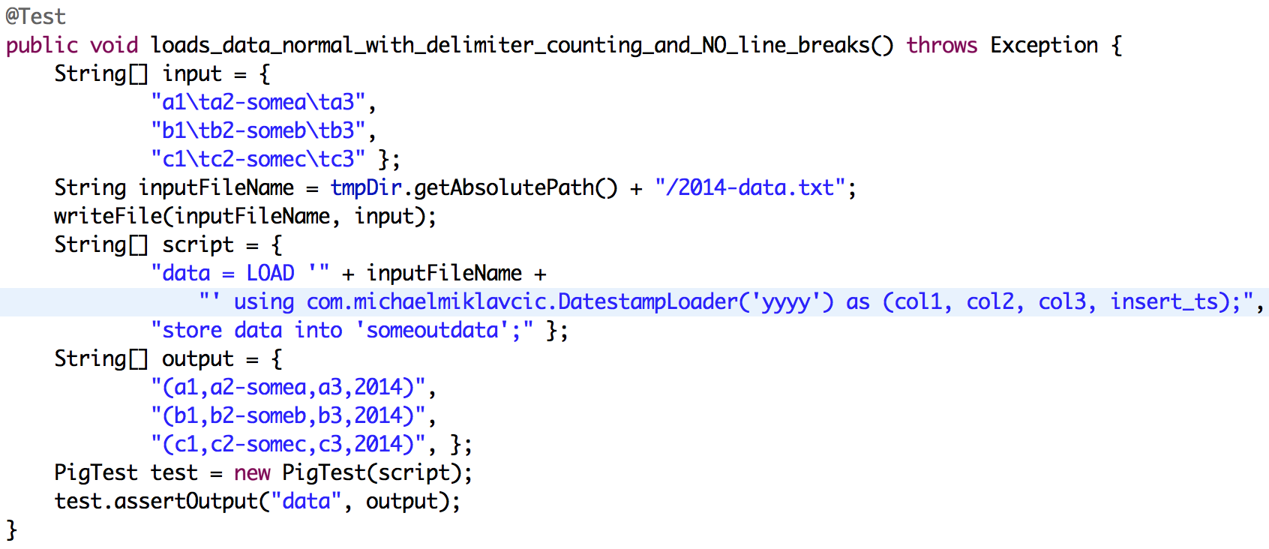
Integration Testing - Pig
You’ve unit-tested your core functionality
Now bring PigUnit into the mix

Slide 20
Integration Testing – Pig Example
Eclipse example - LoaderTest

Slide 21
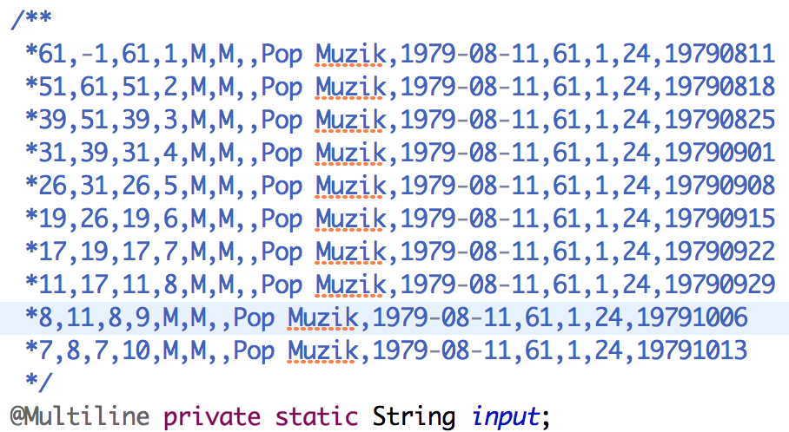
Integration Testing - Pig
Using the Java multi-line string library can improve readability
http://www.adrianwalker.org/2011/12/java-multiline-string.html

Slide 22
Acceptance Testing

Slide 23
Testing on a Cluster
What does your environment look like?
Single cluster
Multiple clusters
Tight production SLAs?
Easiest approach is with single massive cluster
Isolate dev, test, and prod via HDFS permissions
Isolate workloads via Queues
Single cluster gives access to more resources
Less work to run tests against a real dataset with a full workload
Data scientists tend to like having access to all the data

Slide 24
Testing on a Cluster
Alternatively, use a separate smaller cluster for dev/test
No need to isolate dev, test, and prod via HDFS permissions
Less need to isolate workloads via Queues
Need to consider getting data into multiple clusters
Harder to get a true sense of how workflow willl act in production
Might not work for data scientists and analytics users

Slide 25
Testing Workflows
Workflow automation systems are a different beast
Apache Oozie provides MiniOozie
Apache Falcon does not have a testing framework
Goal here is to perform end-to-end testing of your pipeline
Test the integration points, which is ultimately the flow of data from one application/process to the next in a data pipeline
Two main options:
Use a separate test cluster for deploying test pipelines
Create separate pipelines for dev/test/prod on the same cluster.
Change permissions/users and data directories for isolation.
Use separate queues
Segue my next talk on Apache Falcon @4PM today ☺

Slide 26
Other Considerations

Slide 27
Test Data
Where do I get my test data from?
Might be PHI constraints – need to anonymize
Cleanup data – headers, delimiters, and more
org.apache.pig.piggybank.storage.CSVExcelStorage
(',','NO_MULTILINE','NOCHANGE','SKIP_INPUT_HEADER')
Store as control-A delimited
Sampling
Grabbed a tiny data sample using Pig – “SAMP = SAMPLE DATA 0.000001;”
Pull sample into project, reference in tests

Slide 28
Thank you !
Michael Miklavcic
mmiklavcic@hortonworks.com
blog.michaelmiklavcic.com

