Slide 1
“Build up you weaknesses until they become your strengths.”
Knute Rockne – Notre Dame football coach

Slide 2
Intermediate Algebra Chapter 1
The
Real Number
System

Slide 3
Objective
Understand the structure of algebra including language and symbols.

Slide 4
Definiton
Variable – a symbol that can vary in value
Constant – a symbol that does not vary in value

Slide 5
Definiton
Expression – a collection of constants, variables, and arithmetic symbols

Slide 6
Definition
Inequality – two expression separated by <, <, >, >,
-2>-3
4 < 5
4 < 4

Slide 7
Definition
Equation – two expression set equal to each other
4x + 2 = 3x - 5

Slide 8
Def: evaluate
When we evaluate a numerical expression, we determine the value of the expression by performing the indicated operations.

Slide 9
Definition
Set is a collection of objects
Use capitol letters to represent
Element is one of the items of the collection
Normally use lower case letters to describe

Slide 10
Procedure to describe sets
Listing: Write the members of a set within braces
Use commas between
Use … to mean so on and so forth
Use a sentence
Use a picture

Slide 11
Julia Ward Howe - Poet
“The strokes of the pen need deliberation as much as the sword needs swiftness.”

Slide 12
Examples of Sets
{1, 2, 3}
{1, 2, 3, …, 9, 10}
{1, 2, 3, … } = N = Natural numbers

Slide 13
Set Builder Notation
{x|description}
Example
{x|x is a living United States President}

Slide 14
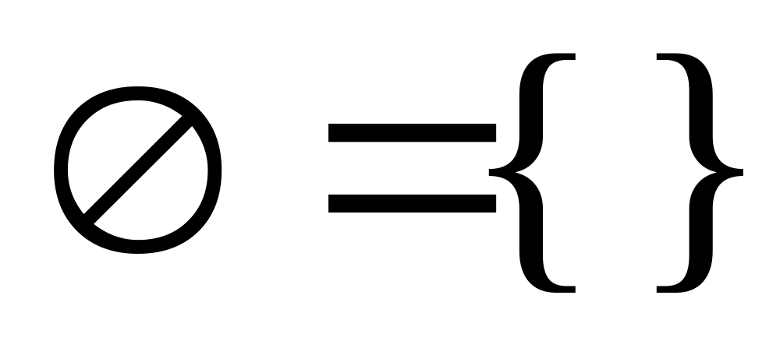
Def: Empty Set or Null set is the set that contains no elements
Symbolism

Slide 15

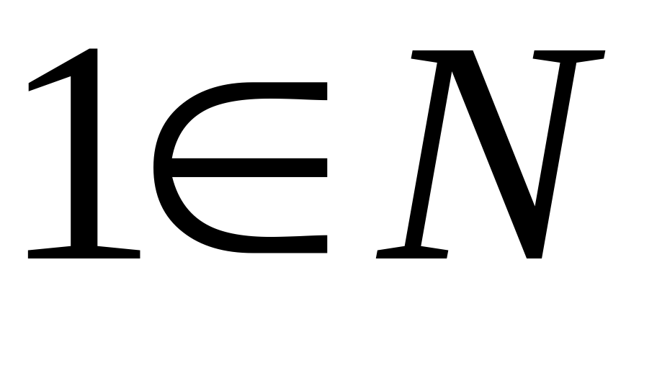
Symbolism – element
“is an element of”

Slide 16
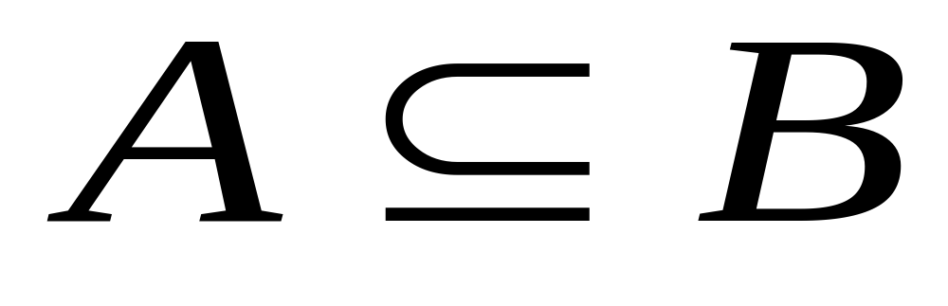
Def: Subset: A is a subset of B if and only if ever element of A is an element of B
Symbolism

Slide 17

Examples of subset
{1, 2} {1, 2, 3}
{1, 2} {1, 2}
{ } {1, 2, 3, … }

Slide 18

Def: Union symbolism: A B
A union B is the set of all elements of A or all elements of B.

Slide 19
Example of Union of sets
A = {1, 2, 3}
B = {3, 4, 5}
A B = {1, 2, 3, 4, 5}

Slide 20
Def: Sets of Numbers
Natural numbers
N = {1,2,3, … }
Whole numbers
W = {0,1,2,3, … }

Slide 21
Integers
J = {… , -3, -2, -1, 0, 1, 2, 3, …}
Naturals
Wholes
Integers

Slide 22
Def: Rational number
Any number that can be expressed in the form p/q where p and q are integers and q is not equal to 0.
Use Q to represent

Slide 23
Def (2): Rational number
Any number that can be represented by a terminating or repeating decimal expansion.

Slide 24
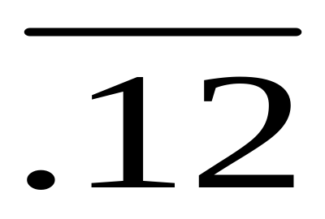
Examples of rational numbers
Examples: 1/5, -2/3, 0.5, 0.33333…
Write repeating decimals with a bar above
.12121212… =

Slide 25

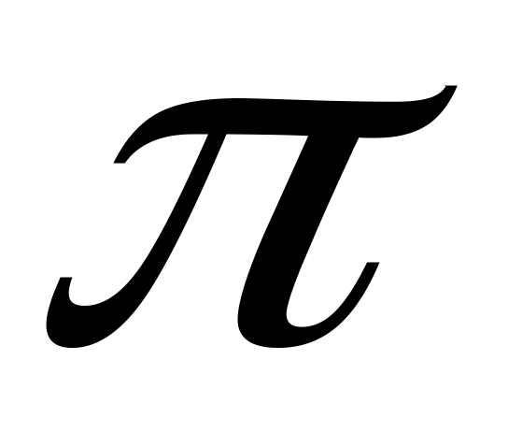
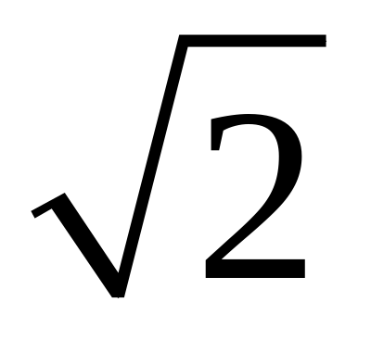
Def: Irrational Number
H represents the set
A non-repeating infinite decimal expansion

Slide 26
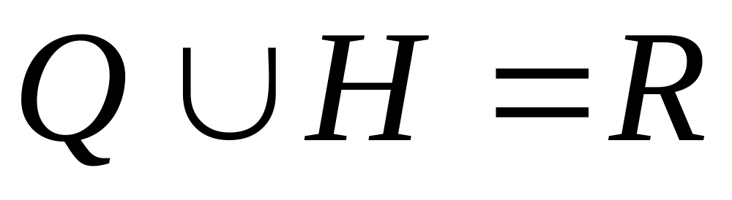
Def: Set of Real Numbers = R
R = the union of the set of rational and irrational numbers

Slide 27
Def: Number line
A number line is a set of points with each point associated with a real number called the coordinate of the point.

Slide 28
Def: origin
The point whose coordinate is 0 is the origin.

Slide 29
Definition of Opposite of opposite
For any real number a, the opposite of the opposite of a number is -(-a) = a

Slide 30

Definition: For All

Slide 31

Def: There exists

Slide 32
Bill Wheeler - artist
“Good writing is clear thinking made visible.”

Slide 33
Def: intuitive absolute value
The absolute value of any real number a is the distance between a and 0 on the number line

Slide 34
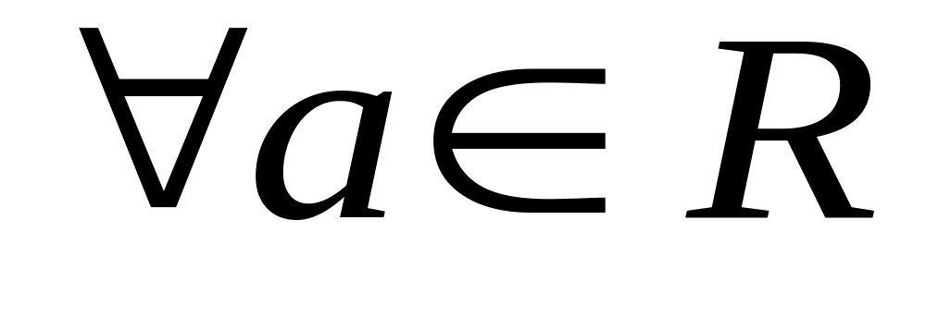
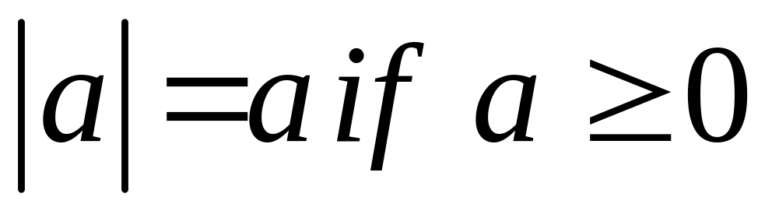
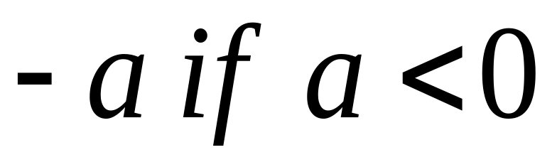
Def: algebraic absolute value

Slide 35
Calculator notes
TI-84 – APPS
ALG1PRT1
Useful overview

Slide 36
George Patton
“Accept challenges, so that you may feel the exhilaration of victory.”

