Slide 1
ENVIROLEARN
A Gamified Environmental Education Platform for Schools
Presented by:
Guide:
Gouri Nandana J
Smt. Chinchu M Pillai
Jerena Ann Jacob
Jyothika Sasi
Nandana S Nair

Slide 2
INDEX
01
Introduction
09
Functional Requirements
02
Problem Statement
10
Non-Functional Requirements
03
Literature Review
11
Hardware & Software Requirements
04
Proposed Solution
12
Result
05
System Architecture
13
Conclusion
06
Use Case Diagram
14
Future Scope
07
Data Flow Diagram (Level 0 & Level 1)
15
References
08
Methodology
EnviroLearn — A Gamified Environmental Education Platform
2

Slide 3
INTRODUCTION
Environmental issues like climate change, pollution, and resource depletion are increasing global challenges.
Early environmental education is essential to develop responsible and sustainability-oriented citizens.
Schools play a vital role in shaping students' attitudes toward environmental conservation.
Technological advancements have made digital learning platforms effective for improving student engagement.
Gamification enhances education by making learning interactive, motivating, and memorable.
EnviroLearn — A Gamified Environmental Education Platform
3

Slide 4
PROBLEM STATEMENT
To develop a software to solve the problem of traditional, low-interactivity environmental education in schools, which leads to:
Reduced student engagement
Low environmental awareness
Limited participation in sustainability practices
EnviroLearn — A Gamified Environmental Education Platform
4

Slide 5
LITERATURE REVIEW (1/4)
Gamified Learning Platforms: Transforming Student Engagement through Digital Tools
Year: 2025
Methodology
Mixed-method study using surveys, platform analytics, and case analysis. Examines use of gamified digital tools such as points, badges, leaderboards, and interactive challenges across school and higher education settings.
Result
Gamified learning platforms significantly improve student engagement, motivation, and academic performance. Students showed higher participation and improved learning outcomes due to real-time feedback.
Limitation
Over-reliance on extrinsic rewards may reduce intrinsic motivation over time. Effective results depend on thoughtful design, access to technology, and proper alignment with educational goals.
🔗 Click to open paper
EnviroLearn — A Gamified Environmental Education Platform
5

Slide 6
LITERATURE REVIEW (2/4)
Online Environmental Gamification and University Students' Pro-Environmental Organizational Citizenship Behaviour
Year: 2025
Methodology
Survey-based study using online environmental gamification platforms (e.g., Ant Forest). Data collected from university students and analysed using regression and mediation analysis based on CAPS theory.
Result
Online environmental gamification significantly increases students' pro-environmental behaviour. Environmental responsibility and environmental passion act as mediators in promoting sustainable actions.
Limitation
Study focused only on university students and relied on self-reported survey data. Results may not generalize to school-level education or younger students.
🔗 Click to open paper
EnviroLearn — A Gamified Environmental Education Platform
6

Slide 7
LITERATURE REVIEW (3/4)
Gamification of Sustainability Communication: Engaging Audiences Through Interactive Platforms
Year: 2020
Methodology
Mixed-method approach using case studies, surveys, and qualitative analysis. Examines gamified sustainability platforms using game elements such as points, badges, leaderboards, and interactive quizzes.
Result
Gamification improves audience engagement, knowledge retention, and motivation toward sustainable practices. Interactive features and feedback increase participation compared to traditional methods.
Limitation
Study focuses mainly on communication and awareness rather than structured learning outcomes. Does not specifically address school-level implementation or curriculum-based educational platforms.
🔗 Click to open paper
EnviroLearn — A Gamified Environmental Education Platform
7

Slide 8
LITERATURE REVIEW (4/4)
The Game with Impact: Gamification in Environmental Education and Entrepreneurship
Year: 2015
Methodology
Case study-based research conducted by the Moldovan Environmental Governance Academy (MEGA). Analyzes gamified environmental education projects (G.R.E.E.N. and Game with Impact) using game elements such as missions, levels, rewards, and collaborative challenges.
Result
Gamification significantly increased youth engagement, participation, and practical involvement in environmental activities. Participants showed improved environmental awareness, leadership skills, and motivation.
Limitation
Study is limited to specific regional case studies and small participant groups. Long-term behavior change and scalability of gamified education platforms require further research.
🔗 Click to open paper
EnviroLearn — A Gamified Environmental Education Platform
8

Slide 9
PROPOSED SOLUTION
A Gamified Environmental Educational Platform using videos, quizzes, and interactive games to educate students and motivate eco-friendly behavior.
🎮
🎬
📝
🏆
Educational Games
Video Learning
Quizzes
Rewards & Progress
Interactive games reinforce environmental learning concepts in a fun way.
Short educational videos on topics like Global Warming, Pollution, Biodiversity.
MCQ-based quizzes based on video content with instant feedback and scoring.
Points, badges, leaderboards, and missions to boost engagement.
EnviroLearn — A Gamified Environmental Education Platform
9

Slide 10
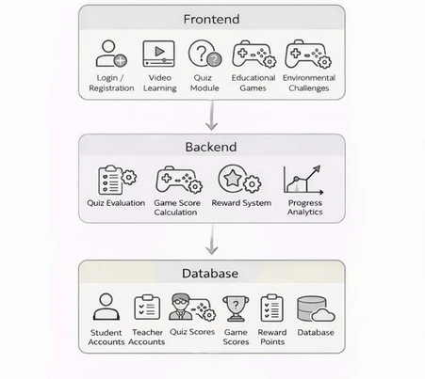
SYSTEM ARCHITECTURE
EnviroLearn — A Gamified Environmental Education Platform
10

Slide 11
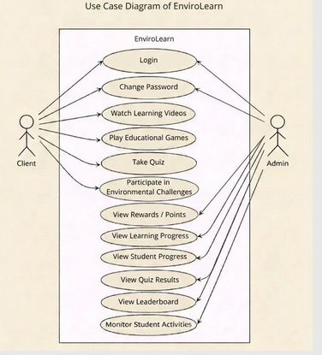
USE CASE DIAGRAM
EnviroLearn — A Gamified Environmental Education Platform
11

Slide 12
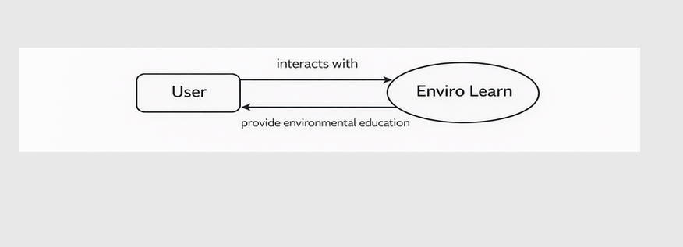
DATA FLOW DIAGRAM — LEVEL 0
Context Diagram showing the top-level data flow between User and the EnviroLearn system.
EnviroLearn — A Gamified Environmental Education Platform
12

Slide 13
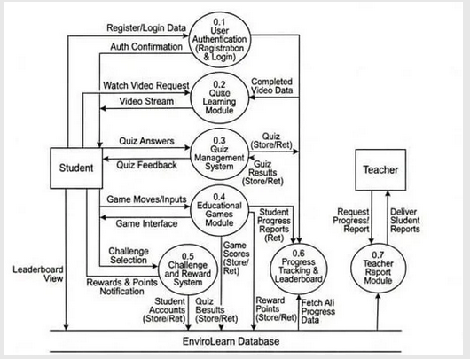
DATA FLOW DIAGRAM — LEVEL 1
Detailed data flow across all modules including Authentication, Quiz, Games, Challenges, Progress Tracking, and Teacher Reports.
EnviroLearn — A Gamified Environmental Education Platform
13

Slide 14
METHODOLOGY
Agile Iterative Development Model
1
Requirement Analysis
4
Backend Development
Identified key user needs, environmental topics, gamification goals, and system scope through discussions and literature review.
Developed Flask (Python) backend with SQLite database for user management, quiz scoring, and reward logic.
2
System Design
5
Testing & Integration
Designed system architecture, DFD, use case diagrams, and UI wireframes for the student and teacher roles.
Conducted functional testing of all modules — login, games, quizzes, videos, challenges, and teacher dashboard.
3
Frontend Development
6
Deployment & Review
Built responsive UI using HTML, CSS, and JavaScript with nature-themed design suitable for school students.
Deployed locally and reviewed with test users. Documentation and final report submitted for evaluation.
EnviroLearn — A Gamified Environmental Education Platform
14

Slide 15
FUNCTIONAL REQUIREMENTS
User Management
Gamification Features
✓ Students and teachers can register and log in securely
✓ Award points for correct answers and task completion
✓ Role-based access control (Student / Teacher)
✓ Assign badges and achievements based on performance
✓ Secure logout functionality
✓ Daily challenge tracking and leaderboard
Video-Based Learning
Progress & Teacher Dashboard
✓ Provide environmental education video lessons
✓ Store and display student progress and scores
✓ Ensure full video watch before proceeding
✓ Teacher can view performance reports and analytics
✓ Present quiz after each video session
✓ Teachers can assign games and quizzes to students
EnviroLearn — A Gamified Environmental Education Platform
15

Slide 16
NON-FUNCTIONAL REQUIREMENTS
⚡
🔒
📈
Performance
Security
Scalability
Fast response times for all games, quizzes, and page loads to ensure smooth user experience.
Secure user authentication, password hashing, and protection of student data.
System supports increasing number of users, modules, and content without degradation.
🛡️
🎨
🔧
Reliability
Usability
Maintainability
Stable operation with data backup support and graceful error handling.
Simple, interactive, and child-friendly UI with intuitive navigation for school students.
Modular Flask-based architecture allowing easy updates and feature additions.
EnviroLearn — A Gamified Environmental Education Platform
16

Slide 17
HARDWARE & SOFTWARE REQUIREMENTS
💻 Software Requirements
🖥️ Hardware Requirements
Frontend:
HTML, CSS, JavaScript
Processor:
Intel i3 or above
Backend:
Flask (Python)
RAM:
Minimum 4 GB
Database:
SQLite, SQLAlchemy
Storage:
Minimum 500 MB free
IDE:
Visual Studio Code
Device:
Laptop, Desktop, Mobile
Version Control:
Git / GitHub
Internet:
Required for hosting
Browser:
Chrome / Firefox (Modern)
Display:
1024 x 768 or higher
EnviroLearn — A Gamified Environmental Education Platform
17

Slide 18
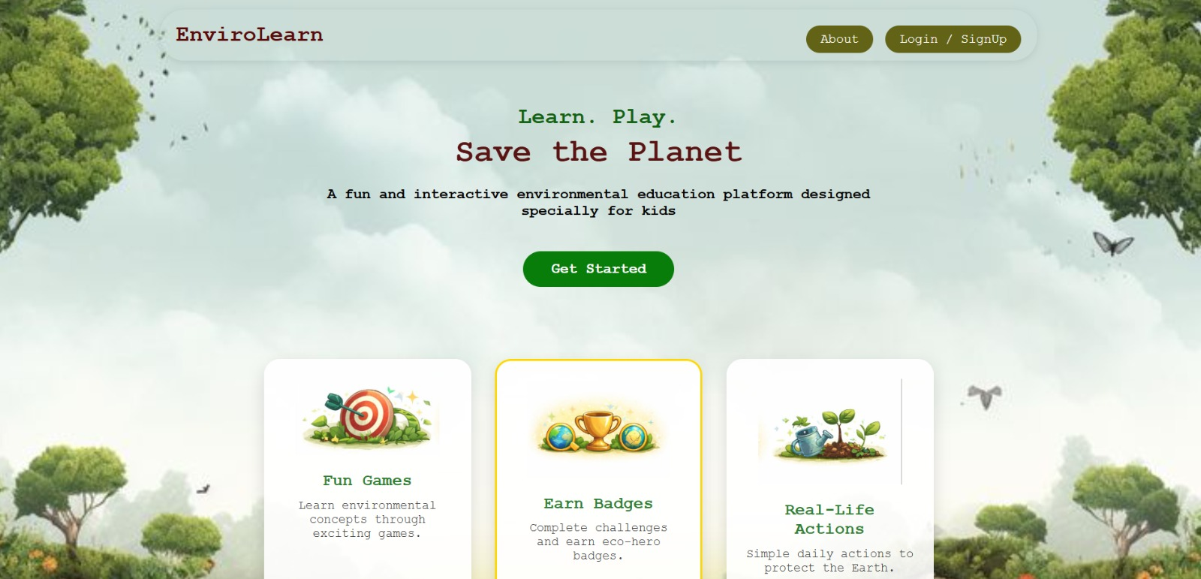

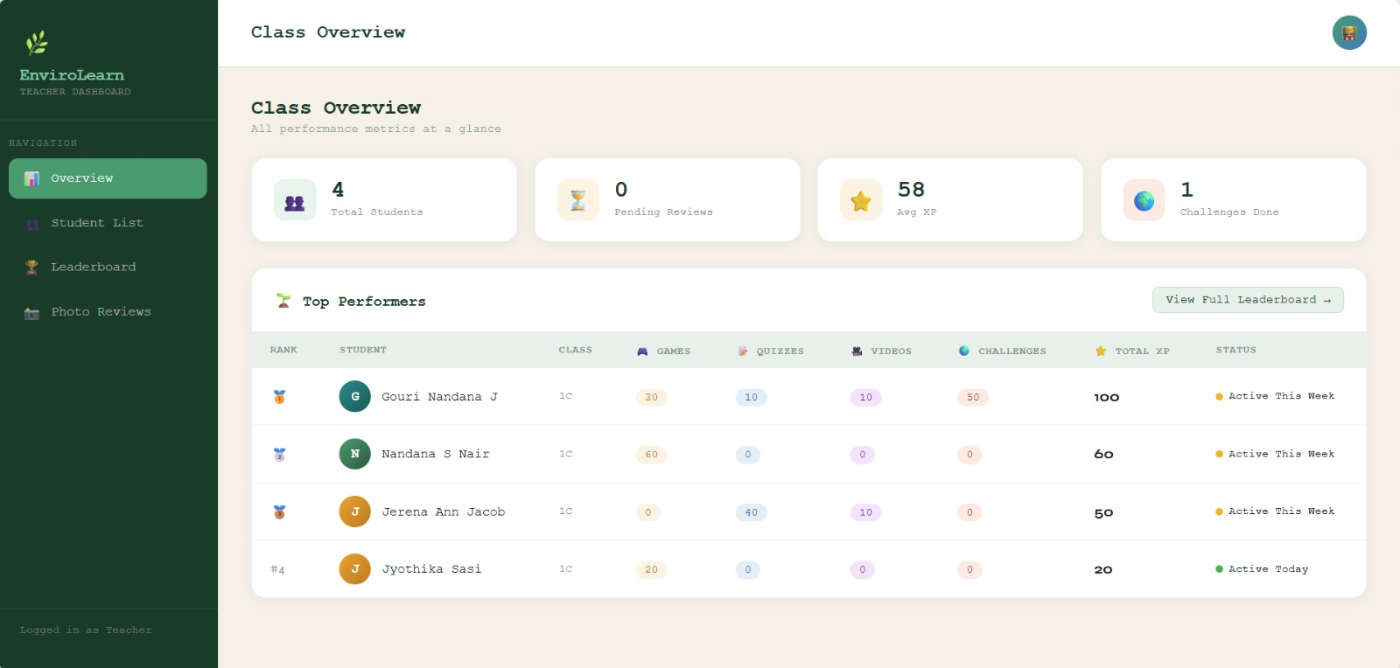
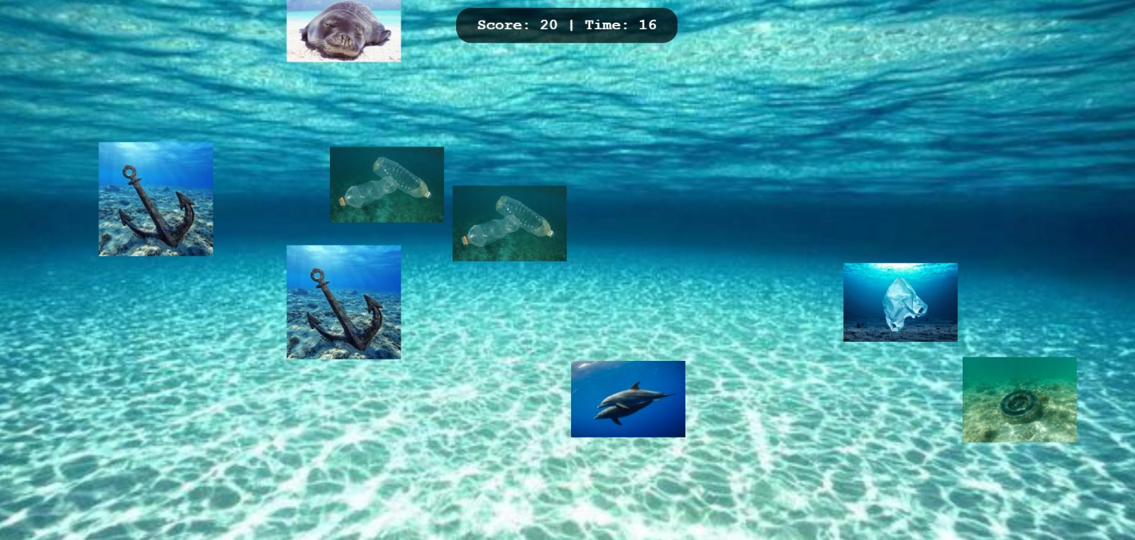
RESULT
Home Page / Main Dashboard
Student Login Page
Main interface where students access Games, Videos, Quizzes, Challenges, and Leaderboard.
Login interface where students enter their details to access the platform.
Teacher Dashboard
Ocean Cleanup Game
Displays class overview, student performance, and leaderboard rankings.
Students collect ocean waste and learn about marine pollution interactively.
EnviroLearn — A Gamified Environmental Education Platform
18

Slide 19
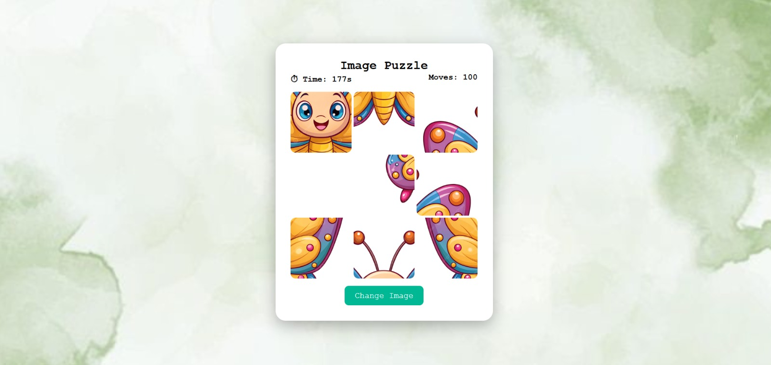
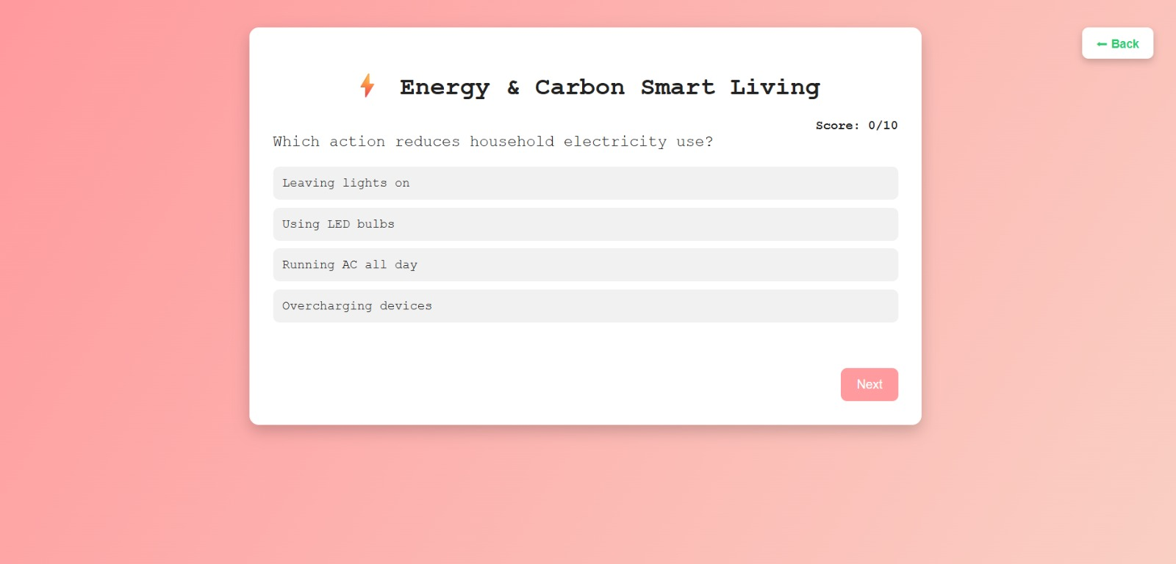
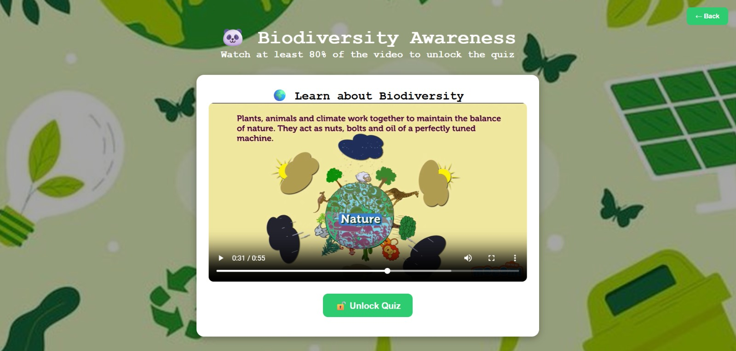
RESULT (CONTD.)
Image Puzzle Game
Quiz Module
Video Learning Module
Puzzle activity improving problem-solving skills while learning environmental concepts.
Interactive MCQ quiz to test students' environmental knowledge with instant feedback.
Environmental video that unlocks a related quiz after 80% viewing — learn then assess.
EnviroLearn — A Gamified Environmental Education Platform
19

Slide 20
CONCLUSION
EnviroLearn successfully addresses the gap in interactive environmental education by delivering a gamified, school-focused learning platform.
🎮
Educational games, videos, quizzes, and challenges make environmental learning interactive and engaging for school students.
🏆
Points, badges, and leaderboards motivate students through gamification, improving participation and environmental awareness.
📊
The teacher dashboard provides real-time analytics on student performance, enabling data-driven teaching.
💡
Built with Flask, SQLite, HTML/CSS/JS — a scalable and maintainable architecture suitable for future expansion.
🌿
The platform bridges the gap identified in literature by targeting school-level learners with curriculum-aligned environmental content.
EnviroLearn — A Gamified Environmental Education Platform
20

Slide 21
FUTURE SCOPE
📱
🤖
🌐
Mobile App
AI Quiz Generation
Multilingual Support
Develop native Android/iOS apps for wider accessibility.
Use AI to auto-generate quiz questions from video content.
Add regional language support for inclusivity across India.
👨‍👩‍👧
🏫
📊
Parent Dashboard
Curriculum Integration
Advanced Analytics
Allow parents to track their child's learning progress.
Align content with CBSE/State board environmental syllabi.
AI-driven insights on student performance trends and weak areas.
EnviroLearn — A Gamified Environmental Education Platform
21

Slide 22
REFERENCES
1
Gamified Learning Platforms: Transforming Student Engagement through Digital Tools (2025)
🔗 Click to open
2
Online Environmental Gamification and University Students' Pro-Environmental Organizational Citizenship Behaviour — MDPI Sustainability (2025)
🔗 Click to open
3
Gamification of Sustainability Communication: Engaging Audiences Through Interactive Platforms — Research Corridor Journal (2020)
🔗 Click to open
4
The Game with Impact: Gamification in Environmental Education and Entrepreneurship — ResearchGate (2015)
🔗 Click to open
EnviroLearn — A Gamified Environmental Education Platform
22

Slide 23
🌿
THANK YOU
for your attention
EnviroLearn — A Gamified Environmental Education Platform for Schools

